Slide 1
Use Of Census Data For Gender Statistics An Extract from 2008 Malawi Gender Thematic report
Presented By:
Kingsley Manda
National Statistical Office

Slide 2
History of Malawi Censuses
First attempt 1891 when Malawi was then a British Protectorate
The population count for that year completely excluded Africans!
Post independence censuses: 1966, 1977, 1987, 1998 and latest 2008
It was both de jure and de facto
The Census collected and disaggregated data on population size and composition; population dynamics; and population characteristics by sex

Slide 3
Method of Analyzing the Gender Aspects of the Populations Census
In undertaking a gender analysis, variables in the population census were developed to check:
What are the gender gaps with regard to a given variable?
What are the gender disparities?
What do these disparities tell us or imply
What factors (direct or indirect) account for these gaps and disparities?
What are the policy implications and recommendations?

Slide 4
POPULATION SIZE AND COMPOSITION
13.1 Million
49% (6.4 million) Males
51% (6.7 million) Females
Sex ratio 94.7
Source: Census Data (1987, 1998 and 2008)

Slide 5
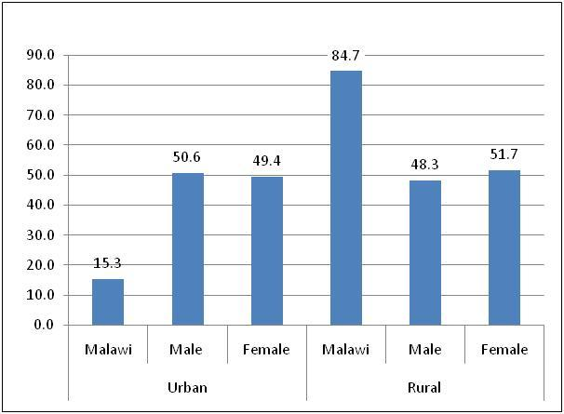
Residence by sex
Most population is in
the rural area
Source: Census Data 2008

Slide 6
Single Mean Age at Marriage (SMAM)
an estimate of the average age at first marriage obtained from the population never married at successive ages
often used as a proxy for the onset of women’s exposure to the risk of pregnancy and related reproductive health risks
 | Proportion Single
Age Group | Male | Female
15-19 | 95.2 | 70.6
20-24 | 54 | 17.4
25-29 | 21.2 | 6.7
30-34 | 7.7 | 3
35-39 | 4.1 | 1.9
40-44 | 2.7 | 1.5
45-49 | 2.1 | 1.2
SMAM | 23.9 | 19.8
Women marry younger than males
predisposes them to early child bearing, higher fertility and longer exposure to associated reproductive risks
Source: Census Data 2008

Slide 7
Single and Mean Age at Marriage by Residence and Educational Attainment
 | SMAM
Characteristics | Male | Female
Residence
Urban | 25.9 | 21.9
Rural | 23.4 | 19.8
Educational Attainment
No Education | 23 | 18.2
Primary | 23 | 19.5
Secondary | 25.2 | 22.1
Post-Secondary | 28.5 | 26.2
Source: Census Data 2008

Slide 8
Adolescent Fertility and Adolescent Mean Parity
an adolescent was defined as a person aged 15-19 years
651,028 were enumerated, constituting 9.69% of the total number of females
The adolescent fertility rate looked at the number of children women aged 15 -19 years had as a proxy indicator of the number of children a woman would have at the end of their reproductive cycle
The adolescent fertility rate (AFR) is of gender concern because it is a proxy indicator of gender inequalities with regard to women’s position and status in society, depicted through early marriage and teenage pregnancy, access to services and opportunities such as education and health care
 | ASFR | Adolescent Fertility Rate | Mean Parity
Malawi | 0.193 | 0.966 | 0.283

Slide 9
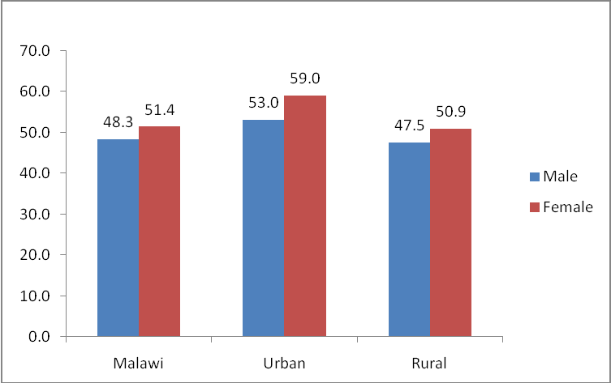
Life Expectancy at Birth by Sex
average number of years a newborn infant is expected to live
It is a measure of a population’s state of general health, reflecting the overall mortality level of a population
Source: Census Data 2008

Slide 10
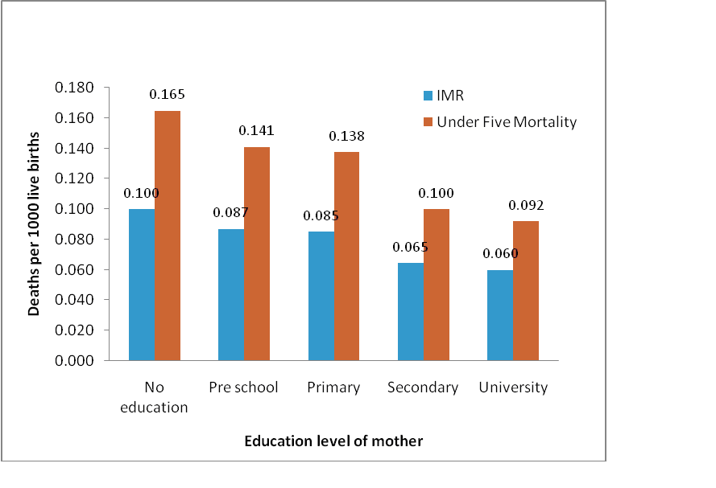
Infant and Under Five Mortality Rate
Both IMR and U5MR can be good measures of socio-economic status of the population and levels of development of the country
IMR in particular could also reflect the social and economic empowerment of women in a community, as well as their ability to access skilled birth attendants for both pre-and ante-natal services
IMR and U5MR by Education level of Mother 2008
Source: Census Data 2008

Slide 11
Total Fertility Rate
is the most significant demographic indicator in the analysis of the impact of national population programmes in particular family planning programmes on individual or group reproductive behaviour
Malawi is still experiencing a high fertility rate, which has significant implications for women’s health and status in society

Slide 12
School attendance by sex for 6 – 24 years
Source: Census Data 2008
gender differences were observed in all categories

Slide 13
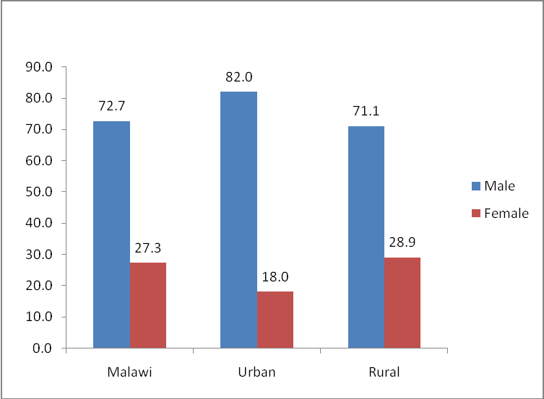
Household Headship by sex and Location
Source: Census Data 2008

Slide 14
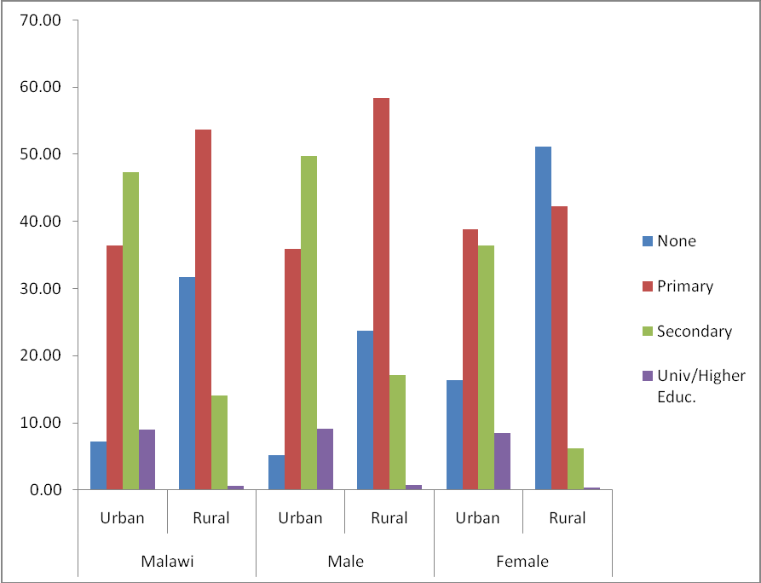
Education Level of the Household Head
education has significant implications for household resources and household survival
is a key indicator for the access to employment opportunities and consequently resources (financial, information and otherwise)
Source: Census Data 2008

Slide 15
Education Attainment
For population aged10 years and over, and the three levels of education
Primary School Leaving Certificate (PSLC)
Junior Certificate of Education (JCE), given at the end of Form Two
Malawi School Certificate of Education (MSCE) acquired after completing secondary school (Form Four). After the MSCE one proceeds to university
Level | None | PSLC | JCE | MSCE
National Male Female | 73 69 78 | 11 12 10 | 9 10 7 | 7 9 5
Urban Male Female | 47 42 53 | 14 13 14 | 17 18 17 | 22 27 16
Rural Male Female | 79 75 84 | 10 11 9 | 7 8 5 | 4 5 2
Source: Census Data 2008

Slide 16
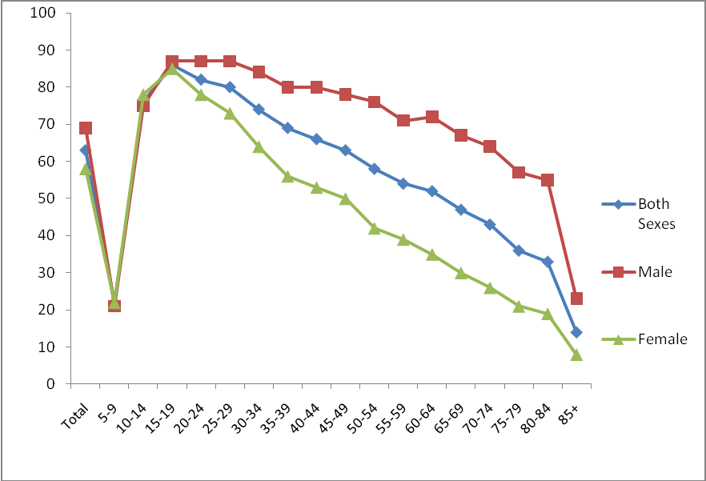
Literacy
defined as ability to read and write in any language
For population aged 5 years and over
also has an impact on efforts to narrow the gap that exists between men and women in accessing information and other resources
Source: Census Data 2008

Slide 17
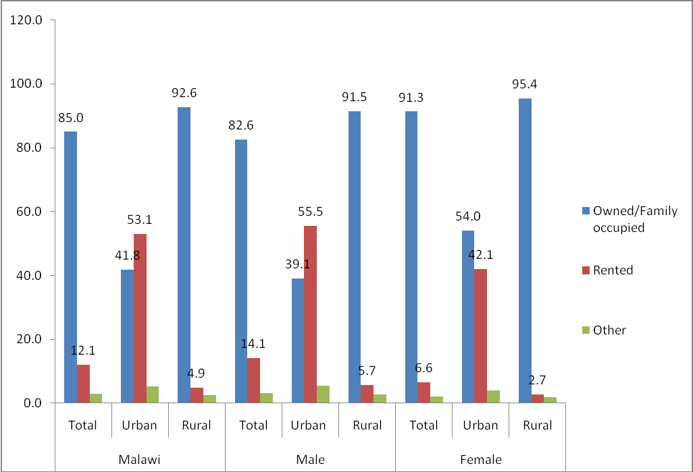
Ownership of Household Structure by Headship
Shelter is one of the basic necessities of human survival
Owning one’s own house is crucial to guaranteeing the security of tenure of the household
Source: Census Data 2008

Slide 18
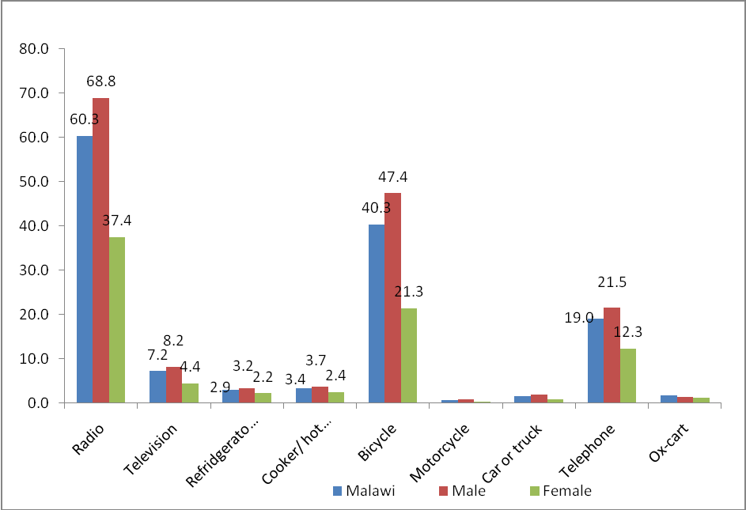
Ownership of Household Assets by Headship
assets a household owns are another key indicator for household wealth and general socio-economic status
Source: Census Data 2008

Slide 19
Thank You!
Get the full report at: www.nsomalawi.mw

