Slide 1
Bringing Gender Issues into Statistics on Work
Tinashe Enock MWADIWA
Education and Gender Statistics Manager
Zimbabwe National Statistics Agency (ZIMSTAT)

Slide 2
In 2011, Zim conducted the Labour Force and Child Labour Survey.
Results disseminated in November 2012
The presentation is looking at areas that will be covered in the Gender Fact Sheet
A publication which is produced after every major census or survey

Slide 3
Presentation Outline
Labour force Participation-
Employment Conditions-
Child Work-
At each area, we are looking at the associated gender issues and the data drawn from the LFCLS

Slide 4
Labour Force Participation
LFPR- a proportion of the working age population (15 years and above) that engages actively in the labour market.
Gender issues are
Are short-and long term labour force participation rates the same for women and men

Slide 5
2004 LFPR

Slide 6
2011 LFPR

Slide 7
Youth Unemployment
Gender Issue- Are young women likely to be unemployed than young man

Slide 8
Employment Conditions
Generally looking at the characteristics of the employed
Gender issues include
Do women have the same chances as men to be in managerial positions
Are women more often than men found in in the informal employment
Are women more likely than men to be in vulnerable employment
Do women and men have equal access to paid employment

Slide 9
Distribution of currently employed population by Occupational Category and Sex, 2011 LFCLS
Occupation Category | Male | Female | TOTAL
Managers | 79.4 | 20.6 | 100 | 58 747
Professionals | 47.7 | 52.3 | 100 | 214 370
Technicians and associate professionals | 67.7 | 32.3 | 100 | 86 013
Clerical support workers | 62.4 | 37.6 | 100 | 68 007
Service and sales workers | 46.9 | 53.1 | 100 | 572 777
Skilled agricultural, forestry and fishery workers | 44.0 | 56.0 | 100 | 3 352 013
Craft and related trades workers | 79.7 | 20.3 | 100 | 303 802
Plant and machine operators, and assemblers | 93.6 | 6.4 | 100 | 162 111
Elementary occupations | 51.0 | 49.0 | 100 | 605 018
Armed forces occupations | 100.0 | 0.0 | 100 | 8 167
Total | 49.8 | 50.2 | 100 | 5 431 026

Slide 10
Informal Employment
Currently employed population (15years +) =5.4 million
4.6 million (84%) were in informal employment
Women constituted 53% of those in informal employment

Slide 11
Distribution of Currently Employed Persons Aged 15 Years and Above by Status in Employment, 2011 LFCLS
Status in Employment | Male | Female | Total
Paid employee- permanent | 21.8 | 9.2 | 15.5
Paid employee- casual/temporary/contract/seasonal. | 11.6 | 7.3 | 9.4
Employer | 0.6 | 0.3 | 0.4
Own account worker (communal, resettlement & peri-urban farmer) | 52.5 | 68.4 | 60.5
Own account worker (other) | 12.8 | 13.6 | 13.2
Contributing family worker | 0.6 | 1.2 | 0.9
Not Stated | 0.1 | 0.1 | 0.1
Total Percent | 100 | 100 | 100
Total Persons | 2 704 060 | 2 726 967 | 5 431 026
Women are generally more in vulnerable employment (own account worker, contributing family workers)

Slide 12
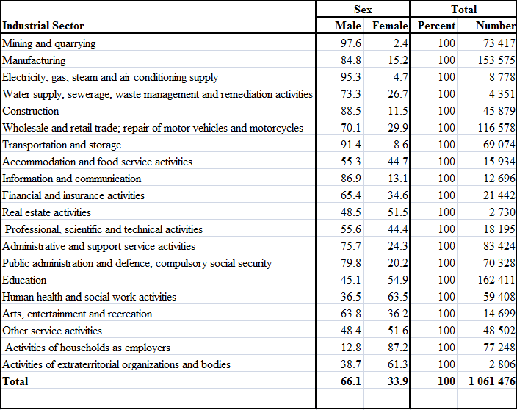
Distribution of Share of Women in Wage (paid) Employment in the Non-agriculture Sector by Industry, 2011 LFCLS

Slide 13
Child Work
The survey looked at work for children 5 to 17 years
Analysis for child labour was confined to the 5 to 14 yr age group as the those aged 15 to 17 are allowed to do some work, as per national law (non hazardous)
Gender Issues
Are boys more often than girls involved in child labour
Does child work affect more boys than girls in terms of school attendance.
Are more girls than boys involved in care activities

Slide 14
Economic and Non-Economic Child Labour By sex, 2011 LFCLS

Slide 15
School Attendance of Children in Economic Child Labour by Sex, 2011 LFCLS

Slide 16
Proportion of Children aged 5-17 Years involved in Care Activities, 2011 LFCLS
Province | Male | Female
Manicaland | 79.7 | 86.9
Mashonaland Central | 71.3 | 84.8
Mashonaland East | 75.3 | 83.0
Mashonaland West | 69.8 | 86.0
Matabeleland North | 69.1 | 80.5
Matabeleland South | 79.2 | 84.9
Midlands | 79.9 | 88.4
Masvingo | 71.2 | 86.4
Harare | 62.6 | 74.3
Bulawayo | 60.5 | 77.3
Rural | 74.7 | 85.9
Urban | 66.3 | 77.9
Total | 72.7 | 83.7

Slide 17
Thank You

