Slide 1

BRINGING GENDER ISSUES INTO HEALTH STATISTICS
THE MALAWI EXPERIENCE
Government of Malawi
National Statistical Office
Kingsley Manda
National Statistical Office
MALAWI

Slide 2
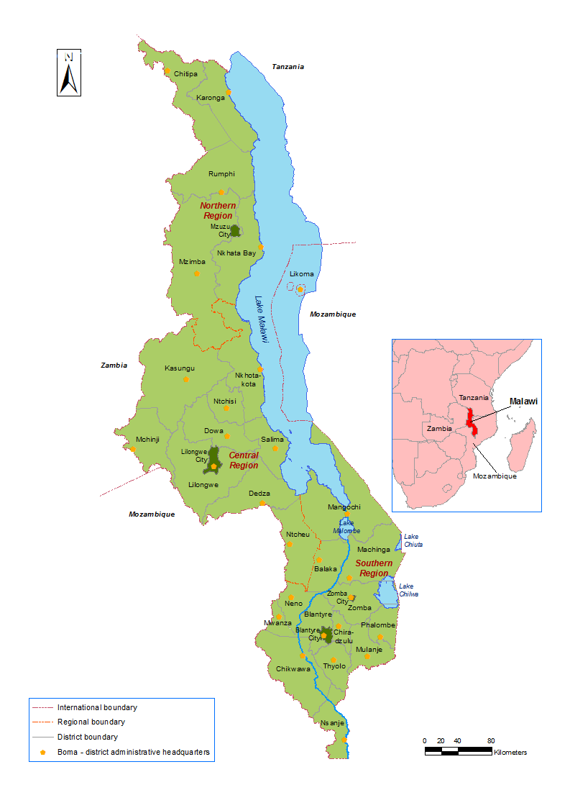
Malawi – Geographic Location

Slide 3
Population structure, Malawi (2008)

Slide 4
POPULATION AND SEX RATIO
 | % | Sex ratio
Malawi | 100
Men | 48.6 | 94.7
Women | 51.4
Rural | 84.7
Rural Men | 48.3 | 93.3
Rural Women | 51.7
Urban | 15.3
Urban Men | 50.6 | 102.6
Urban Women | 49.4
Population 2008 – 13.1 Million
Projected 2012 – 14.8 Million
Source: Population Census 2008

Slide 5
MAJOR SOURCES OF GENDER STATISTICS IN HEALTH
- HEALTH RELATED STUDIES
Examples:
Multiple Indicator Cluster Survey (MICS) 2006
Malawi Demographic and Health Survey (MDHS) - 1992, 2000, 2004, 2010

Slide 6
EXAMPLES OF INDICATORS FROM HEALTH SURVEYS
Early childhood mortality rates by Gender
Source: Malawi DHS 2010
Neonatal, post-neonatal, infant, child, and under-5 mortality rates for the 10-year period preceding the survey

Slide 7
EXAMPLES CONTINUED
Percentage of children age 12-23 months by sex and type of vaccines received
 | BCG | DPT/Pentavalent (DPT - HepB –Hib) |  |  | Polio
Sex |  | 1 | 2 | 3 | 0 | 1 | 2 | 3 | Measles
Male | 96.6 | 96.6 | 95.4 | 92.7 | 73.8 | 95.8 | 93.3 | 86.1 | 91.7
Female | 97.8 | 98 | 96.7 | 93.4 | 74.3 | 97.5 | 95.6 | 85.1 | 94.3
Sex | All basic vaccinations | Number of children
Male | 81.1 | 1,895
Female | 80.8 | 1,880
Source: Malawi DHS 2010

Slide 8
EXAMPLES CONTINUED
Percentage of women and men age 15-49 who have heard of AIDS
 | Women |  | Men
Age | Have heard of AIDS | Number of women | Have heard of AIDS | Number of men
15-24 | 99.3 | 9,559 | 98.7 | 2,987
15-19 | 99 | 5,005 | 98.2 | 1,748
20-24 | 99.7 | 4,555 | 99.5 | 1,239
25-29 | 99.7 | 4,400 | 99.7 | 1,099
30-39 | 99.6 | 5,772 | 100 | 1,746
40-49 | 99.1 | 3,288 | 99.4 | 986
Source: Malawi DHS 2010

Slide 9
EXAMPLES CONTINUED
HIV Prevalence by Sex and Age
 | Women |  | Men
Age | % HIV positive | No | % HIV positive | No
15-19 | 4.2 | 1,545 | 1.3 | 1,703
20-24 | 6.4 | 1,401 | 2.8 | 1,176
25-29 | 13.5 | 1,407 | 6.9 | 1,041
30-34 | 20.7 | 937 | 10.8 | 885
35-39 | 23.8 | 806 | 18.1 | 757
40-44 | 20.4 | 533 | 20.9 | 506
45-49 | 16.1 | 462 | 14.9 | 429
Source: Malawi DHS 2010

Slide 10
HEALTH MANAGEMENT INFORMATION SYSTEM (HMIS)
Another major source of health statistics aggregated sex
Established in 2002 by Government of Malawi
Implemented by the Ministry of Health through
  Government health facilities
  Non Governmental/Private health facilities
They submit reports to District Health Office (DHO)
DHO submit reports to Ministry headquarters
Collects, among other information:
  Information related to disease surveillance
  Vital statistics
  Maternal and child and reproductive health indicators

Slide 11
MALAWI NATIONAL REGISTRATION BUREAU
Another source of health statistics aggregated by sex
Officially set up in 2007and launched in 2012
Mandated to establish the National Registration and Identification System (NRIS) for Malawi
works hand in hand with the Ministry of Health
Register children within 6 weeks of birth
mainstreams birth registration into immunization and antenatal care programs

Slide 12
CHALLENGES/ISSUES
Health surveys focuses on a particular group.
  e.g. MICS and DHS mainly focuses on monitoring the situation of women and children
Health Management Information System (HMIS)
  Unavailability of people with prerequisite skills
  Lack of computers at hospital and health center level for data entry
  These challenges affect data quality
  Completeness of data
    Not all health facilities are submitting reports to district health office
    Not all data elements are reported by those facilities that report
  Timeliness of reporting
    -Facilities send Quarterly Reports to DHO late
    -DHOs send reports to Headquarters late
    -HMIS has been unable to provide data timely

Slide 13
SUGGESTIONS
Need to have a Comparative Evaluation of Indicators for Gender Equity and Health
developing a core set of gender and health indicators that can be used for comparisons across peer countries and communities
Establish statistical unit within CSO’s to coordinate collection gender related statistics

Slide 14
Thank You for Listening!
Visit our website: www.nsomalawi.mw
Email: enquiries@statistics.gov.mw
demography@statistics.gov.mw

