Slide 1
The 2010 Population and Housing Census of Mongolia: Census PES
A.Amarbal
Director of Population and Housing Census Bureau, National Statistical Office

Slide 2
Content
History of population censuses of Mongolia
PES of Population and Housing Census of 2000
Features of the 2010 Population and Housing Census of Mongolia
Preparatory work of 2010 census PES
Further activities

Slide 3
History of population censuses of Mongolia
10th Population census
First PES
Social economy

Slide 4
Post enumeration survey of 2000
Provincial census committees carried-out the PES as according to guidelines and methodology provided by the NSO.
Enumerators and supervisors were assigned for different enumeration areas for the PES.
The main objectives of the PES were to evaluate coverage and age distribution errors.

Slide 5
PES - 2000
Started 1 day after the census enumeration completed and lasted for three days.
(13-15 January 2000)
Matched the census records with small sized samples of PES.
Performed age and sex distribution analysis.

Slide 6
PES - 2000
PES questionnaire
Front page
Address, type of household
Population questionnaire
First and last name
Sex
Age
Residency status
Duration of residency
Employment of the last 7 days
Occupation
Main economic activity of work

Slide 7
Results of 2000 PES
About 99 percent of census and PES participants responded same age.
About 99 percent of the participants responded same answer to the question of employment in the last 7 days.
Age index estimation:
Whipple’s Index (to test for age heaping): 1.3
Myer’s Index to check age accuracy: 99.3

Slide 8
Features of the 2010 Population and Housing Census of Mongolia
To be conducted with independent law of Population and Housing Census;
Will utilize digital mapping for census planning and conducting;
Will develop web-based spatial dissemination for the census results;

Slide 9
Law on Population and Housing Census
Chapter one - General provisions
Chapter two – The economic guarantee of census conducting
All costs related with the enumeration process shall be compensated from the State and local budget.
Chapter three – The types, period of duration and scope of the census
Nation wide census for every 10 years
Inter-censual survey for every 5 years between nation wide censuses
Chapter four – Census organizational structure
National Statistical Office shall have professional, specialized and permanent unit in its structure responsible for census.
Chapter five – State, non-governmental organization and citizen’s participation in carrying out census
Chapter six – Miscellaneous
Confidentiality, storage and protection of reported data

Slide 10
Main stages of the 2010 census
The 2010 Population and Housing Census of Mongolia
2012-2013
Database development and dissemination
2011-2012
Analysis
183 days
7 days
60 days
Data processing
2010.01.18
Preparations
Enumeration
Post enumeration
2011.07.01
2011.02.20
2008 .01.03
Law on PHC
Preliminary results
2011.08.01
Main results
2000

Slide 11
Main stages of the 2010 census
The 2010 Population and Housing Census of Mongolia
2012-2013
Database development and dissemination
2011-2012
Analysis
2010-2011
Census enumeration
3 days
PES
183 days
7 days
60 days
Data processing
2010.05.13
Preparations
Enumeration
Preliminary results
2011.07.01
2011.02.20
2008 .01.03
Law on PHC
2011.08.01
Main results
2000

Slide 12
Administrative units of Mongolia, 2010
Aimag, capital city (province) /22/ | Aimag /21/ | Capital city /1/
Soum, district (district) /338/ | Soum /329/ | District /9/
Bagh, khoroo (county) /1700/ | Bagh /1568/ | Khoroo /132/

Slide 13
Organizational structure of
the 2010 Population and Housing Census
State Census Committee
Number of personals
NATIONAL STATISTICAL OFFICE
CAPITAL CITY CENSUS COMMITTEE
AIMAG CENSUS COMMITTEES
CENSUS COMMITTEE AT MINISTRIES
550
Capital city census bureau
Aimag census bureaus
Census bureaus at ministries
280
DISTRICT CENSUS COMMITTEES
SOUM CENSUS COMMITTEES
3600
District census bureaus
Soum census bureaus
2000
Khoroo census bureaus
Bagh census bureaus
6800
CONTROLLERS
CONTROLLERS
CONTROLLERS
3600
ENUMERATORS
ENUMERATORS
ENUMERATORS
12100

Slide 14
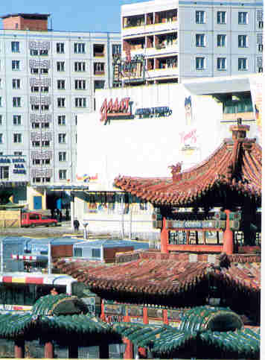
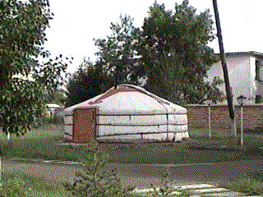
Work plan for Controllers and Enumerators
11/11/2010
7 days
17/11/2010
Urban area
Controller
1.Enumerator
2.Enumerator
4.Enumerator
3.Enumerator
80-90 households or
300-550 persons
80-90 households or
300-550 persons
80-90 households or
300-550 persons
80-90 households or
300-550 persons
Controller
1.Enumerator
2.Enumerator
4.Enumerator
3.Enumerator
5.Enumerator
Rural area
30-35 households or
120-160 persons
30-35 households or
120-160 persons
30-35 households or
120-160 persons
30-35 households or
120-160 persons
30-35 households or
120-160 persons

Slide 15
Questionnaire form for the 2010 Population and Housing Census
Law on Population and Housing Census
Main topics stated in Article11.1:
Demographic and social;
Geographical migration;
Economic activities;
Housing conditions;
Additional topics stated in Article 11.2:
MDG’s indicators;
Others;

Slide 16
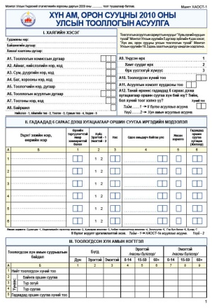
Composition of the census questionnaire
Type | Structure | Number of questions
Main questionnaire | Front page
 | Address section | 12
 | Information of persons residing abroad for over six months | 7
 | Summary section | 5
 | Population questionnaire | 25
 | Housing questionnaire | 21
Module questionnaire | Household deaths and maternal mortality questionnaire | 8

Slide 17
Compatibility with international methodology
Principles and Recommendations for PHC – Revision 2 |  | Recommended | Included
Population | Main topics | 31 | 31
 | Additional topics | 15 | 6
 | Total | 46 | 37
Housing | Main topics | 19 | 18*
 | Additional topics | 19 | 8
 | Total | 38 | 26
* - Occupancy by one or more households

Slide 18
Training
Trainers’ training
Census Committee and Temporary Bureau Trainings
Controllers and enumerators trainings
110 persons
September 2010
13200 persons
September, October 2010
16900 persons
October 2010
Training materials:
Documented materials
DVD or digital format materials

Slide 19
PES – 2010
Census enumeration period | 2010.11.11-17
PES enumeration period | 2010.11.19-21
Objectives | Estimate coverage error Estimate content errors
Organization | Provincial census committees will carry-out the PES operations in corresponding provinces as according to guidelines provided by the NSO. Different enumerators and supervisors will be assigned to PES enumeration areas.
Sample frame | One percent of total capital city population based on the census daily reports.
Workload per enumerator | 300-350 persons

Slide 20
PES – 2010
Number of census units to be chosen
Number of enumerators in aimags and the capital city | Number of census units to be chosen
5234 | 52 /over 16200 persons / /To be chosen from 9 districts of the capital city and 21 aimag centers./

Slide 21
PES questionnaire - 2010
 | 2010 PES questionnaire
Front page | Administrative unit Enumerator number Questionnaire form number Type of household Household address Number of persons residing abroad for over 6 months (main indicators)
Population questionnaire | Last name, first name Relationship to head of the household Sex Age Residency status Duration of residency Administrative unit in which the person was enumerated during the census

Slide 22
Further activities
Determine the sampling method for the PES,
Further investigate common approaches of planning and implementation of PES,
Further study methods of coverage and content error evaluation,
Learn experiences of census evaluations

Slide 23
Thank you for your attention.
A.Amarbal, Director
Population and Housing Census Bureau
National Statistical Office
Government Building No.3, Baga Toiruu – 44
Ulaanbaatar – 20a, Mongolia
Tel: +976-11-329940
Fax: +976-11-327885
E-mail: censusbureau@nso.com
Web: www.toollogo2010.mn

