Slide 1
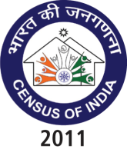
The Global Summit on CRVS Civil Registration System and Sample Registration System
R. K. Gautam
Director
Office of the Registrar General, India

Slide 2
Sub- Topics
History of Civil Registration System & Vital Statistics in India
The Registration of Births & Deaths Act, 1969 (RBD Act, 1969)
Salient features of the RBD Act, 1969
Roles and Responsibilities of registration functionaries
Forms under the system of registration of births and deaths

Slide 3
Sub- Topics
Sources of data for generating Vital Statistics
Process of compilation of Vital Statistics
Process of Dissemination of Vital Statistics
Level of Registration

Slide 4
Introduction to Civil Registration System
Civil Registration System popularly known as birth and death registration system is the recording of vital events i.e. live births, still births and deaths under the statutory provisions on a continuous and permanent basis. The registration records are useful primarily as legal documents and secondarily as a source of statistics.
In India, the system of civil registration has been in operation for more than a century.
At present the registration of births and deaths is being done under Registration of Birth and Death Act,1969.

Slide 5
CIVIL REGISTRATION SYSTEM
National
Vital Statistics including Registration of Births and Deaths at Sl. No. 30 falls under Concurrent List of the Constitution of India.
Mandatory under RBD Act 1969

Slide 6
Civil Registration System
Comprehensive and complete CRS has multi-faceted implications on socio-economic development of a country.
A complete & up to date CRS can provide:
Reliable Statistics on fertility & mortality at all level of aggregations
Almost on a real time basis which is not possible from any sample survey.
Key for evidence based planning and has no parallels
The levels of registration reflects the quality of governance.

Slide 7
Civil Registration System
The essential features of Civil Registration System are:
Universality
Continuity
Compulsory
Permanence

Slide 8
Civil Registration System
CRS has the following components:
Law
Civil Registration Structure
People Participation
Services to Public
Checks and Balances

Slide 9
Civil Registration System (CRS)- Scenario
Registration of Births and Deaths in India is mandatory with the enactment of Registration of Births and Death Act (RBD Act), 1969.
Registration of Births and Deaths falls under the Concurrent list of the Constitution.
Registrar General, India unifies and coordinates the activities of the States.
States are responsible for implementation of RBD Act.
National Population Policy mandates cent percent registration.

Slide 10
Registration of Births and Deaths Act, 1969
Uniform law across the country for the registration of births and deaths
Reporting and registration of all births and deaths compulsory
Responsibility to report the event
For Domiciliary births ------head of households
For Institutional events --- in charge of the institution

Slide 11
Appointment of Notifiers
Free registration of births/deaths
Delayed Registration of events
Penalties on the persons/ establishments
Issue of certified extracts from the birth or death register
Registration of birth without name

Slide 12
HISTORICAL BACKGROUND
Mid of 19th Century
Registration of deaths with a view to introducing sanitary reforms for control of pestilence and diseases
Indian Famine Commission, 1880
Central Births, Deaths and Marriages Registration Act, 1886
Conference on Improvement of Vital Statistics 1961 recommendation

Slide 13
RBD Act 1969
Bill received assent of the President on May 31, 1969.
Notified in the Gazette of India Extraordinary, Part II Section I, on June 2, 1969.
Enforced on April 1, 1970.
Model Rules 1970.
A new set of Model Rules under the revamped system Jan 1, 2000.

Slide 14
Salient features of the RBD Act, 1969
Uniform law across the country on the registration of births and deaths.
Reporting and registration of all births and deaths compulsory.
Registrar General, India to ‘co-ordinate and unify’ the implementation of the Act.
Provision of birth registration - without the name of the child.
Name can be entered later but not after 15 years from the date of registration.

Slide 15
Salient features of the RBD Act, 1969 contd…
Penalties for non-reporting/non-registration of the events.
Issue of extract – Birth / Death certificate.
Correction or cancellation of entries
Issue of free certificate of birth/death in case the registration is done within 21 days.
Provision for delayed registration.

Slide 16
Registration Hierarchy
Registrar General, India
Chief Registrar
District Registrar
Registrar
Coordinates
and unifies the implementation
of the Act in the country
Chief Executive authority
in the State/Ut for implementing
the provisions of the Act
Supervision of
the registration of
births and deaths
in the District
Registration of
births and deaths and
submission of statistical
Information on registered
births and deaths

Slide 17
Registration Hierarchy
National level:
Registrar General, India
Joint Registrar General
Assistant Registrar General for the States
State level:
Chief Registrar
Additional Chief Registrar/Deputy Chief Registrar
District level
District Registrar
Additional District Registrar
Local level
Registrar of Births & Deaths
Sub-Registrar for specified areas within the area under the jurisdiction of a Registrar.

Slide 18
Revamping of the Civil Registration System
The process of registration has been revamped
To reduce the paper work
To speed up the tabulation of CRS data.
The procedures for registration of births and deaths have been modified to some extent and the forms redesigned.
Most of the tables in the tabulation plan are prepared based on the information of place of usual residence of mother in case of births and place of usual residence of deaths in case of deaths.

Slide 19
Revamping of the Civil Registration System
Salient features of the revamped system are:
revision in the content and size of the registration forms,
redesigning of forms by segregating the legal items from the statistical items,
addition of new relevant items viz. birth weight, duration of pregnancy, age of mother at the time of marriage; and deletion of the Notifier forms, etc.
Consequently, the number of forms was reduced from 21 to 13.

Slide 20
Forms used under the revamped system of registration of births and deaths
Form No. 1: Birth Report Form;
Form No. 1A: Birth Report for Adopted Child;
Form No. 2: Death Report Form;
Form No. 3: Still Birth Report Form;
Form No. 4: For Medical Certification of Cause of Death (for Hospital Patients);
Form No. 4A: For Medical Certification of Cause of Death (for Non-Institutional Deaths);
Form No. 5: Birth Certificate;

Slide 21
Forms used under the revamped system contd..
Form No. 6: Death Certificate;
Form No. 7: Birth Register;
Form No. 8: Death Register;
Form No. 9: Still Birth Register;
Form No. 10: Non–Availability Certificate;
Form No. 11: Summary Monthly Report of Births;
Form No. 12: Summary Monthly Report of Deaths;
Form No. 13: Summary Monthly Report of Still Births.

Slide 22
Statistical Reporting System
Registrar
Monthly Statements on
registered births and deaths
Consolidated monthly returns on
registered births and deaths
for the district
District Registrar
Chief Registrar
Annual Statistical Report
Annual Report on working of the Act
State Govt.
Annual Statistical Report
-Vital Statistics of India
Registrar General, India
Annual Report on
working of the Act
Govt. of India

Slide 23
Sources of data on Vital Statistics in India
In India, the vital statistics are mainly generated through:
Population Census- Decadal Process
Civil Registration System
Sample Registration System (a demographic survey)

Slide 24
Population Census
The population census is the most comprehensive source of basic demographic characteristics providing data on size, structure and growth of population even for smaller administrative areas.
It is a decadal operations. Hence, does not provide information on growth of population and related demographic variables on yearly basis.

Slide 25
Process of Compilation & Dissemination of Vital Statistics
CRS:
On the basis of returns/reports received from States, annual report on Vital Statistics of India based on CRS are being released.
SRS:
On the basis of data received from SRS sample units, Annual Statistical Report based on Sample Registration System are being released.

Slide 26
Civil registration systems are considered to be complete if they cover 90% or more of all live births and deaths.
In India, the coverage of registration system is incomplete and not up to the mark to be utilized for statistical purposes at the National level.
However, there are 21 and 14 States/UTs where the coverage of birth and death registration respectively is more than 90%.

Slide 27
Performance Indicator (Level of Registration)
The level of registration (LOR), defined as the percentage of registered births/deaths to the births/deaths estimated through SRS, determines the performance level of a State /Union Territory in respect of registration of births and deaths.

Slide 28
Registration Scenario in India during last 5 years
LOR (Birth) – India: 69.0% to 83.6 % ( + 14.6 %)
LOR (Death)– India: 63.2% to 67.4% ( + 4.2%)
15 States/UTs have achieved 100% registration of births.
7 States/UTs have achieved 100% registration of deaths.
Some of the major States remains the main concern.

Slide 29
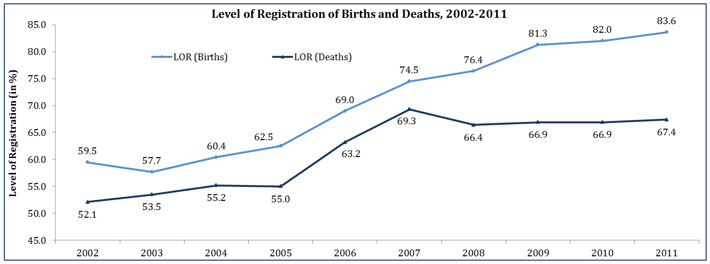
Still about every 5th birth & every 3rd death goes un-registered.

Slide 30
Medical Certification of Causes of Death (MCCD)
Introduced in early 1970s to provide cause-specific mortality profile.
Restricted to urban areas, that too few selected hospitals.
At various stages of implementation across different States.
Coding is as per ICD-10.
Covers about 20% of the total registered deaths only.
Garbage codes(R00-R99) are to the tune of 12.5%.

Slide 31
Time Series on Medically Certified Deaths vis-a-vis Total Registered Deaths Reported for the Period 1986-2010
ORGI has expanded the scope under MCCD to all Institutions including individual practitioners and the coverage , extended to rural areas as well.

Slide 32
Evaluation :
Despite having statutory provisions, registration data are deficient due to incomplete coverage and under-registration.
Extent of incomplete coverage and under-registration varies from State to State.

Slide 33
Why SRS is implemented ?
The increasing acuteness of the population problem and the deficiencies in the statutory Civil Registration System, intensified the need for quick and reliable estimates of birth and death rates on current and continuous basis.

Slide 34
Sample Registration System
Genesis
Initiated in 1969-70 for want of complete registration from CRS.
Objectives
Provide reliable annual estimates of birth, death and infant mortality rates at the State and National levels separately for rural and urban areas.
Also provides Child Mortality Rate (CMR), Total Fertility Rate (TFR), Sex Ratio at Birth and 0-4 age, Institutional deliveries, Medical Attention before death, etc.
Under 5 mortality rate also generated from 2008 annually.
Features
One of the largest demographic household sample survey in the world
Sample size determination based on IMR
Permissible level of RSE: 10% (bigger states)
1.3 million households and about 7 million population
Only panel survey with dual recording
Panel revised once in 10 years based on the latest available Census frame

Slide 35
Sample Registration System (SRS)
SRS organised by the Office of the Registrar General, India in 1964-65 on a pilot basis and became operational on full scale from 1969-70.
One of the largest demographic sample of household survey covering 1.3 million households and about 7 million population in the new SRS (based on 2001 census frame).

Slide 36
SRS is a dual recording system with the main objective of providing reliable annual estimates of birth and death rates at the State and National levels.
SRS also provides estimates of Infant Mortality Rate (IMR), Under Five Mortality Rate (U5MR) and Total Fertility Rate (TFR).

Slide 37
Main components of SRS
Baseline survey of sample units.
Continuous enumerations of vital events namely births and deaths.
Half-yearly survey.
Matching of events collected by enumeration and supervisor.
Field verification of unmatched and partially match events.

Slide 38
The field investigation under SRS consists of a continuous enumeration of births and deaths by an enumerator (preferably an anganwadi/local teacher) and an independent six-monthly retrospective survey by a full-time supervisor.
The data obtained by the two methods are matched. The partly matched and unmatched events are re-verified in the field to get an unduplicated count of events.

Slide 39
Revision of SRS Sample Frame
The revision of SRS sampling frame is undertaken every ten years based on the results of latest census. While changing the sample, modifications in the sampling design; wider representation of population; overcoming the limitations in the existing scheme; meeting the additional requirements etc. are taken into account.
The first replacement was carried out in 1977-78 and the last being in 2004. The revision of SRS sample based on 2011 Census frame has been done.

Slide 40
Revision of SRS Sample Frame
Based on the recommendations of the Technical Advisory Committee(TAC) on SRS, the sample units have been increased from 7597 in 2004 to 8861 units for 2014.
New SRS frame will be effective from 1.1.2014. baseline survey is expected to start in January, 2014.
At present ground identification and segmentation work is under process.

Slide 41
Replacement SRS sample units
 | 1969-70 | 1977-78 | 1983-85 | 1993-95 | 2004 | 2014
Rural | 2432 | 3684 | 4176 | 4436 | 4433 | 4967
Urban | 1290 | 1738 | 1846 | 2235 | 3164 | 3894
Total | 3722 | 5422 | 6022 | 6671 | 7597 | 8861

Slide 42
Sample design of current SRS
The sample design adopted for SRS is uni-stage stratified simple random sampling without replacement, except for larger villages. For larger villages with population 2000 or more, two stage stratified sampling has been adopted .
The final level of stratification for all strata is Female literacy.
Rural stratification:-
Each major state is geographically divided into NSS Natural division.
There are 2 to 6 natural divisions in a state formed by grouping contiguous administrative districts with distinct geographical and other natural characteristics.
Within each Natural division, villages are grouped into two strata based on size class.
Stratum – I: population less than 2000
Stratum – II: population 2000 or more

Slide 43
For villages with population less than 2000 (stratum-I), the entire village has been selected.
Villages having population 2000 and above were segmented in such a way that the population within each segment was more or less of equal size not exceeding 2000 each. All the segments were shown on the village map and one was randomly selected.

Slide 44
Urban stratification
Uni-stage stratified simple random sampling has been adopted with 2001 census urban enumeration blocks as the sampling units.
The cities/towns have been stratified in 4 Strata as
per following criteria:
Stratum – I: Less than one lakh
Stratum – 2: 1-5 lakh
Stratum – 3: 5 lakh and above
Stratum – 4: Four metro cities, Delhi, Mumbai, Chennai and Kolkata as separate strata. ( proportional allocation to slum population)

Slide 45
A simple random sampling of enumeration block is selected without replacement from each of the size classes of towns/cities in each State/UT.
The following statement shows the number of sample units selected in 2004 separately for rural and urban areas for all States/Uts.

Slide 46
Information collected under SRS
Births:
Particulars of the child: Place of birth, date of birth, live birth/still birth, single/multiple birth, sex etc.
Particulars of the mother:
Mother’s relation to head, residential status, present age, religion, type of medical attention received at delivery etc.

Slide 47
Deaths:
Particulars of the deceased: Place of death, date of death, relationship to head, Residential status, sex, age at death, marital status, religion, Medical attention before death.

Slide 48
Estimation Procedure
The estimation of population, live births, deaths and infant deaths are obtained using unbiased method of estimation.
Estimates of birth rate, death rate and infant mortality rates are obtained as the ratio of estimated births to estimated population, estimated deaths to estimated population and estimated infant deaths to estimated births, respectively.

Slide 49
Publications
SRS-Bulletin : Annual publication giving annual vital rates at all- India and State/Ut levels.
SRS Statistical Report: detailed the tables giving fertility and mortality indicators are published in this annual publication.

Slide 50
Other Publications
SRS based Abridged life Table
Baseline Survey Report
Special Bulletin on Maternal Mortality in India
Report on Causes of Death in India

Slide 51
MILLENNIUM DEVELOPMENT GOALS(MDG)
Of the 8 MDGs, IMR, U5MR and MMR are generated by SRS.
Goal No. | Goals | Indicators | Targets by 2015
4 | Reduce infant mortality | Infant Mortality Rate (IMR) | 28
 | Reduce child mortality | Under 5 Mortality Rate (U5MR) | 42
5 | Improve maternal health | Maternal Mortality Ratio (MMR) | 109

Slide 52
RESULTS FROM SRS 2011
IMR in India has registered 3 points decline to 44 in 2011 from 47 in 2010.
Every 7th death in India pertains to an infant.
As per SRS 2011 estimates:
1 in every 23 infants - National level
1 in every 21 infants - Rural area and
1 in every 34 infants - Urban area die within one year of birth (against 1 in 36 under MDG)

Slide 53
IMR ESTIMATES BY RESIDENCE 1990-2011
Declined in Rural IMR is steeper (38 points i.e. 1.8 points annually) compared to Urban (21 points i.e. 1.0 points annually).

Slide 54
IMR ESTIMATES BY SEX 1990-2011
Female infants continue to experience a higher mortality than male infants

Slide 55
NEO-NATAL MORTALITY BY RESIDENCE 1990-2011
NNMR has declined by 22 points (Rural by 23 vis-à-vis urban 14 points) in last 21 years at an annual average decline of about 1 point.
The Rural-Urban Gap is narrowing.

Slide 56
IMR Vs. NNMR Vs. PNNMR 1990-2011
Share of NNMR in the overall IMR is increasing over the years- and constitute 70% in 2011.
Appropriate interventions are required to effectively curb NNMR

Slide 57
U5MR ESTIMATES 2011
U5MR denotes number of children (0-4 years) who died before reaching their fifth birthday per 1000 live births
U5MR for the country has declined by 4 points over 2010 (55 in 2011 against 59 in 2010)
A uniform decline of about 4-5 points is seen in male and female U5MRs.

Slide 58
U5MR BY RESIDENCE : 1990-2011
U5MR for the country declined by 63 points (rural by 67 points vis-à-vis urban 36 points) in the last 21 years at an annual average decline of about 3 points.
Urban areas have achieved MDG target (42) but rural is still far off.

Slide 59
U5MR BY SEX: 1990-2011
Male-female mortality differential has narrowed down over the years, yet the gap remains significant.

Slide 60
MMR ESTIMATES 2007-09
MMRatio measures number of women aged 15-49 years dying due to maternal causes per 1,00,000 live births.
Decline in MMR estimates in 2007-09 over 2004-06:
At the country level, it has declined to 212 from 254 (a fall of about 17%)
It varies between 81 in the State of Kerala to 390 in Assam ( a variability of 5 times).
MDG target of 109 have been achieved by 3 States viz. Kerala, Tamil Nadu & Maharashtra.
4 States viz. Andhra Pradesh, West Bengal, Gujarat and Haryana are in closer proximity to achieving the MDG target.

Slide 61
Maternal Mortality Ratio (MMR); India, EAG & Assam, Southern States and Other States, 2004-06 and 2007-09
India & Major States | MMR 2004-06 | MMR 2007-09
INDIA TOTAL | 254 | 212
Assam | 480 | 390
Bihar/Jharkhand | 312 | 261
Madhya Pradesh/Chhattisgarh | 335 | 269
Orissa | 303 | 258
Rajasthan | 388 | 318
Uttar Pradesh/Uttarakhand | 440 | 359
EAG AND ASSAM SUBTOTAL | 375 | 308
Andhra Pradesh | 154 | 134
Karnataka | 213 | 178
Kerala | 95 | 81
Tamil Nadu | 111 | 97
SOUTH SUBTOTAL | 149 | 127
Gujarat | 160 | 148
Haryana | 186 | 153
Maharashtra | 130 | 104
Punjab | 192 | 172
West Bengal | 141 | 145
Other | 206 | 160
OTHER SUBTOTAL | 174 | 149

Slide 62
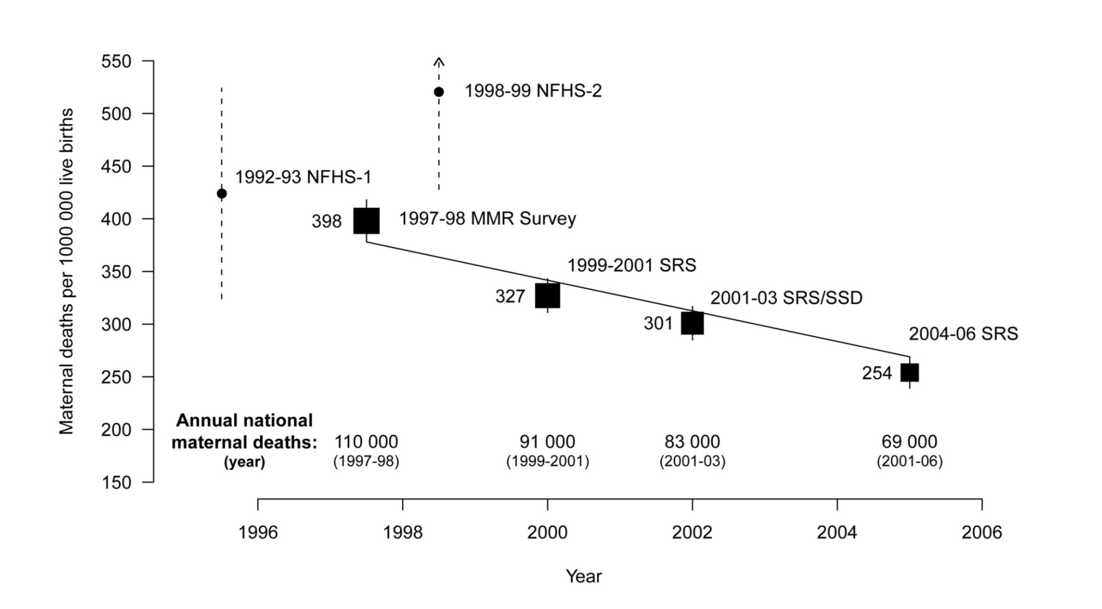
TREND IN MMRatio- India
2007-09 SRS
212
56 000 (2007-09)
(2004-06)
2009
Difficult to achieve the MDG target of 109 by 2015.

Slide 63
LEVELS OF MMRATIO BY REGIONS, 2007-09
Region | MMR | Life time risk | % share of female Popln. | % to total maternal deaths
EAG states | 308 | 1.1% | 48.0 | 61.6
Southern states | 127 | 0.3% | 21.0 | 11.4
Other states | 149 | 0.4% | 31.0 | 27.0
India | 212 | 0.6% | 100 | 100
½ of the female population of EAG States contributes about 2/3rd of Maternal Deaths.

Slide 64
Total Fertility Rate (TFR) estimates 2011
TFR for the country has come down to 2.4 from 2.5 in 2010.
A rural woman (TFR 2.7) at the National level would have about one child more than an urban woman (TFR 1.9), on an average.
10 Major States have achieved the 2.1 replacement level of TFR.
The highest TFR is 3.6 for Bihar and the lowest 1.7 for Tamil Nadu & West Bengal.

Slide 65
Total Fertility Rate (TFR) BY RESIDENCE, 1990-2011
TFR for the country declined by 1.4 points (down by more than a child), rural TFR also by 1.4 points and urban TFR by 0.9 point over last 21 years.

Slide 66
Thank You

