Slide 1
Barriers to women’s
labour force participation
AUSTRALIA

Slide 2
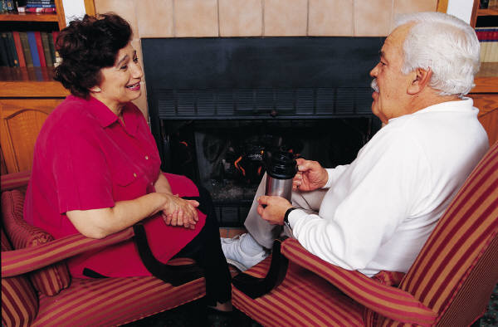
Overview
Considers women’s economic security including labour force participation, earnings and employee entitlements
Examines barriers to women’s participation in the labour market
Discusses work/life balance
Outlines Australian Government response

Slide 3
Background
Participation in the labour force has many benefits for the individual and society as a whole
Higher economic growth is in part achieved though higher labour force participation
Improving women’s participation is critical to securing financial well being

Slide 4
Utilising all our talents
“…integrating women into our economies can yield a broad range of economic gains from increased profits, productivity gains, better corporate leadership, and more efficient utilization of all of our resources and talents.”
Melanne Verveer
Ambassador-at-Large for Global Women’s Issues

Slide 5
Women’s economic security
Labour force participation
International comparison
Labour force participation in Australia
Employed persons, employed part-time
Hours worked (full-time/ part-time)
Unemployment, underemployment and underutilisation
Women’s self-employment

Slide 6
International comparison
Employment rate (a) in OECD countries, women 15-64 yrs, 2012
Percent (%) of female population
Ave 60.1
(a) Employment rate of women as percentage of female population (15-64)
Notes:
This graph shows a comparison of the employment rate for women across OECD countries. Australia ranks as one of the countries with a high rate of women employed. Countries with higher employment rates for women include Iceland, Norway and New Zealand.
Assisting more women to enter or remain in the workforce for longer is a major public policy issue in Australia.

Slide 7
Labour force participation in Australia
(a) Data averaged using 12 months in the financial year.
(b) Labour force estimates dating back to (and including) 2008-09 have been revised in accordance with a new benchmarking
process. Labour force population benchmarks are now updated more frequently when preliminary population estimates become
available, and again when these preliminary estimates are subsequently revised.
Source: ABS data available on request, Labour Force Survey.

Slide 8
Labour force participation – hours worked
(a) Financial year average hours worked. The time includes all paid and unpaid overtime but excludes hours paid for but not worked during the reference period due to leave (e.g. annual, sick or maternity leave) or for any other reason (e.g. public holidays, meal breaks, time spent on travel to and from work).
(b) Full-time or part-time status is based on usual and actual hours worked by the respondent during the survey reference week. Those who usually worked 35 hours or more a week (in all jobs) and those who, although usually working less than 35 hours a week, worked 35 hours or more during the reference week are classified as full-time. Those who usually work less than 35 hours (in all jobs) and did so during the reference week, or were not at work in the reference week are classified as part-time.
(c) Labour force estimates dating back to (and including) 2008-09 have been revised in accordance with a new benchmarking
process. Labour force population benchmarks are now updated more frequently when preliminary population estimates become
available, and again when these preliminary estimates are subsequently revised.
Source: ABS data available on request, Labour Force Survey.

Slide 9
Labour force participation - unemployment
Data averaged using 12 months in the financial year.
Data averaged using four quarters in the financial year.
Data averaged using four quarters in the financial year.
(a) Labour force estimates dating back to (and including) 2008-09 have been revised in accordance with a new benchmarking
process. Labour force population benchmarks are now updated more frequently when preliminary population estimates become
available, and again when these preliminary estimates are subsequently revised.
Source: ABS data available on request, Labour Force Survey.

Slide 10
Self Employed
Women ‘entrepreneurs’
(a) Employees without paid holiday and paid sick leave entitlements.
Source: ABS data available on request, Forms of Employment Survey.
33 % business owners are women 35-44 years of age
40 % business owners provide unpaid child care

Slide 11
Women’s economic security
Employee Entitlements
(a) Employees without paid holiday and paid sick leave entitlements.
Source: ABS data available on request, Forms of Employment Survey.
22% of women aged 20-74 years work without leave entitlements in their main job, compared to 17% of men

Slide 12
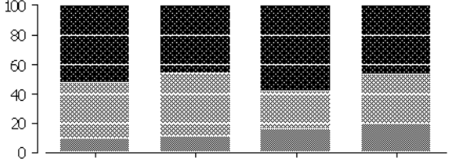
Women’s economic security
Employee Entitlements
PARENTS IN COUPLE FAMILIES(a), ACCESS TO PAID CARERS AND
MATERNITY / PATERNITY LEAVE, 2007
100
80
60
40
20
0
Mothers
paid carers
leave
Mothers
paid maternity
leave
Fathers
paid carers
leave
Fathers
paid paternity
leave
Has entitlements Doesn’t have entitlements Doesn’t know if has entitlements
Where both parents were working as employees (excluding owner-managers and contributing family workers).
Source: ABS Survey of Employment Arrangements, Retirement and Superannuation, 2007 (cat. no. 6361.0)

Slide 13
Women’s economic security
Earnings
(a) Total cash earnings of employees is equal to ordinary time earnings plus overtime earnings. (b) In 2011-12 dollars, adjusted using changes in the Consumer Price Index. (c) The survey refers to the last pay period ending on or before 19 May 2006, 15 August 2008, 21 May 2010 and 18 May 2012. Source: ABS data available on request, Survey of Employee Earnings and Hours.

Slide 14
Current Situation
Gender wage gap – little or no gain i.e. gap is as wide in 2012 as in 2006
Women in relatively low paid jobs compared to men e.g. caring (children and elderly), nursing, clerical admin
Wage gaps are narrower in public sector e.g. teaching & public service - widest in financial sector
Women pay a wage penalty for having children – many want to work PT on return to work, some want less responsibility – trade off wages for flexibility

Slide 15
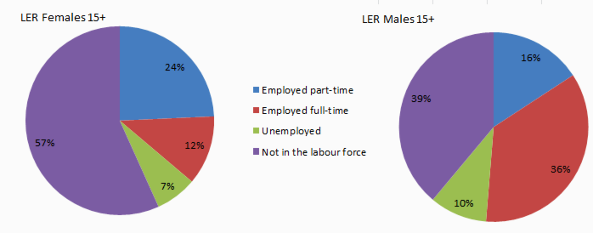
At risk households
Males and females aged 15 years and over living in low economic resource households (LER), by labour force status, 2009-10
More than half of the women in LER households are not in the labour force.
Of those that work, they are more likely to do so part-time (and vice versa for men).

Slide 16
At risk households
Males and females aged 15 years and over living in LER households
Current weekly personal and household income by source, 2009-10
Personal income Household income
Males Females Males Females
Mean $ per week
298 149 527 474
122 219 322 353
32 6 47 36
13 20 29 33
2 2 4 4
467 396 930 901
Income sources
Employee income
Gov pension and allowances
Own unincorporated business
Other sources
Investment income
Total weekly income
Female Personal income is half that of males.
Most income for women in LER households is from government pensions and allowances.

Slide 17
Vignettes
Mary aged 45, three children aged 10,10 and 16 years, separated - works two jobs; low pay rates - no tertiary training - provides care for parents - needs flexible working conditions
Rose aged 32, three children, 12 months in childcare, 3 years in pre-school and 6 year old starting school, married - university degree - maintained employment attachment - cannot get childcare - needs flexible working conditions
Joy aged 36, two children, 12 and 14 years, married - university degree - resigned while caring for children - retrained to re-enter workforce - pay rates too low and stress too high - enjoys lower skilled work with flexibility

Slide 18
Barriers to women’s labour force participation
“Once women hit their mid-20s, female participation rates decline for the next two decades. As women move from full-time to part-time employment to accommodate the needs of their families, their careers are interrupted, for which they pay an excessive price.
Women who put their careers on hold for even a couple of years are left with risks of being on lower salaries than men; side-lined from leadership positions; and with little in the way of retirement savings.”
Untapped opportunity, The role of women in unlocking Australia’s productivity potential, July 2013; Ernst and Young

Slide 19
Barriers to women’s labour force participation
Education and skills
Caring responsibilities
Disability, poor health & mental illness
Geography
Gender segregation, and
Policy disincentives to workforce participation

Slide 20
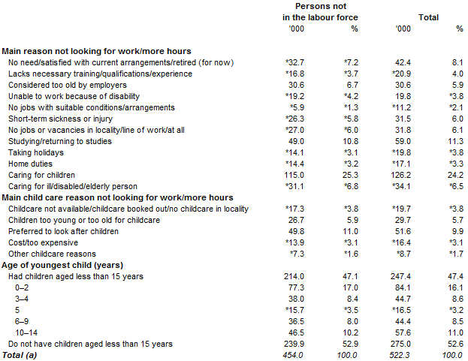
Barriers to women’s labour force participation
WOMEN AGED 18 YEARS AND OVER, WANTED A JOB OR MORE HOURS AND WERE AVAILABLE TO START WORK/ MORE HOURS WITHIN FOUR WEEKS
Selected main reason not looking for work/ more hours
(a) Includes people who reported other main reasons not looking for work/more hours. Includes 42,300 people (16,700 men and 25,600 women) who were not in the labour force and took inactive steps.
Source: ABS Barriers and Incentives to Labour Force Participation, Australia, July 2010 to June 2011, (cat. no. 6239.0)

Slide 21
Work/Family Balance
(a) Data based on person's primary activity.
(b) Definition of unpaid work: Household or community work activity undertaken without pay (excluding work in a family business) that could be replaced by market goods or paid services. It includes: volunteering or other community work undertaken without pay, domestic work, child care, informal care of older people or people with a disability, shopping, and communication and travel associated with these activities.
(c) Aggregated time for primary activity averaged across all persons.
Source: How Australians Use Their Time, 2006 (cat. no. 4153.0)
(a) Includes childcare as either a primary or secondary activity
(b) Children aged 0–14 years.
(c) Aggregated time averaged across all parents in the population group (whether they engaged in caring for children or not).
Source: ABS data available on request, Time Use Survey.

Slide 22
Public policy response
The Australian Government has implemented a range of programs to increase women’s workforce participation and address barriers
As part of this assistance the Government also funds programs to assist fathers to take on more caring responsibilities

Slide 23
Public policy response
Workplace Gender Equality Act 2012
Paid Parental Leave
Increase in Superannuation
Support for more women in leadership positions in both the government and private sectors

Slide 24
Fair Work Act
Implemented a strong safety net of 10 National Employment Standards (NES)
The NES provide all employees in federal system with clear comprehensive and enforceable minimum protections
The Fair Work Commission can order equal pay for work of equal and comparable value

Slide 25
Questions?

Slide 26
Questions?

Slide 27
Other measures of labour
Underemployed workers Underemployed workers are employed persons who want, and are available for, more hours of work than they currently have. They comprise: persons employed part time who want to work more hours and are available to start work with more hours, either in the reference week or in the four weeks subsequent to the survey
persons employed full time who worked part-time hours in the reference week for economic reasons (such as being stood down or insufficient work being available). It is assumed that these people wanted to work full time in the reference week and would have been available to do so.
Underemployment rate The number of underemployed workers expressed as a percentage of the labour force.

Slide 28
Other measures of labour
Underutilisation rate This is the sum of the number of persons unemployed and the number of persons in underemployment, expressed as a proportion of the labour force. See 'Unemployed' and 'Underemployed workers'. Unemployed Persons aged 15 years and over who were not employed during the reference week, and:had actively looked for full-time or part-time work at any time in the four weeks up to the end of the reference week and were available for work in the reference week; or
were waiting to start a new job within four weeks from the end of the reference week and could have started in the reference week if the job had been available then.
Unemployment rate The number of unemployed persons expressed as a percentage of the labour force.

