Slide 1
From raw data to easily understood gender statistics
Haoyi Chen
Social and Housing Statistics Section
United Nations Statistics Division

Slide 2
SEX versus GENDER in statistics: a summary
+
Sex = a biological individual characteristic recorded during data collection in censuses, surveys or administrative sources
Demographic, social and economic characteristics
Gender-sensitive methods of data collection
Data disaggregated by sex
Gender issues = questions, problems and concerns related all aspects of women’s and men’s lives, including their specific needs, opportunities, or contributions to society
Analysis of sex-disaggregated data and /or qualitative information for a population group
Gender statistics
Gender inequalities
Gender = A social construct. Refers to socially-constructed differences in attributes and opportunities associated with being female or male and to the social interactions and relationships between women and men

Slide 3
Presentation of gender statistics
General goals
Highlight key gender issues
Facilitate comparisons between women and men
Reach a wide audience
Encourage further analysis
Stimulate demand for more information

Slide 4
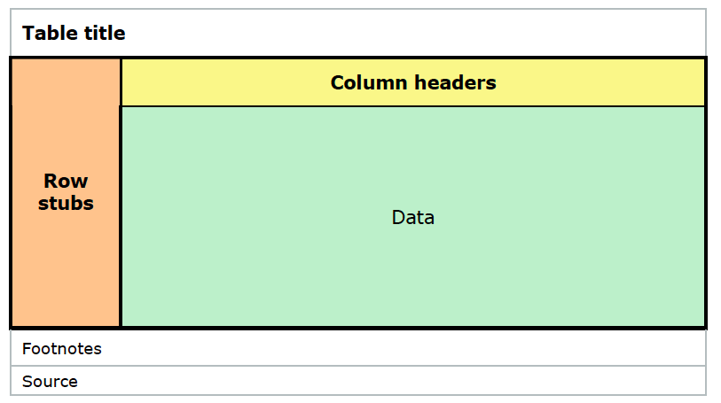
Some basics about tables & graphs
A good example
Employed population by occupation and sex, Iraq, 2013
Title: What, where, when
Footnotes: how data calculated/definition
Source: organisation, data collection method

Slide 5
Some basics about numbers
Use minimum of decimal points and be consistent
Use thousand separators
Align the numbers on the decimal point: right-justify them, do not center!!
Do not leave any data cell empty – “NA” or other symbols and define them

Slide 6
What’s wrong with the table?
Employment by industrial sectors

Slide 7
What’s wrong (answer)
Which geographic area the data refer to?
Data source is not identified.
The values are centered rather than right-aligned.
The values should not be displayed with more than 1 decimal (too much information).
Values should have the same number of decimal places as the other values

Slide 8
Basic table for analysis of gender statistics (1)
Distribution of each sex by selected characteristic (distribution of women and men by economic activity status):
Women and men totals are used as denominators, proportions calculated by columns
Used for comparison of women and men with regard to the characteristic; and the basis for many gender indicators
The basis for calculating gender gap: the proportion of women employed is lower than the proportion of men employed by 34 percentage points
Proportion employed
Economic activity status for population 15-64 years old, Peru, 2007
 |  |  |  | Percentage distribution |  |  | Sex distribution (per cent)
 | Women | Men |  | Women (per cent) | Men (per cent) |  | Women | Men | Total
Employed | 3460389 | 6186103 |  | 39 | 73 |  | 36 | 64 | 100
Unemployed | 154781 | 301469 |  | 2 | 4 |  | 34 | 66 | 100
Not in the labour force | 5156664 | 2030531 |  | 59 | 24 |  | 72 | 28 | 100
Total population | 8771834 | 8518103 |  | 100 | 100
Source: United Nations Statistics Division, DYB, Census Data Sets

Slide 9
Basic table for analysis of gender statistics (2)
Sex distribution within the categories of a characteristic
Categories of the characteristics are used as denominators; proportions are calculated by raw.
Used to show the under- or over-representation of women or men in selected population groups.
Most often utilized for selected groups where women represent a minority, such as parliamentarians, managers, mayors, or researchers.
Economic activity status for population 15-64 years old, Peru, 2007
 |  |  |  | Percentage distribution |  |  | Sex distribution (per cent)
 | Women | Men |  | Women (per cent) | Men (per cent) |  | Women | Men | Total
Employed | 3460389 | 6186103 |  | 39 | 73 |  | 36 | 64 | 100
Unemployed | 154781 | 301469 |  | 2 | 4 |  | 34 | 66 | 100
Not economically active population | 5156664 | 2030531 |  | 59 | 24 |  | 72 | 28 | 100
Total population | 8771834 | 8518103 |  | 100 | 100
Source: United Nations Statistics Division, DYB, Census Data Sets

Slide 10
Presentation of gender statistics in graphs
Graphs
Summarize trends, patterns and relationships between variables.
Illustrate and amplify the main messages of the publication, and inspire the reader to continue reading.
Are generally better understood and interpreted by the average reader, and therefore appeal to a wider audience.

Slide 11
Line charts
Give a clear picture of changes over time or over age cohorts.
Other examples:
literacy rates over time
labour force participation rates over time
Generally recommended to start from zero at the y-axis of a quantitative variable, however, in this case, starting from age 35 facilitates the comparison of women’s and men’s trends.
Design note: only one type of gridline used
Life expectancy at birth by sex, South Africa, 1950-2010
Source: United Nations, 2011.

Slide 12
Line charts (cont’d)
A graph can summarize trends and patterns that cannot easily be discovered in data tables. In the example given, three points are made:
At all ages, labour force participation rates are lower for women than for men
In the last two decades women’s participation rates increased. The same was not observed for men.
In the most recent year observed, women tend to withdraw from the labour market after age 30
Labour force participation rate by age group, by sex, Chile, 1990 and 2008
Source: ILO, LABORSTA.

Slide 13
Vertical bar charts
Simple bar charts
Bar charts are common in presentation of gender statistics
Simple bar charts are suitable for indicators such as
total fertility rate by region,
antenatal care by urban/rural areas,
proportion of women married before age 18 by level of education.
Design notes:
Ticks are not necessary on the axis representing a qualitative variable
Adding 3-D visual effect will not change the main story, but it will make the graph unnecessarily complicated and misleading
Women aged 15-49 who have experienced physical violence since age 15 by wealth quintile, India, 2005-06
Source: India Ministry of Health and Family Welfare, Government of India, 2007.

Slide 14
Vertical bar charts (cont’d)
Grouped (or clustered) bar charts
In gender statistics, women and men are shown as two sets of differently colored bars side by side within each category, so that the status of women is easily compared with the status of men.
Design note: labels for values presented in the graph have been removed not to distract the viewer from the main message: gender gap in school attendance is considerably higher in the poorest quintile
Primary school net attendance rate for children in the poorest and wealthiest quintiles, by sex, Yemen, 2006
Source: Yemen Ministry of Health and Population, and UNICEF, 2008

Slide 15
Dot charts
Primary school net attendance rate for girls and boys by wealth quintile and by urban/rural areas Yemen, 2006
If grouped bars are needed and more data points have to be illustrated, the bars can become too thin and difficult to interpret.
use dot charts
Design notes:
This presentation highlights even more the gender gap
The gender-blind total has been removed from the graph to keep the attention on the gender gap
Source: Yemen Ministry of Health and Population, and UNICEF, 2008

Slide 16
Stacked bar charts
Most effective for categories adding up to 100 per cent.
Design note: Category/categories of most interest should be placed at the bottom to facilitate the comparison.
Common problems:
more than three segments of the bar are difficult to compare from one bar to another
One or more categories may be too short to be visible on the scale
Property titles by sex of the owner and urban/rural areas, Viet Nam, 2006
Source: Viet Nam Ministry of Culture, Sports, Tourism and others, 2008.

Slide 17
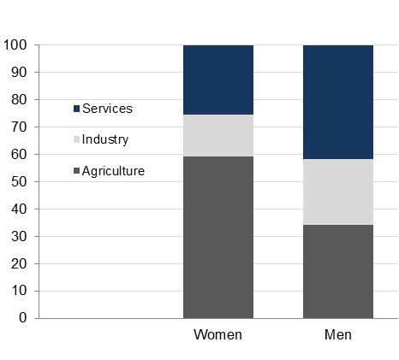
Stacked bar charts (cont’d)
Sometimes used to illustrate the distribution of a variable within the female and male population.
Common error: too many categories
Employment by sector, by sex, Morocco, 2008
Source: ILO-KILM, accessed March 2012.

Slide 18
Horizontal bar charts
Considered when many categories need to be presented, or where categories presented have long labels.
Horizontal bar charts may be preferred for showing some type of time use data, because the left-to-right motion on the x-axis generally implies the passage of time
Design notes:
women and men are presented side by side within each category, so that the main comparison is between women and men
Categories of marital status are displayed in order of stages of the life cycle
Time spent on care for children, sick and elderly by sex, urban/rural areas and marital status, Pakistan, 2007 (minutes per day in total population aged 10 and above)
Source: Government of Pakistan, Federal Bureau of Statistics, 2009

Slide 19
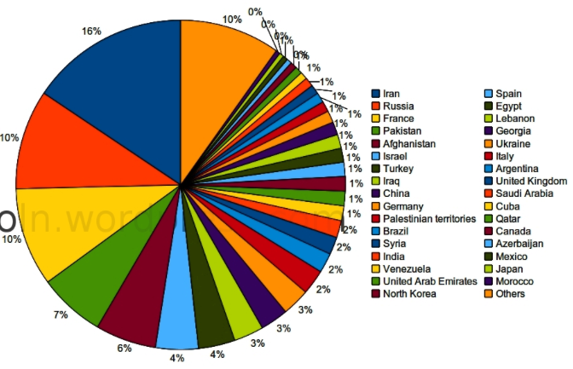
Pie charts
Suitable for illustrating percentage distribution of qualitative variables.
An alternative to the bar charts
Common error: too many categories
Women married before age 18 in urban and rural areas, Gambia, 2005-06 (per cent)
Source: The Gambia MICS 2005-06 Report

Slide 20
Scatter plots
School attendance rates for 6-17 years old by sex and state, India, 2005-06
Used to show the relationship between two variables
Useful when many data points need to be explained, such as in the case of a large number of regions or sub-regions of a country
Design note: the four states where girls have significantly lower school attendance rates than boys have been highlighted.
Keep the box square!
Source: India Ministry of Health and Family Welfare, Government of India, 2007

Slide 21
Presentation of gender statistics in tables
Tables
They may not have the appeal of graphs, but are necessary forms of presentation of data.
Types of tables:
Large comprehensive tables, often placed in the annex of the publication (Annex Tables).
Text tables: smaller tables that are referred to and are part of the main text in the publication. Needed as support for a point made in the text.
Text tables are always a better alternative than presenting many numbers in a text, making the explanation more concise.
As with the graphs, the selection of the data to be presented in small tables depends on the findings of analysis in terms of most striking differences or similarities between women and men.
Some of the data that need to be presented may be easier conveyed in a table than in a graph (see next examples).
When data do not vary much across categories of a characteristic…
… or they vary too much

Slide 22
List tables
States with lowest proportions of women aged 15-19 who have had a live birth, India, 2005-06
Tables with only one column of data
Can be used, for example, to present data with not much variation between categories.
 | Women 15-19 who have had a live birth (per cent)
Himachal Pradesh | 2
Jammu & Kashmir | 3
Kerala | 3
Goa | 3
Delhi | 4
Uttaranchal | 4
Punjab | 4
Source: India Ministry of Health and Family Welfare, Government of India, 2007

Slide 23
Tables with two or more columns
Adult crude death rates by cause of death, South Africa, 2008. Selected top causes of death
Can be used when the values observed for some categories vary extremely compared to the rest of categories
Design notes to facilitate the comparison between women and men:
Data are rounded to integers
The gender-blind total was deleted
 | Crude death rates (per 10,000 persons age 15-59)
Causes of death | Women | Men
HIV/AIDS | 81 | 65
Respiratory infections | 8 | 11
Diarrhoeal diseases | 7 | 5
Malignant neoplasms | 6 | 7
Cardiovascular diseases | 5 | 7
Injuries | 3 | 12
Maternal conditions | 3 | ..
Nutritional deficiencies | 2 | 1
Tuberculosis | 2 | 7
Source: WHO, Global burden of disease 2008; online database

Slide 24
Tables with two or more columns (cont’d)
Can be used as a form of presentation when the focus of analysis is a breakdown variable (education of mother in the example below) that is associated with a number of related indicators expressed in different units
Demographic indicators by mother’s number years of schooling, India, 2005-06
Number of years of schooling | Women age 15-19 who have had a live birth (per cent) | Total fertility rate (live births per 1000 women) | Under-five mortality (deaths per 1000 live births)
No education | 26 | 3.55 | 81
< 5 | 16 | 2.45 | 59
5-7 | 15 | 2.51 | 55
8-9 | 6 | 2.23 | 36
10-11 | 4 | 2.08 | 29
12 + | 2 | 1.80 | 28
Source: India Ministry of Health and Family Welfare, Government of India, 2007

Slide 25
User friendly presentations of gender statistics Summary
Women and men should be presented side by side to facilitate comparisons.
Women should always be presented before men.
The words women/men and girls/boys should be used instead of females and males whenever possible.
When data are presented to a broader audience, numbers should be rounded to 1,000, 100 or 10 and percentages to integers, to facilitate the comparison between women and men
The gender-blind total should be deleted in tables and graphs to facilitate comparisons between women and men.

Slide 26
User friendly presentations of gender statistics Summary (cont’d)
Charts that give clear, visual information should be used instead of tables whenever possible.
Too many categories should be avoided in pie charts and stacked bars.
Use the same color for women and the same color for men along all charts
Preference should always be given to a simple layout in designing charts:
Only one type of gridline, either vertical or horizontal should be used, or not at all;
Ticks are not necessary on the axis representing a qualitative variable;
Labels for values presented inside a graph are, in general, distracting and redundant;
Graphs with a third unnecessary dimension are misleading.

