Slide 1
Integrating a Gender Perspective into Poverty Statistics
Haoyi Chen
Social and Housing Statistics Section
United Nations Statistics Division

Slide 2
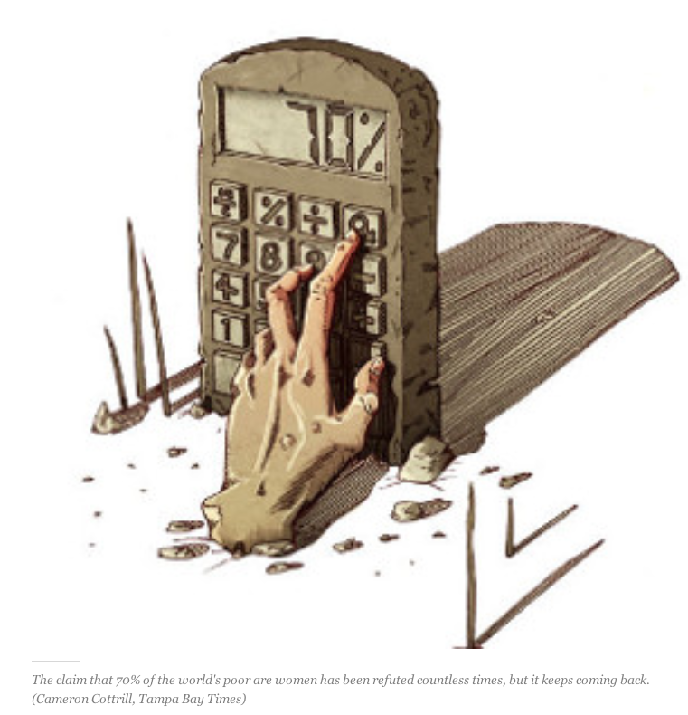

Slide 3
Measuring poverty from a gender perspective
Household level poverty
  Numbers of women and men living in poor households
  Female vs male headed households
Individual level poverty
  Intrahousehold allocation of resources
  Economic autonomy of women

Slide 4
Gender and Household level income/consumption poverty

Slide 5


Women and men living in poor households
Household 1
$5/day per person
Not poor
Poverty line
$1.25/day per person
Household 2
$1/day per person
Poor
Calculation: based on household income or expenditure

Slide 6
Women and men living in poor households
Example: Poverty rates by sex of the household members, selected African countries,1999-2008 (latest available)
(Source: United Nations, 2010)

Slide 7
Example: Poverty rates by sex of the household members, European countries, 2007-2008 (latest available)
Women and men living in poor households
→ significant differences between female and male poverty rates for European countries (countries with higher proportions of one-person households, especially of older persons)
(Source: United Nations, 2010)

Slide 8
Women and men living in poor households:
A poor measure of gender gap in poverty?!
Intrahousehold inequality not taken into account - women who are poor but live in non-poor households are not counted among the estimated poor
Poverty rate comparison across countries influenced by
  Household living arrangement: higher share of women with less income in one household vs 1-person families
  Ageing: more women than men in older ages
It is just the distribution of population by sex in poor households!

Slide 9
Example: Share of women in population and total poor, below and above 65 years, European countries, 2007-2008
Women and men living in poor households
→ Can be useful to point out the vulnerability of older women in certain contexts (especially in countries with high proportion of older persons living alone)
(Source: United Nations, 2010)

Slide 10
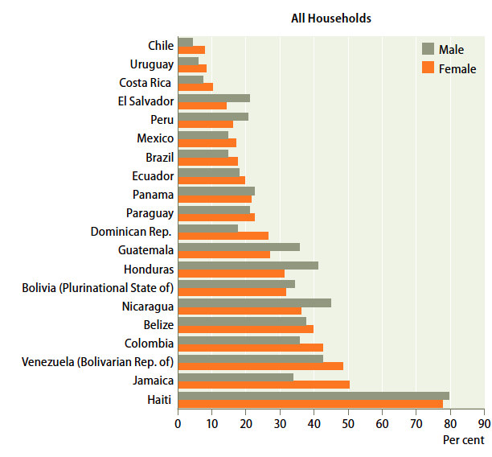
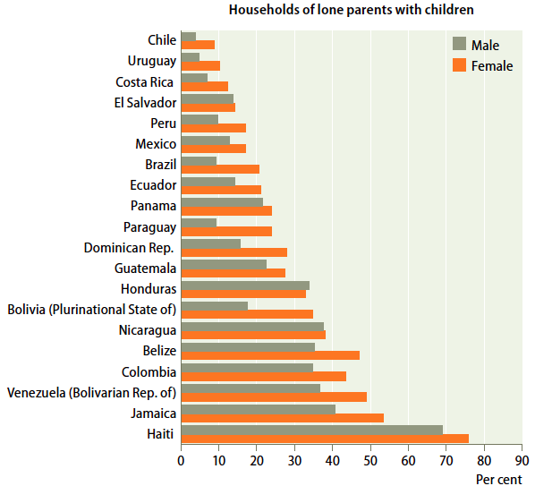
Poverty rate: female- and male-headed households
Variation by type of households
Poverty rate by sex of the head of the household, Latin America and the Caribbean, 1999-2008 (latest available)
(Source: United Nations, 2010)

Slide 11
Example:
Poverty rate for three sets of “female-headed” households, Panama, 1997 LSMS
Poverty rate: female- and male-headed households
Variation by definition of “household head”
Self-declared female-headed households: 29% poverty rate
Only 40-60% overlapping between categories
Households headed by “working female”: 23% poverty rate (more than half of total household labour hours worked by a single female member)
“Potential” female-headed households: 21% poverty rate (no working-age male present)
(Source: Fuwa, 2000)

Slide 12
Female-male difference in poverty rate for one-person households
(Source: United Nations, 2010)
Notes:
Poverty line plays a role in gender gap

Slide 13
Poverty rate: female- vs male-headed households
The unresolved issue: gender-based inequality within the household.
  Within the same household:
  Women may have a subordinated status relative to men
  Women may have less decision power on intrahousehold allocation of resources
  Fewer resources may be allocated to women and girls
Difficult to measure intrahousehold inequality using consumption as an indicator of individual welfare (food/housing/water supply/sanitation)
Female-headed households and male headed households are heterogeneous categories:
  Different demographic composition
  Different economic composition
  The head of household may not be identified by the same criteria
Use of different poverty line may have an impact on the female and male comparison

Slide 14
Poverty rate: Female- and male-headed households – key points
Disaggregate the types of female- and male-headed households, as relevant for your country, as much as possible, by taking into account demographic and/or economic characteristics of the household members
Use clear criteria in identifying the head of household
  Specification of criteria for identifying the head of household in the field in the interviewers manual and during training (make sure female heads of household are not underreported, especially when adult male members are part of the household)
  Use for analysis heads of household identified, at the time of the analysis, based on demographic and/or economic characteristics
  Avoid using self-identified heads based on no common criteria
Try analysis based on different poverty lines

Slide 15
Measuring poverty based on individual-level data: a requirement for gender statistics

Slide 16
A. Use of non-consumption indicators of poverty
Non-consumption indicators more successful in illustrating gender inequality in the allocation of resources within the household
  Measured at individual level
  Correspond to a shift in thinking poverty: from poverty as economic resources to avoid deprivation to poverty as actual level of deprivation, not only in terms of food and clothing, but also in areas such as education and health
Examples of potential dimensions for individual-level measures of poverty and intrahousehold inequality:
  Education
  Health and nutrition
  Time use
  Access to food and clothing
  Asset ownership
  Participation in intrahousehold decision-making
  Social participation
  No consensus of what dimensions to include + need for international standards on individual-level measures of gender-related intrahousehold poverty and inequality

Slide 17
B. Access to income, property ownership and credit
Access to income
  Gender division of labour: women spend more of their time on unpaid domestic tasks; on the labour market, women are more often than men in vulnerable employment with low or no cash returns
  As a result, compared to men, women’s income tends to be smaller, less steady and more often paid in-kind
Ownership of housing, land, livestock or other property
  Gender inequality with regard to inheritance rights, rights to acquire and own land, and rights to own property other than land; women may not be able to obtain property that is rightfully theirs due to lack of education, information and knowledge of entitlements.
  As a result, women tend to have less access to property than men
Access to credit
  Women more likely to lack income and property ownership to be used as collateral for credit; women’s business may be more often in informal or low-growth sectors with less opportunities for loans
  As a result, women’s chances to obtain formal credit are smaller than men’s.

Slide 18
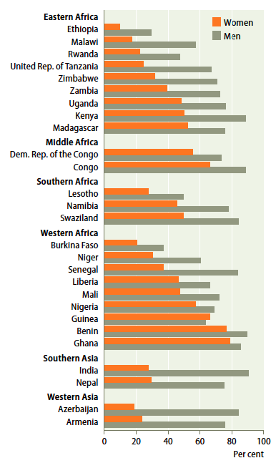

Example: access to income
(Source: United Nations, 2010)

Slide 19
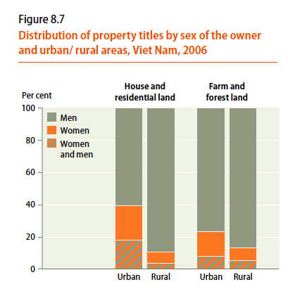
Property ownership by sex
The EDGE project:
developing guidelines on measuring individual-level asset ownership
(Source: United Nations, 2010)

Slide 20
Access to income, property ownership and credit
From gender issues to gender statistics
Policy-relevant questions on gender | Data needed | Sources of data
Do women earn cash income as often and as much as men? | Employment by type of income and sex. Value of individual income by sex | Household surveys such as living standard surveys, LFS, DHS, or MICS Living standard surveys such as LSMS or EU-SILC (European Union Statistics on Income and Living Conditions)
Do women own land as often and as much as men? Do women appear as often as men on housing property titles? | Individual ownership of land by sex Distribution of land size by sex of the owner Distribution of housing property titles by sex of the owner | Household surveys such as living standard surveys; agricultural censuses or surveys Multi-purpose household surveys; administrative sources
Do women apply for and obtain credit as often as men? Are some types of credit and some sources of credit more often associated with women than men? | Applicants for credit by sex, purpose of credit, source of credit and approval response. | Multi-purpose household surveys, including LSMS surveys

Slide 21
Access to income, property ownership and credit
Gender-related measurement issues
Data on individual income and its share in total household income difficult to measure in some countries and may be more severely underestimated for women
Data on ownership and access to credit most often collected only at household level or agricultural holding level, without the possibility of identifying joint ownership.
When data on ownership of agricultural resources and decision-makers are not collected at more disaggregated level (individual level and subholding level - such as plots of land and type of livestock), the status of women and men may be misrepresented.

Slide 22
The gendered experience of poverty

Slide 23
Example: Primary school net attendance rate for girls and boys by wealth quintiles, Yemen, 2006
Source: Ministry of Health and Population and UNICEF, 2008. Yemen Multiple Indicator Cluster Survey 2006, Final Report

Slide 24
Example: Women age 15-49 who have experienced physical violence since age 15 by wealth quintile, India, 2005-06
Source: Ministry of Health and Family Welfare Government of India, 2007. National Health Family Survey 2005-06

Slide 25
Example: Married women aged 15-49 not participating in the decision of how own earned money is spent, for poorest and wealthiest quintiles, 2003-08 (latest available)
Source: United Nations, 2010

Slide 26
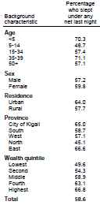
Frequent problem in tabulation of data: “sex” just one of many variables listed in a two-way table (see example)
Make sure data are tabulated disaggregated by sex, poverty status/wealth category AND the characteristic of interest at the same time.

Slide 27

Three key points in improving the availability and quality of gender statistics in the area of poverty
  Use detailed types of female- and male-headed households to obtain more relevant household-level statistics on gender and poverty
  Use a broader concept of poverty to highlight issues of gender-based intrahousehold inequality and economic dependency of women on men
  Use disaggregated data by poverty or wealth status to highlight the gendered experience of poverty (poverty affecting women and men in different ways)

Slide 28
Visit us at:
http://unstats.un.org/unsd/gender/default.html

