Slide 1
Mid-Decade Assessment of the United Nations
2010 World Population and Housing Census
Program
Arona L. Pistiner
Office of the Associate Director for 2020 Census
U. S. Census Bureau
New York, New York
October 29, 2013

Slide 2
UN Economic and Social Council Resolution 2005/3
The resolution, in part, states the need for the census and urges member countries to support three essential goals:
  Agreeing on international principles and recommendations to conduct a census;
  Conducting a population and housing census at least once in the time frame 2005 to 2014; and
  Disseminating their census results in a timely manner for effective socio-economic planning and monitoring of population issues, policies, and trends.

Slide 3
2010 World Population and Housing Census Programme (2005-2014)
In February 2010, at the 42nd session of the UN Statistical Commission Meeting, the Commission requested a review of the 2010 Population and Housing Census Programme for their 2012 meeting.
Primary objectives:
  Document the early lessons learned from the 2010 census round; and
  Identify preliminary 2020 census round (most likely, years 2015 to 2024) recommendations for this Commission.

Slide 4
Scope of the Review and this Presentation
The program review:
Informed UN Statistical Commission on early lessons learned from the 2010 census round.
Provided recommendations for the Statistical Commission to consider moving towards the 2020 census round.
Made observations and points to consider about the current state of world census taking.
Provided a global perspective of census taking from the 192 UN States Members (not the 235 countries/areas).

Slide 5
Programme Review Methodology
Step 1: Initial research and gather data about the project. (mid-April - May 2011)
Step 2: Questionnaire development, reviews, and translation. (May)
Step 3: Distribution and receipt of the questionnaires. (13 June – 1 September)
(First deadline to return questionnaires was 29 July, second deadline 1 September)
Step 4: Translation of non-English questionnaires and/or open-ended questions.
(3 August – 24 August)
Step 5: Data Capture using CSPro. (8 August – 11 August and 1 September)
Step 6: Qualitative and Quantitative Analysis. (8 August – 16 September)
Step 7: Synthesize information, draft paper and reviews. (by 11 October)
Step 8: Submit paper to the UN Statistics Division. (31 October)
Step 9: Prepare presentation statement and reviews. (23 January 2012)
Step 10: Present findings at UN Statistical Commission Meeting. (28 February)
Phase 2: Summer 2012

Slide 6
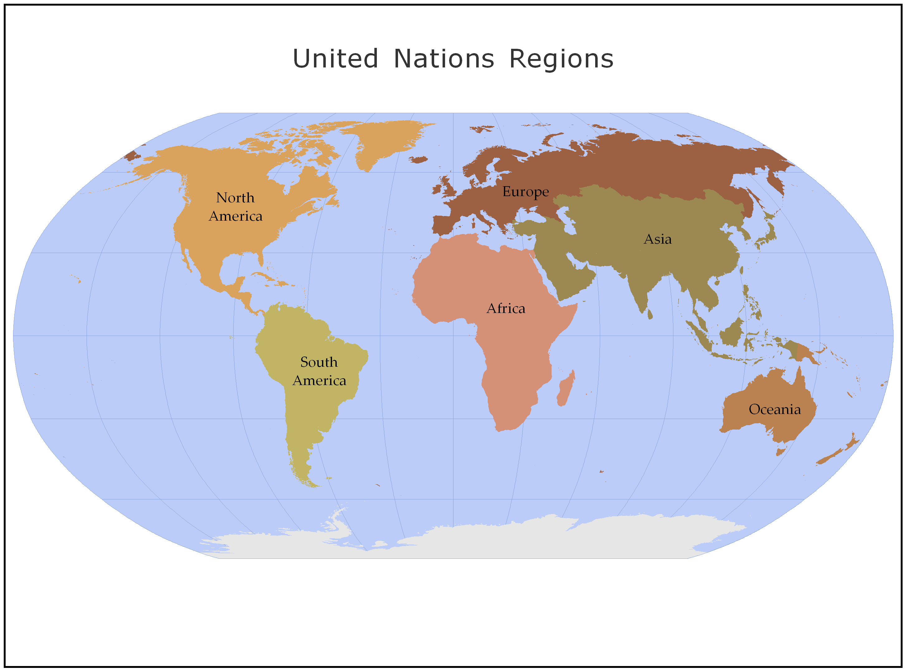
UN Regions of the World

Slide 7
Regional Participation Rates
UN Regions | Number of Countries in Region | Number of Countries Responding by August 17, 2012 | Percent of Countries Responding
Africa | 53 | 27 | 51%
Asia | 48 | 31 | 65%
Europe | 43 | 36 | 84%
North America | 23 | 18 | 78%
South America | 12 | 7 | 58%
Oceania | 13 | 7 | 54%
Totals | 192 | 126 | 66%

Slide 8
Number of Countries by Main Census Methodology Used
Census Methods | Number of Responding Countries | Percent of Responding Countries
Full Field Enumeration | 105 | 85.37%
Administrative Registers | 12 | 9.76%
Pre-existing Administrative Records | 0 | 0.00%
Rolling Census | 0 | 0.00%
Other | 6 | 4.88%
Total Responded to Question | 123 | 100.00%
No response to Question | 3 | -
Total Countries in Survey | 126
Source: Questions 4.

Slide 9
Enumeration Methods by Main Census Methodology
Enumeration Methods | Totals |  | Full Field Enumeration |  | Administrative Registers
Enumeration Method | No. | % | No. | % | No. | %
Total | 123 | - | 105 | - | 12 | -
Face-to-Face Interviewer, Paper Questionnaire | 94 | 76.42% | 90 | 85.71% | 1 | 8.33%
Face-to-Face Interviewer, Electronic Questionnaire | 14 | 11.38% | 9 | 8.57% | 3 | 25.00%
Telephone | 14 | 11.38% | 10 | 9.52% | 2 | 16.67%
Self-Enumeration, Paper Questionnaire, Collected by Enumerators | 30 | 24.39% | 28 | 26.67% | 0 | 0.00%
Self-Enumeration, Paper Questionnaire, Return by Mail | 18 | 14.63% | 13 | 12.38% | 2 | 16.67%
Self-Enumeration, Internet | 33 | 26.83% | 26 | 24.76% | 3 | 25.00%
Register-Based Enumeration | 18 | 14.63% | 5 | 4.76% | 10 | 83.33%
Pre-existing Administrative Records | 8 | 6.50% | 4 | 3.81% | 1 | 8.33%
Other | 2 | 1.62% | 2 | 1.90% | 0 | 0.00%
Source: Questions 4 and 6.

Slide 10
Successes By Main Census Methodology
Census Successes | Full Field Enumeration |  | Administrative Registers
Success | No. | % | No. | %
Total | 105 | - | 12 | -
Kept Within Budget | 51 | 48.57% | 4 | 33.33%
Met Deadlines | 56 | 53.33% | 3 | 25.00%
Improved Logistics and Coordination | 54 | 51.43% | 1 | 8.33%
Improved/Maintained Response/Participation Rates | 43 | 40.95% | 2 | 16.67%
Improved/Maintained Data Quality | 52 | 49.52% | 4 | 33.33%
Improved Data Dissemination | 45 | 42.86% | 3 | 25.00%
Implemented New Technologies | 64 | 60.95% | 3 | 25.00%
Implemented New Methodologies | 39 | 37.14% | 3 | 25.00%
Other | 15 | 14.29% | 4 | 33.33%
Source: Questions 4 and 9.

Slide 11
Challenges By Main Census Methodology
Census Challenges | Full Field Enumeration |  | Administrative Registers
Challenge | No. | % | No. | %
Total | 105 | - | 12 | -
Cost | 78 | 74.29% | 5 | 41.67%
Timeliness | 47 | 44.76% | 4 | 33.33%
Response Rates | 38 | 36.19% | 3 | 25.00%
Data Quality | 39 | 37.14% | 8 | 66.67%
Public Perception | 40 | 38.10% | 2 | 16.67%
Privacy Issues | 27 | 25.71% | 4 | 33.33%
Other | 24 | 22.86% | 3 | 25.00%
Source: Questions 4 and 8.

Slide 12
Collaboration with Other Countries for the 2010 Census Preparation
Census Topics | Collaborated |  | Provided |  | Received
 | No. | % | No. | % | No. | %
Alternative Census Methodologies | 27 | 21.43% | 11 | 8.73% | 13 | 10.32%
New Technologies | 23 | 18.25% | 13 | 10.32% | 28 | 22.22%
Questionnaire Design | 27 | 21.43% | 19 | 15.08% | 28 | 22.22%
Cartography/Mapping | 20 | 15.87% | 15 | 11.90% | 32 | 25.40%
Data Collection | 15 | 11.90% | 18 | 14.29% | 14 | 11.11%
Data Capture | 21 | 16.67% | 14 | 11.11% | 24 | 19.05%
Data Processing | 21 | 16.67% | 13 | 10.32% | 35 | 27.78%
Data Analysis | 16 | 12.70% | 8 | 6.35% | 23 | 18.25%
Post-Enumeration Survey | 14 | 11.11% | 7 | 5.56% | 19 | 15.08%
Data Dissemination | 34 | 26.98% | 10 | 7.94% | 27 | 21.43%
Other | 5 | 3.97% | 3 | 2.38% | 5 | 3.97%
Source: Question 34.

Slide 13
How should the UN Share Information with Countries for 2020 Census Round?
Facilitation Techniques | Number of Countries | Percent of Countries
Workshops or Meetings | 106 | 84.13%
Working Papers, Technical Manuals, or Technical Reports | 104 | 82.54%
Updated UN Principles and Recommendations | 100 | 79.37
Training | 89 | 70.63%
Conferences | 87 | 69.05%
Website Repository | 85 | 67.46%
Collaboration with Other Countries | 75 | 59.52%
Social Media | 32 | 25.40%
Other | 2 | 1.59%
Source: Questions 37

Slide 14
What Types of Assistance and Materials Are Needed from the
UN Statistics Division for the 2020 Census Round?
Assistance/Materials | Number of Countries | Percent of Countries
Updated UN Principles and Recommendations | 99 | 85.34%
Working Papers, Technical Manuals, or Technical Reports | 94 | 81.03%
Workshops | 91 | 78.45%
Training | 78 | 67.24%
Collaboration with Other Countries | 52 | 44.83%
Consultations with Other Countries | 45 | 38.79%
None | 3 | 2.59%
Other | 2 | 1.72%
Source: Question 38

Slide 15
Considerations for Future Population and Housing Census Programme Reviews
Lessons Learned 1
Establish an international working group to develop and test an instrument to look at census challenges, lessons learned, and directions for the future. This survey would be used in the beginning of a census cycle, at the mid point, and at the end to assess the trends of the decade. Repeated use of the same instrument will enable comparison of data throughout the decade. Create a companion document explaining the purpose of each survey question.

Slide 16
Consideration for Future Population and Housing Census Programme Reviews – Continued
Lessons Learned 2
The 2012 program review provided an initial evaluation of the censuses conducted and lessons learned but it was too early in the decade to get a good assessment of the program from most countries, as the bulk of census taking occurs in the years ending in 10 and 11. The UNSD should consider conducting another lessons learned evaluation as the 2010 census round closes out in 2014.

Slide 17
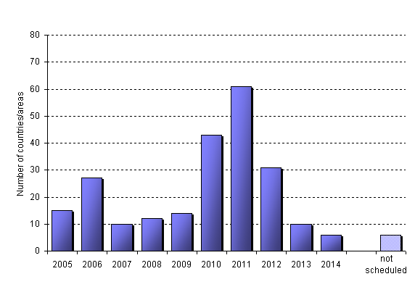
Distribution of conducted and scheduled censuses over the period of the 2010 Census Round*.
*For every country or area only the first census in this round is included.
Source: UN Statistics Division

Slide 18
Considerations for Future Collaboration to Improve Worldwide Census Taking
Lessons Learned 3
The UN should call for continued and increased collaboration and cooperation in respect to census activities among countries.
Lessons Learned 4
Work should be done to develop an accurate, viable method to obtain the costs of conducting a census that can be used to compare census cost across regions and/or countries.

Slide 19
Considerations for Future Collaboration to Improve Worldwide Census Taking - Continued
Lessons Learned 5
The UN should create a task force or committee to rethink, update, and synchronize definitions of census terminology for data sources and enumeration methods based on current practices. Make sure terminology and acronyms are defined and consistently used.

Slide 20
UN Statistical Commission Considerations for the
2020 Census Round (2015 to 2024)
Lessons Learned
Propose a UN Resolution to kick-off the 2020 World Program on Population and Housing Censuses.
Plans should be made for Expert Meetings to discuss detailed 2010 lessons learned, emerging trends for 2020, and the role of the UNSD in providing assistance.
Due to the anticipated increased use of new technologies and emerging trends in census taking, a revision 3 to the UN Principles and Recommendations for Population and Housing Censuses should be developed.
The UN should provide training and guidance on determining which census methodologies to use to meet the needs and unique situation of each country.

Slide 21
Thank you!

Slide 22
For the Report of the United States of America on the 2010 World Programme on Population and Housing Censuses:
http://unstats.un.org/unsd/statcom/doc12/2012-2-Censuses-E.pdf
For the Mid-Decade Assessment of the United Nations 2010 World Population and Housing Census Program:
http://unstats.un.org/unsd/demographic/meetings/egm/NewYork/2013/list_of_docs.htm
For additional information:
Arona Pistiner
Arona.L.Pistiner@census.gov

Slide 23
Background Slides
Please note: The maps could not be revised in time for this meeting. Data shown is based on countries responding to the survey by September 1, 2011.

Slide 25
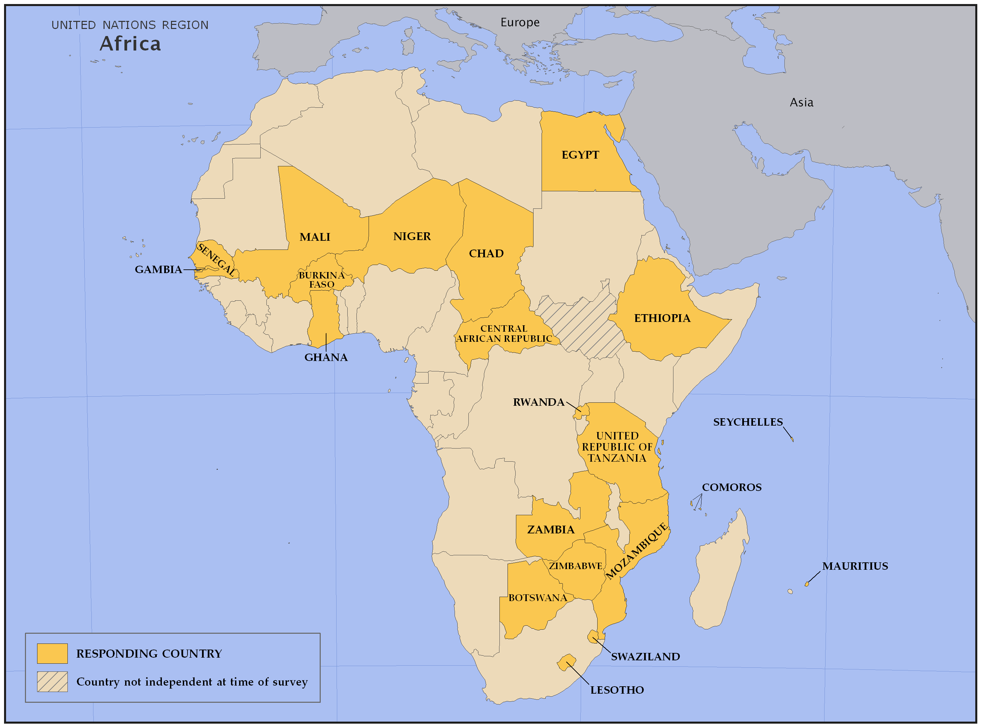

Slide 26
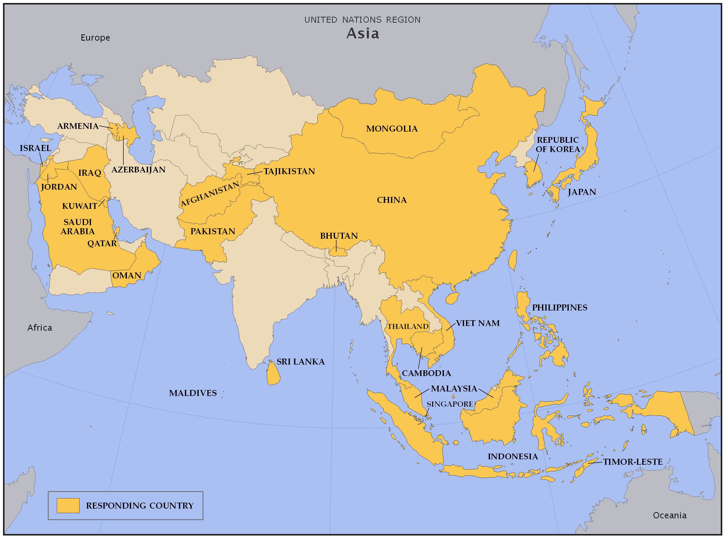

Slide 27
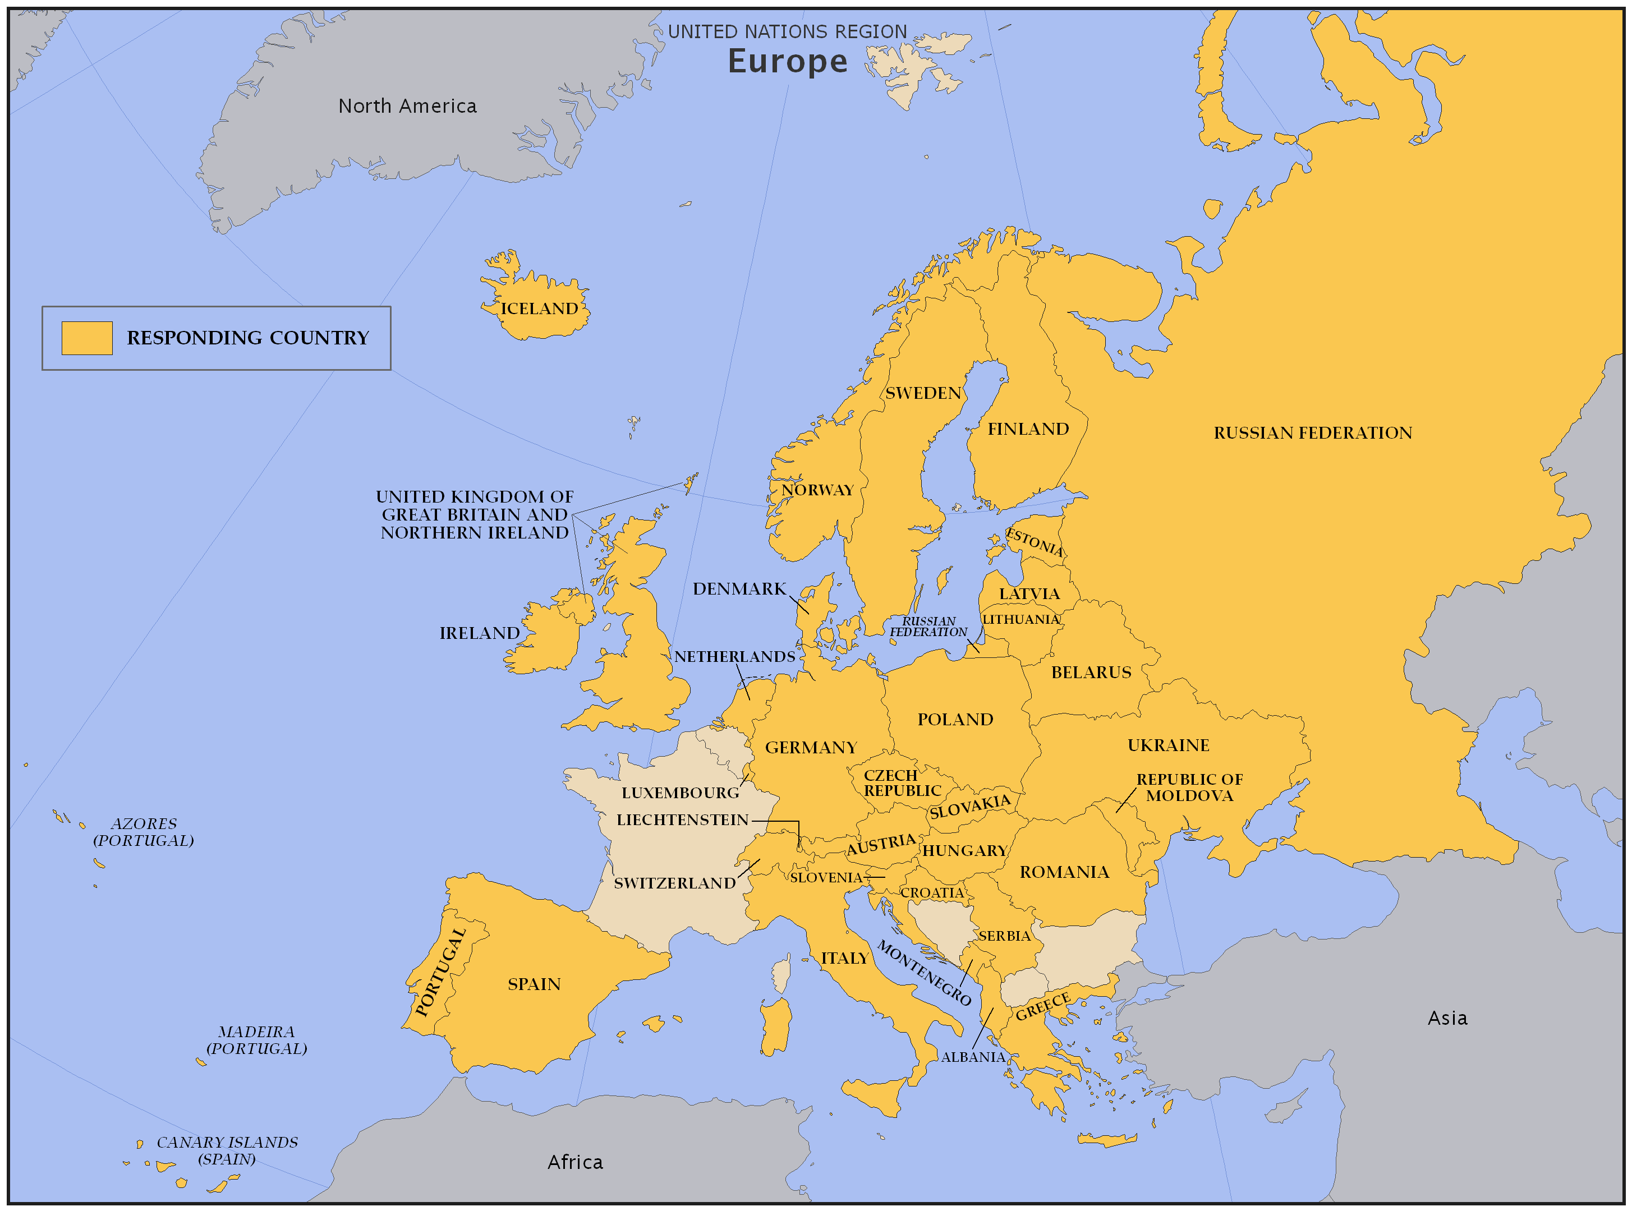

Slide 28
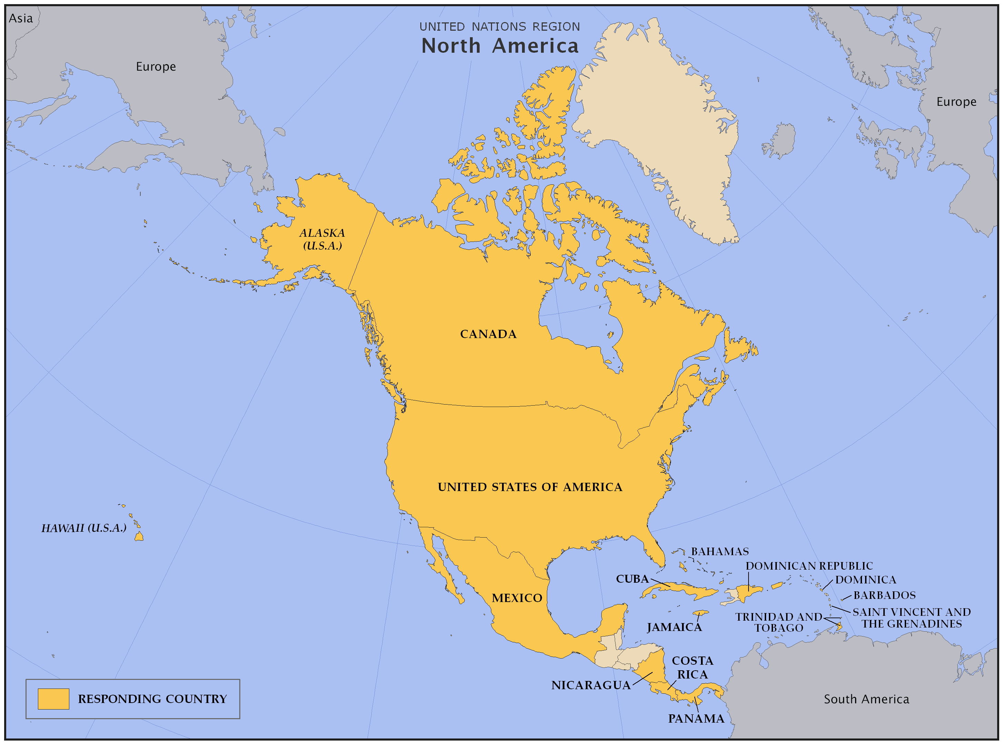

Slide 29
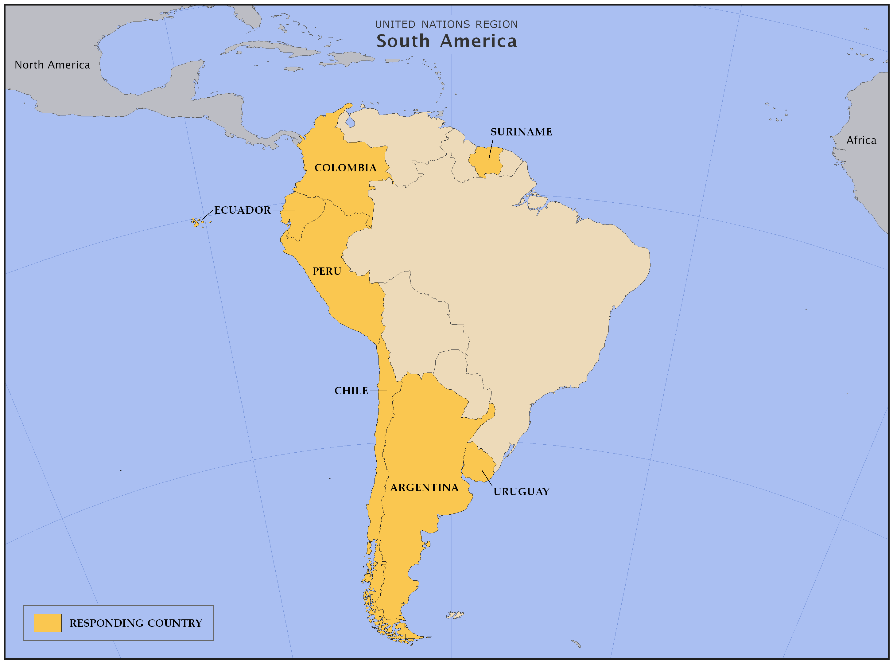

Slide 30
