Slide 1
The development of a register-based census Census 2011 in Sweden
www.scb.se/hob
UN EGM 29 oct-1nov 2013
Åke Bruhn
Project Manager

Slide 2
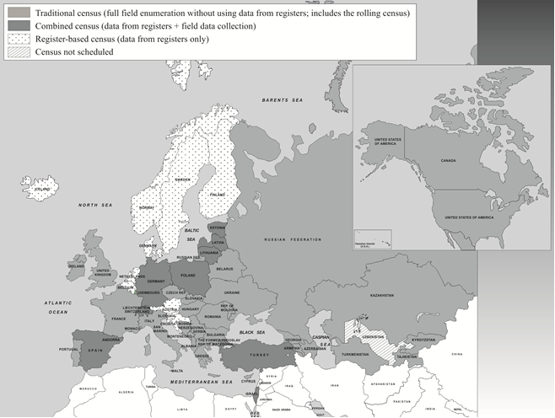
Census 2010 situation in UNECE

Slide 3
Why develop a totally register-based Population and Housing Census?
A long history of Censuses - Latest Population and Housing Census in 1990
Between 1970 and 1990 a mix of register and questionnaires
Until 1985 a control of the registration of the population
EU regulation regarding Census 2011
A fully register-based Census
Cost aspects
Reduction of response burdens
Through time reduced response rate
Provides means for yearly statistics on households, housing and dwellings

Slide 4
Needed conditions
Infrastructure
adresses
identifiers
Administrative routines
first registration
updating
trust and willingness
Regulations
statistical act
data act
secrecy act

Slide 5
Census Regulations
Government resolution 1995 that the next census should be totally register-based
A task for investigating mutual possibilities was given in 2001
Law on Dwelling register in June 2006
Law on registration of population with a dwelling identity in July 2006
Ordinance for a Dwelling register in Mars 2007
Regulations of the National Land Survey Board in August 2007
EU regulation in June 2008

Slide 6
Input register-based Census
External keepers of registers
Businesses
National
Tax Board
National Land Survey
Schools
National
Tax Board
National
Tax Board
SCB:s spheres
Businesses
Individuals
Real Estates
Subject fields for
Census/Statistics
Population
Employ-ment
Occu-
pation
Education
Household
Family
Living
condition
Housing
Building

Slide 7
Household, housing and dwelling statistics from registers
Pre-conditions :
Addresses and an up to date dwelling register. Every separate dwelling must be identified by a unique address
Dwelling and building Statistics
Enabled by dwelling register with unique identities
Household Statistics
Enabled by registration with the dwelling identity in the population register
Housing statistics
Enabled by linking of dwelling- and population registers

Slide 8
Who is doing what?
Local authorities gives addresses to every entrance and keeps the dwelling register up to date
Land Survey Board collects and delivers data about real estates, buildings and dwellings
Real estate owners reports initial data to The Land Survey Board and changes to the local authorities
Real estate owners reports dwelling identities to each occupant
Tax board register the population in dwellings instead of as today in real estates
SCB links registers and uses administrative registers for producing statistics
Residents in multi-dwelling buildings report their dwelling number to the Tax Board – and get their dwelling number added to their addresses
Notes:
Lägenhetsregistret och folkbokföringen på lägenhet är intimt sammanknippade. Utan folkbokföringen ingen hushållsstatistik och begränsade möjligheter till andra sambearbetningar.
Även viktig källa att hitta udda lägenheter

Slide 9
Census - HoB
Census 2011
Collection
Processing, quality assessment
Dissemi-nation
HoB (New household, housing and dwelling statistics)
Planning
Content, quality improvement
Dissemination
2011
2012
2013
2014
2015
= Time of referens Census 2011
= Time of referens HoB yearly statistics

Slide 10
Thank you for your interest !
Questions ?
Åke Bruhn
ake.bruhn@scb.se

