Slide 1

The 2010
Indonesia Population Census
M.Sairi Hasbullah
The Head of BPS-Statistics Jawa Timur
BPS-Statistics Indonesia
Presented on the United Nations Expert Group Meeting on
Revising the Principles and Recomendations for Population and Housing Censuses.
New York, 29 October-1 November 2013

Slide 2
Objectives
Enumerate all peoples living in Indonesia:
How large Indonesia as a nation in terms of population.
What we as Indonesian doing (jobs characteristics)
The Achievement of Indonesian people in quality of life.
The Richness of Indonesian in terms of its diversities as a nation.

Slide 3
Indonesia, 2010 Population Census: The Largest
The Census constitute a crucial input in the processes of planning and development.
The 2010 Indonesia population census, which performed on 1-31 May 2010, is one of the biggest census exercise ever attempted in Indonesian history, covering Indonesia’s population of more than 237 million people.
The previous censuses were conducted in 1961, 1971,1980,1990 and 2000.

Slide 4
Questionnaire and enumeration approach
4 types of questionnaires:L1: for household listing: L2: for homeless and ships crews; C1: complete enumeration for individual and households characteristics (the true census); C2: for special objects: remote areas or special conditions,
Enumeration Method: face to face interview; self enumeration (condominium, apartment, and for special exclusive elite households).
Language Used: Indonesian, English, Chinese, Korean and Japanese (for expatriates)

Slide 5
43 Questions
Indonesia 2010 population census consists of 43 questions ranging from: the name, basic information related to household members, vital statistics related to fertility and mortality, population mobility especially permanent migration, religion, ethnicity, nationality human capital variables such as education, employment, health and environment, and housing characteristics.

Slide 6
A Big Task (1)
The Indonesia Census was conducted in 33 provinces, 471 Districs, 6523 subdistricts and 88 361 villages (880 000 Census Block)
With around 700 000 field enumerators and supervisors (local people mostly community volunteers).
Training for field enumerators and supervisors: Using DVD as instruction media and direct communication to assure the same standard of training
The census was conducted by Team. Every Team consisted of 3 enumerators and 1 supervisor.
Special Day: 15 of May 2010: Census to the homeless.

Slide 7
A Big Task (2)
It is certainly not easy to implement population census successfully in a very large country like Indonesia with its scattered islands.
Census requires: the readiness of well planned equipment, manpower, finance, and mobilization of all resources within the government, local authorities and communities.
Among the most important is the ability to organize the whole dimensions of census activities.

Slide 8
The Important of Precise and Good Planning
Good planning: to formulate the basic concept, the operational plan covering timing, the population to be enumerated, the unit of enumeration, the questionnaires, the census moment, the duration of enumeration, the preliminary field works and many other things that have to be well prepared.
The need to have good field enumerators and supervisors requirement is highly important.

Slide 9
Quality Assurance
There have been multi level supervisor including the taskforce team from BPS in the district, provincial and national level.
BPS-Statistics Indonesia also created a special forces to guarantee the quality gained in the field by the enumerators. At least 1600 BPS staffs and the students of the Institute of Statistics went to the field for quality assurance.

Slide 10
Extra Time for Those who have not been Counted Yet
BPS-Statistics Indonesia gave an opportunity for those who have not been counted yet during the enumeration period: Giving extra 2 weeks to report to BPS District or to local officers in order to be counted by the special team.
Special team for special areas (condominium, high level officers, housing estates etc)
Special enumeration for member of legislative body and high level exsecutive leaders.

Slide 11
Data Processing
Use of ICR Technology
33 Processing centers were set up through out Indonesia (33 provinces)
The processing involves: receiving, guillotine, scanning, correction, completion and validation of around 60 million households.

Slide 12
The problems of Data Processing
The questioner should be with color (not black and white color)
If the questioner use black and white color the box (for answer code) often be read as 11.
The Scanner machines are very sensitive to dust in the questionaire.
Pencil used should be very sharp, if not the figue 1 read by scanner as 0.
For the big country like Indonesia the management of the document for data processing should be very careful and effective.

Slide 13
Post Enumeration Survey (PES)
To know the degree of census errors (coverage and content errors)
PES was conducted in 33 provinces with 1200 census blocks out of 842 850 total census blocks.
PES was conducted by special enumerators. Independent from the census enumerators.

Slide 14
Disemination of the Results
The general report: 16 of August 2010 (2,5 months after the census) consists of total number of population by sex and regions (provinces and districts throughout Indonesia)
The complete /detailed report: November-desember 2010 ( 5-6 months after the field enumeration)

Slide 15
The Road to Success: Census Campaign (1)
To better inform the public about the important of census.
To get awareness and cooperation from the people.
Key Messages: benefit of the census (allocation of public utilities, infrastructure and the fulfillment of people’basic needs)

Slide 16
The Road to Success: Census Campaign (2)
Campaign Media: TV Spot (Public Service Announcements) in 6 Most popular television during the prime time program. TV blocking time Talkshow. Pers conference. Radio Spot. Printed media campaign (advertisements), billboard, banner, special car sticker etc.

Slide 17
The Road to Success: Census Campaign (3)
Souvenir: mug, pencil, ballpoint, comic book, pillow, goody bag, block note, T- shirt, shoes, umbrella, hat, pin, and many other items.
Special forces campaign from Women Organization lead by the BPS-Statistics Indonesia’s women organization: intercity travelling campaign.

Slide 18
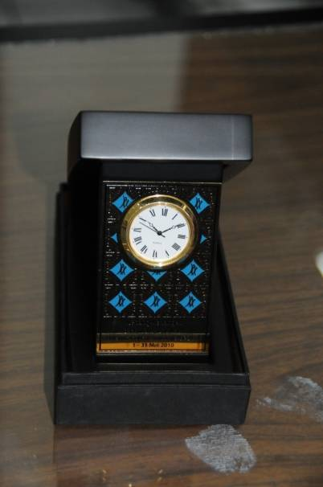

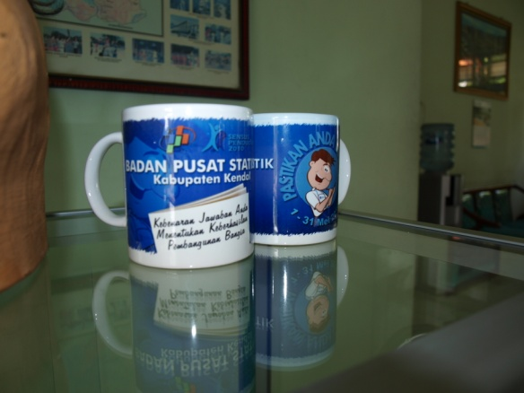
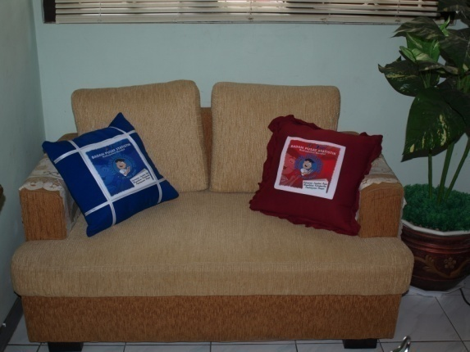


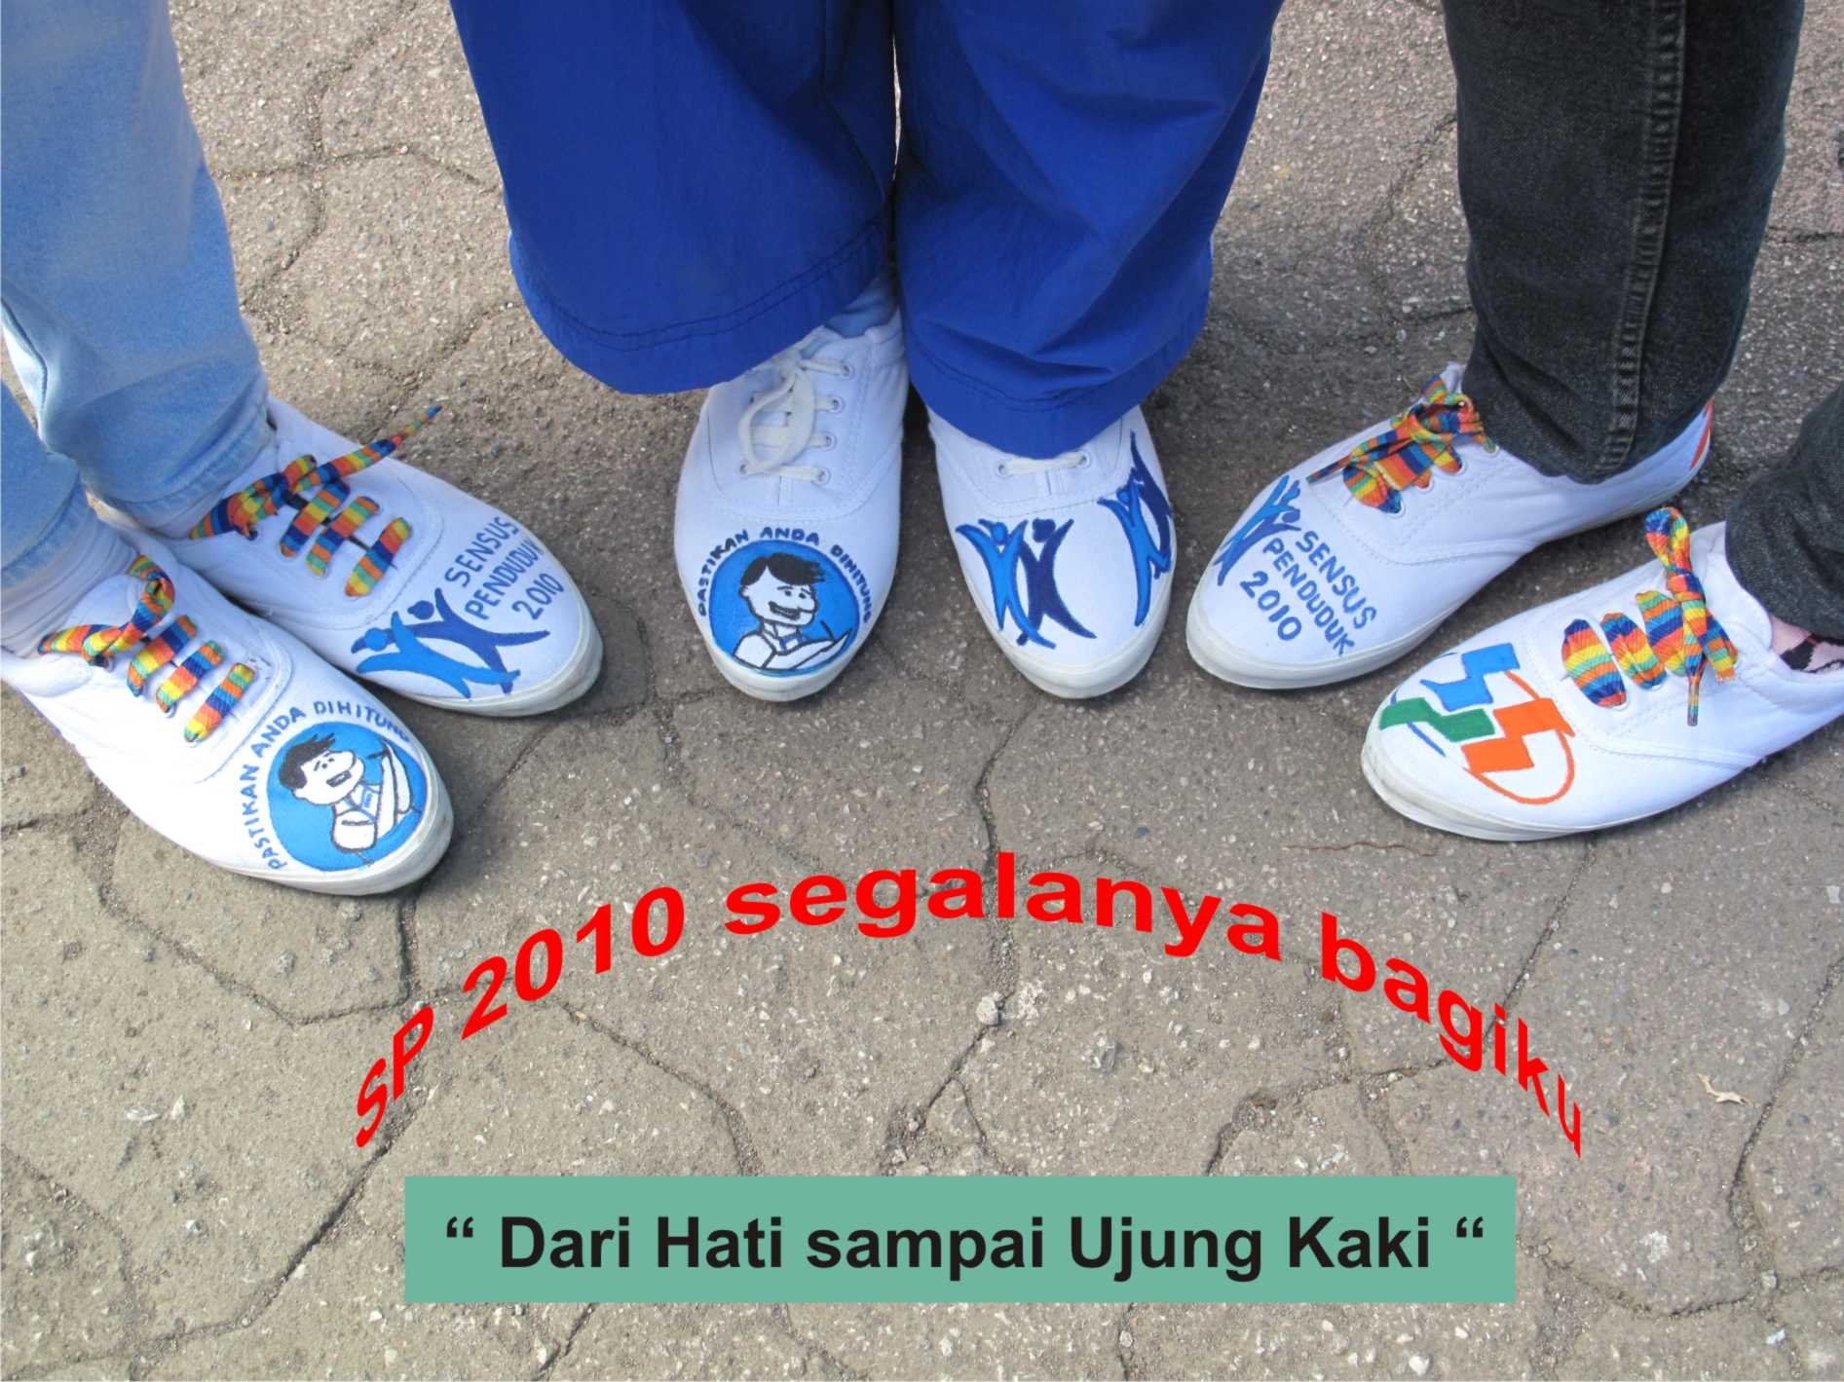
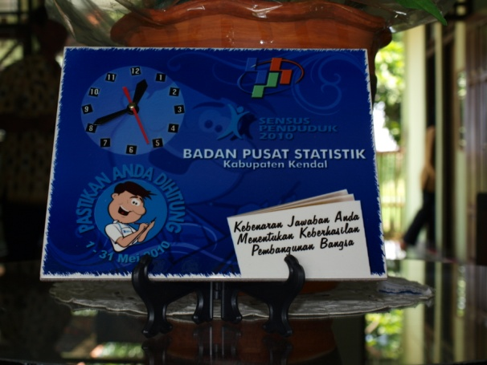


Slide 19
The Road to Success: Census Campaign (4)
Seminars conducted both in Jakarta and in the regions (provinces and districts)
Special meeting with community organization, civil society .
Market visit by BPS-Statistics Indonesia Women Organization (Dharma Wanita) to both tradisional and modern market.

Slide 20
Success of the campaign: The people Invite and wait for us to come
Throughout Indonesia most people wait the enumerators to come and census them.
People, in all level, ask actively if they had not been cencused.
We call census campaign as the Census War.

Slide 21
What were the problems
Eventhough there were successful campaign lead to the succes of the enumeration, but there was small number of people who were less cooperative especially those who live in condominium, exclusive areas, apartment etc.
BPS-Statistics Indonesia tried to persuade them, through soft approach, to participate.

Slide 22
2.5 Months: General Report of the Census Result
The President of the Republic of Indonesia gave speech during the parliament meeting, 16 of August 2010, concerning the general results of Indonesia May 2010 Population Census.
All Governor s and head of the districts/municipalities also announced the general results of the census to their people.

Slide 23
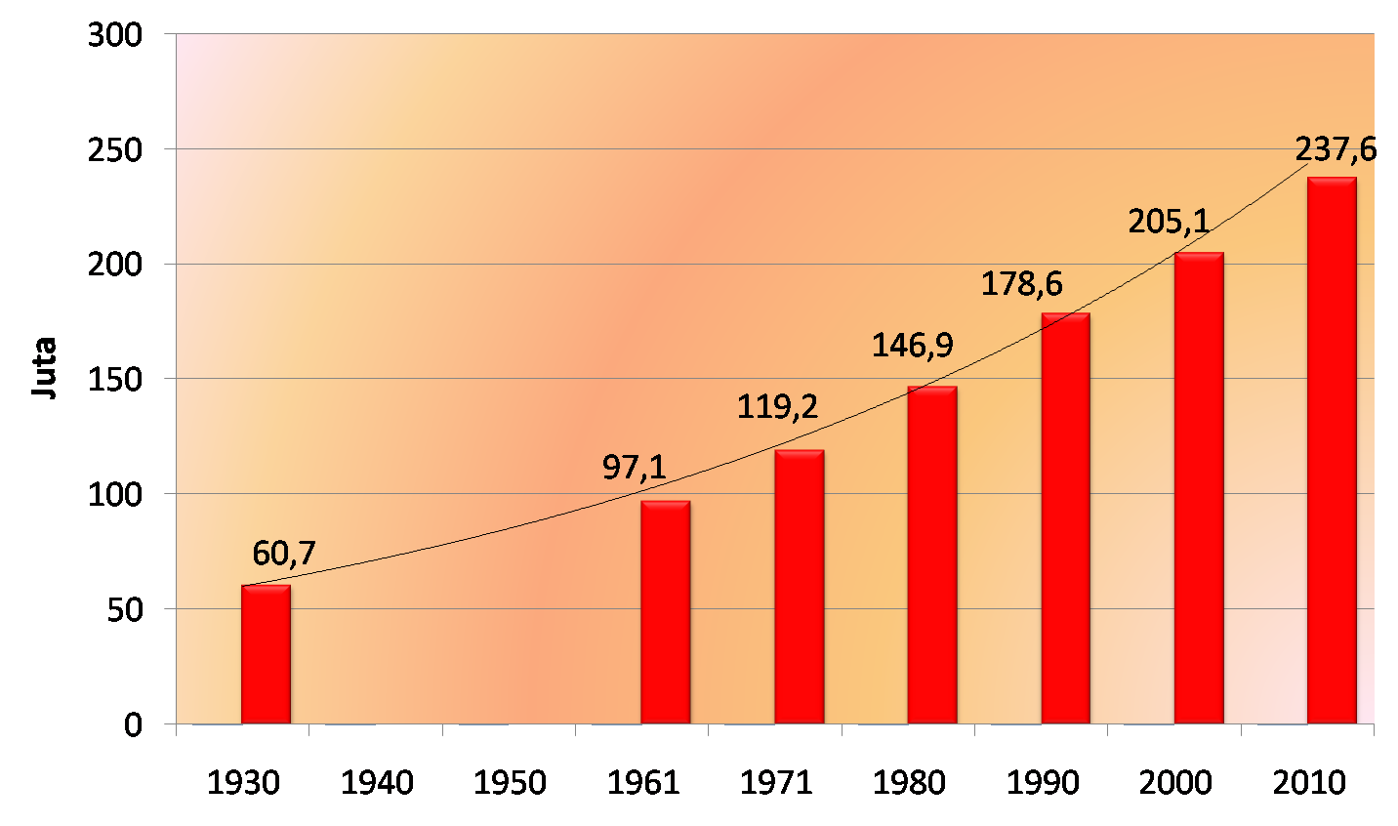
Population Trend of Indonesia
1930 – 2010
Source: BPS-Statistics Indonesia
In 1930, from the Result of 1930 Population Census, the total population of Indonesia reached of 60,7 million, increased to 97,1 million in 1961 and 119,2 million in 1971.
Within only 39 years, the total population of Indonesia doubled from 119,2 million in 1971 to 237,6 million in 2010 (2010 Population Census).

Slide 24
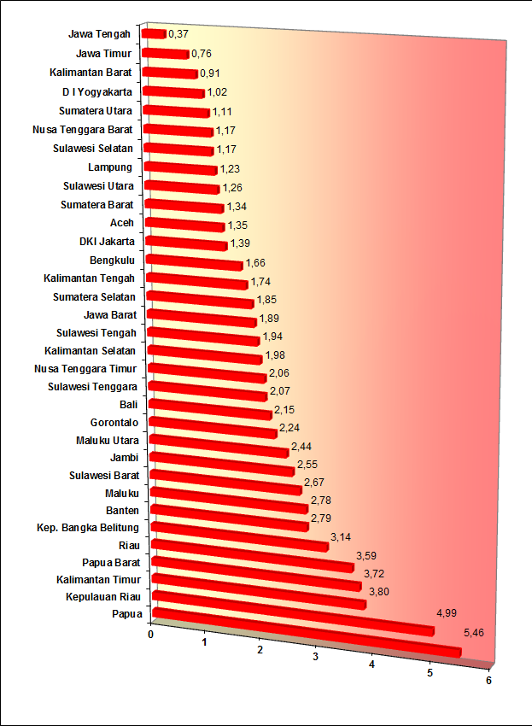
Population Growth of Indonesia 2000 – 2010
Althrough the small provinces of Papua, Kepulauan Riau, East Kalimantan, and West Papua experienced the highest population growth, but the problem was that the high level of population growth of West Java Province achieved of 1,89% annually. It means the surrounding Jakarta (the capital city of Indonesia) experienced a very high population growth which would contribute to the population problem of Jakarta

Slide 25
Comparation
Cost for enumerators:
Malaysia paid 250 ringgit or equivalent to US $ 83.3 per month per enumerator.
India paid 5 500 ruppee or equivalent to US $ 117 per month per person
Indonesia paid Rp 2 000 000 or equivalent to US $ 222.2 per month per enumerator.

Slide 26
M. Sairi Hasbullah
BPS-Statistics Indonesia
The Head of BPS- Statistics Jawa Timur
New York. USA
29 October-1 November 2013
Thank you for the opportunity to share our census with you all, and we also would like to learn from your experiences

