Slide 1
Session 8 Data Processing Estonian case study
United Nations Technical Meeting on Use of Technology in Population and Housing Censuses
28^{t h} - 1st December 2016
Statistics Estonia
Diana Beltadze

Slide 2
Data arrangement I stage

Slide 3
Data processing started on the 31.12.11 and lasted up to the 31.10.12

Slide 4
Issues after data collection
Identification of persons (missing personal codes)
Identification of addresses
Elimination of duplicates
Encoding
Majority of identification and encoding exercises were completed by the end of April.

Slide 5
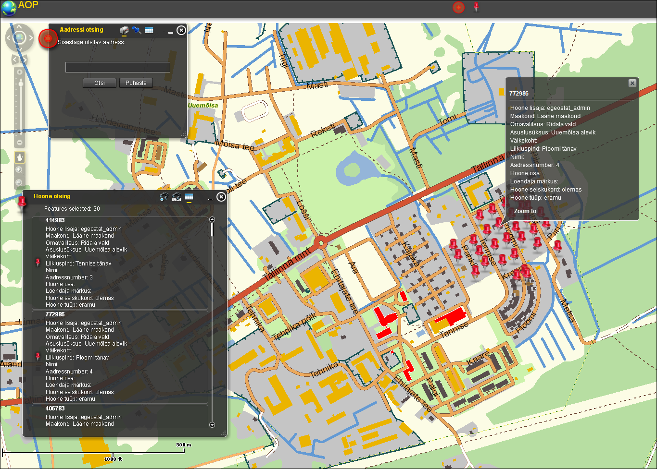
Address operator map application

Slide 6
Primary data correction team
Data correction manager
Operator for ID codes
Coders
Operator for addresses
Operator for duplicates
Senior coder
Coder

Slide 7
Encoding of text answers
Variable | Manual % | Automat %
Occupation | 98,1 | 1,9
EMTAK | 91,9 | 8,1
Religion | 68,0 | 32,0
VS-RTK | 50,4 | 49,6
Citizenship | 71,4 | 28,6
Language | 0,4 | 99,6
Nationality | 73,3 | 26,7
Dialect | 52,9 | 47,1
Address | 100,0 | 0,0

Slide 8
Data processing work flow
Population register
VVIS
I STAGE VVIS
Buildings register, Land Board
Data collection system, primary data correction
Education register
II stage
VAIS
Data correction system, imputations, controls etc

Slide 9
Data processing, stage 2
VAIS is a collection of tools and technologies aimed at automating data processing (Phase 5 in GSBPM).
In essence, the task of check, clean, and transforming statistical activity data can be identified as taking the raw data from one or more sources and transforming it to data warehouse(observation registry) for statistical analyse

Slide 10
Metadata driven template based tool
Template driven approach provides an universal solution for three main goals:
Create an easy to use statistical data processing tool requiring minimal programming skills for transformation package creation.
Create a metadata driven process-oriented and automated statistical data processing tool.
Create an extendable data transformation tool.

Slide 11
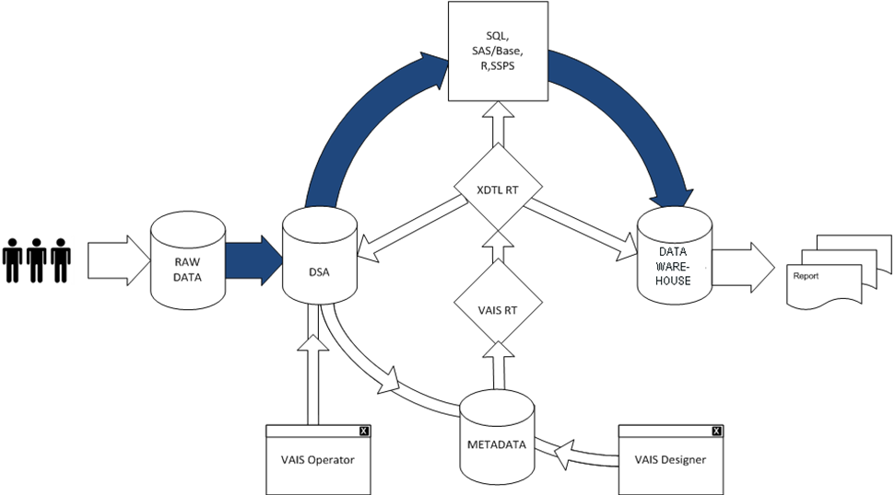
Data processing with VAIS includes:
Automating and speeding up data transformation
Raw data, transformation metadata
and source data audit trails
Metadata driven template
based tool
Balancing automation
and manual intervention

Slide 12
Balancing automation and manual intervention
Manual data processing
RAW data
Data Warehouse
Automated data processing
OK?
Metadata (validation and transformation rules)

Slide 13
Implementation
VAIS development 05.2010- 10.2011
Data processing of Population and Housing Census 2011 (01.11.2011-30.10.2012)
Reuse administrative data (2012)
Data collecting system for administrative data (ADAM) and eSTAT development for prefilling questionnaires in eSTAT with administrative data (annual bookkeeping report). (31.08.2011). VAIS is used for converting administrative data into the statistical data format. (for the year 2012 i.e for the reference year 2011 data collection)
Data processing of other statistical activities (first pilots 2012)
Data processing of next registry based Population and Housing Census (pilot 2014)

Slide 14
VAIS budget
Investments 0,7 million EUR
Support 0,1-0,2 million EUR (11.2011-12.2012)
VAIS development duration was 18 months

Slide 15
Conclusion: different ways to avoid and correct mistakes
using data from population register
controls in time of filling in questionnaire
using classifications in questionnaire
identification persons and addresses
coding
removing duplicates
additional controls
imputation

Slide 16
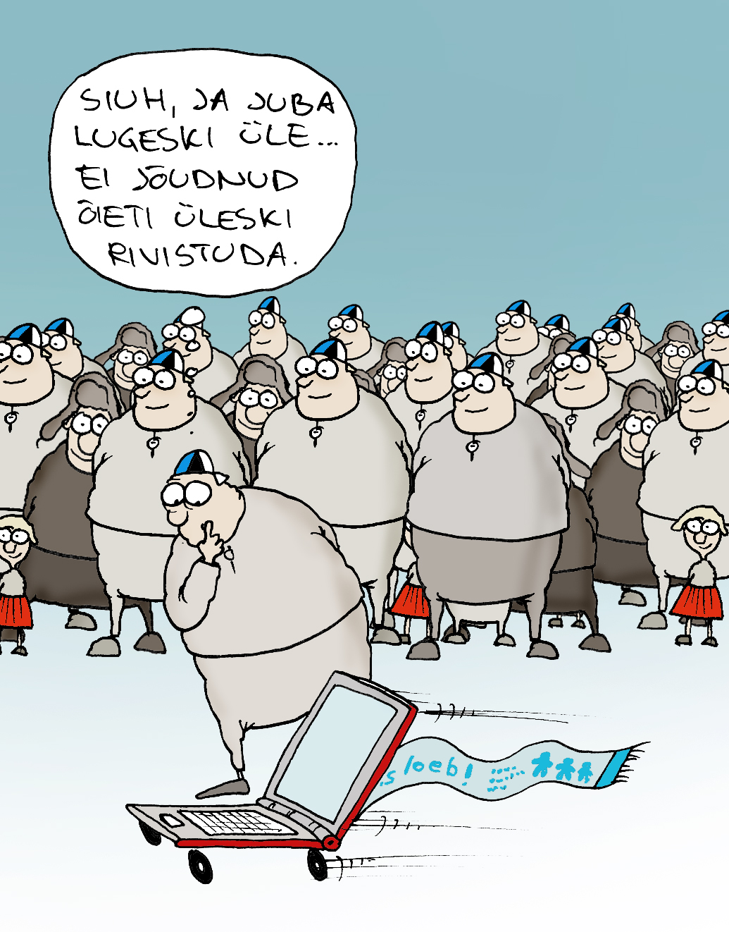
Thank You!

