Slide 1
الديوان الوطني للإحصائيات National Office of Statistics
Use of New Technology in data collection for general census of population and housing in Algeria RGPH2018
Mme Amal Lakehal, ONS, Algeria
M. Abderrahmane Taleb, ONS, Algeria
28 November-1 December 2016, Amman, Jordan

Slide 2
Sommaire
Introduction
Main phases of RGPH 2018
Field Work organization
Use of technology for data collection ( 03 dimensions to explore )
Implementation of data collection solution
Enumerator Application
Controller Application
Daily monitoring Application
Practical implementation
Estimation of the volume of the information flow
Challenges and constraints

Slide 3
Introduction
Algeria is preparing to realize his sixth population and housing census, after those realized in 1966,1977,1987,1998 and 2008.
The country covers an area of almost 2382 000 km² (ranked 10th in the world), and a volume of population estimated at 42.5 millions in 2018.
Administratively, the territory is divided into 48 wilaya (departments) and 1541 municipalities .
New approach in 2018 Census : use of tablets in data collection

Slide 4
Main phases of Algerian census
Preparatory phase: cartographic preparatory work , preparation of data collection documentation, questionnaires, training, test census,….
Data exploitation and dissemination phase :
Processing data
Preliminary results
Final results
Execution phase : data collection .
(50 000 enumerators during two weeks)
Notes:
4

Slide 5
Main phases of Algerian census
Preparatory phase
Cartographic preparatory work . (18 months)
Objective : division of national territory to enumerators area.
Design and methodology
- Phase 1: cartographic up date .
- Phase 2: Division into EA.
- Phase 3: Building’s numeration in the field
- Phase 4: preparing EA notebook.
- 2600 municipal delegate
- 61 ide wilaya engineer ,
- 200 supervisor of NSO .
Other tasks .
Training:
- Cartography,
- Municipal delegates
- Trainers.
Test Census
Monitoring
Design and implementation of software and hardware for data collection
Notes:
5

Slide 6
Field Work Organisation
National monitoring
Regional monitoring ( 04 annexes)
Enumerators : 50 000
Wilaya supervisor ( 48 wilayas)
Controler 11 000 ( 1 for 5 enumerators )

Slide 7
Use of technology for data collection ( 03 dimensions to explore )
1. Design dimension ;
2. Logistic dimension ;
3. Implementation of a scheme for data flow

Slide 8
Use of technology for data collection
Design dimension ; implementation of a software adapted fore mobile technology use in data collection . Adopt a package of programs that ensure data entry, verification of data quality and ensure monitoring for census data collection at different levels of control ( in the field, at regional and national level).

Slide 9
Use of technology for data collection
Logistic dimension ; Acquire a hard platform with appropriate equipments in the NSO to ensure data collection process ;
data center,
Specialized connection,
Design a Data transmission scheme

Slide 10
Use of technology for data collection
Design a Data transmission scheme: taking into account the use of a secure national cloud during data collection and other technics for data storage before validation, encryption and data security….

Slide 11
Data collection software
A Data entry program for enumerators with appropriate controls and logic rules.
A control and validation data program for controllers that verify field work for 05 enumerators per controller
A supervision program for supervisors that verify daily performance, daily report, regional report, data quality indicators, ….

Slide 12
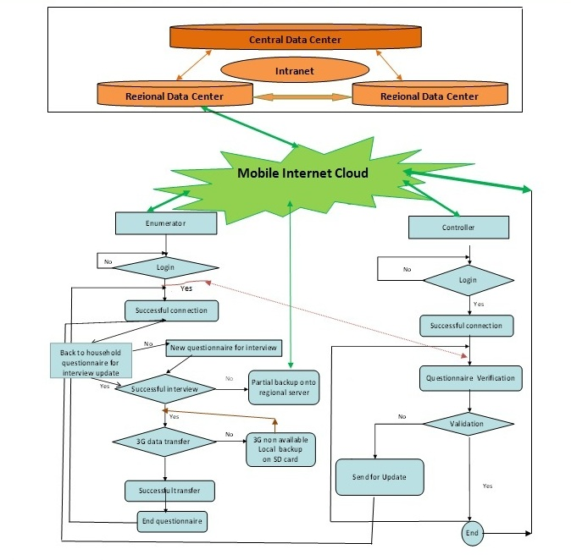
Flow chart Diagramme

Slide 13
Implementation of Data collection software
Equipment used for data collection
Enumerator
Enumerators will have a PDA for data entry, a Notebook in paper format that resume all building in the EA and a sketch map of his EA
that he must visit it
2. Controller
Will have a Notebook more bigger for a complete overview of questionnaires . Every controller must verify data and performance of 5 enumerators

Slide 14
Implementation of Data collection software
A list of logins for Enumerators and controllers will be previously defined :
Username: which is the number of the EA
Password : which represent the code PIN of the mobile chip
Each enumerator will have his own access login in EA

Slide 15
Implementation of Data collection software
Enumerator Program
Connected to program with cell phone using 3G and a personal login
Data entry for a new questionnaire , complete or correct a preview one . Only enumerator can modify data collected
Questionnaire will be put in a state of validation

Slide 16
Implementation of Data collection software Enumerator Program ( at the end of the interview)
In case the 3G is available : a direct secured transfer to Data base located in the regional data center
Encrypted asynchrony backup on tablets SD card is established in a transfer queue that will be done automatically
If the interview is not complete , partial saving is possible and recorded on data base

Slide 17
Implementation of Data collection software
Controller Program
Access to his application by entering his login
Read and verify questionnaires
If the questionnaire is complete and coherent it will be considered ( by the app )as “validate questionnaire”, if else it will be “On waiting validation”

Slide 18
Implementation of Data collection software
Supervisor program
At department levels: regional and national level
Daily reports progress of data collection field
Elaborate quality and monitoring indicator at required level of aggregation

Slide 19
Implementation of Data collection software : Practical implementation
NSO
Mobile phone operator
National committee
Design of the IT solution architecture
Monitoring of works
Set up the necessary infrastructures and equipment
Engineering of different programs and software
Accompaniment during all stages of process
Ensure inter sectorial coordination related to the use of ICT : Ministry of posts and telecommunications, l’ARPT (regulation agency of posts and telecommunications)
Ministry of interior and local collectivities network ….
Transfer of technology to NSO staff
Ensure the adaptation with difficulties of fieldwork
Training sessions for NSO staff

Slide 20
Estimation of the volume of the information flow
Hypotheses
50000 enumerators in the four regional offices of the NSO :
17 819 enumerators in Center region
16749 enumerators in East region
12437 enumerators in west region
2995 enumerators in south region
An average of 150 questionnaires per enumerator during data collection period.
10 Questionnaire per enumerator daily .
Questionnaire has an average size of 50 Ko .

Slide 21
Estimation of the volume of the information flow
Conclusion
So, the volume of data flow transmitted at time t by regional office is given as follows :
890950 Ko by regional office in center .
837450 Ko by regional office in East .
621850 Ko by regional office in West .
149750 Ko by regional office in South .
So the required bit rate bandwidth is 890950 Ko approximately 1Go.

Slide 22
Challenges and constraints
Training of staff at all levels
Take account of linguistic aspects in Data Entry application
Take account to reserve sufficient time for testing all applications and programs
Need of fast intervention for technical problems during field work ( two week of data collection )
Data security
Need of sufficient number of IT coordinators during data collection (bridging the deficit through other partners or institutions)
Using paper questionnaires ( 20% of total need ) in case of technical problems in tablets or internet connection

Slide 23
شكرا Thank You

