Slide 1
United Nations Regional Workshop on the 2020 World Programme for Population
and Housing Censuses for Arabic-speaking Countries
5-8 December 2022
Algiers, Algeria
Types of administrative registers
Meryem Demirci
UN Statistics Division
Statistics Division

Slide 2
Introduction
Administrative registers used for population and housing censuses are in general categorized under two groups:
Base Registers
Specialized (or supplementary) Registers
How we define base and specialized registers?
What registers are base ?
What registers are specialized?
Source: UNSD Handbook on Registers-Based Population and Housing Censuses
https://unstats.un.org/UNSDWebsite/statcom/session_53/documents/BG-3e-Handbook-E.pdf
Statistics Division

Slide 3
Definitions of Base and Specialized Registers
Base registers are those that hold the basic information relating to the stock of the entire set of ‘population’ units that are being counted in the census – typically persons, dwellings and buildings.
Each unit is usually identified by a unique number such as a PIN, real property number or a dwelling number.
The specialised registers hold the record for each unit, often identified by the same unique number as in the base register, with information necessary for the specific administrative function of the data holders, and from which one or more of the characteristic variables that may be required for the census (such as educational attainment, occupation, disability or income) can be derived.
Such specialised registers may not necessarily cover the whole of a census’s target population
Statistics Division

Slide 4
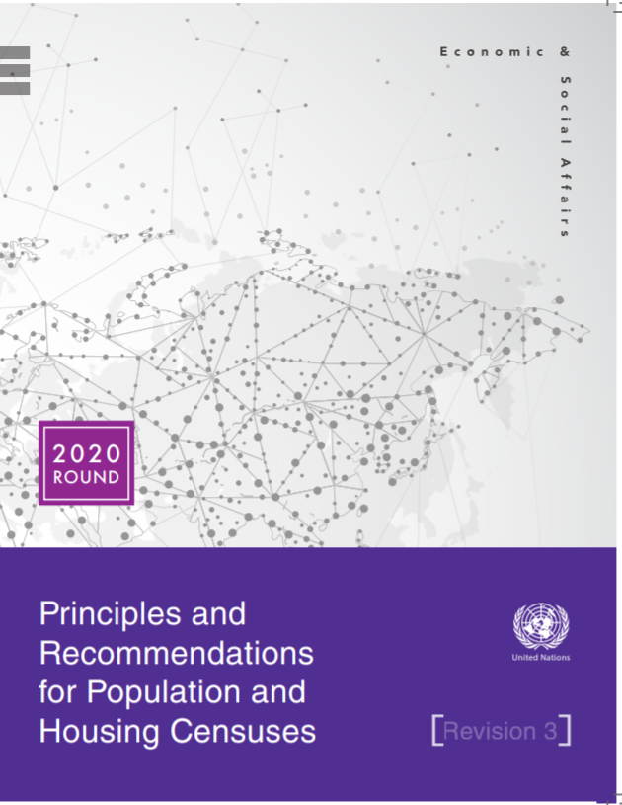
Any type of censuses links persons with housing units
Population count
Characteristics of population
Age, sex, marital status
fertility, mortality
International and internal migration
Disability
Education
Employment/unemployment
Occupation (ISCO) /Industry (ISIC)
Number of buildings and housing units (inc. occupied and vacant)
Characteristics of
Buildings- types of building, construction year and materials, farm building, availability of elevator, etc.
Housing units- conventional/non-conventional dwellings, types of housing unit, rooms, electricity, water supply system, fuel used for cooking, etc.
Statistics Division

Slide 5
Types of administrative data sources used for population and housing censuses
Base registers
Specialized registers
Population register (PIN)
Address/dwelling/building register (Address ID)
Establishment/business register (Enterprise ID, farm ID)
Social security/pension
Tax
Employment, unemployment/jobseeker
Education and student
Health
Border control
Foreigners, residence permits
….
Statistical UNITS are different
“Person, Address and Establishment
Statistical UNIT is identical throughout data sources,
“person”
Statistics Division

Slide 6
Base registers for censuses
Population Register
Main purposes of establishing population register
Establishing personal identification
The administration of pensions, health, educational and other services
Establishing ownership of a residence or the right to work
Resident population
Citizens + Foreigners
Deaths
Emigration
Births
Immigration
Each personal record includes:
Name, sex, date of birth,
Place (country) of birth,
Marital status,
PIN,
Country of citizenship,
Residence address,
Date of arrival at or departure from that address/country
Statistics Division

Slide 7
Base registers for censuses
Building and dwelling registers
The location of building, usually as a formal address (maybe also geocoordinates)
The type and purpose of each building
–used wholly or partially for residential purposes and whether they are occupied or vacancy or
- are used for non-residential purposes,
Characteristics of buildings (construction year, size, water/gas/electricity installations, etc.)
Characteristics of dwellings (size, floor level, ownership/tenure, etc.)
Regularly updates for new buildings, expanded or demolished old buildings
Statistics Division

Slide 8
Base registers for censuses
Address registers
Address register, covering all units
Residential buildings/dwellings –households and institutional places
If non-residential places, types of buildings
Such as school, health center, hospital, government offices, establishments
Country practices show different types of relations between address and building/dwelling
the address as an attribute in building and dwelling registers
the building or register as an attribute of addresses in the address register
separate database
No international agreed definition of an address register
It is necessary to have a list of places where people might live, to be able to assign a location and link the place to the population register
Statistics Division

Slide 9
Base registers for censuses
Business Register
A list of enterprises with information about their characteristics could be used for the purpose of the census, especially for producing information on
Place of work
Industry –activity of the establishment in which the job of the employed person (or unemployed person) is located
Industrial sector of employment
The size of the workforce in terms of numbers of persons employed and employees
Statistics Division

Slide 10
Specialized (or supplementary registers)
This type of registers:
contains records relating to those characteristics for which census information is required and from which the requisite variables for core and non-core topics can be derived using the PIN for record linkage
may also help to identify issues of coverage by, in particular, identifying ‘signs of life’ activities
Statistics Division

Slide 11
Key specialized registers
Social security or pension registers
Registers that are held by official bodies for the purposes of the administration of national social insurance programmes and the allocation of benefits and allowances that encompass, for example, the unemployed, families, pensioners
Tax registers
Registers that are held by national and local tax authorities for the purposes of the administration and collection of income tax, purchase taxes, property and wealth taxes
Employment, unemployment and jobseeker registers
These are sources of information from which the country’s official employment and unemployment figures are usually taken
Health registers
These are registers (usually) maintained by national or local health authorities for the purposes of providing health-related services and could be used
to create data on health status and level of disability
to improve the quality of (statistical) population register
Statistics Division

Slide 12
Key specialized registers
Education and student registers
maintained both centrally and by individual educational and academic establishments for the purpose of registering admissions and the performances of students as well as the employment of teaching staff
Registers of persons living in institutional places,
such as nursing homes, boarding schools, dormitories, and prisons can provide some basic information on members of each population group, including sex, date of birth, ID number, marital status, place of birth, citizenship, etc
Registers of foreign nationals or of residence permits
may provide information on migrants, year of entry into the country, citizenship and refugees/asylum seekers
electoral registers will identify households containing those residents entitled to vote
registers of motor vehicles may allow the collection of data on car availability
Statistics Division

