Slide 1
Regional Workshop on the 2020 World Programme on Population and Housing Censuses:
International standards and contemporary technologies
27, 28, 31 January and 1 February 2022
Overview of the 2020 Round of Population and Housing Censuses
UN Statistics Division
Statistics Division
Demographic and Social Statistics Branch
Demographic Statistics Section

Slide 2
Content
Introduction to 2020 World Population and Housing Census Programme
Census-taking in 2010 round
Methodological framework for population and housing censuses
UNSD mid-2020 round survey
UNSD recent activities on the impact of the Covid-19 pandemic on census-taking
Statistics Division
Demographic and Social Statistics Branch
Demographic Statistics Section

Slide 3
Introduction
2020 World Population and Housing Census Programme:
UN Statistical Commission endorsed the draft Resolution on 2020 World Population and Housing Census Programme and submitted it to the Economic and Social Council of the United Nations for adoption
On 10 June 2015 ECOSOC adopted the Resolution
Statistics Division
Demographic and Social Statistics Branch
Demographic Statistics Section

Slide 4
Introduction
2020 World Population and Housing Census Programme:
Urges Member States:
conduct at least one PHC in the period from 2015 to 2024
take into account international and regional recommendations relating to PHC
give attention to advance planning, cost efficiency, timely dissemination & easy access to census results
set quality standards for PHC to uphold the integrity, reliability, accuracy & value of PHC results
take into account the importance of PHC for the 2030 Agenda for Sustainable Development
Mandates UNSD:
prepare international statistical standards, methods and guidelines for the conduct of PHCs
coordinate activities among stakeholders in assisting Member States to plan and carry out PHCs
monitor and regularly report to the Statistical Commission on implementation of the Programme
Statistics Division
Demographic and Social Statistics Branch
Demographic Statistics Section

Slide 5
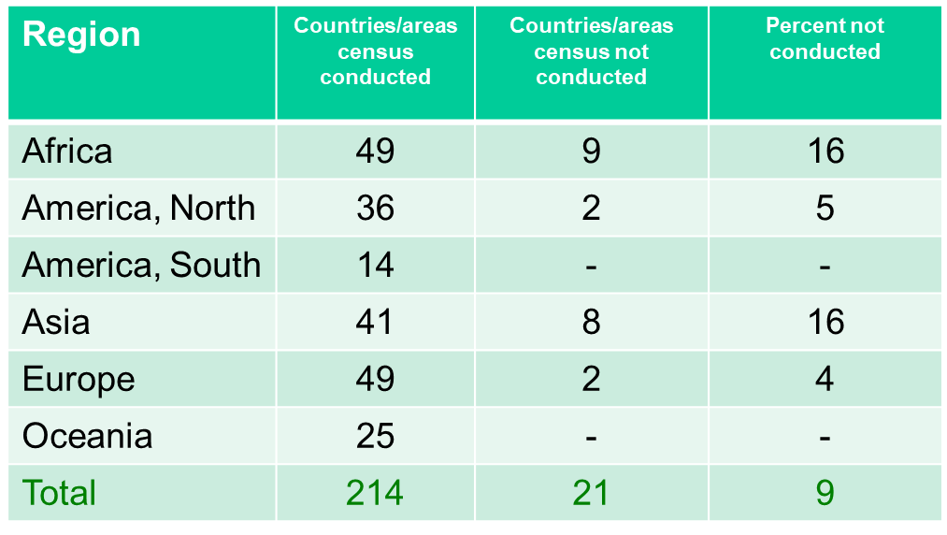
2010 Round
Censuses conducted from 2005-2014 – 93% of world population
Statistics Division
Demographic and Social Statistics Branch
Demographic Statistics Section

Slide 6
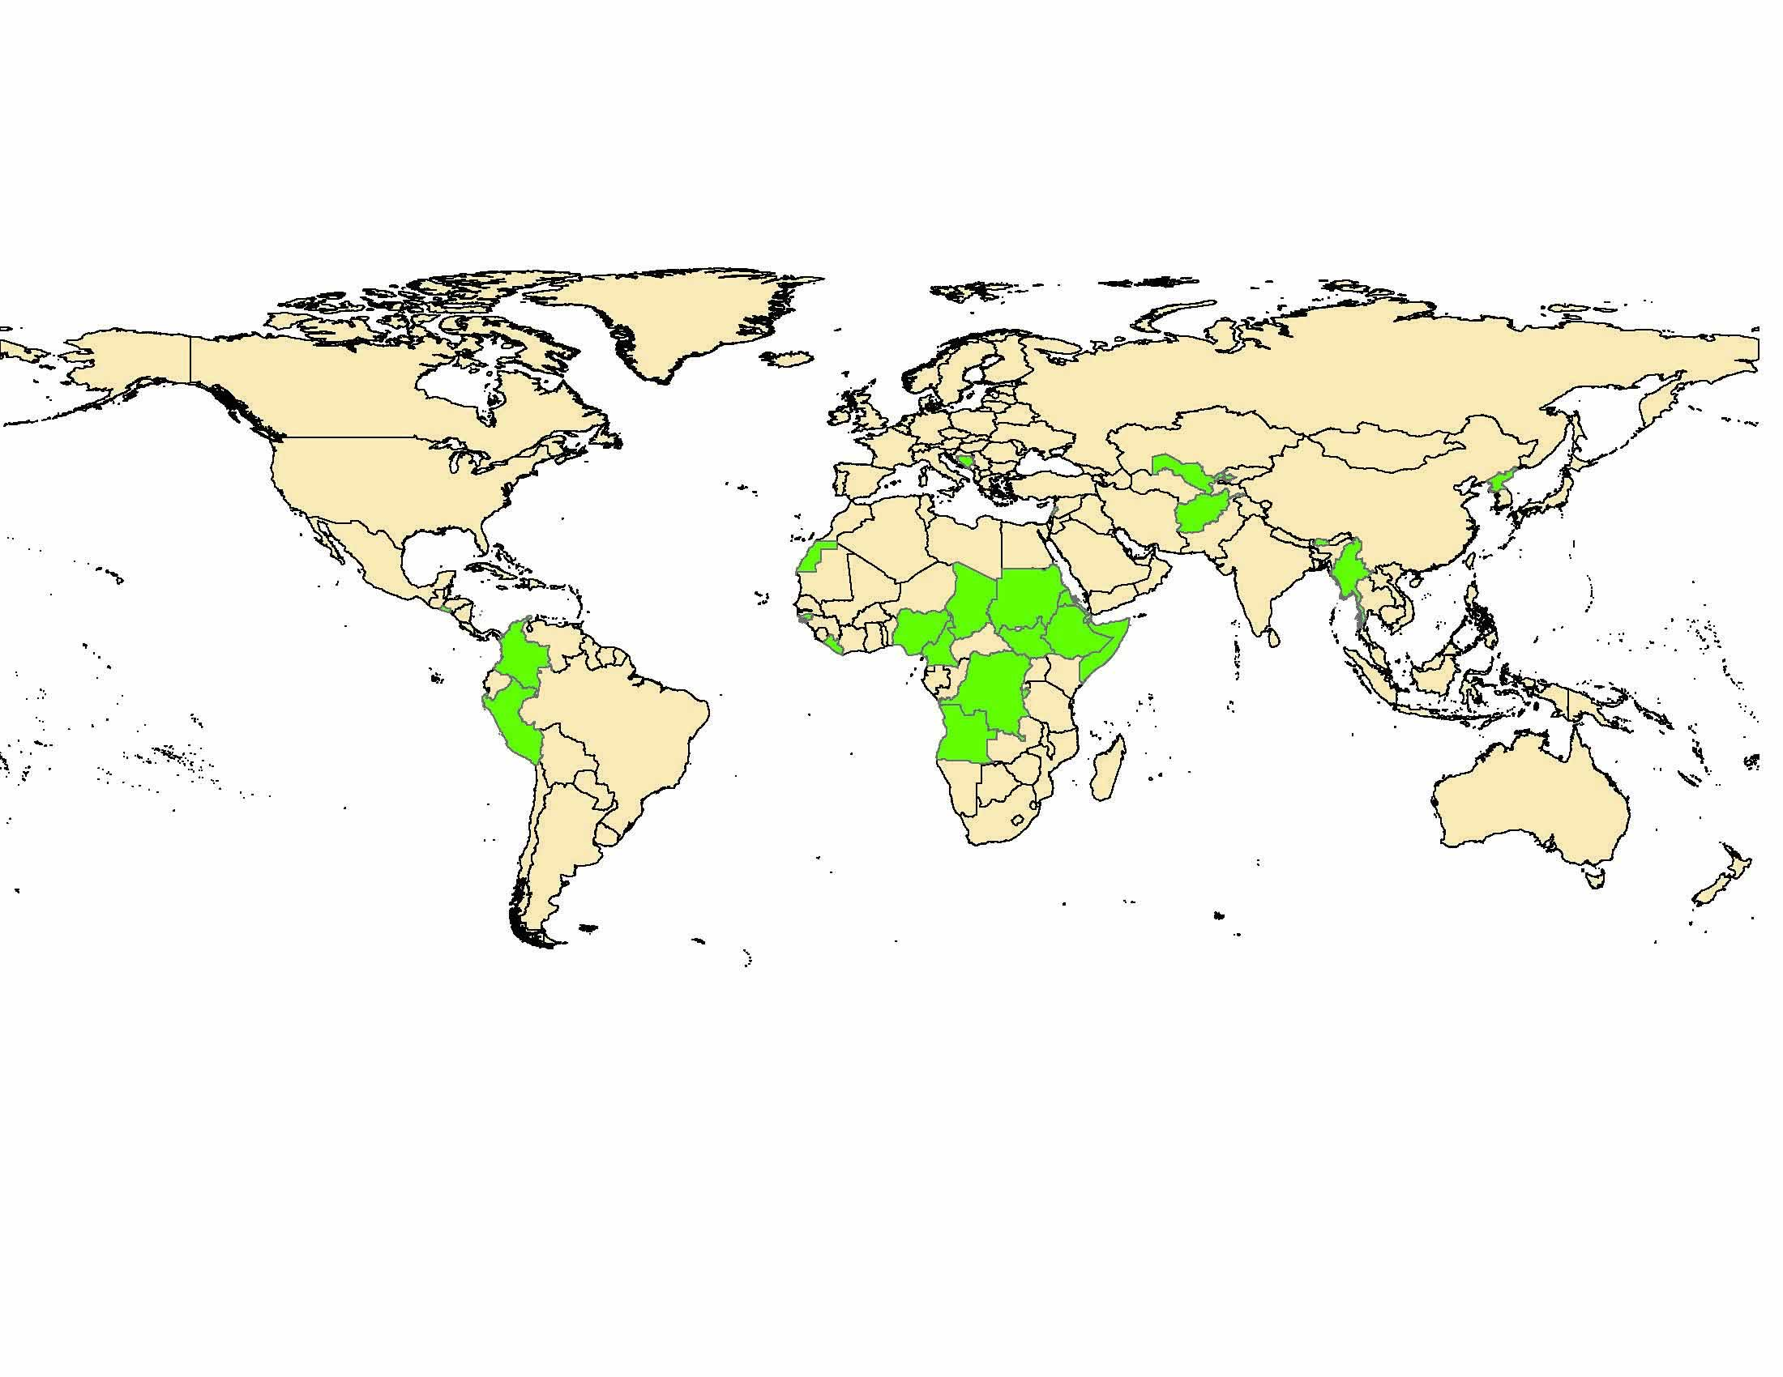
2000 Round of censuses
Statistics Division
Demographic and Social Statistics Branch
Demographic Statistics Section

Slide 7
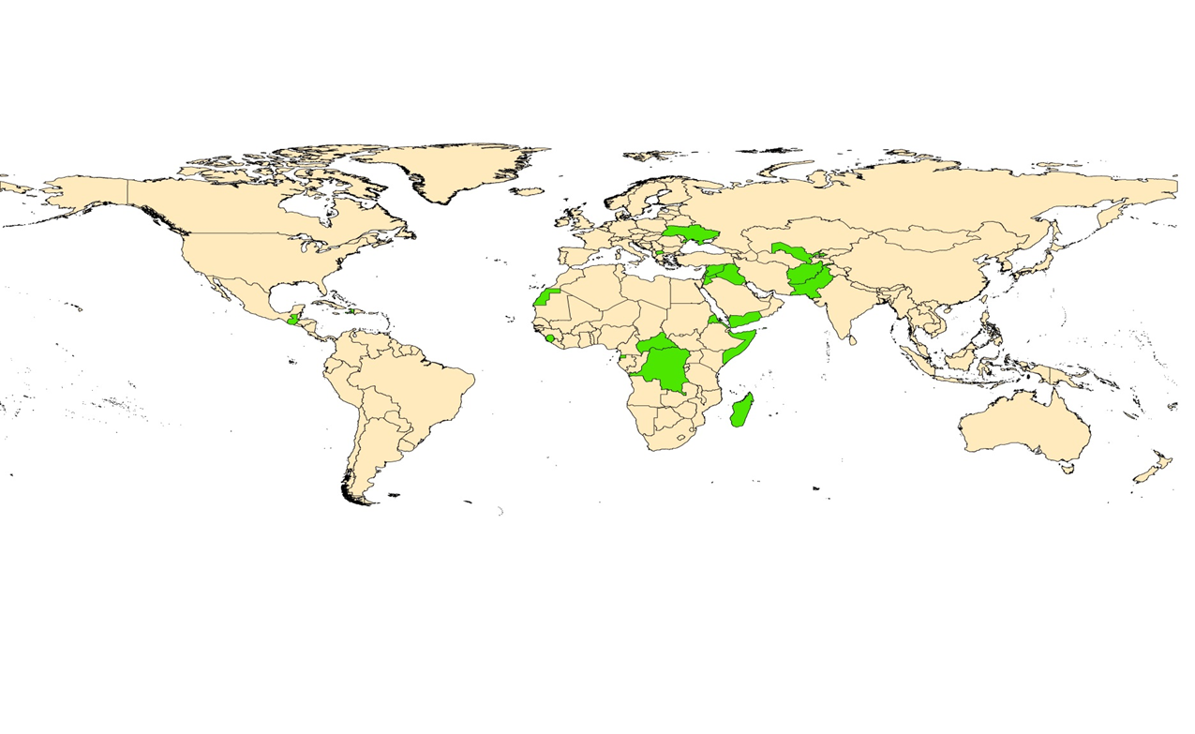
2010 Round of censuses
Statistics Division
Demographic and Social Statistics Branch
Demographic Statistics Section

Slide 8
2010 Round of censuses
Achievements
Multi-modal approaches
Contemporary technologies
Hand-held devices, internet
Web-based dissemination
Geo-spatial technologies
Direct collaboration between countries
Implementation of international standards
Statistics Division
Demographic and Social Statistics Branch
Demographic Statistics Section

Slide 9
Trends in the use of technology
Census Rounds
 | Before 1990 | 1990 | 2000 | 2010 | 2020
Mapping | Sketch | Digital Sketch | Digital Sketch | Digital Georeferenced data Sketch
Enumeration | Paper questionnaire | Paper questionnaire | Electronic questionnaire – Internet Paper questionnaire | Electronic questionnaire – Internet, hand-held devices and telephone Real-time monitoring Paper questionnaire
Data Processing | Manual data capture | Optical data capture Manual data capture | Optical data capture Manual data capture | Optical data capture Automatic data capture (Internet and hand-held devices) Web-based manual data capture Manual data capture
Dissemination | Paper publication |  | Paper publications Online / digital publications | Online interactive databases Digital publications Paper publications
Statistics Division
Demographic and Social Statistics Branch
Demographic Statistics Section

Slide 10
2010 Round of censuses
Challenges
Census costs
Timeliness in releasing data
Public perception and cooperation
Low response rates
Managing the outsourcing of census operations
Inadequate and insufficient exploitation of census statistics
Statistics Division
Demographic and Social Statistics Branch
Demographic Statistics Section

Slide 11
UNSD Methodological framework for Censuses
Principles and Recommendations for Population and Registration,
Revision 3 (2015)
Handbook on Management of Population and Housing Censuses
Revision 2 (2016)
Technical Report on Post Enumeration Surveys (2010)
Handbook on GIS in support of Census Activities (2009)
Under review
Handbook on Measuring Economic Activity
(2010)
Revised under E-learning course
Handbook on Measuring International Migration through censuses
(2017)
NEW
Guidelines on the use of registers and administrative data for population and housing censuses
(ECE 2018)
Guidelines on the Use of Electronic Data Collection Technologies in Population and Housing Censuses
(2019)
NEW
Handbook on Editing for Population and Housing Censuses Revision 2
(2019)
Technical report on Measuring SDG Indicators through Population and Housing Censuses and Civil Registration Data
(2021)
NEW
Handbook on Registers-Based Population and Housing Censuses
(Upcoming)
NEW
Statistics Division
Demographic and Social Statistics Branch
Demographic Statistics Section

Slide 12
UNSD Methodological framework for Censuses
New Handbook - Registers-Based Population and Housing Censuses
The objective is to provide advice and guidance to national statistical authorities that are considering changing census methodology from traditional census to other approaches involving the use of administrate registers and/or administrative data sources.
It discusses the process of transitioning from the traditional census to a combined or fully register-based censuses, consisting of five chapters:
Introduction
Moving to a register-based approach (necessary preconditions, census-specific preconditions, difficulties and challenges)
Types of administrative sources (base registers and specialized registers)
Transforming administrative data into census data (creating a statistical population register and integrated registers for census information)
Quality assessment (source quality, input quality, process quality and output quality)
Expert Group Meeting was conducted on 15-17 December 2021
Statistics Division
Demographic and Social Statistics Branch
Demographic Statistics Section

Slide 13
UNSD Mid-2020 round survey
UNSD launched a Survey on the implementation of the 2020 World Programme
July – August 2019
Short list - 11 questions in total
138 countries/areas replied
Statistics Division
Demographic and Social Statistics Branch
Demographic Statistics Section

Slide 14
UNSD Mid-2020 round survey-major findings
Population and housing census methodology- 2020 round of censuses
Census method | Number | Percent
Total | 138 | 100
Traditional census | 95 | 69
Register based | 42 | 30
Fully register based | 15 | 11
Combined 1 (registers and full field enumeration | 19 | 14
Combined 2 (registers and Sample surveys) | 8 | 6
Rolling census | 1 | 1
About 30% of countries conducted/planning to conducted their census with the use of registers
Statistics Division
Demographic and Social Statistics Branch
Demographic Statistics Section

Slide 15
UNSD Mid-2020 round survey-major findings
Data collection modes
Mode of enumeration | Number | Percent
Total | 123 | 100
PAPI | 52 | 42
CAPI | 88 | 72
Self-response paper questionnaire (mail in/mailed back) | 12 | 10
Self-response paper questionnaire (delivered/collected by enumerator) | 18 | 15
CAWI Internet self-response | 47 | 38
Telephone interview (paper questionnaire | 2 | 2
CATI – Telephone interview, electronic questionnaire | 15 | 12
Not decided | 2 | 2
Note: The sum of categories exceeds the total as one response could include more than one category; countries were asked to select all that apply.
About 70 percent of countries used/planning to use tablets or other devices for data collection
About 38 percent of countries used/planning to use online questionnaire for data collection
Statistics Division
Demographic and Social Statistics Branch
Demographic Statistics Section

Slide 16
UNSD Mid-2020 round survey-major findings
Collection of GPS coordinates
GPS coordinates | Number | Percent
Total | 138 | 100
Not collecting coordinates | 21 | 15
Enumeration area (centroid and/or boundary) | 105 | 76
Building and housing unit location | 97 | 65
Roads and other features (such as railroads, water bodies, landmarks, facilities…) | 29 | 21
Other | 12 | 9
Note: The sum of categories exceeds the total as one response could include more than one category; countries were asked to select all that apply.
About 75 percent of countries collected/planning to collect GPS coordinates of enumeration areas
About 65 percent of countries collected/planning to collect GPS coordinates of building/housing units
Statistics Division
Demographic and Social Statistics Branch
Demographic Statistics Section

Slide 17
UNSD activities on the impact of the Covid-19 pandemic on censuses
On 11 March 2020, WHO declared COVID-19 a global pandemic
UNSD, as secretariat of the 2020 World Programme recognized the need to monitor the impact of COVID-19 on PHCs and conducted a series of activities:
Three surveys to monitor the impact of the Covid-19 pandemic
1st survey in March/April 2020 to collect information on the implementation of 2020 censuses
2nd survey in September 2020 in collaboration with World Bank
3rd survey in December 2020/January 2021 to collect information on the implementation of censuses in 2020 and 2021
Technical guidance notes on Personal Protection Equipment (PPE) for Census (UFPA and UNSD), September 2020
Statistics Division
Demographic and Social Statistics Branch
Demographic Statistics Section

Slide 18
UNSD activities on the impact of the Covid-19 pandemic on censuses
Dashboard to monitor the impact of the Covid-19 pandemic, April 2021
UN/DESA Policy Brief #118, Policy Implications of the disruption of the implementation of the 2020 World Population and Housing Census Programme due to the COVID-19 pandemic, October 2021
Two Virtual Expert Group Meetings on the impact of the Covid-19 pandemic on conducting censuses and on census data quality concerns
February and November 2021
Statistics Division
Demographic and Social Statistics Branch
Demographic Statistics Section

Slide 19
Technical Guidance Note on PPEs
Key recommendations:
Develop a national guidance on recommended PPE requirements for census in consultation with national health authorities
Review census operational and logistical planning
Implement social distancing measures
Use PPE (face masks, sanitizers, others)
https://unstats.un.org/unsd/demographic-social/census/documents/ppe_in_censuses.pdf
Statistics Division
Demographic and Social Statistics Branch
Demographic Statistics Section

Slide 20
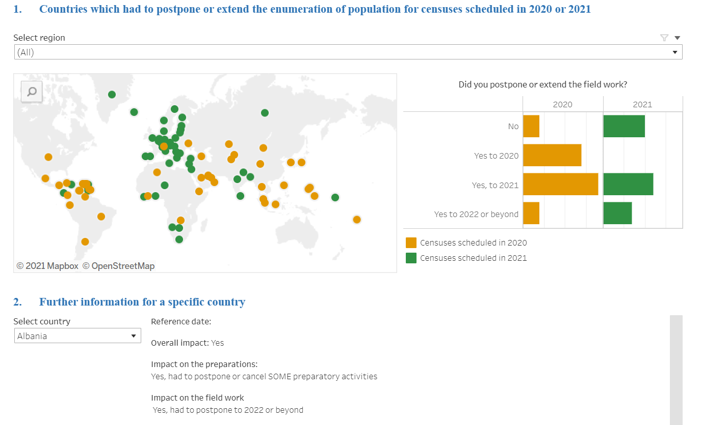
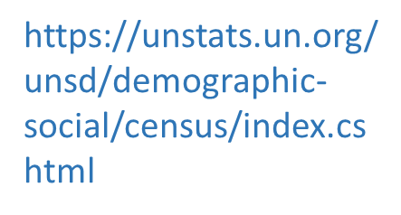
Dashboard on Impact of Covid-19 on 2020 round of censuses
UNSD launched this webpage to provide an overview of the pandemic's consequences in terms of census-taking in the 2020 round. The webpage is updated periodically as replies and updates from national statistical offices are received
Statistics Division
Demographic and Social Statistics Branch
Demographic Statistics Section

Slide 21
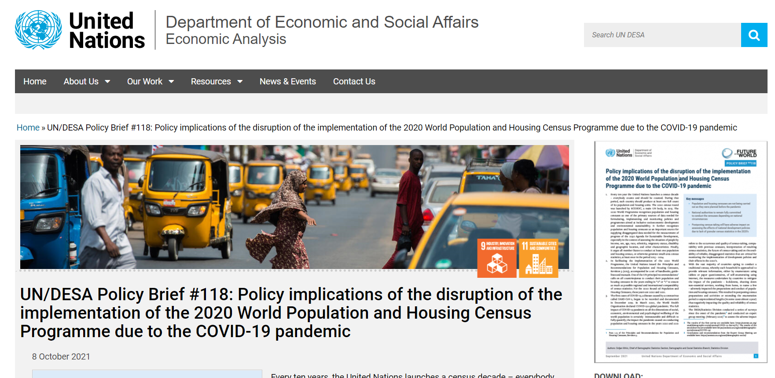
UN/DESA Policy Brief on the 2020 World Census Programme
Key messages
PHCs are not being carried out as they were planned before the pandemic
National authorities to remain fully committed to conduct the censuses depending on national circumstances
Postponing census-taking will have adverse impact on assessing the effects of national development policies due to lack of granular census statistics in the 2020`s
https://www.un.org/development/desa/dpad/publication/un-desa-policy-brief-118-policy-implications-of-the-disruption-of-the-implementation-of-the-2020-world-population-and-housing-census-programme-due-to-the-covid-19-pandemic/
Statistics Division
Demographic and Social Statistics Branch
Demographic Statistics Section

Slide 22
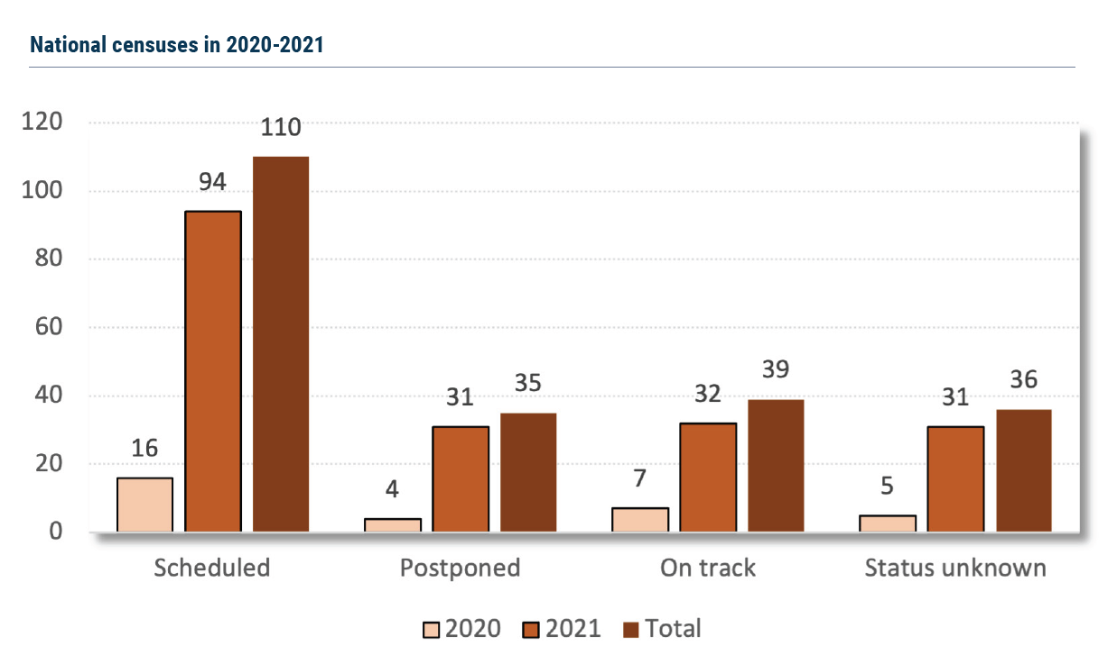
UN/DESA Policy Brief on the 2020 World Census Programme
Current state of the census taking
Out of 110 national censuses for which data were available and that were scheduled (before the pandemic) to take place in 2020 and 2021,
71 (65%) are either postponed or with unknown status
39 were conducted or are planned to be conducted by end of 2021
Statistics Division
Demographic and Social Statistics Branch
Demographic Statistics Section

Slide 23
UN Expert Group Meetings on the impact of the Covid-19 pandemic
More than 100 experts from over forty national statistical offices, regional and international organizations participated to each EGM
First EGM on 9-12 February 2021
Second EGM on 2-5 November 2021
Main objectives:
Monitor and document challenges in conducting censuses during the pandemic
Discuss alternative solutions in designing census operations for producing relevant, timely and reliable statistics
Discuss the effects of the pandemic on data quality and census measurements
Forty-five country presentations
https://unstats.un.org/unsd/demographic-social/meetings/2021/egm-covid19-census.cshtml
https://unstats.un.org/unsd/demographic-social/meetings/2021/egm-covid19-census2/
Statistics Division
Demographic and Social Statistics Branch
Demographic Statistics Section

