Slide 1
Session 5 - Process and output quality for the 2021 Canadian Census
Second Expert Group Meeting on the Impact of the Covid-19 Pandemic on Conducting Population and Housing Censuses and Data Quality Concerns
November 4th, 2021

Slide 2
The Canadian Census of Population
Conducted every 5 years
In 2021: May to mid-August (extended to September for certain areas)
Primary objective: count every person and dwelling in Canada
Enumerates people based on where they usually live
35 million individuals enumerated in 2016
Majority of population concentrated in urban areas (mostly in the South)
Majority of territory is rural/remote areas

Slide 3
The Canadian Census of Population Context & Challenges
Collection Methodologies
Mail-out (86% of dwellings)
Urban areas where invitation/reminder letters can be delivered directly to the dwelling
Mail-out with drop-off (>6% of dwellings)
Mix of mail delivery where possible (like mail-out) and enumerators dropping Census materials at remaining dwellings
List/leave (6% of dwellings)
Rural areas where enumerators are sent to list all dwellings and deliver Census material
Canvasser/Reserve (1% of dwellings)
Remote areas where Census questionnaires are typically completed via in-person interviews
Collecting in the brown and tan regions (where materials cannot be mailed) requires enumerators

Slide 4
2021 Census collection timelines
Self-response
- Big push in May
- Several reminders (wave methodology)
- Encourage Electronic
Questionnaire (EQ)
- Paper Questionnaire (PQ) available on request
- Census Help Line for questions
Non-Response follow-up (NRFU)
- June until August
- By phone and in-person (PQ used by field enumerator)
Dwelling Classification Survey
- June until August
- After NRFU is done in a given collection unit
- Sample of NR and unoccupied private dwellings
- Used to adjust Census counts (based on occupancy error)

Slide 5
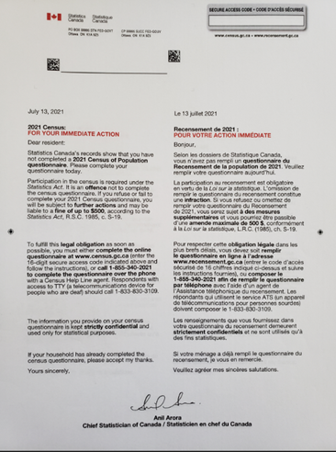
New Census plan in reaction to COVID-19
Minimize in-person contacts
More resources deployed for telephone attempts
When face-to-face visits were required:
Enumerators were provided with Personal Protective Equipment and practiced physical distancing
Soft approach during the first contact to encourage self-resp.
A final wave (reminder letter) was added towards the end of NRFU to encourage self-response
New strategies for collective dwellings and remote areas
Contingency strategy (imputation stage)
Administrative sources to list individuals living in Canada in May 2021 along with qualifying attributes like name, date of birth, sex and address.
→ Improve donor pool if NR is higher than expected

Slide 6
Sources of errors during census enumeration
Mitigation & Quality driven Operation
Wave Methodology Publicity Campaign Push for EQ Response management strategy
Improvement of coverage questions in the EQ Failed-Edit Follow-Up Operation Dwelling Occupancy Verification Operation Response management strategy Dwelling Classification Survey
Type of error
Item non-response (measurement) and Total Nonresponse
Coverage (individuals and dwellings)

Slide 7
Flag suspicious collection areas and follow-up with field enumerators
Many errors found and corrected
Response management strategy
RR targets met
Quality conditions met
To stop collection Response Rates must meet targets and additional Quality Indicators
Stop
collection
Quality thresholds are set but are flexible and adjusted as needed
Occupied ratio
Refusal rate
Absent rate
Unoccupied rate
Occupant moved rate

Slide 8
Collection Response Rates - Highlights
Collection Rate | 2016 Census | 2021 Census
 | Actual | Planned | Actual
Global Census Collection Rate | 98.4% | 98% | 98.0%
Long Form Collection rate | 97.9% | 96% | 97.4%
Internet | 68.3% | 80% | 84.1%
Paper | 20.5% | 10% | 4.1%
Self-Response | 88.8% | 90% | 88.1%
NRFU | 9.7% | 8% | 9.9%
Workload at start of NRFU | 3.7 M | 4.0M | 4.6M

Slide 9
Admin data imputation plan
Objective: ensure high-quality population and dwelling counts by improving imputation of non-response using admin data is a safe, appropriate way
Results: imputation using admin data improved the quality of population counts, and admin data is available for about half of non-responding households
Criteria: Imputation will use admin data:
At the Collection Unit (CU) geographic level | Where response rates are below 90%
When good quality admin data are available | Only number of residents, date of birth, sex at birth
After collection, during data processing

Slide 10
Assuring quality with new tools, experts and governance
Strategic Management Committee
(Chaired by Chief Statistician)
Census Project Team
(Chaired by Census Manager and including sub-project managers and functional areas)
Census Steering Committee
(Co-Chaired by two Assistant Chief Statisticians and including functional area Directors General)
Data Quality Review Board
(Chaired by the Director of the Census Operations Division)
New - Census Certification Review Committee
(Co-Chaired by DG Methodology & DG Census Subject Matter and including functional area Directors General )
New - Centralized Testing Unit
Improved
Consult internal and external partners
Corporate
Directive on the Validation of Statistical Output
Quality Assurance Framework
Census Program
NEW - Census Data Quality Improvement Register
Sub-project / Task
NEW - Certification automated tools (Pre-certification, outlier and harmonisation)
Quality Guidelines
NEW - TestRail software used for test case documentation and reporting
Recommendations and approval of the data for release
Dissemination tools (new - quality indicators)
NEW/Improved - Test plans approval and documentation
NEW - Certification training and documentation
NEW - Tabulation system and automated tools
NEW - Automated processing testing tools
Corporate tools (G-TAB, G-SPEC, CANCEIS)
Improved - Certification Strategy (new - common approach and tools, segregation of duties)
NEW - Certification-stage weights

Slide 11
Census Certification Review Committee (CCRC) will provide a challenge function and advise for consultations with external experts
Subject Matter (SM) Divisions consulting external stakeholders during certification
Internal and External peer review

Slide 12
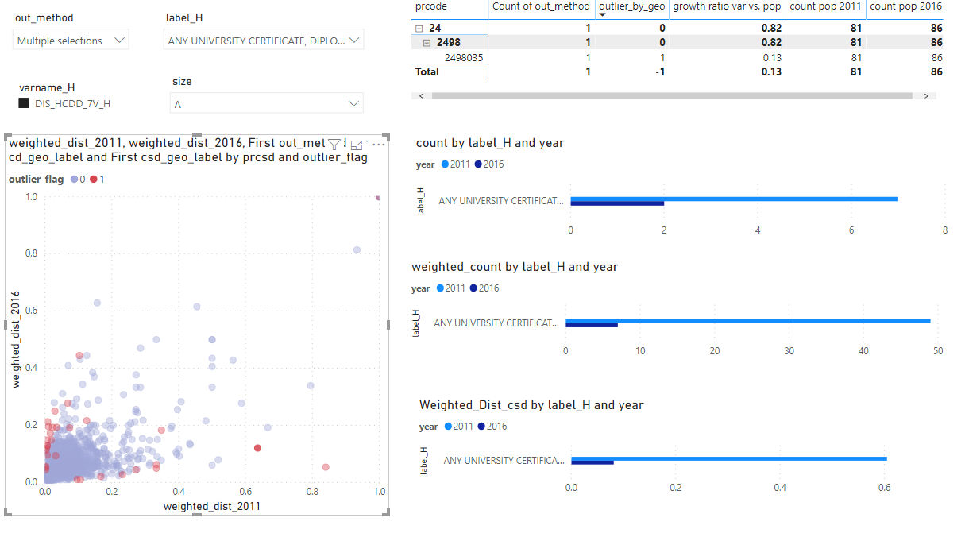
New certification tools - examples
Outlier Scatter Plots
Interactive scatter plots emphasizing outliers will be available at the csd, cd, and cma level;
Filters will be used to choose the domain of interest;
Accompanying tables and plots provide information about the selected points to help a user understand the flagged anomaly;

Slide 13
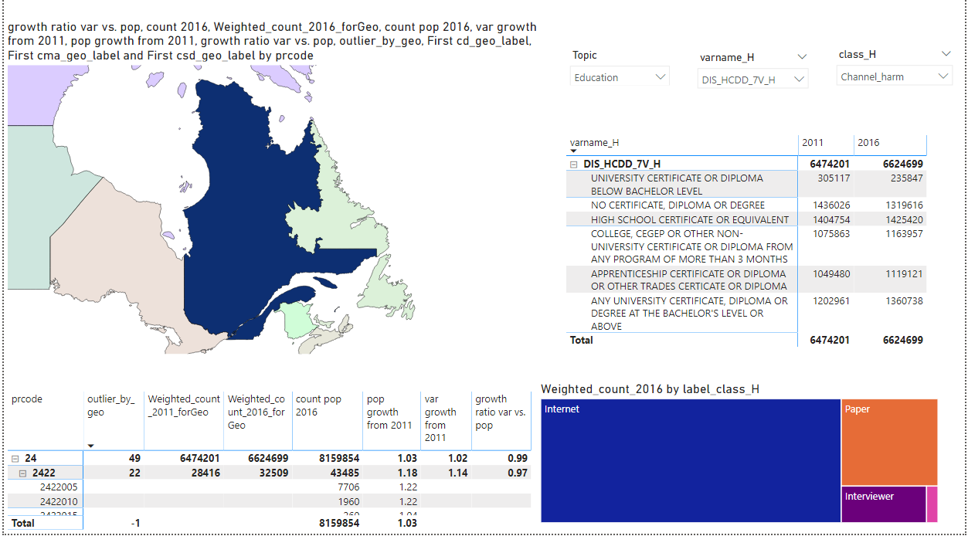
New certification tools - examples
Summary Statistics Displayed in Interactive Maps and Tables

Slide 14
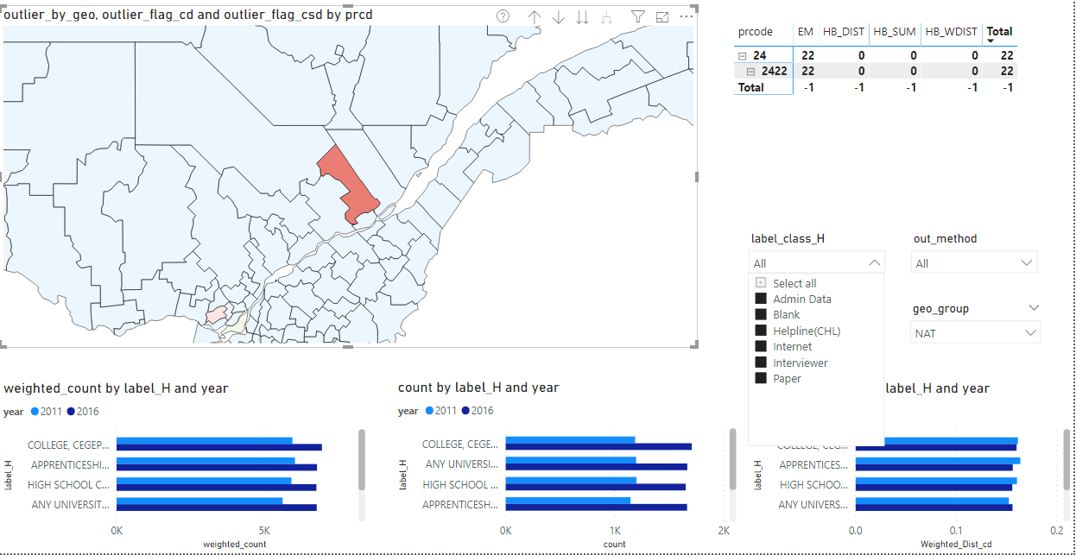
New certification tools - examples
Outliers flagged and displayed in interactive maps
Aggregates of outlier flags by geography with some explanatory information

Slide 15
Quality Indicators Available to Users
Total non-response rate
Question-level:
Item non-response rates
imputation rates
Variance-based for long-form estimates: confidence intervals

Slide 16
Thank you - Merci
For more information, please contact:
Pour plus d’information, veuillez contacter:
patrice.mathieu@statcan.gc.ca

