Slide 1
Changes to Questionnaire for 2021 COVID Response
Jon Wroth-Smith

Slide 2
Background
England & Wales Census took place in March 2021 during the pandemic
ONS undertook an analysis of which questions were likely to be impacted and the additional guidance that should be included
Objectives of this exercise were:
- To reduce respondent burden
- To reduce the impact on the call centre where there is uncertainty
- To eliminate inconsistencies in how people interpret questions
- To understand the data that we would collect and how this related to user need
- To assistance with data collection from other ONS surveys
Although users would ideally like to understand what the ‘new normal’ is, they were aware that this would not exist by March 2021 and therefore are content for census to capture the ‘current circumstances’ of the population.

Slide 3
Questions impacted
Majority of the questions not impacted at all:
Household: Relationships within the household, type of accommodation, self-containment of accommodation, type of central heating,
Individual: Name, sex, date of birth, marital/ legal civil partnership status, national identity, qualifications, religion, Welsh language skills (Wales only), English language proficiency, Armed forces, gender identity, sexual orientation.
Small number with a minor impact:
Household: Tenure, number of cars or vans, number of bedrooms
Individual: Intention to stay, main language, passports
Notes:
NEED TO ADD MORE CONTEXT - WHY DON’T THINK A PROBLEM
Does your household own or rent [piped address]?
Payment holidays may influence response
Lives here rent-free could be taken to include ‘rent holiday’
In total, how many cars or vans are owned, or available for use, by members of this household?
Respondents may not know how to answer in relation to SORN vehicles. Online guidance states to not include these vehicles.
If someone has moved into the household because of the pandemic, respondents may not know whether to include their vehicles
How many bedrooms are available for use only by this household?
Include all rooms built or converted for use as bedrooms
If additional people have moved into the household because of the pandemic, rooms may have been temporarily converted for use as a bedroom and respondents, my not know how to answer
Include panel refers to rooms converted for use as bedrooms’ but this is in relation to ‘permanent’ conversion, as stated in online guidance
Including the time already spent here, how long do you intend to stay in the United Kingdom?
Length of stay may have been affected by the pandemic, such as staying longer than originally expected, and not knowing when they can leave
What is your main language?
This is the language you use most naturally. For example, it could be the language you use at home.
Possible that language use may have been affected by the pandemic.
For example, a furloughed worker who spoke English predominantly at work, but another language at home, may respond differently, if use of English has been reduced
What passports do you hold?
Given the reduction in travel, people may have let passports expire
There may be delays in getting documents renewed

Slide 4
Larger potential for impact
Who usually lives here
Second address
Students Term-Time Address
Usual address one year ago
5. Labour market and travel to work
6. Visitors – name, sex, date of birth, usual address
7. Health reporting

Slide 5
Approach
Through testing we revised question guidance to get people in different circumstances to answer consistently (for the most part) for their current circumstances.
Changes could be made relatively easily to the electronic questionnaire (eQ) but it wasn’t possible to make changes to paper questionnaires as printing was carried out in advance.
We were conscious of the need to implement changes which had been tested to avoid unintended consequences
Supporting guidance was available alongside the paper questionnaire to provide clarification. This included the contact centre and support provided by field staff

Slide 6
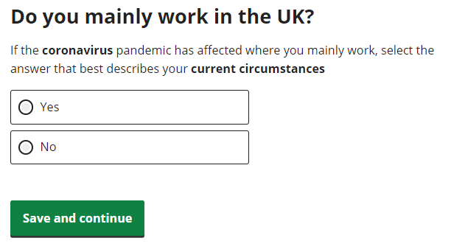
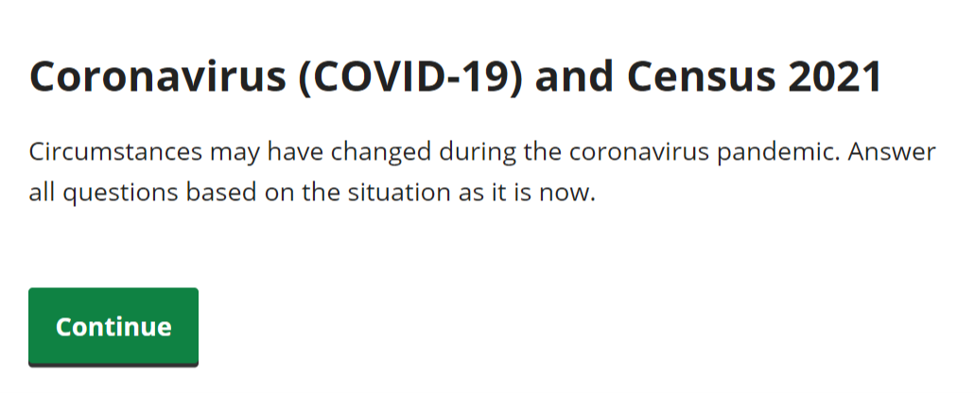
Changes made to Electronic Questionnaire
Two additional screens and nine additional pieces of question guidance were inserted to clarify the need for respondents to refer to the ‘current’ context/timeframe, with the exception of the already backward looking ‘Address one year ago’ question

Slide 7
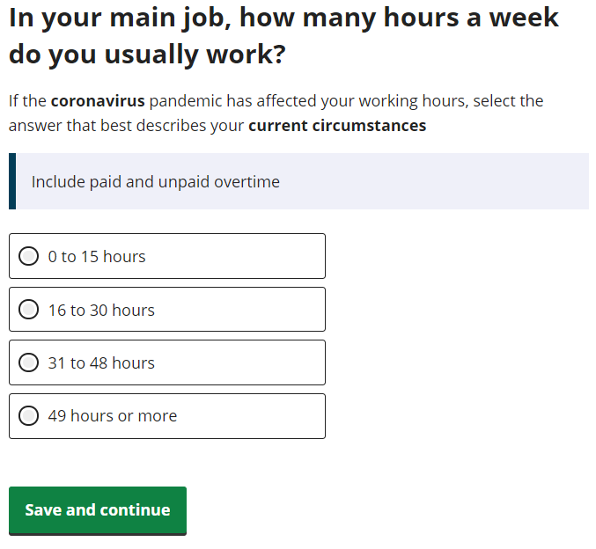
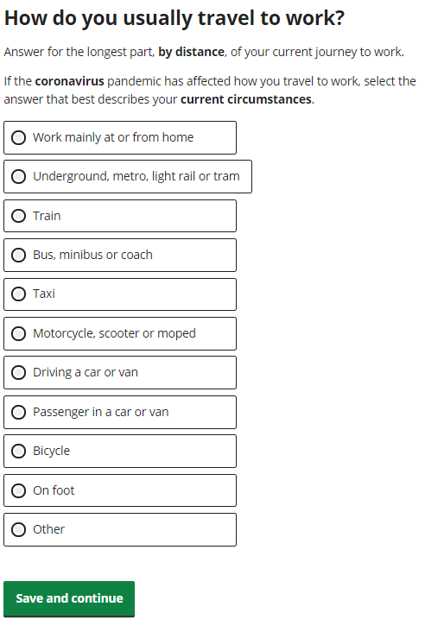
Changes made to Electronic Questionnaire

Slide 8
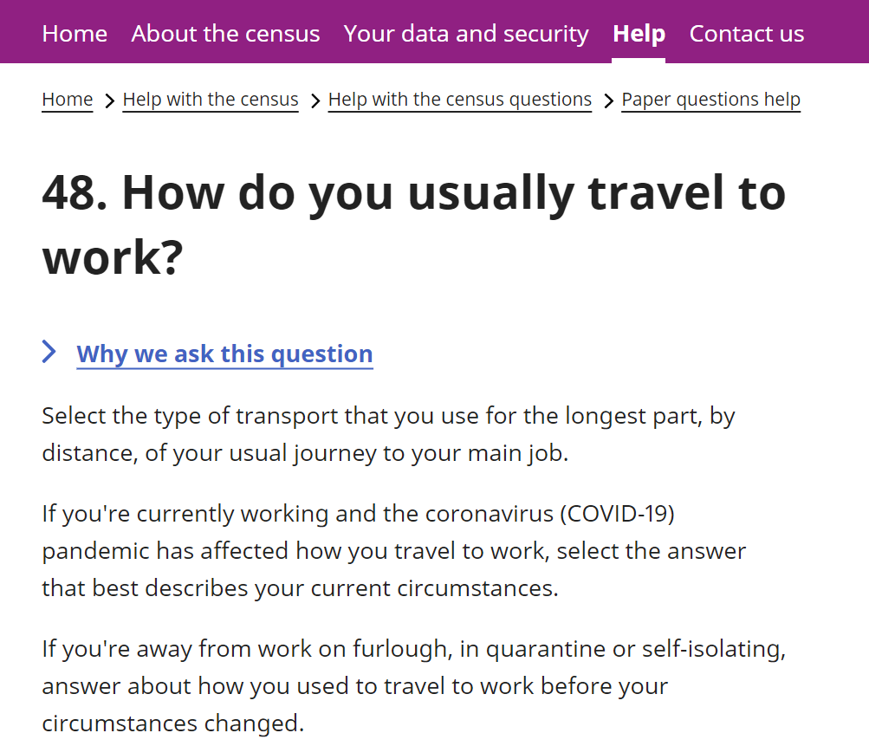
Guidance Changes
Alongside changes made to electronic questionnaire, guidance was also changed for:
Published supporting material and comms
Contact centre and online help
Field operations
Specific guidance also issued around other topics (though no changes to questionnaire)
Students (clarifying the need to complete at term-term address)
Second homes (clarifying the need to complete a form for a second residence as well as main address)

Slide 9
Conclusions
Emphasis was on respondents completing the census based on current circumstances
Predicting what the ‘new normal’ would risk significant inconsistencies and error
Generally changes worked well with respondents understanding what we were asking
Understanding user need and question testing were essential parts of this work
ONS are developing plans to ensure that the census statistics can continue to relevant into the next decade e.g. using other data sources alongside or integrate with census data

