Slide 1
Effects of the Covid-19 pandemic on data analysis and comparability overtime
United Nations Expert Group Meeting on the impact of Covid-19 Pandemic on Conducting Population and Housing Censuses and on Census Data Quality Concerns
9-12 February 2021
Office of Registrar General & Census Commissioner, India

Slide 2
Outlines
Introduction
Legacy
Vastness
Calendar
National Population Register
Methodology
Data collection using Technology
Training
Houselisting Questions
Population Enumeration Questions
Effects of the Covid-19 pandemic on Census Results
Comparability with other Data Sources
Major Challenges for comparison
Census of India 2021

Slide 3
Census of India – Introduction
Only source of primary data at village, town and ward level
Biggest source of comprehensive data on:
Housing Condition; Amenities & Assets
Demography
Scheduled Castes and Scheduled Tribes
Urbanization
Literacy & Education
Language, Religion & Migration
Economic Activity
Fertility
Census of India 2021

Slide 4
Census of India – The Legacy
First non-synchronous Census conducted in 1865-1872
First synchronous Census conducted in 1881 (throughout the Country)
Next census in 2021 (16th in the series and 8th since Independence)
Census is conducted under Census Act 1948 and Census Rules, 1990
Utility : Delimitation/Reservation of Constituencies - Parliamentary/Assembly/ Panchayats and other Local Bodies
Census of India 2021

Slide 5
Census 2021 - Vastness
States/UTs : 36
Districts : 734
Census Charges : 18,000*
Villages : 6.5 lakhs*
Towns/Cities : 8,000*
Enumeration Blocks : 25 lakhs*
Enumerators & Supervisors : 31 lakhs*
Questionnaires : 16 languages
Instruction manuals : 18 languages
 |  | D | I | F | F | I | C | U | L | T | A | R | E | A
 |  | I |  | D | A | T | A | P | R | O | C | E | S | S | I | N | G
 |  | F |  |  |  | E | D | I | T | R | U | L | E | S
 |  | F | U | N | C | T | I | O | N | A | R | I | E | S |  | D
 |  | I |  |  | S | C | A | N | N | I | N | G |  |  |  | I
 |  | C | P | R | I | N | T | I | N | G |  | I |  | C | O | S | T
 |  | U |  |  |  | M |  |  |  |  |  | O |  |  |  | T
 |  | L |  | T |  | A |  | T | R | A | I | N | I | N | G | R
M | O | T | H | E | R | T | O | N | G | U | E | S |  | J |  | I
A |  | P |  | C |  | E |  |  |  |  |  |  |  | U |  | B
P |  | E |  | H |  | R |  |  | V |  |  |  |  | R |  | U
P |  | O |  | N |  | I |  |  | U |  |  |  |  | I |  | T
I |  | P |  | O |  | A |  |  | L |  | C |  |  | S |  | I
N |  | L |  | L |  | L |  |  | N |  | O |  |  | D |  | O
G |  | E |  | O |  | S | U | P | E | R | V | I | S | I | O | N
 |  |  |  | G |  |  |  |  | R |  | E |  |  | C
 |  |  |  | Y |  |  |  |  | A |  | R |  |  | T
 |  |  |  |  |  |  |  |  | B |  | A |  |  | I
 |  |  |  |  |  |  |  |  | L |  | G |  |  | O
 |  |  |  |  |  |  |  |  | E |  | E |  |  | N
 |  | A | W | A | R | E | N | E | S | S
* Approximate numbers
Census of India 2021

Slide 6
Census of India – Calendar
Phase-1: Houselisting & Housing Census (HLO) and updation of National Population Register (NPR)
April to September 2020 ( a period of 45 days as chosen by the State Govt.)
30 days for HLO and 15 days for updation of NPR
Postponed due to outbreak of COVID-19 pandemic
Phase-2: Population Enumeration (PE)
9th to 28th February 2021
1st to 5th March 2021 (Revisional Round)
Data Dissemination
Provisional population – within 3 weeks
HLO data – 6 to 8 months
PE data - Village-wise primary data – within 1 year
Other PE data and Finalization of NPR data – within 2 years
6

Slide 7
National Population Register (NPR) updation
NPR was first prepared in 2010 alongwith first phase of Census 2011
A few fields of NPR 2010 were updated and Mobile, Aadhaar and Ration Card number were collected during 2015 NPR updation exercise
Now it has been decided to update NPR with Houselisting and Housing Census
By linking NPR with registration of birth and death, real time population register will be available leading to register based census in future
7

Slide 8
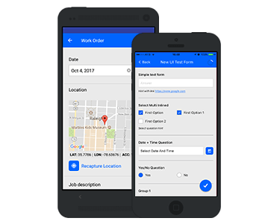
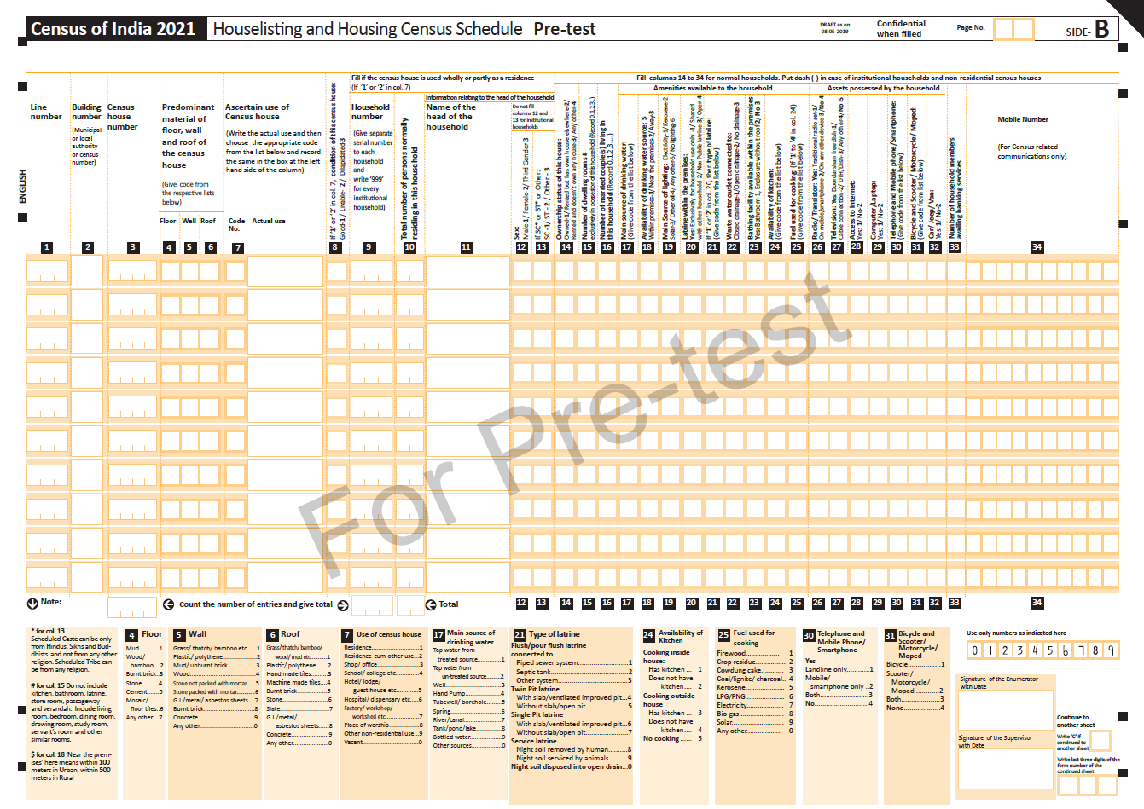
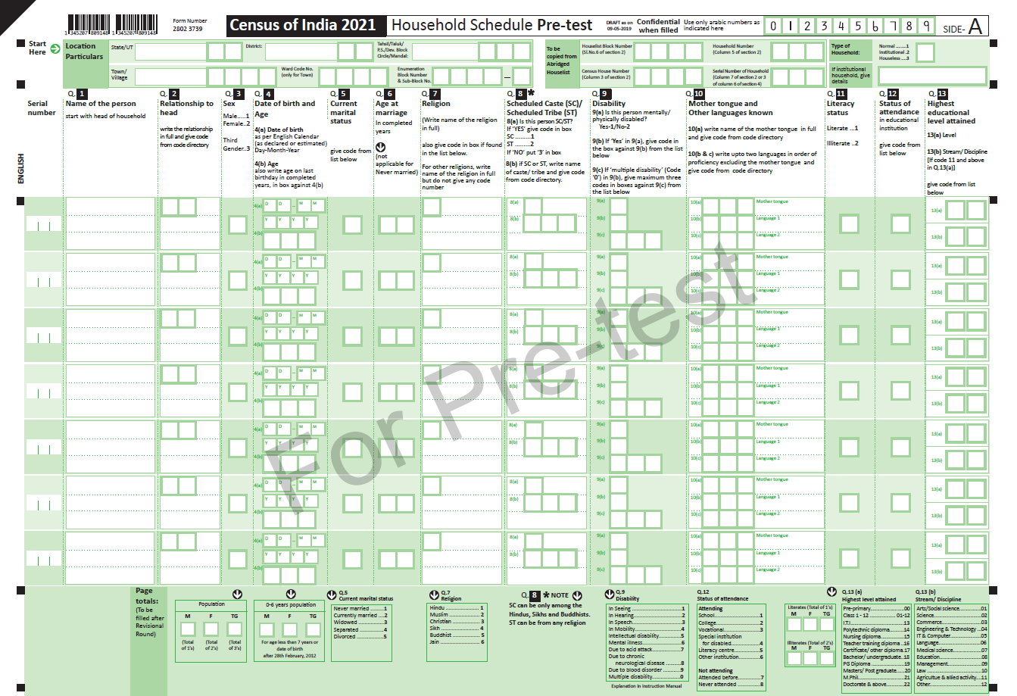
Methodology
Digital data collection
Mobile App
Self Enumeration
Enumerators to use their own device
Management & monitoring through Census web portal (CMMS)
Minimum descriptive entries through coded responses
or
ORGI
Scanning Centre
ORGI Server
8

Slide 9
Data Collection Using Technology
Mobile App for Data Collection
Mobile Apps and Web applications developed:
Houselisting and Housing Census OFFLINE Mobile App
Mobile app for Geo tagging of Enumeration Blocks
Self-Enumeration web application for updation of NPR
National Population Register OFFLINE Mobile App
Population Enumeration OFFLINE Mobile App powered with code-directories for descriptive entries
Self-Enumeration web application for Population Enumeration
Apps in 16 languages in which Census is conducted.
Internet availability required for registration of enumerator and uploading of data only.
9

Slide 10
Training
Three tier structure of trainers to train 33,00,000
enumerators and supervisors
Out of the 90 National Trainers 60 from ORGI
and 30 from faculty of State Administrative
Training Institutes (ATIs)
Master Trainers will be mostly from States and
some from Directorates of Census Operations
All the 43,000 Field Trainers will be from States/UTs
90 National Trainers
1,000 Master Trainers
43,000 Field Trainers
31 Lakh Enumerators & Supervisors
Census of India 2021

Slide 11
Houselisting Questions 2021
Category | Questions on
Housing condition | Material of floor, wall and roof Use & condition of house, ownership, no. of rooms, no. of married couples
Amenities available | Drinking water, Lighting, Latrine facility, drainage connectivity, bathing, kitchen,, fuel used for cooking
Assets possessed | Radio/Transistor, Television, Computer/Laptop Telephone/Mobile phone/ Smart phone Bicycle, Scooter/Motor Cycle/Moped, Car/Jeep/Van Access to Internet
Other | Main Cereal Consumed Mobile number
Census of India 2021

Slide 12
Population Enumeration Questions 2021
Category | Questions on
Demographic | Sex (M, F, Transgender) Date of Birth & Age Marital status Age at marriage Children born and surviving
Socio-cultural | Relationship to head Religion SC/ ST Disability Mother Tongue Other languages known Literacy status Educational level Stream/ Discipline
Category | Questions on
Economic | Work status – Main, marginal and non-worker Category of economic activity Occupation Nature of Industry Class of worker Non economic activity Seeking or available for work Mode of travel and distance to place of work
Migration | Birth Place / Place of last residence Reason for migration; Duration of stay since migration
Census of India 2021

Slide 13
Effects of the Covid-19 pandemic on Census Results
The pandemic may effect following Census Measures:
Migration
Workers
Fertility
Population attending educational institutions
Rural-Urban distribution of population
Distance to travel place
Access to internet
Ownership status
This effect may vary depending on the actual year in which Census takes place.
13

Slide 14
Comparability with other Data Sources
Data set from Census | Other data set available from sample survey/Administrative records etc to which census data may be compared
Fertility Data | Data from Sample Registration System (Data availability-Yearly)
Workers data | Periodic Labour Force Survey (PLFS) (Data availability – quinquennial)
Migration data | Data from National Sample Survey
Population attending educational institutions | Data from Ministry of Education
Decadal growth | Backward interpolation
Rural-Urban Distribution | Post Enumeration Survey
14

Slide 15
Major Challenges for comparison of Census data with other data sources
Difference in Concepts and Definition
Methodology for data Collection
Time gap between two data sources
15

Slide 16
Thank You
http://www.censusindia.gov.in

