Slide 1
Achieving and Assessing Census Data Quality Amid the Uncertainty of a Pandemic United Nations Expert Group Meeting on the Impact of the Covid-19 Pandemic on Conducting Population and Housing Censuses and on Census Data Quality Concerns
Beatrice Baribeau
Statistics Canada
February 10, 2021
This presentation describes planned approaches that have not yet been implemented in Statistics Canada’s programs.

Slide 2
Overview
The Canadian Census of Population – context and challenges
Mitigation & Contingency planning due to COVID
Plan A: Adapting collection strategies
Plan B: Plan A + Ongoing research for contingency planning
Assessment of Data Quality
Certification
New quality indicators

Slide 3
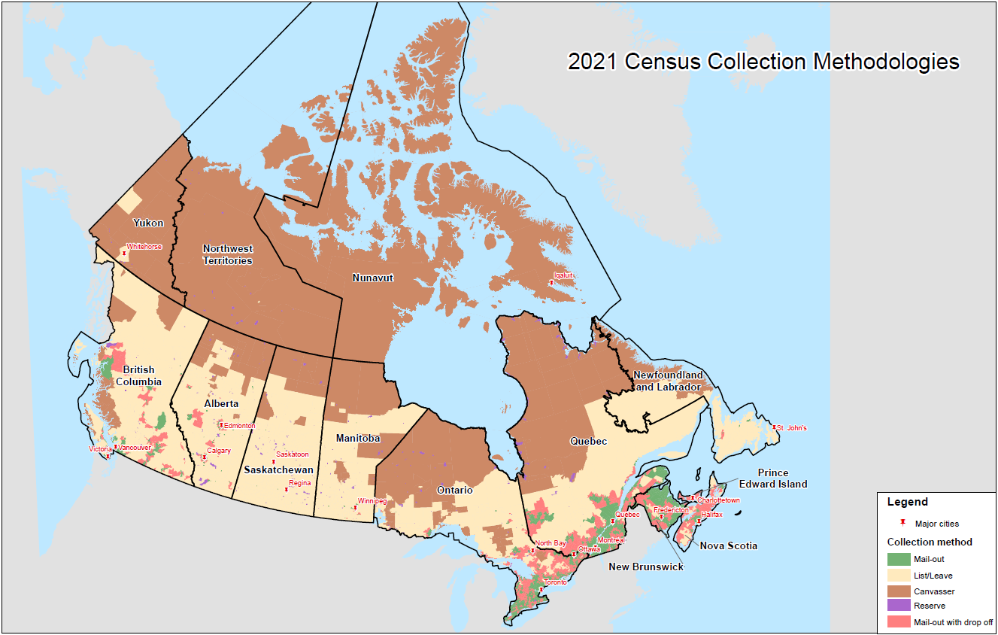
The Canadian Census of Population Context & Challenges
Collection Methodologies
Mail-out (86% of dwellings)
Urban areas where invitation/reminder letters can be delivered directly to the dwelling
Mail-out with drop-off (>6% of dwellings)
Mix of mail delivery where possible (like mail-out) and enumerators dropping Census materials at remaining dwellings
List/leave (6% of dwellings)
Rural areas where enumerators are sent to list all dwellings and deliver Census material
Canvasser/Reserve (1% of dwellings)
Remote areas where Census questionnaires are typically completed via in-person interviews
Collecting in the brown and tan regions (where materials cannot be mailed) requires enumerators
*Risk*

Slide 4
2021 Census Wave Methodology
The wave methodology is designed to achieve high response rates and elicit self-response through varied, targeted prompts
NRFU Final Wave
July 19-20
May 11
CENSUS DAY
Wave 1
MO Invitation
Letter
May 3
Wave 2
Reminder
Letter
May 12-20
Wave 3
Final Notice
May 20-31
Text message
reminder or
Automated call
May 31
NRFU
Non-Response
Follow-up
June 2 –July 30
Mail-out
90%
Non-Response
Non-Response
Non-Response
Non-Response
Paper Questionnaire Request System/Process
Available to respondents from May 3 – June 30 (automated system)
Wave 1
DD Invitation
Letter
May 3 -10
Wave 2
Reminder/
Thank you card
May 12-14
NRFU
Non-Response Follow-up
May 21 – July 16
List-Leave
Non-Response
List/Leave /
Drop-Off
9%
NRFU
Non-Response Follow-up
June 2 – July 30
Drop-Off
Non-Response
Wave 1
MO Invitation
Letter
May 3
Canvasser /
Reserve
1%
NRFU
Non-Response Follow-up
May 14- July 16
Wave 1
DD Invitation
Letter
May 3 -10
Non-Response
MO: Mail-out
DD: Door-dropper
Material delivered by CPC

Slide 5
Mitigation & Contingency planning due to COVID
Plan A:
Optimal collection strategies to achieve high response through self response rates and minimal contact in nonresponse follow-up
COVID may interfere with collection.
To ensure quality we need
to be ready with a Plan B
Plan B:
Plan A + Statistical contingency planning based on administrative data to treat nonresponse

Slide 6
Plan A: Mitigating Risks to Response Rate by Optimizing Collection
Base Collection strategy:
Promote self-response
Concentrate nonresponse follow-up (NRFU) where needed most
NEW for Non-response follow-up:
When face-to-face visits are required:
Enumerators will be provided with PPE and will practice physical distancing
Soft approach will be used during the first contact to encourage self-response
wave methodology + SMS and email reminders
Tolerance strategy identifies where targets are met to re-allocate resources
Additional telephone resources allocated
A final wave (reminder letter) was added
Local hiring is a priority
Dynamic model to assess progress
Identify unoccupied/cancelled dwellings for more efficient NRFU

Slide 7
Plan B: Contingency planning with admin data
Response Rates
High
Apply usual donor imputation for the short form of the Census
Invoke Statistical Contingency Plan
New imputation step for
Imputing occupied dwellings and imputing age & sex
Lower
Need to determine a trigger for plan
Plan B:
Use admin data
Need criteria to determine eligibility

Slide 8
Plan B: Contingency planning with admin data
Eligibility For Admin Data Imputation
Identified necessity (quality risks) & potential for improvement from admin data
Available admin data deemed of reliable quality
Admin data imputation fits within other established imputation procedures
1
A lot of research has been conducted.
Key Findings presented in next slides
2
3

Slide 9
Plan B: Contingency planning with admin data
Household Model indicators:
Probability that the dwelling is occupied
Probability that DOB and sex attributes are correct
The ‘person-place’ model: assess the probability that the admin address reflects the true address for an individual. Using this model, choose address with highest probability for each individual and form household
The ‘household composition’ model: assess the probability that the admin derived household members reflect the true household composition at a given address
Admin Data Quality Indicators
Probabilities produced from the models serve to create the modelled admin households and indicate their quality.
Some Concepts

Slide 10
Plan B: Contingency planning
with admin data
Household Composition Model for Occupied Dwellings
Match category* for a given dwelling h: | % of dwellings
Perfect match: All persons match | 59.2%
Partial Match: Not a perfect match but at least one person matches | 32.3%
Non-match: no person matches | 8.5%
Finding 1:
Across all dwellings, the results are relatively good with close to 60% of dwellings being a perfect match and 91.5% being at least a partial match to 2016 Census households.
*Admin-based households assessed by comparing to 2016 Census data

Slide 11
Plan B: Contingency planning
with admin data
Assessing Quality of the
Household Model
Availability and Performance by 2016 mail-out and non-mail-out areas
 | 2016 Mail-Out | 2016 Non-Mail-Out
Admin Data Available | 87.9% | 49.1%
Predicted to be a Perfect Match | 61.0% | 32.5%
Error Rate of Predicted Perfect Matches | 19.5% | 23.3%
Finding 2:
In non-mailout areas (where response rates are more at risk) admin data is less available and the quality is reduced.

Slide 12
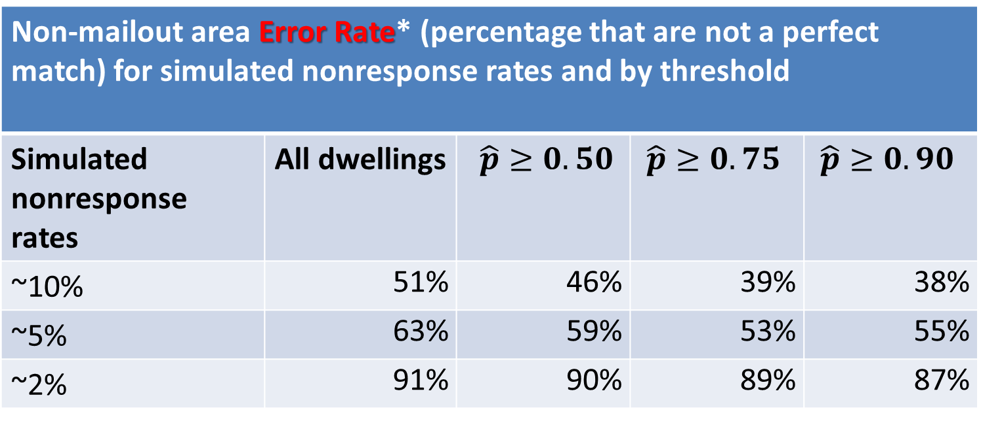
Plan B: Contingency planning
with admin data
Assessing Quality of the
Household Model
Non-mailout area Error Rate* (percentage that are not a perfect match) for simulated nonresponse rates and by threshold
Simulated nonresponse rates | All dwellings | $\hat{p}≥0.50$ | $$\hat{p}≥0.75$$ | $$\hat{p}≥0.90$$
~10% | 51% | 46% | 39% | 38%
~5% | 63% | 59% | 53% | 55%
~2% | 91% | 90% | 89% | 87%
Finding 3:
Applying a threshold to the minimum probability required reduces the error rate
Higher thresholds results in lower error rates.
*2016 Non-mailout dwellings and short-form only
Finding 4:
The error rates for perfect matches of nonresponding households increase as nonresponse decreases.
(Some imperfect matches will still be partial matches).

Slide 13
Plan B: Contingency planning with admin data
Imputation using admin data will respect other established procedures for whole household imputation of nonresponding households
To ensure proper number of households imputed as occupied, with correct distributions by size
Coverage studies (which rely on admin data) will continue to produce unbiased estimates of net undercoverage even in the presence of admin data imputed households
Contingency Plans and other potential impacts

Slide 14
Plan B: Contingency planning with admin data – Next Steps
Eligibility For Admin Data Imputation
Identified necessity (quality risks) & potential for improvement from admin data
Available admin data deemed of reliable quality
Admin data imputation fits within other established imputation procedures
Compare simulated results using admin data to those without using admin data
1
2
Operationalize an admin imputation process respecting other constraints
3

Slide 15
Assessment of Data Quality - Certification
Returning Features
New/Improved for 2021
Investigating data quality measures
total non-response rates
item non-response rate
edit failure rates
imputation rate
change rate
data comparison before and after imputation
Coherence
Past censuses
other surveys
administrative sources.
Cross-tabulations
Checked for consistency and accuracy
Consult internal and external experts when needed (Improved in 2021)
Outlier Identification and verification (New in 2021)
Checks to ensure no systematic error has been introduced (New in 2021)
Data visualization and maps (New in 2021)
+

Slide 16
Assessment of Data Quality – Reporting on Quality
New quality indicators are being introduced for the 2021 Census.
For the short-form and long-form Census:
Moving from Global non-response to using Total Non-response and having item/question quality indicators
the imputation rate (imputation of a component or entire household
the non-response rate (when no item response is obtained)
In addition, for the long-form Census (based on a sample):
Using confidence intervals in Census tables
Using an extension of the Wilson confidence interval adapted for weighted totals
Key quality metrics with increased value if nonresponse is higher

Slide 17
Conclusion
Collection strategies have been adapted to the current context
A Plan B to impute (age and sex) using admin data is being strategically designed. This Plan B will be implemented only if:
Census quality is at risk
Simulations have shown admin data will improve quality
Reliable admin data is available for nonresponding households
The household composition in available admin data households used for imputation corresponds to required imputations by distribution and size
Coverage Studies are designed to be unbiased with invocation of a contingency plan
Thorough certification will be conducted
Resulting quality will be reported transparently though new quality indicators

Slide 18
Thank you! / Merci!
Questions?
beatrice.baribeau@canada.ca

