Slide 1
The Statistics Canada population centre and rural area definition and the proposed European and Global version of the degree of urbanization: a short comparative overview.
Presented at the UN Expert Group meeting on Statistical Methodologies for Delineation Cities and Rural Areas
January 29th, 2019 by
Peter Murphy
Chief, Geographic Concepts, Standards and Areas
Statistical Geomatics Centre,
Strategic Data Management Branch
Statistics Canada
peter.murphy2@canada.ca

Slide 2
The Statistics Canada definition for population centres and rural areas: - a high level description.
A population centre has a population of at least 1,000 and a population density of 400 persons or more per square kilometre, based on population counts from the current Census of Population.
Population centres are classified into three groups, depending on the size of their population:
small population centres, with a population between 1,000 and 29,999.
medium population centres, with a population between 30,000 and 99,999.
large urban population centres, with a population of 100,000 or more.
All areas outside population centres are classified as rural areas.
Taken together, population centres and rural areas cover all of Canada.

Slide 3
The Statistics Canada definition for population centres and rural areas: - recent context and experience.
Urban Areas were re-titled to Population Centres in 2011.
A review of the population centre concept was undertaken in 2012.
Based on the review, population centres were re-delineated using a revised set of criteria for the 2016 Census:
new delineation threshold.
the inclusion of new data sets (employment density).
This review was also integrated into the 2013-14 review of the census metropolitan areas* (CMA) and census agglomeration* (CA) concept and delineation methodology:
Population centres continue to be used to determine if a new CA should be delineated or previously existing CA is removed at the next Census, and when a CA is promoted to the status of a CMA.
Within the CMA and CA delineation methodology, population centres (pop >= 10k) are used to defined the primary or secondary delineation cores.
* core-based functional areas

Slide 4
The Statistics Canada definition for population centres and rural areas: - delineating population centres with a revised set of rules for the 2016 Census.
The longstanding rule that dictated that previous census population centres had to be retained if their population was 1,000 or more was removed.
Current census (2016) dissemination blocks (DBs) were used as the building blocks for the delineation.
Current census (2016) population counts and land area were used to calculate density at the DB level.
The population density of 400 persons per square kilometre was retained as the initial density threshold and a second population density threshold of 200 persons per square kilometre was added.
Employment density was also added to the delineation. Employment density was calculated for each dissemination block based on data obtained from Statistics Canada's Business Register (2016) and a threshold of 400 employees per square kilometre was chosen for the delineation.

Slide 5
The Statistics Canada definition for population centres and rural areas: - changes to populations centres and the rural area, 2011 to 2016.

Slide 7
The proposed and Statistics Canada’s definitions: - a high level comparison.
The concepts and elements of the delineation methodologies are similar (level 1) if not familiar. Some of the similarities include:
Minimum population concentration and densities thresholds.
Clustering of adjacent building-blocks (grid, Blocks) that meet the above.
Test emerging clusters of building units (grid cells, Blocks) to determine if combining them is desirable (or not). Enclaved and other anomalous cases/situations are resolved.
Both definitions (level 1) define rural (grid-cell) areas based on what is not urban.
The use of the largest delineated entities from both methodologies as core areas in the delineation of FUAs, CMAs and CAs respectively.

Slide 8
The proposed and Statistics Canada’s definition compared: - differences (mainly parameters) between the definitions and delineation methodologies.
Statistics Canada’s definition does not classify entities to a comparable level 2 classification:
urban clusters into two categories town, suburban, and rural into Village, dispersed and mostly uninhabited.
The two definitions use different classifications of delineated entities (level 1):
Population density is not a explicit factor in the population centre classification.
Some of the differences between the two delineation methodologies include:
The delineation building block:
Grid-cells are of consistent size.
Blocks area vary in size: tend to be much smaller in built-up areas and very large in sparsely populated regions.
The population concentration and density thresholds:
The 1,000 population minimum for population centres and the two used in the proposed definition: are 50,000 and 5,000 respectively for the urban centres and urban clusters.
The population centre density minimum is 400 person/ km²; there are several densities in the proposed definition – level 1 & 2 (e.g. 1,500 km², 300 km² ).
The use of built-up information in proposed delineation methodology.
The use of employment density in the population centre delineation methodology.
The merge rules differ.
The above differences between the two definitions/methodologies should explain most of the differences in outcomes when the two definitions/methodologies are applied.

Slide 9
The proposed definition and Statistics Canada’s definition compared: - some initial observations.
What fits well:
99% of rural grid-cells are consistent with the rural area defined by Statistics Canada.
95.5% of urban centre grid-cells are consistent with population centres defined by Statistics Canada.
What fits less well:
29.3% of suburban and 14.9% of town grid-cells are associated with the rural area defined by Statistics Canada.
45% of village grid-cells are associated with the rural area defined by Statistics Canada.
An observation:
34.8% of suburban and town grid-cells are associated with areas within larger population centres.
17 larger population centres are not classified among the 51 urban centres (cities).
Overall urban centres are smaller than comparable population centres.

Slide 10
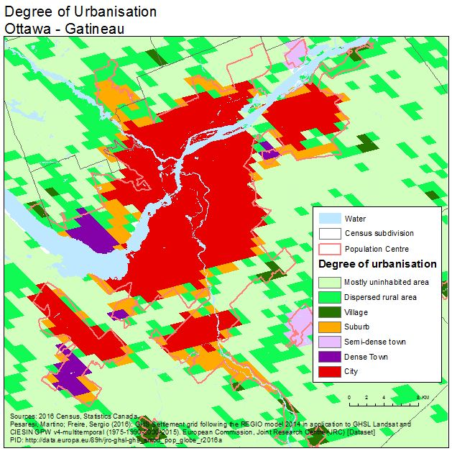
Ottawa, Kanata, Barrhaven and Orleans

Slide 11
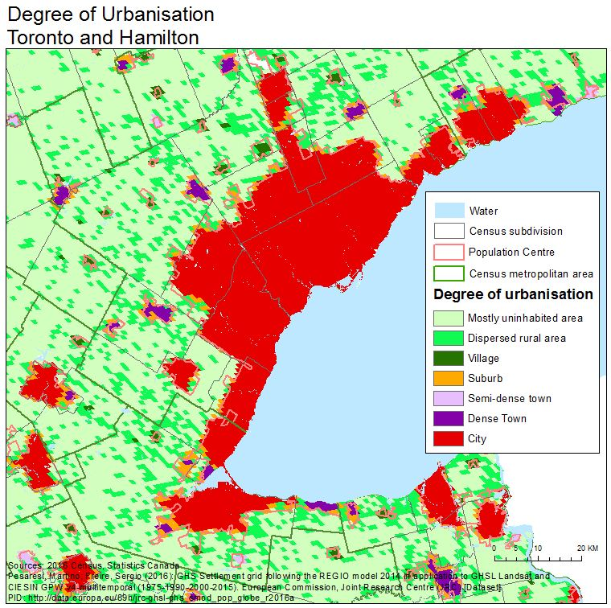
Toronto and Hamilton

Slide 12
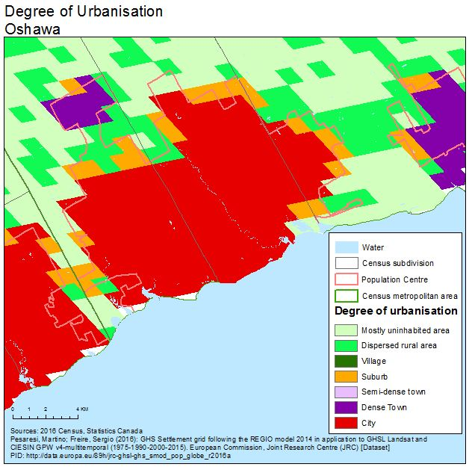
Oshawa

Slide 13
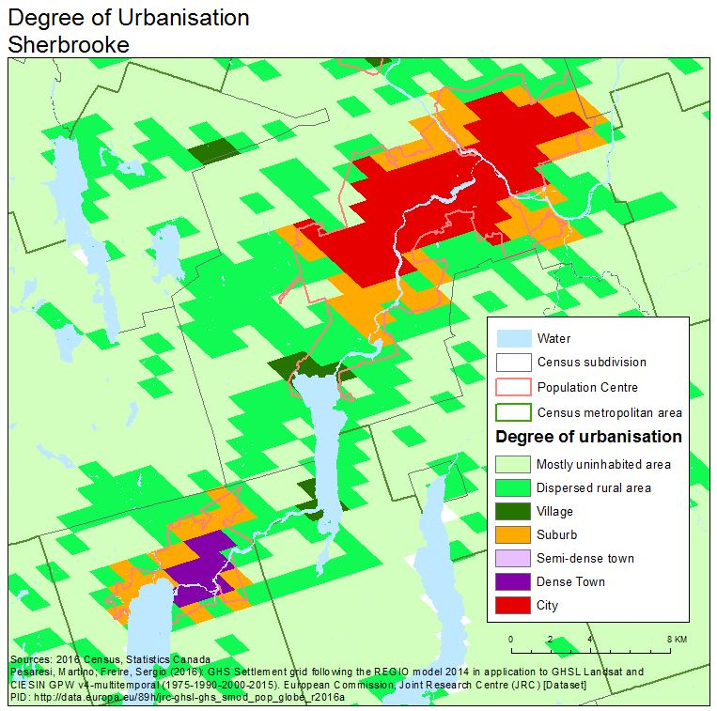
Sherbrooke and Magog

Slide 14
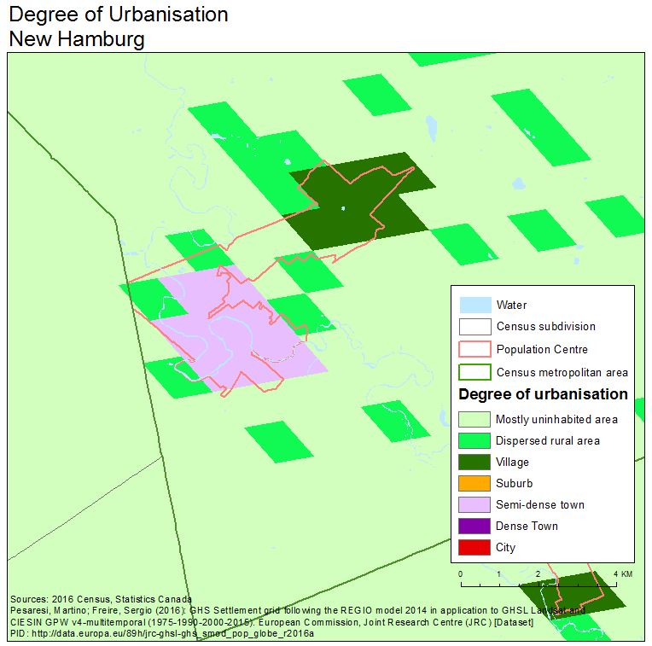
New Hamburg, Ontario

Slide 15
The proposed definition and Statistics Canada’s definition compared: - some tentative conclusions and other considerations.
The existing population centre and the degree of urbanization concepts are similar.
The differences in the delineation methodologies result in different outcomes:
fewer larger population centres are identified as urban centres.
urban centres tend to be smaller than the corresponding population centres that are used as core areas for CMA and CA delineation.
Urban clusters are less consistent with the mid to smaller sized population centres.
The village classification (level 2) is almost evenly distributed between the Statistics Canada rural areas and the existing population centres.
The grid-cell based Rural area (level 1) and the Statistics Canada rural area are consistent.
The level 2 classification may inform the existing Statistics Canada population centre and rural area classification (e.g. suburban, and further classification of rural).
An early assessment would be to view the proposed definition as complimentary to the existing definition: it may help inform us on the existing definition.
Nomenclature and language are important – be mindful of the connotation of certain terms.

Slide 16
Thank you
Peter Murphy
peter.murphy2@canada.ca

Slide 18
The Statistics Canada definition for population centres and rural areas: - delineation rules in more detail.
The current population centre delineation rules ranked in order of priority:
If a dissemination block or group of contiguous dissemination blocks, each having a population density of at least 400 persons per square kilometre for the current census, then the dissemination block or group of contiguous dissemination blocks is delineated as an initial population cluster.
If a dissemination block has a population density of at least 200 persons per kilometre or an employment density of 400 employees per square kilometre and it is adjacent to a initial population cluster, then it is added to that cluster.
In order to be retained as a population centre, the resulting population cluster must have a minimum population of 1,000 and a population density of at least 400 persons per square kilometre.
If the distance between two population centres is less than two kilometres, then the population centres are, in most cases, combined to form a single population centre. Certain restrictions apply when combining population centres located less than two kilometres apart. For example, population centres are only combined provided they do not cross census metropolitan area (CMA) or census agglomeration (CA) boundaries, or if the population centre, which is also a secondary core, is not combined with another core. In some instances, population centres are not combined because the current block structure does not always permit such a merger. For example, if the addition of intermediate blocks would cause the population density of the newly-formed population centre to drop below 400, then the blocks would not be added and the two near adjacent population centres would remain separated.
Dissemination blocks that correspond to airport locations and are less than two kilometres away from the population centre are added to the population centre, provided they do not compromise the population density threshold of 400 persons per square kilometre.
Interior holes are filled and other irregularities to outer boundaries are smoothed.

