Slide 1



In the Name of Allah
Statistical Centre of Iran
Islamic Republic of Iran’s Population and Housing
Census-2016
Management Information System and Other Tools for Management and Monitoring of
Field Enumeration
12-15 March 2019
Ankara

Slide 2
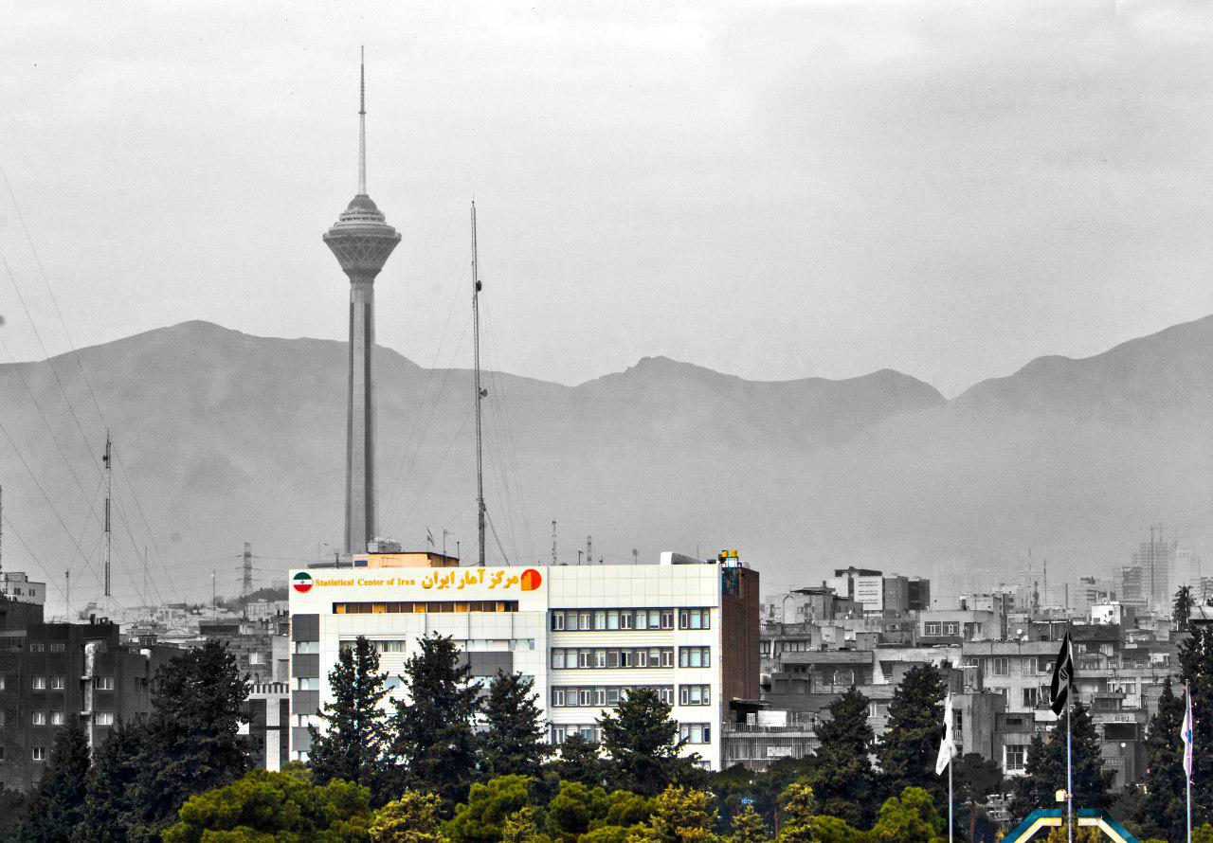


Statistical Centre of Iran
Ali Akbar Mahzoon
Director General, Office of Population and Labour Force Statistics & Census
Vahid Akhoondi
System Analyst & Project Manager

Slide 3

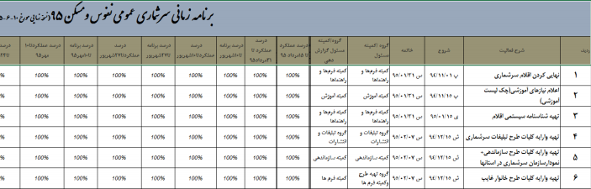
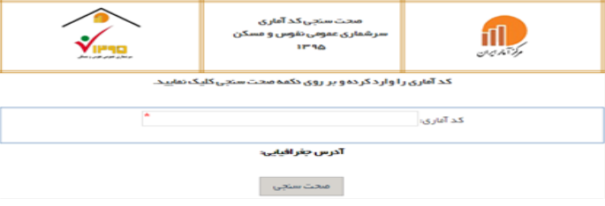
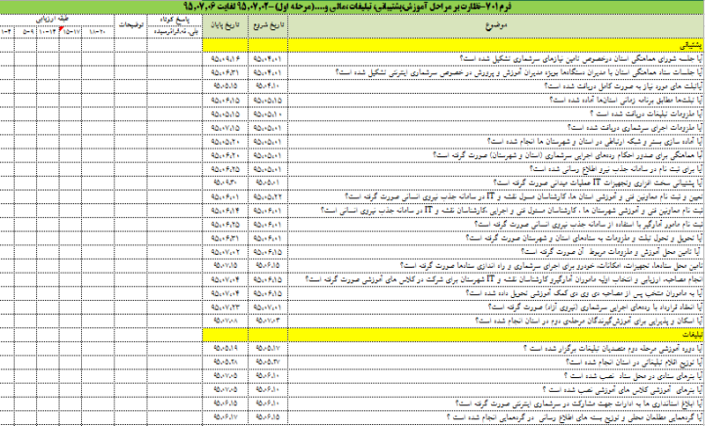
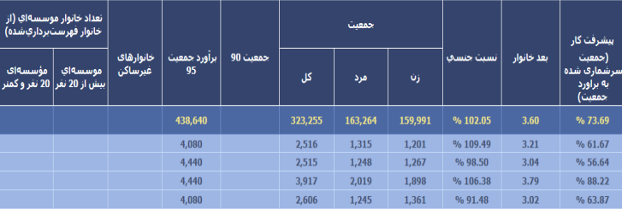
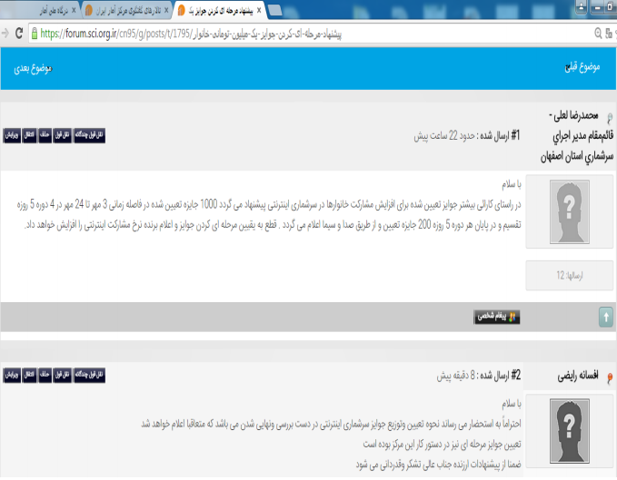
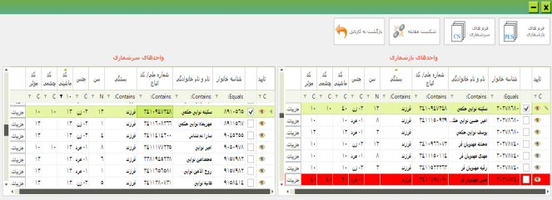
Management Information Systems

Slide 4
Census Scheduling System
Census Scheduling System
Monitor the progress of census activities
A tool for the integration and coordination of census activities

Slide 5
Management and Monitoring
Intra-organization
Extra-organization
Attending field operations and checking the coverage, quality of work of the enumerators
Resolve issues and problems of implementation

Slide 6
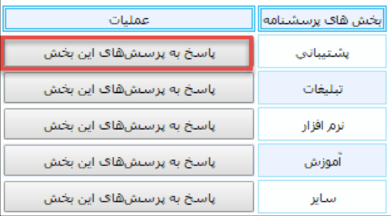
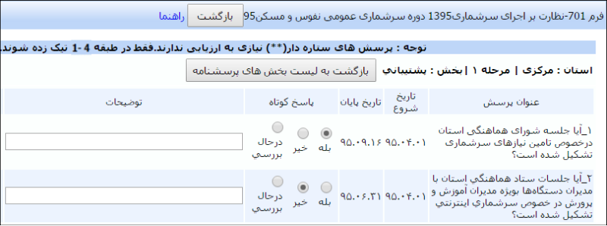
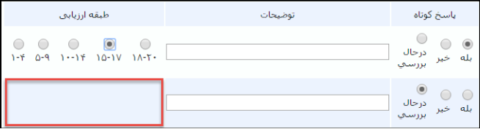
Quality monitoring system
Completing Activities Checklists by Census Supervisors

Slide 7

Census Controlling System
Census Controlling System
Online Monitoring of the smallest area at the administrative levels (block and village)
Online Monitoring of all enumerators
Online Monitoring of progress
Online and on-time precise reporting

Slide 8
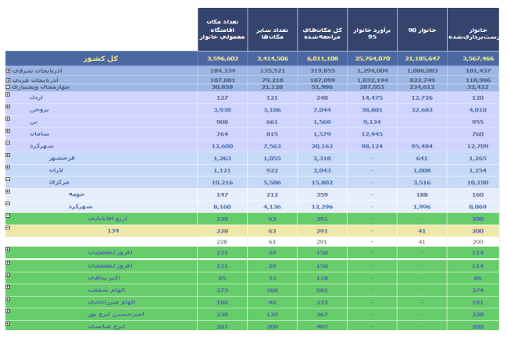

Census Controlling System
Census Controlling
System

Slide 9
Census Controlling System
Census Controlling
System

Slide 10
Census Forum
Census Forum
Information/ Request
Response
Information is transmitted through the executive categories quickly.
Groups and committees have their own space in the forum.

Slide 11
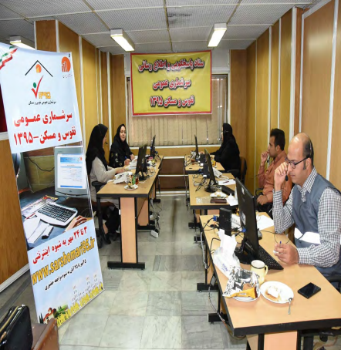
Call center
Call center
Transfer of household questions and problems through the forum to different categories of the census.

Slide 12

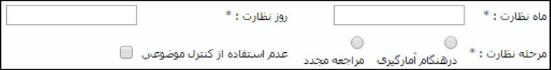
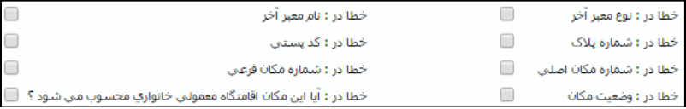
Quality monitoring system
Quality monitoring system for census activities
During the Census, supervisors reported on the quality of the various activities through the system.

Slide 13
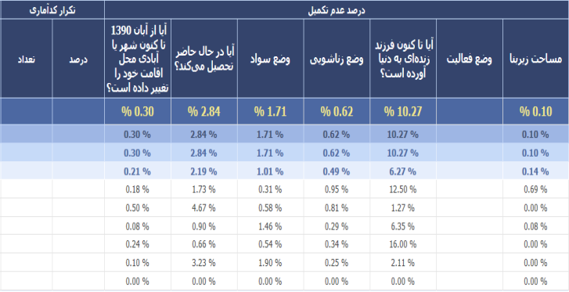
SIJAD Warning reports
SIJAD warning reports to enumerators and supervisors

Slide 14
Verification of the statistical code
Verification of the statistical code
Registering town and village of residence
Controlling the accuracy of data
The minimum number of digits
Coding
Impossibility to produce or guess

Slide 15

SMS Monitoring
SMS Monitoring
Monitor the sending of SMS messages confirming the registration of households.
Troubleshooting Problems
Sending statistical code and thank you SMS to the
mobile number

Slide 16



How to have access to census data
Publications of detailed and general results
SCI’s website address:
www.amar.org.ir
DVD
Primary results: till the end of March, 2017
Detailed results and preparation of publications: September, 2017

Slide 17
Selected Results of the 2016 National Population and Housing Census

Slide 18
Changes trend in population and household
1986-2016
Household size | Household | Sex ratio | Female | Male | Population | Year
3.3 | 24196035 | 103 | 39427828 | 40498442 | 79926270 | 2016
3.5 | 21185647 | 102 | 37244000 | 37905669 | 75149669 | 2011
4 | 17501771 | 104 | 34629420 | 35866362 | 70495782 | 2006
4.8 | 12398235 | 103 | 29540329 | 30515159 | 60055488 | 1996
5.1 | 9673931 | 105 | 24164049 | 25280961 | 49445010 | 1986

Slide 19


Population Age Pyramid 2011-2016
Male
Born in 1980s
Population growth of 0-4 years old

Slide 20
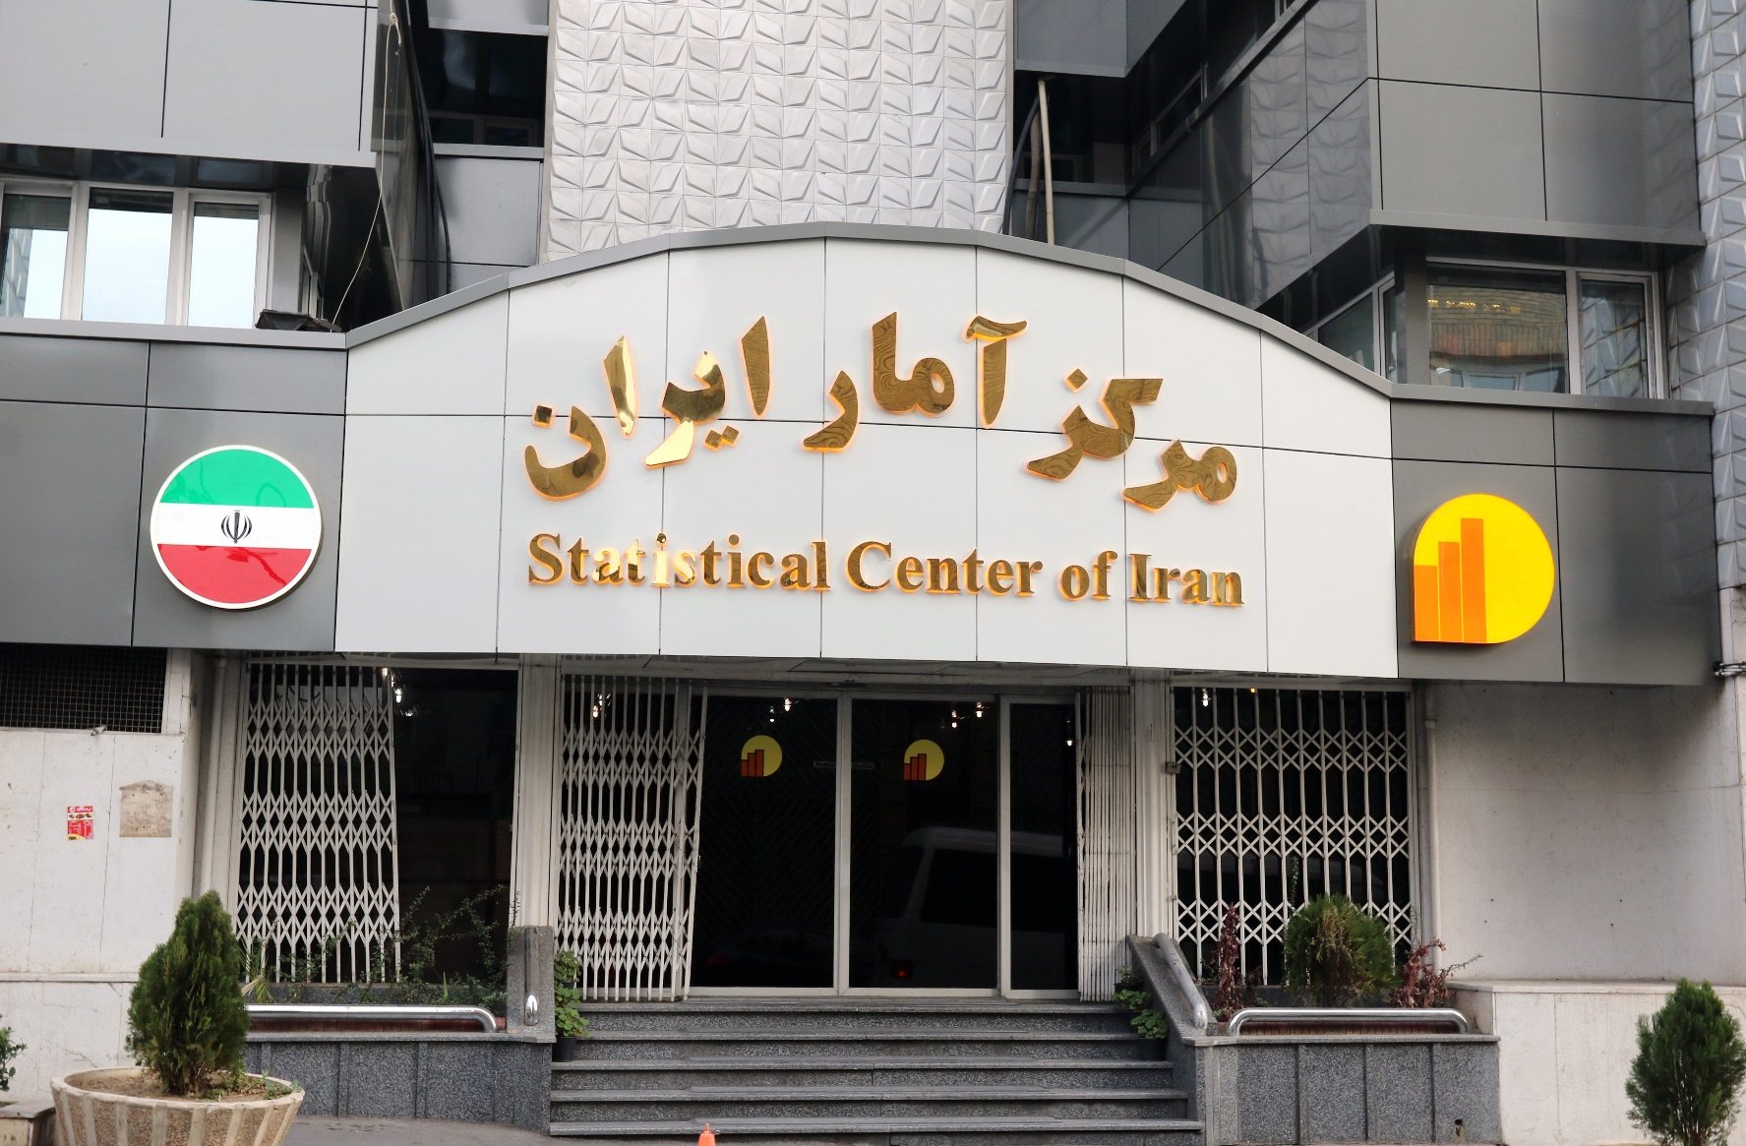
Thank you
www.amar.org.ir

Slide 21
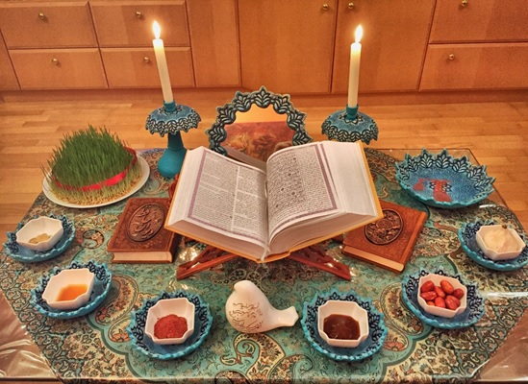

Happy
Nowruz
21th March
The International Day of Nowruz
(first day of Spring)

