Slide 1
In the Name of Allah
Statistical Centre of Iran
Islamic Republic of Iran’s Population and Housing
Census-2016
Data Collection with the Internet
12-15 March 2019
Ankara

Slide 2
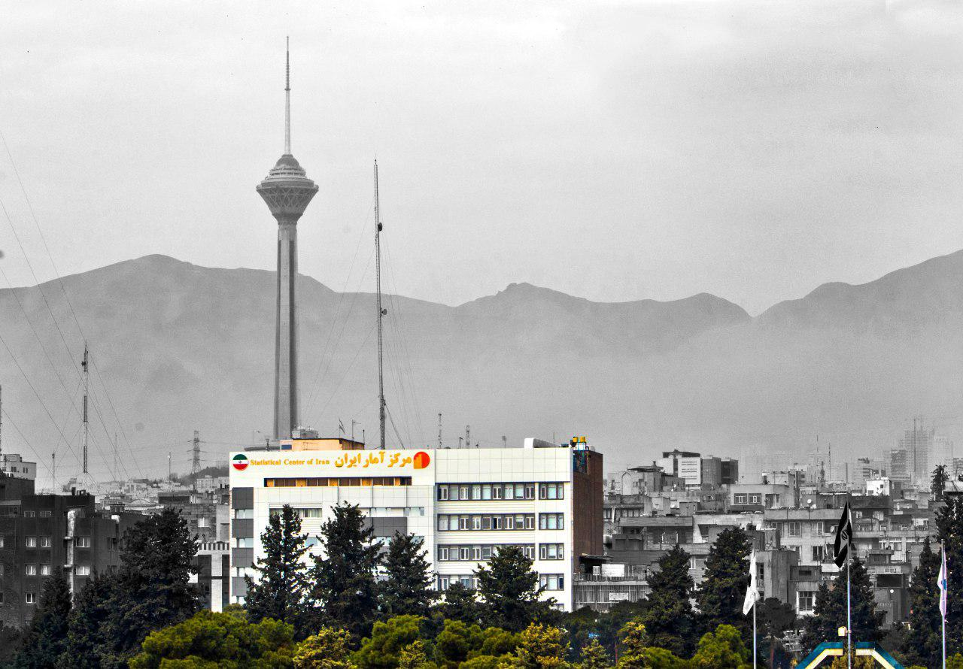
Statistical Centre of Iran
Ali Akbar Mahzoon
Director General, Office of Population and Labour Force Statistics & Census
Vahid Akhoondi
System Analyst & Project Manager

Slide 3
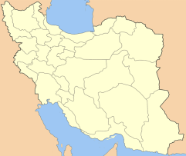
Phases of Census
Visiting the census’ web site and completing questionnaire
Phase 1: Internet Census
Receiving internet code
Taking statistical code
Phase 2:
Face to Face Interview
Visiting all Places by Enumerator
Face to Face interview
Calling to Call Centers
Sticking “Absent
Household Notice
Card”
Visiting the census’ web site
By household
By Enumerator

Slide 4
www.sarshomari95.com
- From 24 September to 21 October for all Households
- From 22 October to 20 November for absent households

Slide 5
Stages of the implementation of the Internet-based Census
Convincing households
to implement census
through internet
www.sarshomari95.com
National code
Security code
√
Access to technical support through a Call Centre
Controlling logical relationships of the questions and warning when necessary
Access to
e-questionnaire
for completing it
√
Sending statistical code and thank you SMS to the
mobile number
SMS
Reception of
statistical code

Slide 6
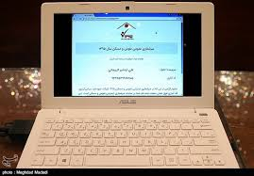
First phase: Internet Census
www.sarshomari95.com

Slide 7
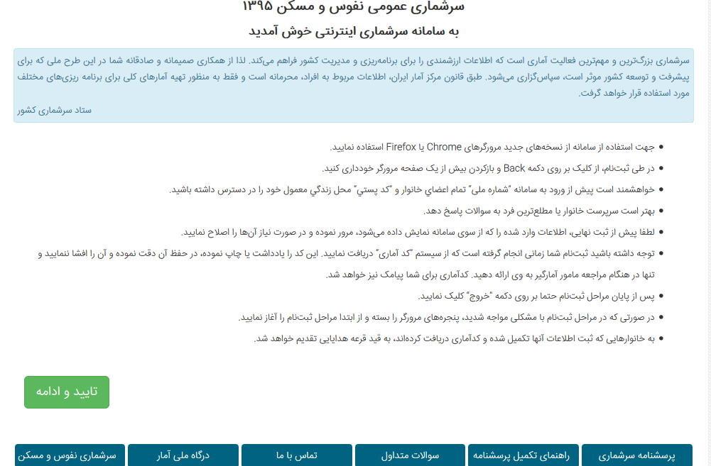
First page of the Internet- based Census Portal
Instructions for filling out e-Questionnaire

Slide 8
Validation of the national code
National code &
Security code
*
شماره ملی سرپرست خانوار
عبارت زیر را بازنویسی نمایید
تایید و ادامه

Slide 9
E-questioners
وضعیت تحصیلی برای افراد 6 ساله و بیشتر
مشخصات عضو خانوار
*
آیا فرد در حال حاضر تحصیل می‌کند
*
نام
*
وضع سواد
*
نام خانوادگی
*
دوره یا مدرک تحصیلی
*
شماره ملی
وضعیت فعالیت برای افراد 10 ساله و بیشتر
*
بستگی با سرپرست خانوار
*
زن/دختر
مرد/پسر
جنس
*
وضع فعالیت
سال تولد
*
وضعیت تاهل برای افراد 10 ساله و بیشتر
*
ماه تولد
*
وضع تاهل
سن
وضعیت فرزند آوری برای زنان 10 ساله و بیشتر (حداقل یک بار ازدواج کرده)
*
وضع حضور در خانوار
*
دین
*
نه
بله
آیا تاکنون فرزند زنده‌ای به دنیا آورده است؟
*
دفترچه بیمه
نوع دفترچه بیمه:
*
تعداد کل فرزندان
*
سایر
کمیته
امداد
تامین
اجتماعی
بیمه سلامت
(خدمات درمانی)
*
تعداد فرزندان در حال حاضر زنده
نه
بله
آیا در 365 روز گذشته فرزند زنده‌ای به دنیا آورده است؟
وضع مهاجرت
*
آیا فرد از آبان ماه 1390 تاکنون شهر یا آبادی محل زندگی خود را تغییر داده است؟
*
نه
بله
*
تعداد کل فرزندان به دنیا آورده در 365 روز گذشته
*
مدت زندگی در همین شهر یا آبادی
*
تعداد فرزندان به دنیا آورده در 365 روز گذشته که در حال حاضر زنده‌اند
*
محل زندگی قبلی
*
استان محل زندگي قبلی
*
شهرستان محل زندگي قبلی
*
شهر محل زندگي قبلی
ثبت اطلاعات
*
کشور محل زندگي قبلی

Slide 10
Statistical (internet) code
Completion of the questionnaire by households through the internet
Receiving Statistical (internet) code
Registering town and village of residence
Controlling the accuracy of data
The minimum number of digits
Coding
Impossibility to produce or guess

Slide 11
Visit peak hour to the census website
Date | hour | Statistical codes Per min.
18 October 2016 | 11.27 | 2114
18 October 2016 | 10.52 | 2128
18 October 2016 | 11.12 | 2129
18 October 2016 | 11.52 | 2136
36 households per Second
Average Registration Time: 17 Minutes

Slide 12
Visit Time to the Website
Time intervals | % of household’s visits
6 to 12 | 28
12 to 18 | 34
18 to 24 | 35
24 to 6 | 3

Slide 13
Used devices

Slide 14
Used browsers

Slide 15
Challenges of Internet based census Portal
The First Experience in the Country and various risks of the Project (Risk management)
Variety of the Targeted Users (Capacity)
Sharp Reduction of Users motivations in Case of facing difficulty in using the Portal (Usability)

Slide 16
Outdoor promotion ( designing and publishing Banners, Placards, wall poster, leaflets, use of Census vest and Bag by enumerator, use of official paper on which census logo was printed )

Slide 17
“Census Assistant” Card for primary school student

Slide 18
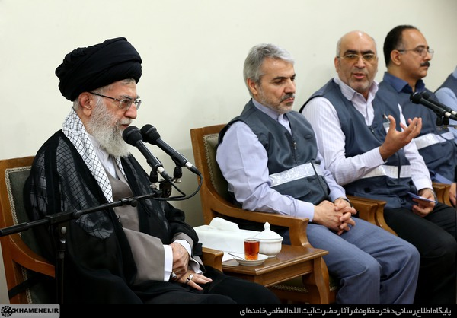
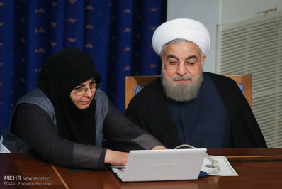
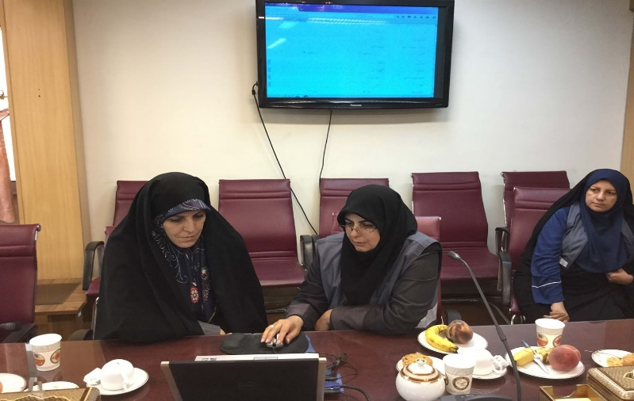
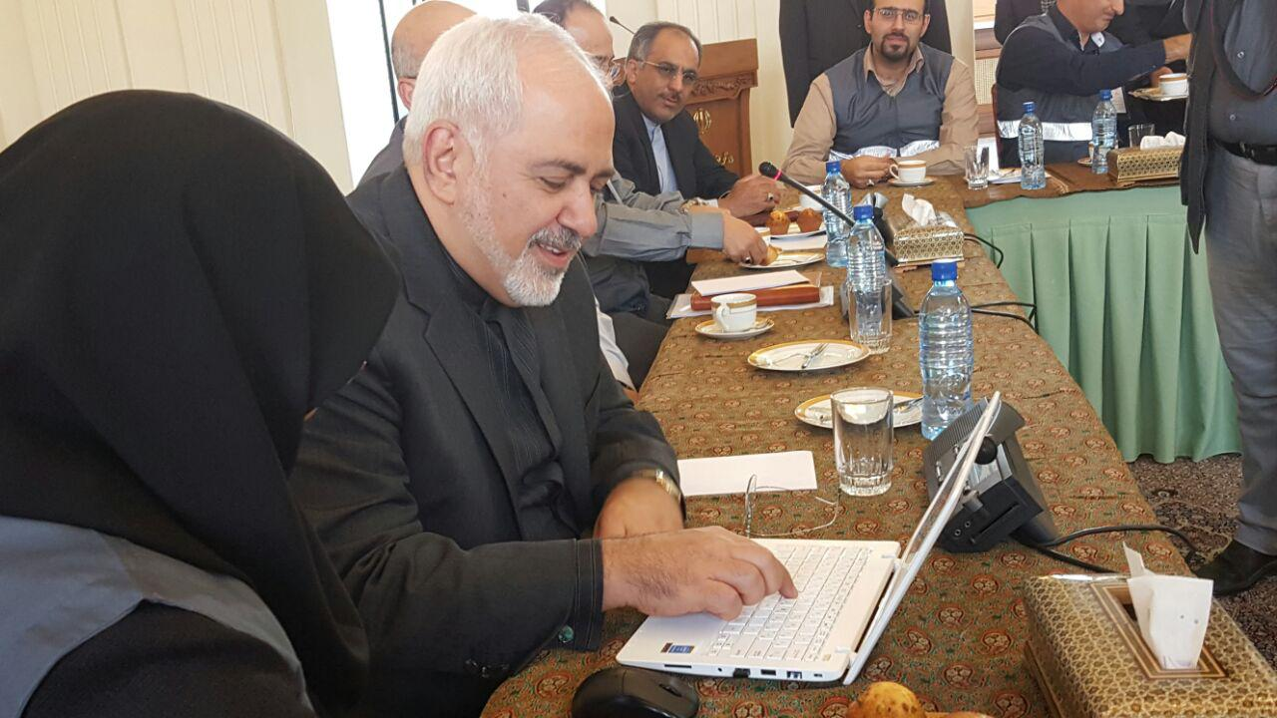
Meeting of Census Officials with Supreme leader and President and Cabinet

Slide 19
Participation Rate on Internet Census
I.R. Iran: 48.4%
Target: 35%

Slide 20
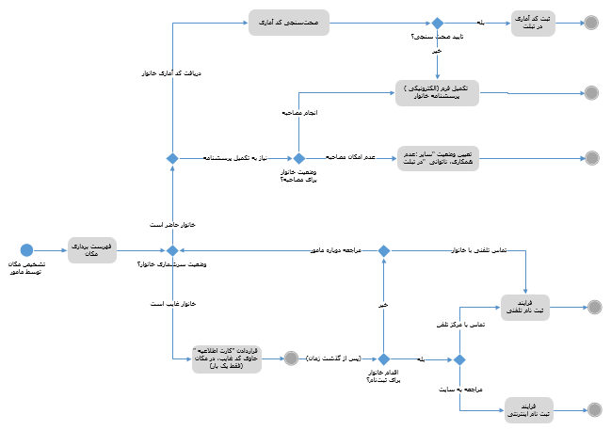
Challenges of Internet based census Portal
Simultaneous provision of 5 Internet Services as well as Telephone-assisted Registration Service (Processes Architecture)
Registration of absent households by internet or phone
In case of missing statistical code, it can be delivered again in determined time
When necessary, the questionnaire can be edited in determined deadline
Connection of absent and internet codes

Slide 21
Challenges of Internet based census Portal
Simultaneous provision of 5 Internet Services as well as Telephone-assisted Registration Service (Processes Architecture)
Volunteer Household
Registration
11,148,762 household
Absent Household
Registration
208,782 household
Correct the Information
116,511 households
Recovering the statistical code
147,258 households
Connection of absent and internet codes
152,417 households

Slide 22
Challenges of Internet based census Portal
Resources and requirements of Telephone-based system
سامانه سرشماري تلفنی
Username & Password
*
نام کاربری
*
رمز عبور
عبارت زیر را بازنویسی نمایید
640 users
ورود به سامانه

Slide 23
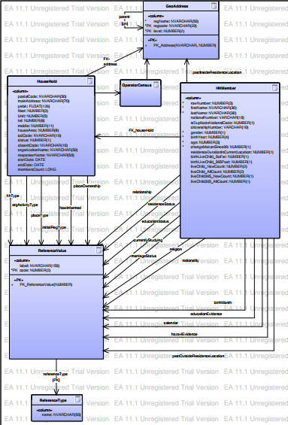
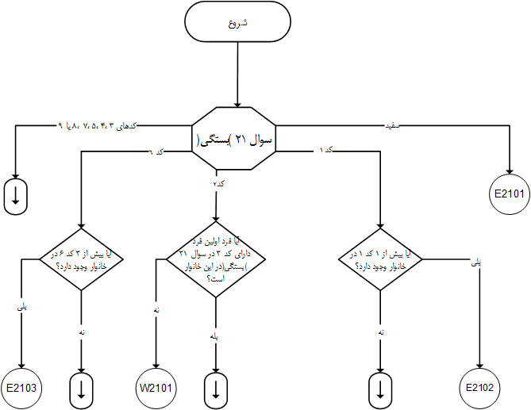
Challenges of Internet based census Portal
Obtaining Data for more than 50 Census Items from one-person household (Database Architecture)
Checking more than 220 Rules and formatting in the Portal (Performance)

Slide 24
Challenges of Internet based census Portal
Security
Base on ISMS (Information Security Management System)
Availability
Integrity
Reliability

Slide 25
Challenges of Internet based census Portal
Hardware infrastructure
Infrastructure Architecture
Servers
Network and Bandwidth
Backup
Monitoring
…

Slide 26
Challenges of Internet based census Portal
Synchronization
Internet
census
Database
Face to Face census
Database
Synchronization

Slide 27
Challenges of Internet based census Portal
Design and Implement Test Scenarios and Monitoring
Functionality
Stress
Security
Resource usage
…

Slide 28
With respect to the accessibility to the existing administrative data in the country and upgrading of statistical system, implementation of register-based census will be the main goal for the next census. To achieve this goal, the following prerequisites are : 1-improving population information bank , 2- Completing and updating address file 3- Linking national code to place code.
Next census

Slide 30
Thank you
www.amar.org.ir

