Slide 1
UGANDA BUREAU OF STATISTICS
Use of electronic data collection technologies: main drivers and decision-making process and
Use of handheld electronic devices for census data collection
Prepared by:
Uganda Bureau of Statistics
SESRIC, Turkey, March 2019
Uganda Bureau of Statistics ¤ Plot 9 Colville Street, Kampala Uganda ¤ Website: www.ubos.org
Tel: +256(0)- 414-706000 ¤ E-mail: ubos@ubos.org
1
Notes:
1

Slide 2
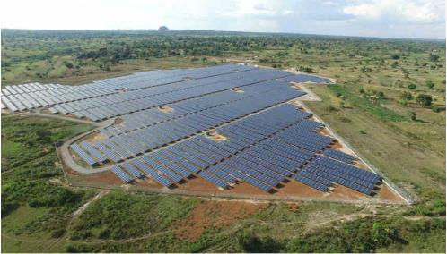
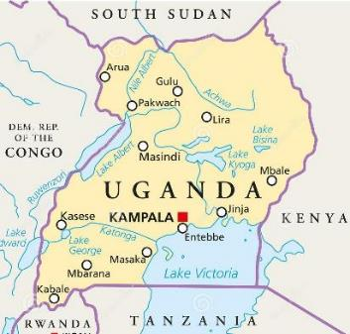
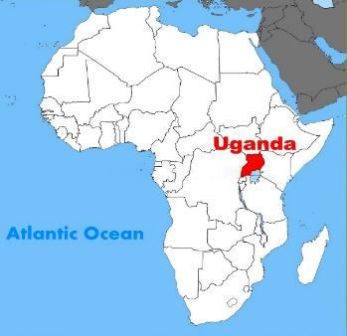
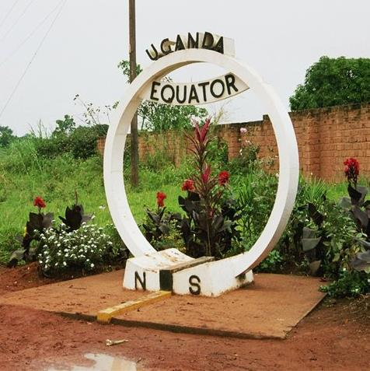
Uganda…
Official Name:
Republic of Uganda
Official Language:
English
Total Area:
241,550 km²
Population:
Census 2014: 34.6M
2018 Projection: 39M
Population density:
173 /km²

Slide 3
Background
Uganda has implemented 10 Population and Housing Censuses to date;
No use of hand held devices has been carried out in NPHC;
However tablets are being used in the large scale surveys

Slide 4
2014 NPHC
The 2014 NPHC was a defacto census
The 2014 NPHC employed OCR/ICR technologies in scanning questionnaires
The first results of the NPHC 2014 were released after 1.5 years

Slide 5
Surveys Using Hand Held Devices
Uganda National Household Survey 2016/17
Increased sample from 7500 HHds (2012/13) to 17,800 (2016/17) with minimal increase in budget ( received a donation of Tablets).
Uganda Demographic and Heath Survey 2016
sample size of 19,600 households;
National Labour force surveys
Varies in sample size
Planned Updating of master list of Education Institutions

Slide 6
Hand held devices in the 2024 NPHC
CAPI will be used in 2024 NPHC data collection, the debate is to what extent
Hybrid of CAPI and PAPI or only CAPI
The decision to use CAPI based on the earlier censuses and the CAPI surveys
Heavy integration of Geo-Spatial technologies

Slide 7
Why use of Hand held devices
Elimination PAPI and associated delays in the release of results;
Use of hand held devices enables real-time data storage using mobile equipment.
Storage and transport costs are minimized
CAPI has features which capture other data eg GPS co-ordinates, pictures, etc

Slide 8
Why use of Hand held devices
Efficiency in handling of enumeration exercise
Immediate error correction while still in household (skips and error messages)
Faster backup and transfer of data;
Improved quality control

Slide 9
Challenges of CAPI
Occasional loss of the Tablets.
Internet coverage in some areas is low or non- existent;
Need for replacement in case of the devices crash.
Power disruptions especially in rural areas
Extended period of Training of field staff since field staff are trained both on the Paper and CAPI
The need to have competent staff in each EA
Attitude change

Slide 10
Some considerations in planning
Sufficient Training for staff involved.
Efficiency of the system in data transfer and backups;
Pretest the system to ensure it is stable.
Security of the data
Automated saving

Slide 11
Conclusion
Use of hand held devices has several advantages over the PAPI;
Early planning is vital;
Capacity building of staff in the use of CAPI is one of the necessities for success;
Field supervision and follow up;

Slide 12
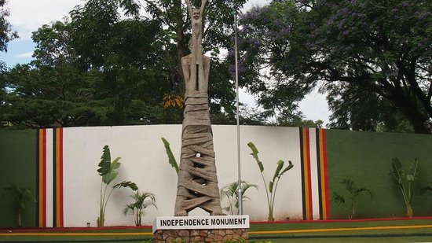
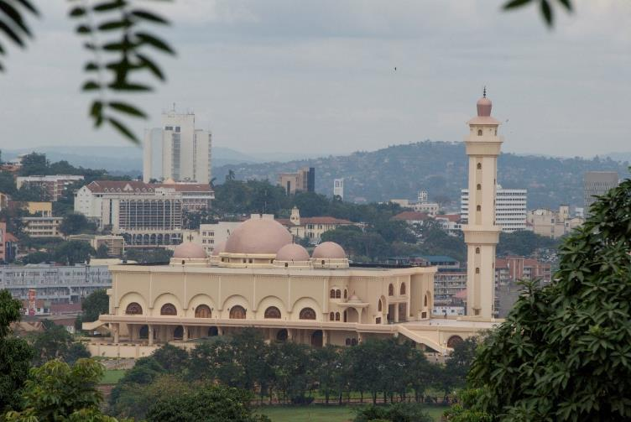

Slide 13
THANK YOU
Uganda Bureau of Statistics
Statistics House
9, Colville Street
Kampala
Tel: +256 414 706000
www.ubos.org

