Slide 1
In the Name of Allah
Statistical Centre of Iran
Islamic Republic of Iran’s Population and Housing
Census-2016
Use of Handheld Electronic Devices for Census Data Collection
12-15 March 2019
Ankara

Slide 2
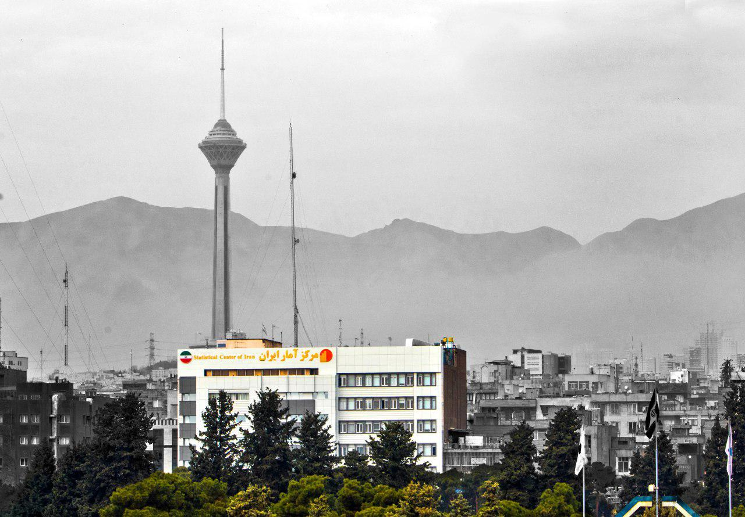
Statistical Centre of Iran
Ali Akbar Mahzoon
Director General, Office of Population and Labour Force Statistics & Census
Vahid Akhoondi
System Analyst & Project Manager

Slide 3
Quick facts about I.R.Iran, 2016 Census
Mean Size of Household 3.3
Percentage of Urban Population
%74
Literacy Rate
Male
% 91
Female
% 84.2
1.65 million
sq. km
Annual Growth Rate 1.24 %
Female 39427828
Population 79926270
Male 40498442

Slide 4
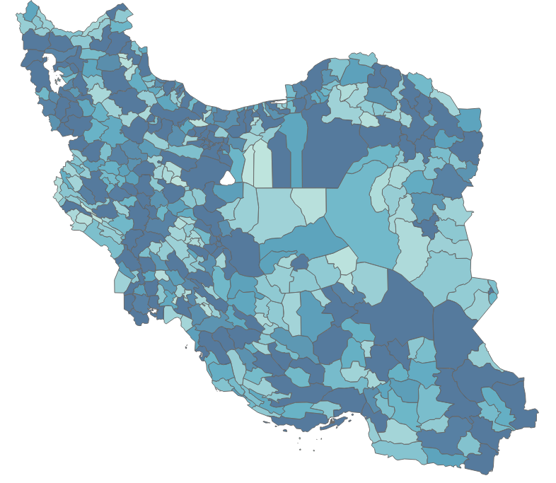
Iran Population Distribution 2016 Census

Slide 5
SCI Experiences on Using Electronic Devices in Statistical Surveys
Year | Survey | Electronic Device
2010 Since 2011 | Survey of Consumption Goods and Services Price of Urban/Rural Households | PDA (Personal Digital Assistant) Tablet
Since 2013 | Labour Force Survey (LFS) | Tablet
Since 2013 | Construction Materials Price Survey | Tablet
2014 | National Census of Agriculture | Tablet
2016 | Population and Housing Census | Tablet

Slide 6
History of the National Population and Housing Census in Iran
According to the Law, the Statistical Centre of Iran was bound to carry out the
national population and housing census once each decade. So far, six censuses
have been implemented in a 10- year interval, during the years 1956, 1966,1976, 1986, 1996 and 2006.
With respect to the changes occurred in age structure and increasing youth
population in the country; in 2007, Council of Ministers approved the census
to be implemented in a five- year interval in the next stage, accordingly, the
seventh and eighth Iranian national census of population and housing were
implemented in 2011 and 2016.

Slide 7
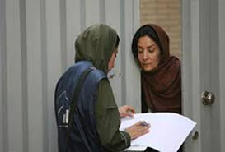
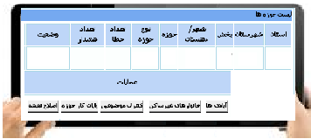
Questionnaire completion and data processing in the censuses
Data Processing | Method | Year
- | - | 1867*
- |  | 1941**
 |  | 1956
 |  | 1966
 |  | 1976
 |  | 1986
 |  | 1996
 |  | 2006
 |  | 2011
 |  | 2016
OMR
OCR
ICR
* Coverage of Census was only consist Tehran (Capital)
**It was incomplete because of the World War II .

Slide 8
CONDITIONS AND CHALLENGES FOR THE IMPLEMENTATION OF the 2016 POPULATION AND HOUSING CENSUS
Social conditions
Tendency for keeping individual privacy
Lack of collaboration in data provision
Increase in the number of absent households
Financial conditions
-Increase in the census costs due to population growth
Statistical conditions
Successful experience of using tablets in surveys and agriculture census
Possibility of using administrative data in censuses with regard to using electronic registration of data in recent years
Increase in the literacy level of the population and penetration rate of the Internet accelerated the Internet method.

Slide 9
I.R. Iran Population and Housing Census-2016
Designing
Pilot
Training
Organization
Implementation
ICT & Process
Dissemination

Slide 10
Organizational Structure of Population and Housing 2016 Census
The National Census Headquarter
Coordination and Integration Council
Secretariat of Headquarters
Security Committee
Plan Preparation Group
ICT Group
Organization and Logistical Group
Publicity and Dissemination Group
Supervision Group
Forms and Handbook Committee
System Designing Committee
Credits committee
Publicity Committee
E Supervision over implementation Committee
Training Committee
Extraction Committee
Logistics and supply committee
Post-enumeration committee
Editing and Imputation Committee
Information dissemination committee
Tabulation and Publication Preparation Committee
Technical support Committee
Organization Committee
Statistical Maps and Address File Committee
Database and Registers data Committee

Slide 11
Phases of Census
Phase 1: Internet Census
24 September to 21 October
Phase 2: Face to Face Interview
22 October to 20 November
Visiting the census’ web site and completing questionnaire
Visiting all Places by Enumerators
Taking statistical code form the visited household provided by the Internet
Receiving internet code
Face to Face interview
Sticking “Absent Household Notice Card”
or
or
By household:
Visiting the census’ web site and completing questionnaire
Calling to Call Centers
or
By Enumerator:

Slide 12
Developing 32 Software for the Census. for example:
internet and phone census
Face to Face interview with Tablet
Map Module
Supervising the filed operation
Post-enumeration
Workforce Recruitment Portal and CRM (Customer Relationship Management)
Virtual training
Editing and imputation
Monitoring the Census infrastructures

Slide 13
Training
Statistical Centre of Iran
324 persons
1st phase TOT
3500 persons
2nd phase
TOT
22000 persons
3rd phase
training of enumerators
In person training: Centralized and Decentralized Distance
Distance training: In addition to in person training, distance
training was also used during 2nd and 3rd phase of training.

Slide 14
Census Data Collection
by Using Tablet
SIJAD
From 22 October to 30 November 2016

Slide 15
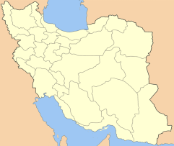
Collecting data by enumerator
Visiting the census’ web site and completing questionnaire
Phase 1: Internet Census
Receiving internet code
Taking statistical code
Phase 2:
Face to Face Interview
Visiting all Places by Enumerator
Face to Face interview
Calling the Census Call Center
Leaving “Absent
Household Notice
Card”
Visiting the census web site
By household
By Enumerator

Slide 16
General Processes of E-Census by use of Tablet
Preparing
tablets
Formation of administrative organization
Taking the working unit
Allocation of working unit

Slide 17
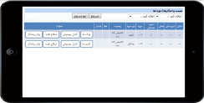
General Processes of E-Census by use of Tablet
Installation of data collection software on tablet devices
Transferring working unit to the tablet
Supplementary and control data base
Collecting data by enumerator
Uploading working unit to the tablet

Slide 18
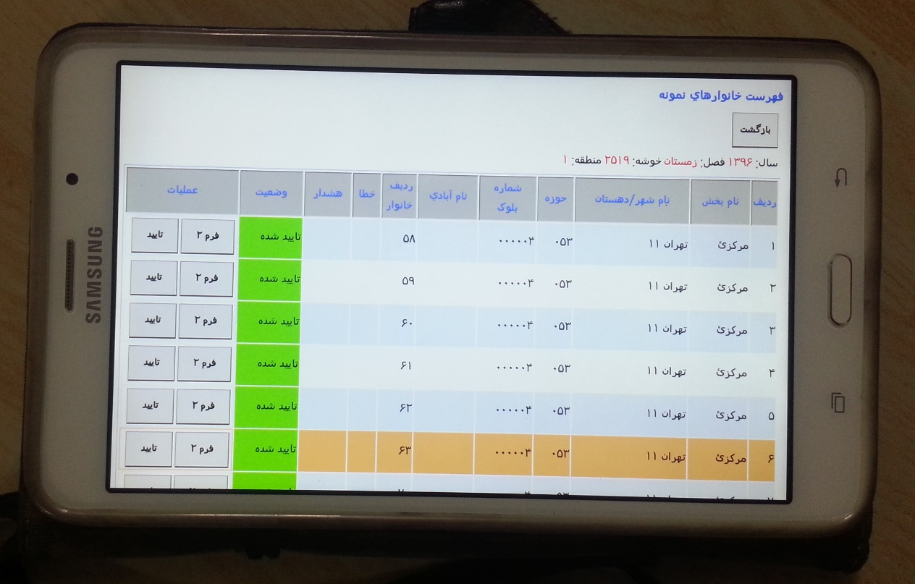
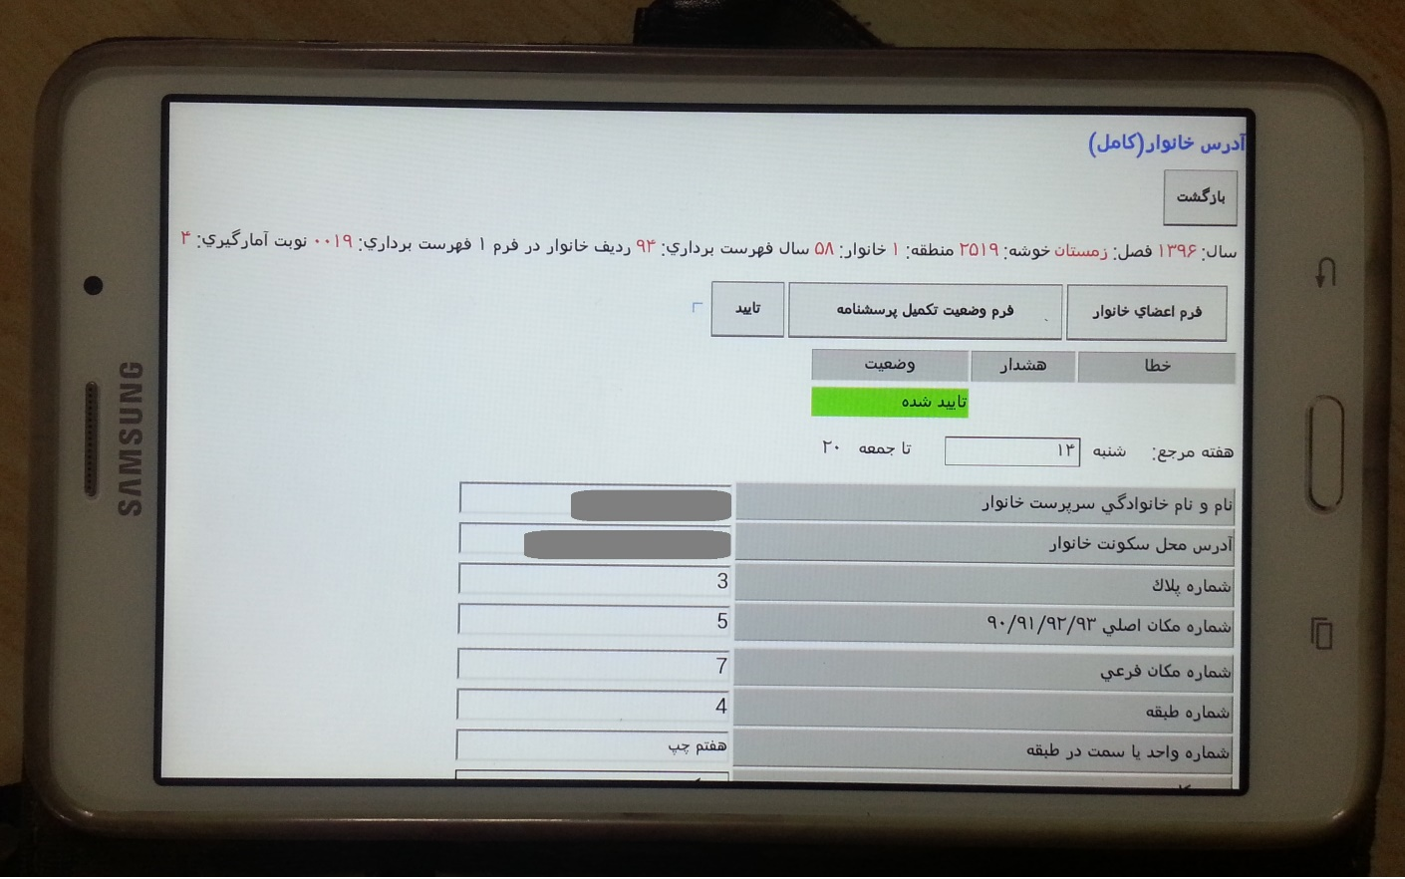
Tablet-questionnaire

Slide 19
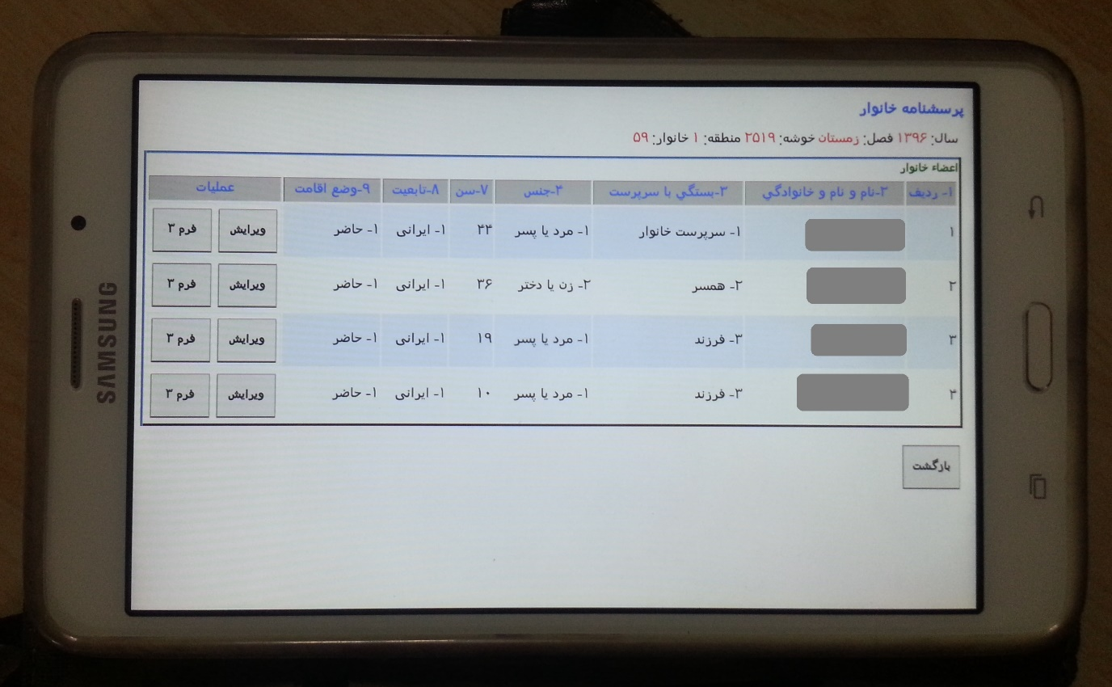
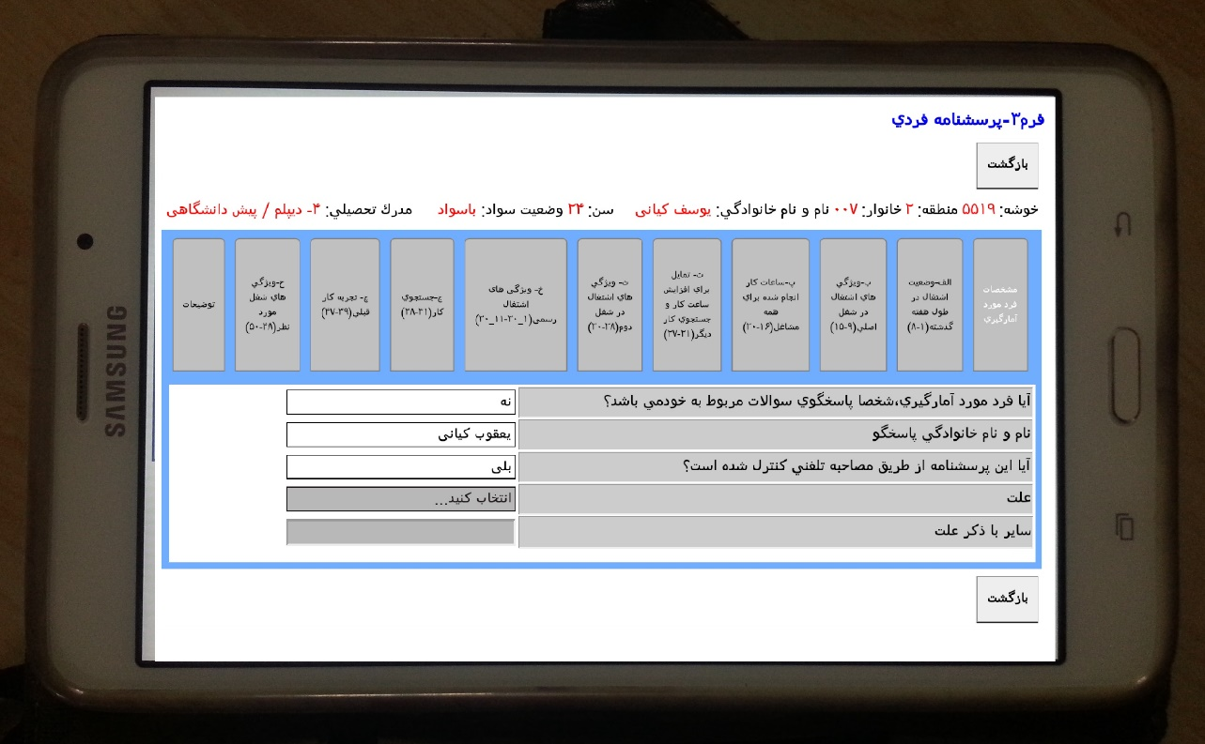
Tablet-questionnaire

Slide 20
Collecting data by enumerator
Visiting the census’ web site and completing questionnaire
Phase 1: Internet Census
Receiving internet code
Taking statistical code
Phase 2:
Face to Face Interview
Visiting all Places by Enumerator
Face to Face interview
Calling the Census Call Center
Leaving “Absent
Household Notice
Card”
Visiting the census web site
By household
By Enumerator

Slide 21
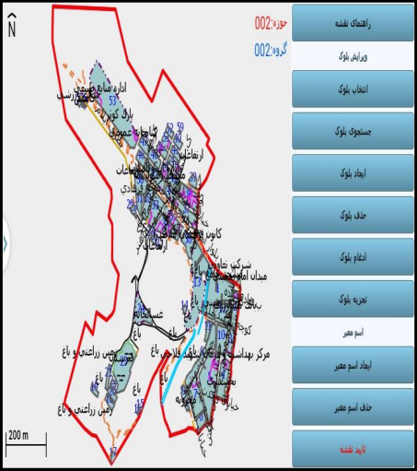
General Processes of E-Census by use of Tablet
Sending
Collected data
Upload working unit to the server
✓ Creating blocks
✓Deleting blocks
✓Integrating blocks
✓Disintegrating blocks
✓Searching the blocks
✓Selecting the blocks
✓Map legend & guide
Map display and correction tools in SIJAD map module
Reviewing map change by map expert
Reviewing work unit information by technical and executive senior expert

Slide 22
General Processes of E-Census by use of Tablet
Correcting work unit based on the feedbacks received
Re-taking work unit with returned questionnaire

Slide 23
Synchronization
Internet
census
Database
Face to Face census
Database
Synchronization

Slide 24
Data collection software (SIJAD)
Data collection software (SIJAD)
Create a questionnaire module
Formation of administrative organization module
Map module
Implement Rules module
Implement Work flow module
Creating Work units module (for enumerators)

Slide 25
Data collection software (SIJAD)
Data collection software (SIJAD)
Download and Upload Working units module (Data transfer)
Create Apk for Install on tablets
Encryption of data
Work progress reports module (Monitoring)
Web module
Supervisor module

Slide 26
Tablets
Notes on the tablet
Features such as Screen, Processor performance, Storage capacity, Operating system, Ruggedness, Portability, Connectivity options, Battery, GPS …
Peripherals such as Power bank, …
Acquiring the device
Reusing

Slide 27
Hardware infrastructure
Hardware infrastructure
Infrastructure Architecture
Servers
Network and Bandwidth
Backup
Monitoring
Local Hardwares
…

Slide 28
Test and Monitor
Design and Implement Test Scenarios and Monitoring
Functionality
Map
Stress
Security
Resource usage
…

Slide 29
Manpower Saving - Environment Saving
Number of Executive Categories in the 2016 Census was 40300 people.
We would need more than 65000 people for carrying out the National Population and Housing Census if we applied the methods used for the 2011 population census
The Firs “No Paper” Census in Iran
Green Census !

Slide 30
Per capita cost of the Censuses in 2010 round
Per capita cost (US$) | Region
2.0 | Africa
33.1 | North America
2.7 | South America
1 | Asia
7.8 | Europe
15.9 | Oceania
Less than 0.5 | I.R. Iran - 2016

Slide 31
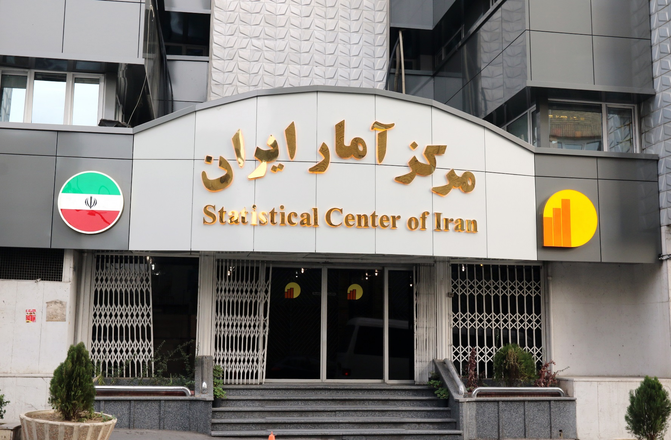
Thank you
www.amar.org.ir

