Slide 1
Use of electronic data collection technologies: main drivers and decision-making process
UGANDA BUREAU OF STATISTICS
By:
Uganda Bureau of Statistics
SESRIC, Turkey, March 2019

Slide 2
Outline
UBOS and its Mandate
UBOS Journey
Key Drivers
Challenges
Looking ahead

Slide 3
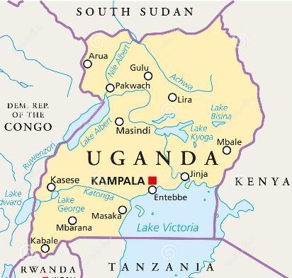
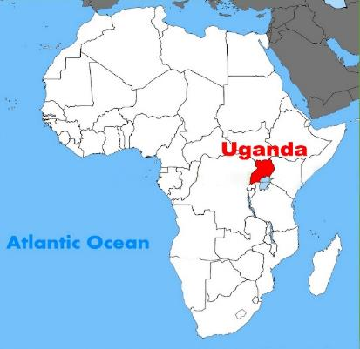
Uganda…
Official Name:
Republic of Uganda
Official Language:
English
Total Area:
241,550 km²
Population:
Census 2014: 34.6M
2018 Projection: 39M
Population density:
173 /km²

Slide 4
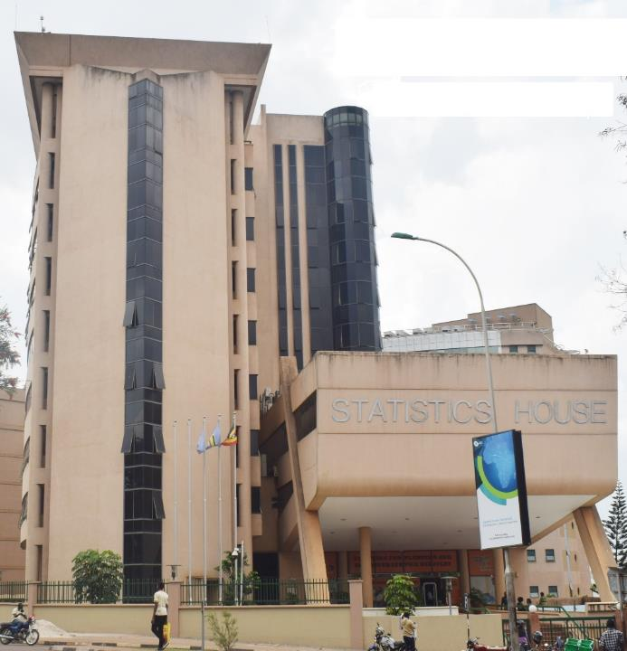
UBOS and its Mandate
Semi-autonomous body formed by the Uganda Bureau of Statistics Act, 1998
The Principal data collecting and disseminating agency responsible for coordinating, monitoring and supervising the National Statistical System.
Source of official statistical information.
Conduct censuses and surveys, and collect routine administrative statistics
Organise and maintain a central depository of Statistical reports, publications, documents and data

Slide 5
UBOS Journey -
Pre and in 1990’s
All Census and Surveys using PAPI, with manual data entry
2012/14
Census and Surveys were PAPI,
2016
Transition from PAPI to CAPI for most surveys using Handheld mobile devices
2018
Piloting citizen self-interview on selected surveys
2020 Round of Census
Planning to use mainly CAPI
Scanning technology used for data capture for Census and UNHS
Piloted BYOD for data collectors
PAPI with scanning for a few selected areas
Increased integration of GIS / Geo-Spatial technologies

Slide 6
Key drivers
Process Turn around time
Data Management
Data quality
Various data types (Form + GPS + pictures + videos + string + numeric + audio + barcodes)
Error reduction, integrated quality checks
Data security
Deployment flexibility
Update to data capture tool can be real time (or close to real time)
Improved field operations
Real time monitoring, reduced complexity of management questionnaires, control forms, transportation to districts and to Lower local Governments
Para-data
Staff management and welfare
workforce for data capture and processing, reduced carrying load for staff.

Slide 7
Challenges
Cost of equipment
Skill set
Technical staff
Field staff – data collectors
Project management
Expectations
Roles (Subject matter Vs ICT)
Risk response strategies (delayed procurement, delayed procurement, data entry plans for paper, system failure)
Change Management
Power and Connectivity
Device Management and handling
Device standardisation vs Data quality (eg. GPS, batteries, processor, storage)

Slide 8
Looking Ahead
Hybrid – PAPI and CAPI
Decision on CAPI solutions/platform to use
Project Management
Field Operations
Power and Connectivity
IT Security
ICT Infrastructure
Back office data center, Connectivity, mobile devices, etc
Staff skills Development
Funding

Slide 9
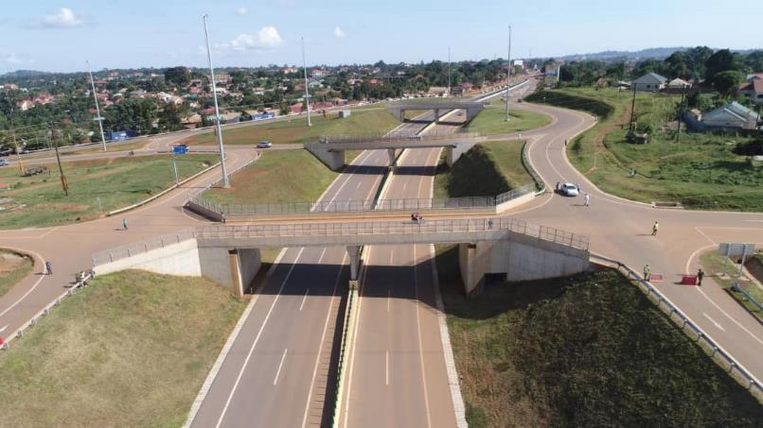

Slide 10
Thank you! Uganda Bureau of Statistics “Enhancing Data Quality and Use”
Uganda Bureau of Statistics
Statistics House
9, Colville Street
Kampala
Tel: +256 414 706000
www.ubos.org

