Slide 1
REGIONAL WORKSHOP ON THE 2020 WORLD PROGRAMME ON POPULATION AND HOUSING CENSUSES: INTERNATIONAL STANDARDS AND CONTEMPORARY TECHNOLOGIES
the NATIONAL STATISTICAL COMMITTEE of the KYRGYZ REPUBLIC
Session 7: Planning and Implementing a Census Geospatial Programme
Experience of the Kyrgyz Republic
Ankara, Turkey 12-15 March, 2019

Slide 2
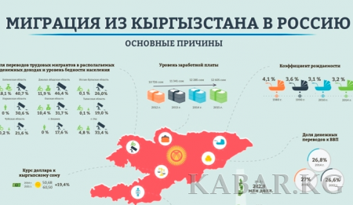
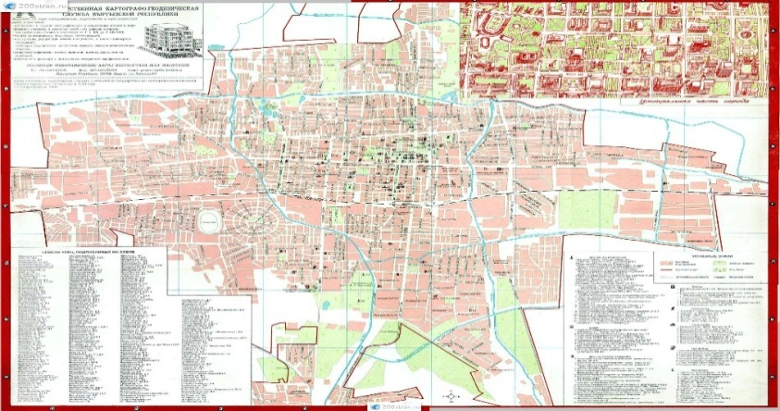
Features of the population and housing census of
the Kyrgyz Republic in 2020
Model block of questions on labor migration of the member states of the EAEU and the CIS
Sustainable Development Goals Indicators (SDGs) – integration of disability questions
Utilization of administrative data of the SRA within the preparatory period (databases: address register, real estate register and GIS)
National Statistical Committee of the Kyrgyz Republic
2
Notes:
As you remember yesterday I talked about new features of the forthcoming census in Kyrgyzstan as migration and sdg, so today I would like to provide information about XXX
In this regards next slide

Slide 3
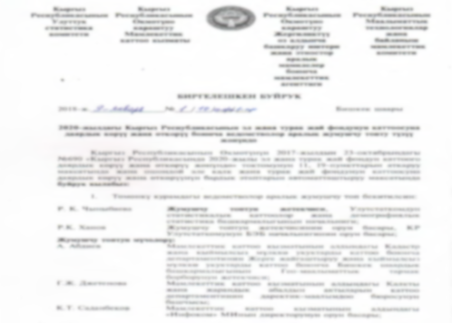
Inter-agency collaboration
The inter-agency order
The inter-agency working group has been established to prepare and conduct the census:
National Statistical Committee
State Registration Service
State Agency of Local Government and Inter-Ethnic Relations
State Committee of Information Technologies and Communications
National Statistical Committee of the Kyrgyz Republic
3
Notes:
NSC initiated
Order includes all representatives of these agencies as well as duties related to particular agencies

Slide 4
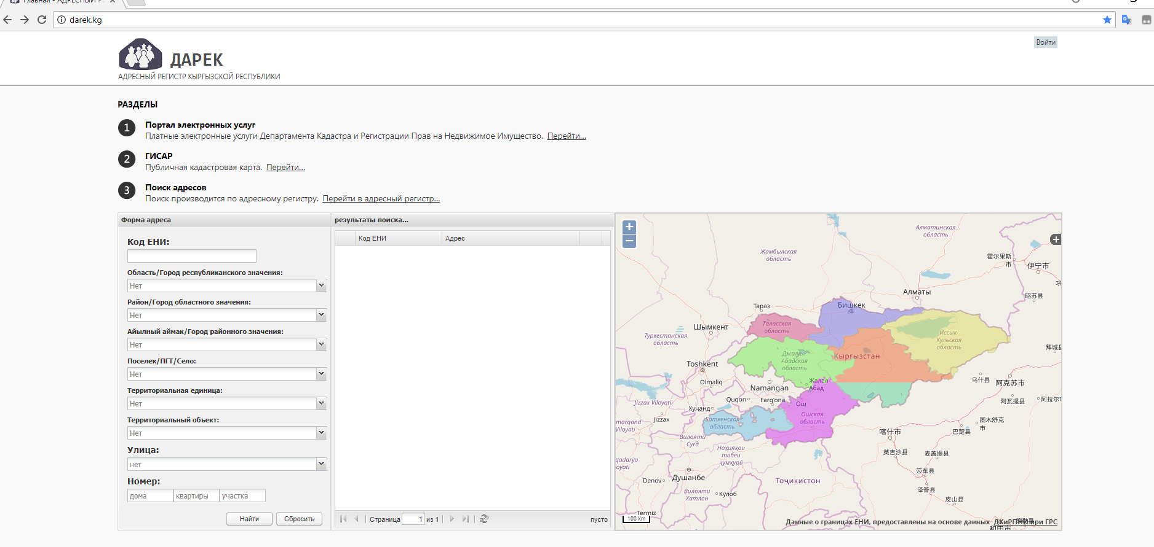
Portal www.darek.kg
Portal www.darek.kg - a single source of addressing information for all state bodies, as well as legal entities and individuals of the Kyrgyz Republic
The portal specifies the names of the streets, which will determine and clarify the addresses.
National Statistical Committee of the Kyrgyz Republic
4
Notes:
Darek means an address from Kyrgyz Language
Every building has unique code which very necessary for census>>>

Slide 5
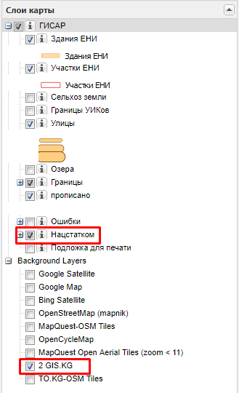
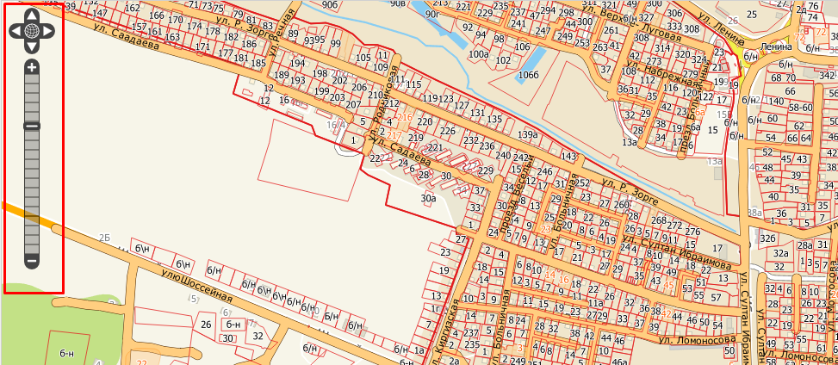
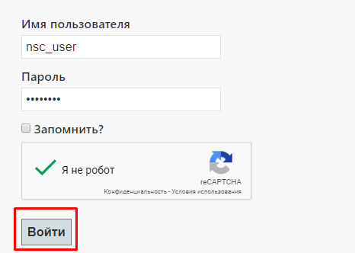
New layer “Нацстатком” of the portal www.darek.kg
8
National Statistical Committee of the Kyrgyz Republic
5
Notes:
What we did within this collaboration , we have created and added a new layer Naztstatcom (a short name of our organization) into this portal
2 GIS ?

Slide 6
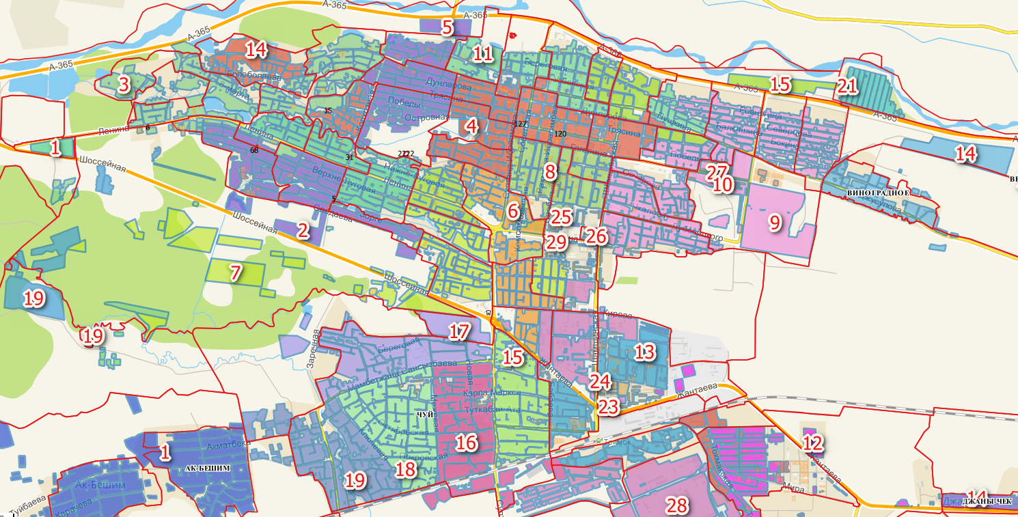
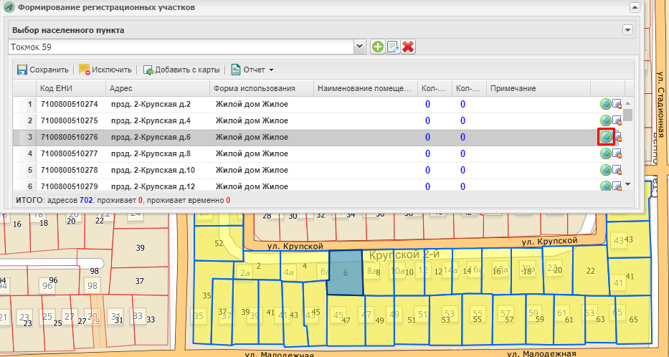
Formation of registrar sites
National Statistical Committee of the Kyrgyz Republic
6
Notes:
Permanently
Temporary
The main goal is to clarify number of buildings

Slide 7
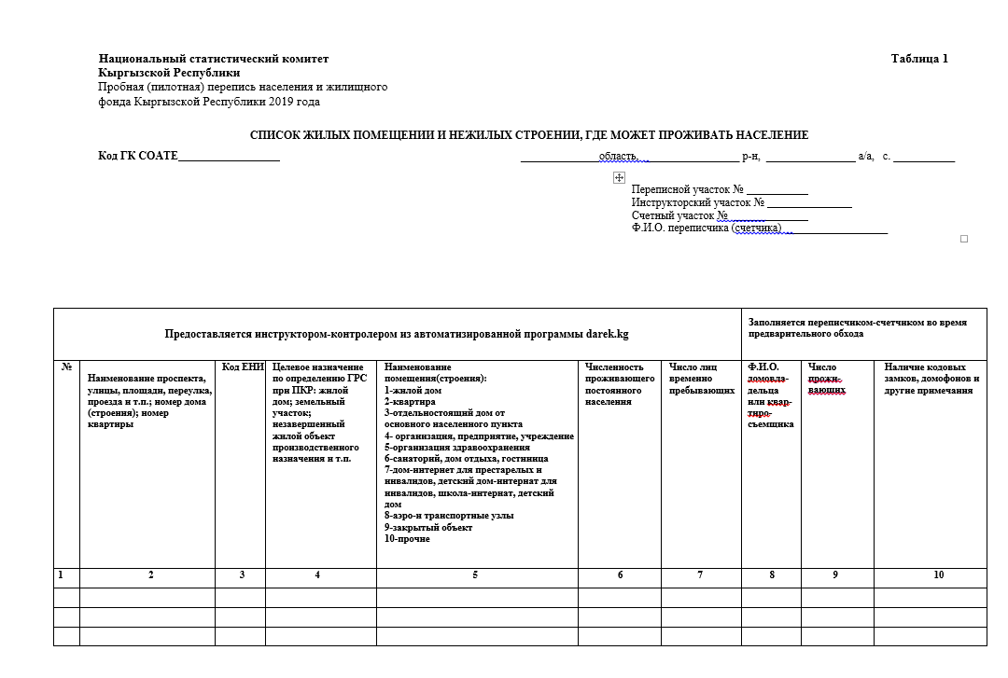
Formation of census departments, instructor and counting areas
Census departments
Instructor areas
Enumeration areas
National Statistical Committee of the Kyrgyz Republic
7
Notes:
The main goal is to distribute properly 3 type and as well as to distribute number of population per one enumerator

Slide 8
Key points
The feature of the upcoming population and housing census in 2020 is the use of administrative data and geographic information systems
For the pilot census of the population electronic registrar plots were created, the formation of the Registration Form “List of living premises and non-residential premises where people can live” was automated
This helps update administrative data during the preparation for the PHC 2020
National Statistical Committee of the Kyrgyz Republic
8
Notes:
Name, number of streets especially in district under construction

Slide 9
Thank you for your attention!
National Statistical Committee of the Kyrgyz Republic

