Slide 1
Geospatial Technology
Indonesia Population Census 2020

Slide 2
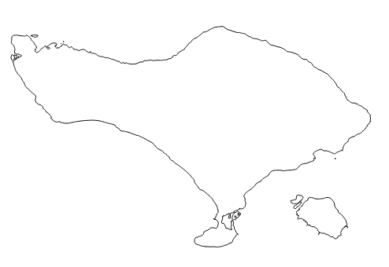
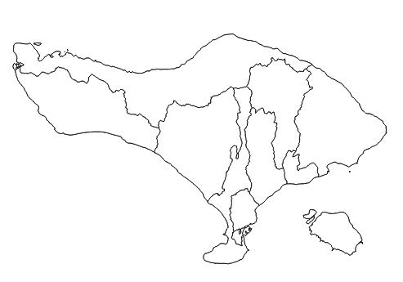
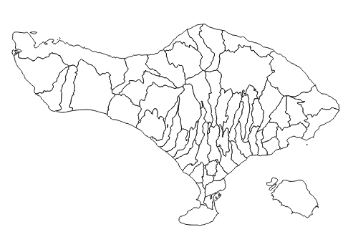
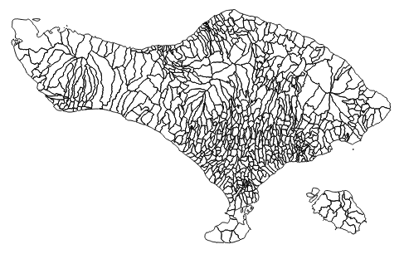
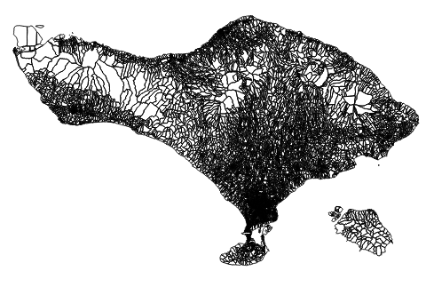

Indonesia Statistical Area
Province
Municipal
District
Village
Census Block

Slide 3
Geospatial for Population Census
2010 vs 2020
2010
2020
Using sketch maps to aid enumerator to identify Census Block;
Enhance quality of digital maps;
Delineating Census Block boundary based on digital images (satellite imagery);
Digital images were limited.
Overlaying digital maps and Google Road to produce paper map;
Using digital maps to aid enumerator to identify Census Block;
Embedding the digital maps in a mobile application;
Collecting Geotag photos of buildings in Census Block (CAPI).

Slide 4
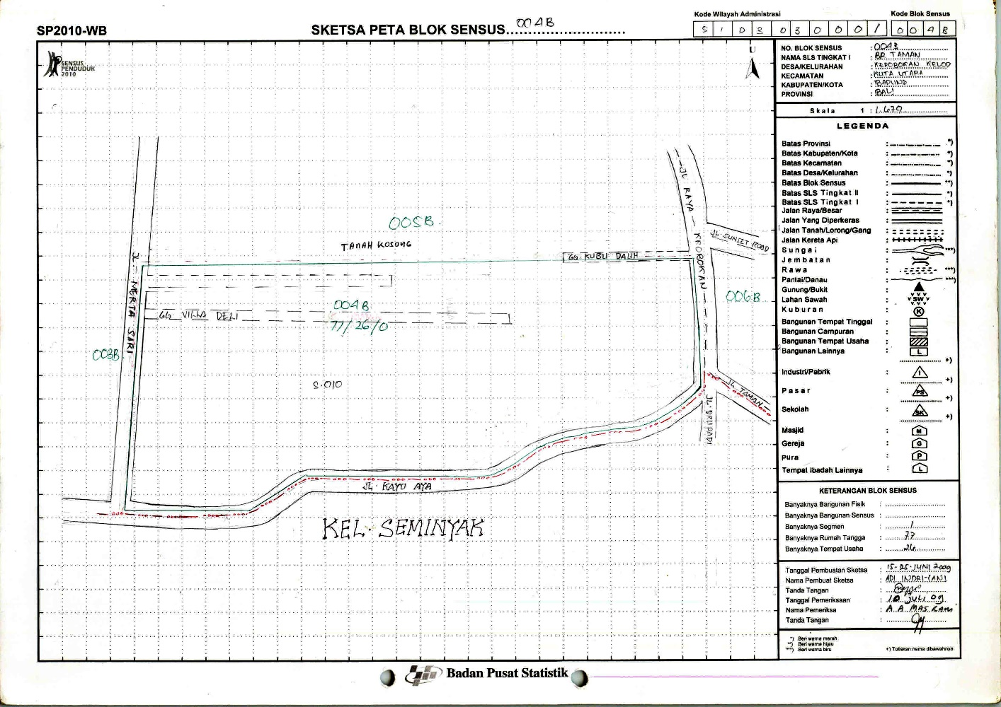
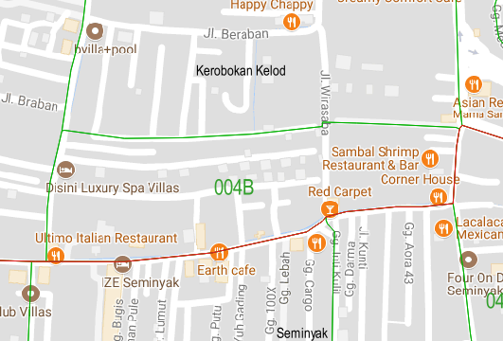
Census Block Map
2010 & 2020
2010
2020

Slide 5
The Integration of Census Activity and Geospatial
2018-2019
2020
2021
Pre enumeration
Preparation of Census Block Maps.
Enumeration
Optimization of digital maps to identify the Census Block using mobile application;
Collecting of building locations.
Post Enumeration
Developing of web GIS for dissemination.
Utilizing digital maps for other census and survey activities.

Slide 6
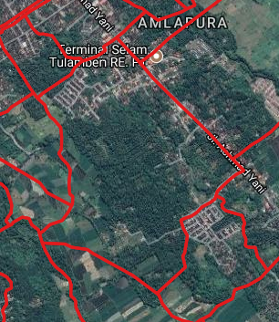
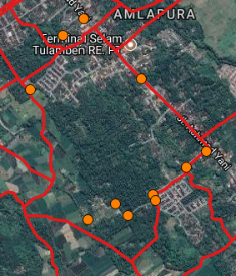
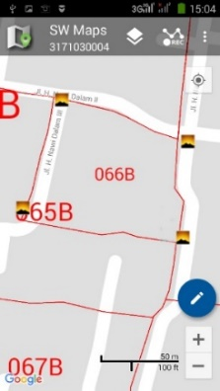
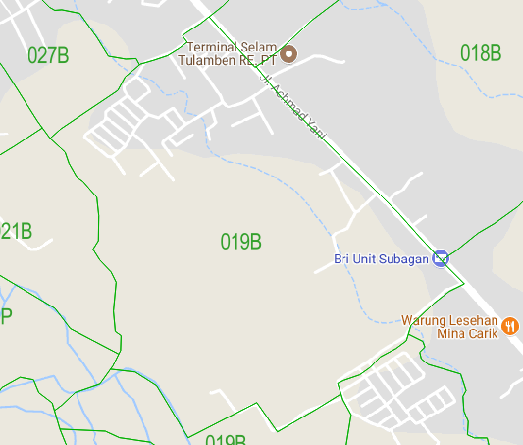
Activity in 2018
Updating digital map based on digital images (Google satellite, SPOT, etc.) and sketch maps;
Establishing Ground truth position and boundary of sample census blocks;
Overlaying between updated digital map and Google Street to produce paper maps.

Slide 7
Activity in 2019
Process:
Establishing Ground truth position and boundary of all census blocks;
Counting of census buildings in each census block;
Geotaging landmarks (Census Block POI and infrastructure);
Updating digital map, delineating census block boundaries based on ground truth;
Overlaying between updated digital map and Google Street to produce paper maps.
Output:
Updated digital map;
Geotagged photos of Census Block POI;
Geotagged photos of infrastructure landmark;
Paper maps of Census Block.

Slide 8
Developed Applications Related to Geospatial

Slide 9
Challenges
The applications are not integrated
The applications use different Databases (silo);
Distribution of Census Block Master to each application by export/import manually;
CAPI application is not support for digital map.

Slide 10
Propose Solutions
Upgrading the system in order to integrate data transactions;
Developing a mechanism to automate proses of data integration;
Developing a mobile application for geospatial data (digital map), as an aid for the enumerator to identify his/her area;
Developing standardization of attributes in order to simplify the updating process.

