Slide 1
Regional Workshop on the 2020 World Programme on Population and Housing Censuses
Key Considerations for Planning and Management of Census Operations
Ankara, Türkiye
12-15 March 2019
Eda Evin AKSU
eda.sahin@tuik.gov.tr
TurkStat Expert
Population and Migration Statistics Group
TurkStat
Turkish Statistical Institute
Demographic Statistics Department

Slide 2
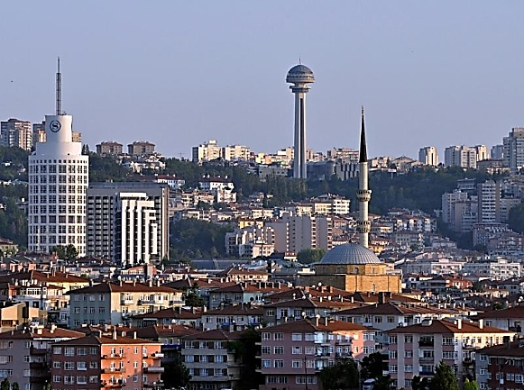
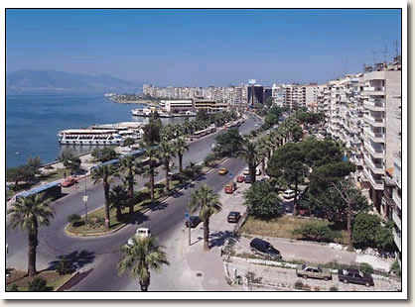
İstanbul
Pop: 15 067 724
Ankara
Pop: 5 503 985
İzmir
Pop: 4 320 519
2018 | Administrative Divisions | Population | Annual Pop. Growth Rate | Median Age | Density (per km²)
Turkey | 81 provinces, 957 districts | 82 003 882 | 14.7‰ | 32 | 107

Slide 3
Contents
CENSUS HISTORY
CURRENT SITUATION
2021 CENSUS

Slide 4
Census History
14 traditional population censuses (1927-2000)
Full enumeration in one-day with national curfew
Paper based questionnaire (ICR method in 2000 Census)
No information on usual residence (de jure)
Need of a large number of staff
High cost
Overcounting
Long duration of data processing (around 3.5 years)
Population statistics are available within 5-10 year interval

Slide 5
Census History
…2007 Address Based Population Registration System…
As linking every person reside in the country with their residence addresses by using the ID numbers, system was established in 2007.
To set up a central address database including all of the addresses in the country.
To construct a separate database for the foreigners living in Turkey.
To obtain the actual information on population size of localities and characteristics of population.
To follow the population movements in the country.
Population size and its basic characteristics have been produced annually from the system since 2007.
But, for 2010 round..

Slide 6
Census History
2011 PHC: Census with combined method
Combined method: Registers + Sample field data
3 months field operation, 40 % PAPI and 60% CAPI
Use of registers for census for the first time (20% of the variables)
Sampling size of survey was about 2.4 million households.
Difficulty in hiring and training of a large group of field staff for a short term work
Relatively high cost
Not being able to produce estimations for small geographic levels based on sample survey
Lack of interest and support of municipalities
Rising concern about confidentiality and privacy

Slide 7
Targets for 2021 PHC
With the goal of producing more timely, less costly, more useful and annual population statistics:
Changing the census methodology from combined to register based.
Using the LFS data by combining them with related registers.
Producing census data on 1 km² grids.
Producing selected set of census variables annually.

Slide 8
Registers Needed
Population
(demography, migration, household/family)
Address
Education
Disability
Employment and Unemployment
Building and Dwelling
Ministry of Family, Labour and Social Services

Slide 9
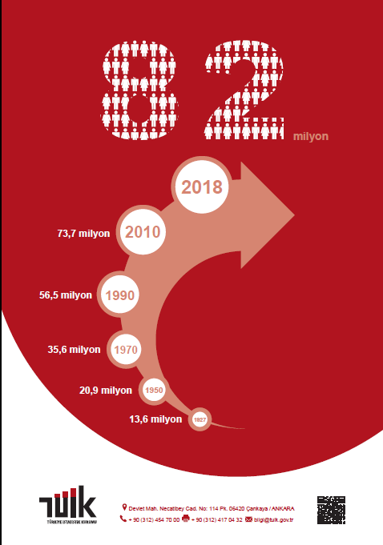
Population Register (PR)
Address Based Population Registration System (ABPRS)
Population of localities
Age & sex
Country of citizenship
Legal marital status
Place/country of birth
Internal migration
Household types, size of households
International migration
Births & deaths
Reason for internal migration (2019)

Slide 10
Address Register (AR)
National Address Database (NAD) + Spatial Address Registration System (SARS)
Unique codes for localities, quarters, streets, buildings and all kind of independent units in the building (dwelling, office etc.)
Type of the building (residential, non-residential, governmental)
Type of the address/living quarter (residence, office, school, student dormitory, hotel, nursing home etc.)
Number of floors in the building
Spatial data (X,Y coordinates)
Ministry of Interior
By the end of (?)

Slide 11
Education Register
National Education Statistics Database
Literacy
Educational attainment
Registers of Ministry of Education and Higher Education Council
Active student records

Slide 12
Disability
Ministry of Family, Labour and Social Services
Registers of persons with disabilities
Social assistance records
Ministry of Health
National Disabilities Data Bank
Other Records
Municipal records (social assistance)
Disabled associations

Slide 13
Employment and Unemployment Register
Registers of Social Security Institution (Labour force status, economic activity)
Registers of Turkish Unemployment Agency (Job applications and unemployment benefits)
Tax records
Farmer Registration System
Social assistance records
Student records
Existing Labour Force Survey data will be used together with the administrative registers

Slide 14
Building and Dwelling Registers (BDR)
Main Sources:
Building permits (municipalities)
Includes most of the required variables
Available since 2007 in electronic format
Property tax records (municipalities)
Kept in local databases of municipalities
Mostly contains different address coding system because some municipalities have not introduced unique address codes of AR to their records yet

Slide 15
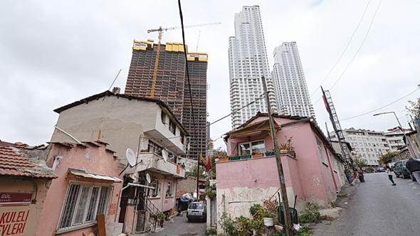
Building and Dwelling Registers (BDR)
Supportive Sources:
Land Registry and Cadastre Information System
(Title Deed Records)
Compulsory Earthquake Insurance Records
Rental Income Declarations (Ministry of Finance, Revenue Administration)
Other (Subscription records of natural gas, water supply and electricity companies etc.)

Slide 16
Plans for Establishing a BDR
After carrying out several studies, it is seen that existing data sources are not sufficient to establish a database for building and dwellings to be used as an administrative registration system.
Therefore missing data should be collected with a special field work.
In order to fulfill this requirement, political decision is needed for two reasons:
High cost of enumeration
Keeping the system up-to-date by ensuring the participation of institutions.
If no such decision will be taken, TurkStat will try to establish a statistical database on this field.

Slide 17
Financing
The cost of all work related to 2021 PHC will be covered from the TurkStat's own budget.
In case of a decision for a survey to collect missing housing data for entire country in 2020:
The budget will be determined in 2019
Related pilot study will be carried out by TurkStat's staff (regional offices).

Slide 18
Census Law
TurkStat has been implementing all statistical activities (including census) according to the Official Statistics Programme, based on the Statistics Law of Turkey
So TurkStat do not need a special census law.
2021 PHC and related issues were added to 2017-2021 term Official Statistical Programme
According to mentioned Law, TurkStat is the authority to determine the statistical methods, definitions, classifications and standards to be used in the production of official statistics in line with national and international norms

Slide 19
Thank you...

