Slide 1
Key Considerations for Planning and Management of Census Operations: Bangladesh Perspective based on POPULATION AND HOUSING CENSUS 2011
Regional Workshop on the 2020 World Programme on Population and Housing Censuses : International Standards and Contemporary Technologies
Ankara, Republic of Turkey
12-15 March 2019
Mohammad Salim Sarker
Deputy Director
Bangladesh Bureau of Statistics Ministry of Planning
1

Slide 2
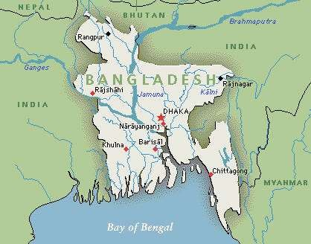
Bangladesh Map
Sylhet

Slide 3
Presentation Outline :
Resume of Censuses in Bangladesh
Census Activities
Data Dissemination
Lessons learned

Slide 4
4

Slide 5
Resume of Census in Bangladesh :
Bangladesh Bureau of Statistics (BBS) is legally mandated to conduct the population and housing census
Census history in this territory
Pre-independence: 1872, 1881,1891, 1901, 1911, 1921, 1931, 1941,1951, 1961
Post-independence: 1974, 1981, 1991, 2001
Last one : During March 15-19 , 2011
Population and housing census is conducted in Bangladesh decennially and the last one is the fifth census in independent Bangladesh
5

Slide 6
Key Consideration for Planning and management of Census operation
Stage 1 : Pre-census activities
Stage 2 : During census activities
Stage 3 : Post census activities
10

Slide 7
Stage 1 : Pre-census Activities :
Updating geo-codes and formation of Enumeration Area (EA) and supervisor maps
Designing and pre-testing of census questionnaire
Preparation of Verbatim training manual
Consultation with stakeholders
Formation of Census Committees
Pre-testing of Census Questionnaire
7 Printing of Questionnaire with quality assurance
11

Slide 8
Stage 1 : Pre-census Activities (contd..)
Pilot Census for verifying overall preparation for the census
Preparation of enumerator and supervisor list
Selection of training centers
Preparation of audio-visual training package in CD & DVD
Preparation of publicity material and actuation of
publicity
Imparting training to the District Census Coordinators( DCC)s and Zonal Officers (ZO)s.
Packing of census materials
Distribution of census materials
14

Slide 9
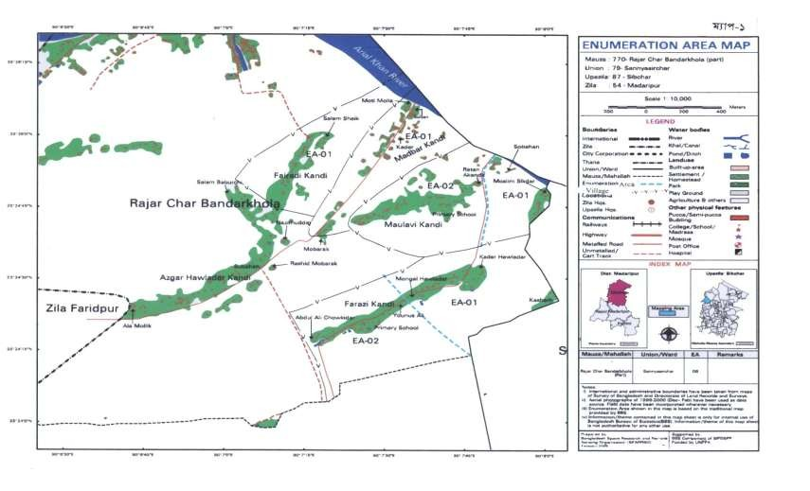
Mauza Map

Slide 10
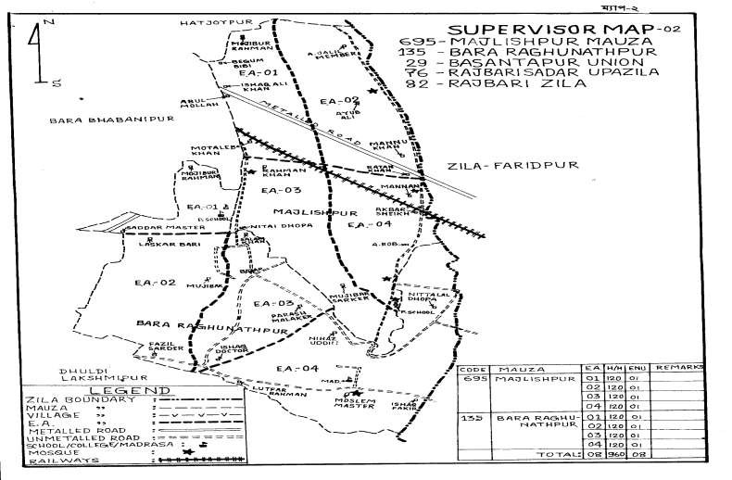
Supervisor Area Map

Slide 11
Census Reference Period
Census moment: Zero hour on 15 March,2011
Census night: Zero hour thru’ 6 a.m. on 15 March,2011
Census period: 15 thru’ 19 March, 2011
15

Slide 12
Census Publicity
Census publicity arranged to create public awareness for census participation as follows :
Publicity through print and electronic media
Big size poster for public places
Brochure for institution
Miking for residential area and market
Banner for main public places
Sticker for vehicles
Postal stamp
16

Slide 13
Census Poster :
18

Slide 14
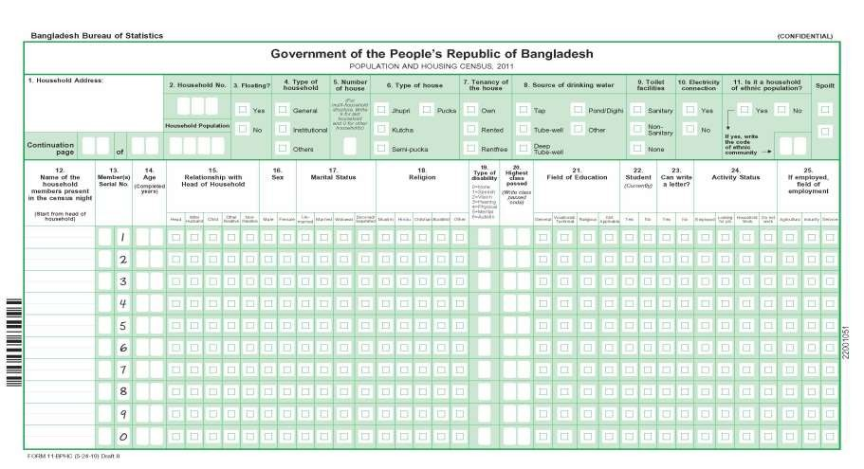
Census Form/Questionnaire 2011

Slide 15
Make active Local Level Census Committees
Union Census Committee
Upazila Census Committee
Municipality/Paurashava Census Committee
District Census Committee
City Corporation Census Committee
Ward census committee ( incase of city corporation)
20

Slide 16
Motivational Campaign to the Citizen
Appeal to the teachers-
(Let the students know the importance of census and motivate them to cooperate the enumerators)
Appeal to public through the Religious Leaders and Religious Institution authority to provide accurate data to the enumerators.
22

Slide 17
Manpower Engagement Planning in the Census Operation in Bangladesh
Chief Census Coordinator: 1
National Census coordinator/ Census Commissioner : 1
Deputy National Census Coordinator :2
District Census Coordinator : 130
Upazila / Thana Census Coordinator : 530
Zonal Officer : 2612
Supervisor : 48531
Enumerator : 296718

Slide 18
Stage 2 : During Census Consideration
Main count were taken place from 15-19 March, 2011
The census calendar at a glance
Activities | No. of days | Date (as in 2011 census)
Training for Master Trainers at BBS HQ | 3 | 22-02-2011 | 24-02-2011
Training for Zonal Officers at District HQ | 3 | 26-02-2011 | 28-02-2011
Holding Census Committee Meeting at Different Levels ( Census Logistics sent to Divisions and Districts by Trucks) | 3 | 02-03-2011 | 04-03-2011
Training for Enumerators and Supervisors (3 batches) | 9 | 05-03-2011 | 13-03-2011
Main Count | 5 | 15-03-2011 | 19-03-2011
24

Slide 19
Quality Control Management :
Close Supervision:
One supervisor for every 5/6 enumerators
One Zonal Officer for 2 Unions/Wards
One UCC for each Upazila
One DCC for each District or part of a big one
Independent Check by observer group.
Use of quality EA and Supervisor Sketch map
Active participation of Local Census Committees
Recruitment of more educated female enumerators
25

Slide 20
Stage 3 : Post Census Activities
Storing and Inventory of documents
Data capture by ICR
Data editing
Compilation of preliminary report
Data analysis and preparation
series and district series
Preparation of manuscripts for National Report
Development of database
Conducting Post Enumeration Check (PEC)
Carrying-out Sample Census
of community
27

Slide 21
Technology Used
Data is being Captured by using ICR machine
iCADE software is used for data capturing
CSPro is being used for data analysis
Data capturing process and iCADE Software is supported by US Bureau of Census.

Slide 22
Post Enumeration Check (PEC)
Post enumeration check was conducted independently under control and supervision of Bangladesh Institute of Development Studies (BIDS) during 10-14 April, 2011.
PEC conducted in 280 enumeration areas
Both the coverage and content errors will be determined judiciously
Adjustment will be made to the census data as per standard procedure
33

Slide 23
Sample Census
A large survey i.e., sample census was conducted to collect detailed socio-economic and demographic data to compliment the main census
Estimation and preparation of demographic indicators
Preparation of national and regional population projection
81 Questions with 10 Modules were used in the sample census
34

Slide 24
Tabulation plan
A tabulation plan has been prepared through input-output analysis :
Disaggregation by Sex, Locality, Division and District
Table number for tabulations of house and housing characteristics are preceded by H , community characteristics by C and Population characteristics by P.
As per draft tabulation plan , there will be 38 Statistical table for district series, 18 for community series, 4 for national volume-2 and 139 for analytical report.

Slide 25
Dissemination Plans
Census results will be disseminated Through:
Printed reports-preliminary, national and community;
Data products-statement, tables, maps, charts, graphs;
Report and data -CD and DVD;
Report and data in Homepage-
(BBS website- www.bbs.gov.bd);
5. Seminar, Workshop and Press Conference

Slide 26
Publication of Reports
Preliminary report - 1
National series (analytical) volume 1
National series(union)- volume 2
Urban area report-volume 4
Demographic report-volume 3
District census report-64 volumes
Community report-64 volumes
Administrative report-volume 5
Reports will be made available in hard copy and CD
and key information in website of BBS (www.bbs.gov.bd)
37

Slide 27
New Features in the Census 2011
Introducing digital map
Ensuring total involvement of field administration
About 30% of ZOs and DCCs are from other organization
Changing the questionnaire format
Maximizing the number of female enumerators
Supplying ‘Training Manual’ and ‘Enumeration Area’ map to all the enumerators and supervisors
Providing audio-visual training in every level
Introducing ICR in data capture
38

Slide 28
Lesson Learned
Consistent and effective training improved quality of census data
Wide publicity improved both coverage and quality of data
Using same map by both the enumerator as well as the supervisor helped to control duplication and omission in the census.
Local level committee were found very effective in motivating the public at large whole heartedly in providing actual data to the census workers.
Audio-visual training is found to be very effective in dissemination of training concepts to the enumerators and supervisors.
Female enumerators were found to be more sincere and
acceptable to the respondent.
It would have been better if Household listing was done during zonal operation
▪

Slide 29
Conclusion
Application of digital map at data collection, audio-visual and small group training at the training phase and rational distribution of work, good governance in census operation and application of ICR technology in data capture and data processing will hopefully end up with quality and credible results .

Slide 30
Thank You for your Patience hearing
44

