Slide 1
United Nations Statistics Division Programme in Support of the 2020 Round of Population and Housing Censuses
Session 2
Srdjan Mrkić
United Nations Statistics Division

Slide 2
Resolution
UN Statistical Commission endorsed the draft Resolution on 2020 World Population and Housing Census Programme and submitted it to the Economic and Social Council of the United Nations for adoption
On 10 June 2015 ECOSOC adopted the Resolution

Slide 3
Resolution
Endorses the 2020 World Programme
Urges each member state to conduct at least one population and housing censuses in the period 2015-2024
Based on international recommendations
Advance planning
Cost efficiency
Coverage
Timely dissemination
Underscores the need for quality standards and assurance and compliance with the Fundamental Principles of Official Statistics

Slide 4
Resolution
Emphasizes the importance of the 2020 Programme for implementing and monitoring the sustainable development agenda
Requests the United Nations to:
Prepare international standards, methods and guidelines
Ensure coordination of activities among stakeholders in assisting Member States in the implementation of the 2020 Programme
Monitor and regularly report on the implementation of the 2020 World Programme

Slide 5
2010 Round
Censuses conducted from 2005-2014 – 93% of world population
Region | Countries/areas census conducted | Countries/areas census not conducted | Percent not conducted
Africa | 49 | 9 | 16
America, North | 36 | 2 | 5
America, South | 14 | - | -
Asia | 41 | 8 | 16
Europe | 49 | 2 | 4
Oceania | 25 | - | -
Total | 214 | 21 | 9

Slide 6
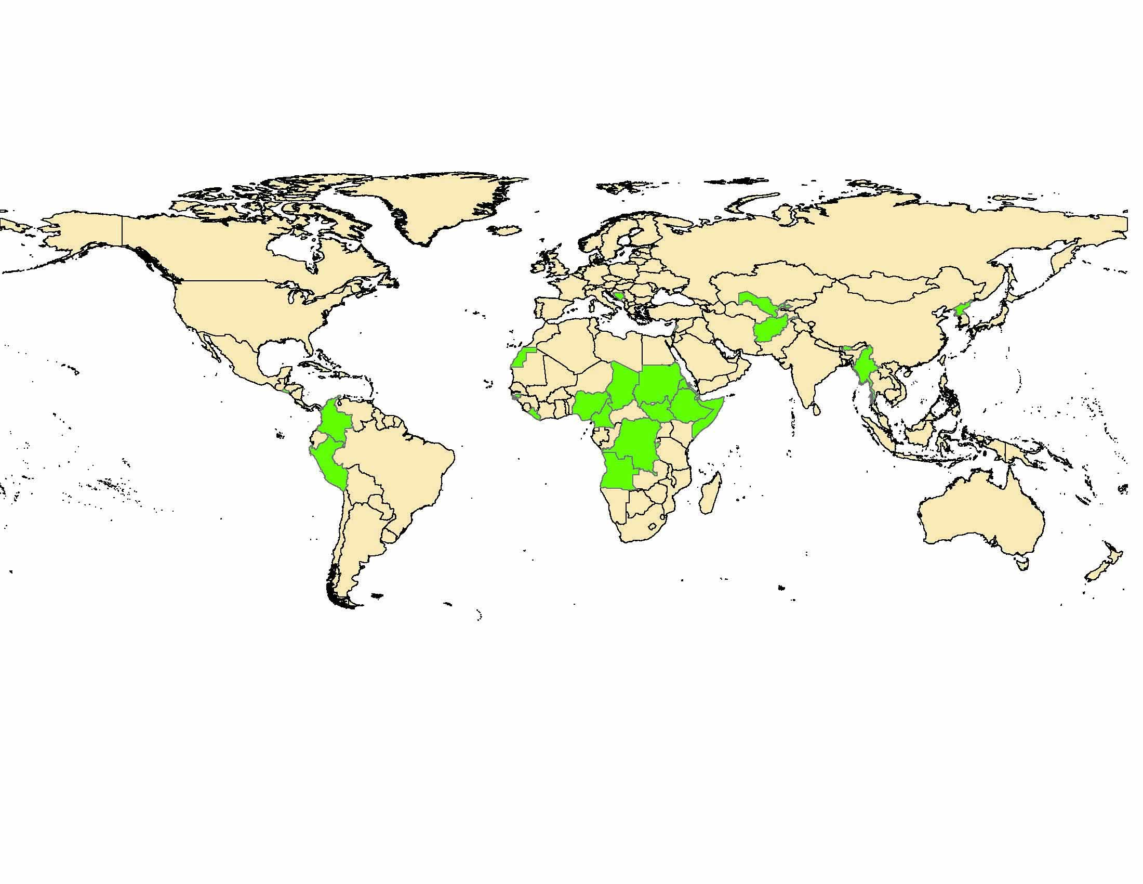
2000 Round of censuses

Slide 7
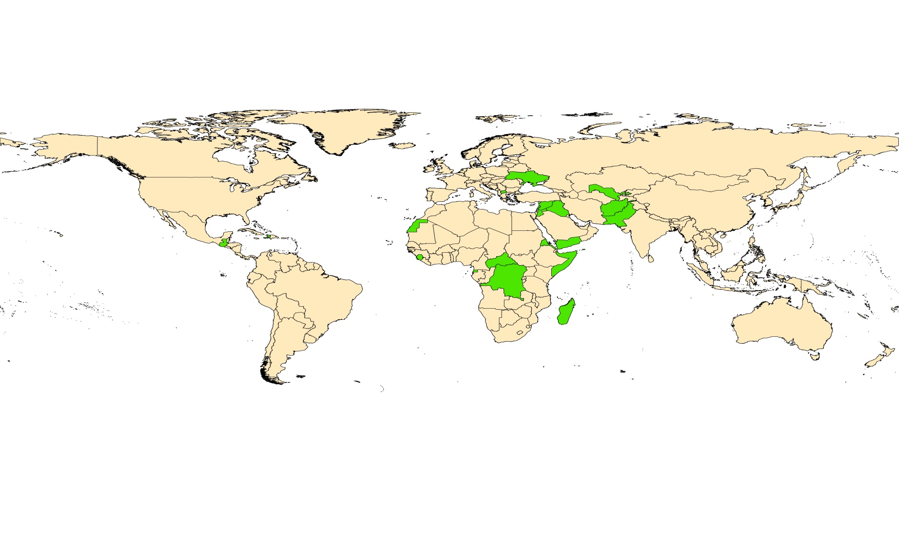
2010 Round of censuses

Slide 8
2010 Round
Achievements
Multi-modal approaches
Contemporary technologies
Hand-held devices, internet
Web-based dissemination
Geo-spatial technologies
Direct collaboration between countries
Implementation of international standards

Slide 9
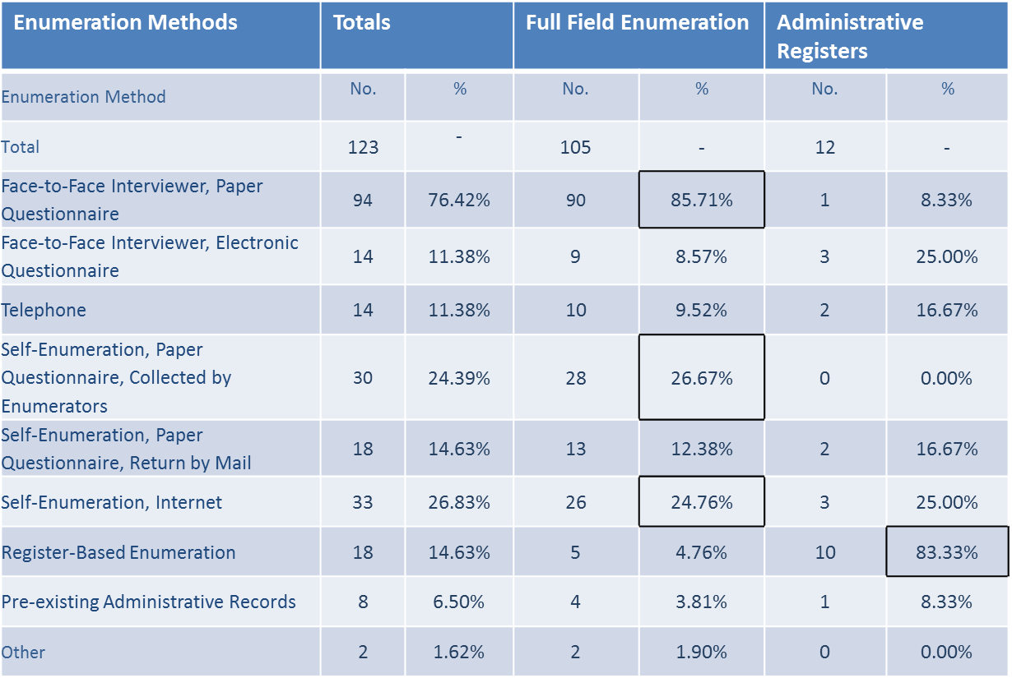
Evaluation of the 2010 Round
Main Census Methodology
Source: UNSD survey conducted in 2013

Slide 10
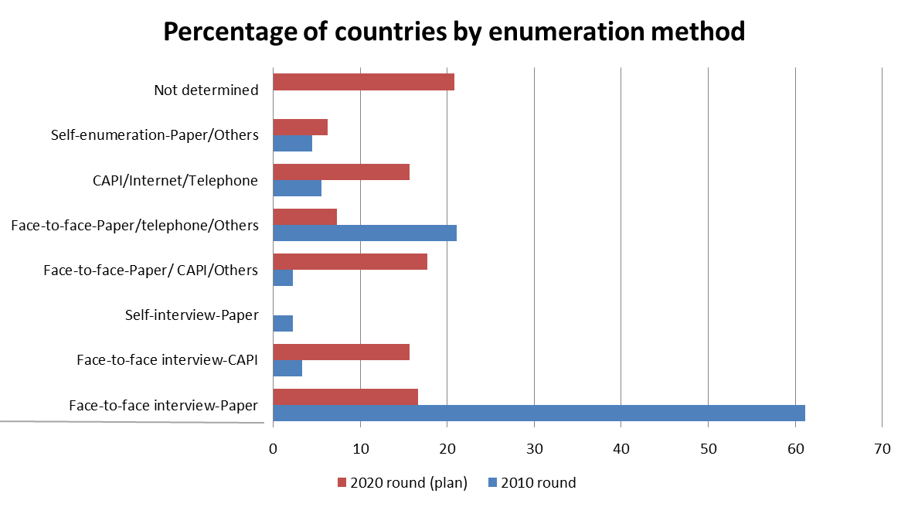
Practices in 2010 round and plans for 2020 round
Multi-methods
One method

Slide 11
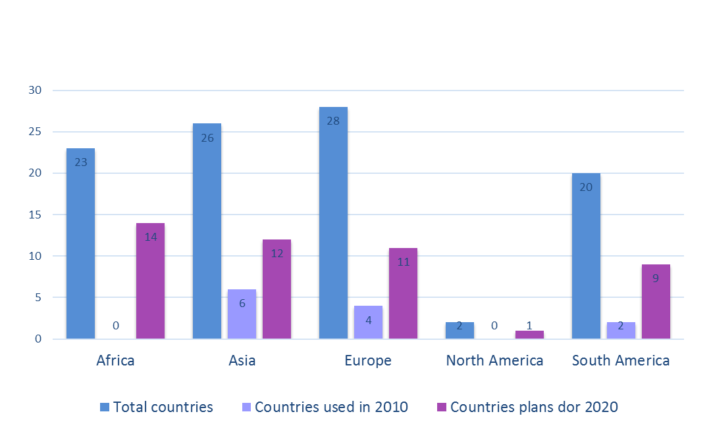
Use of CAPI in 2010 and plans for 2020
Source: 2016 UNSD survey- 123 countries responded
responded

Slide 12
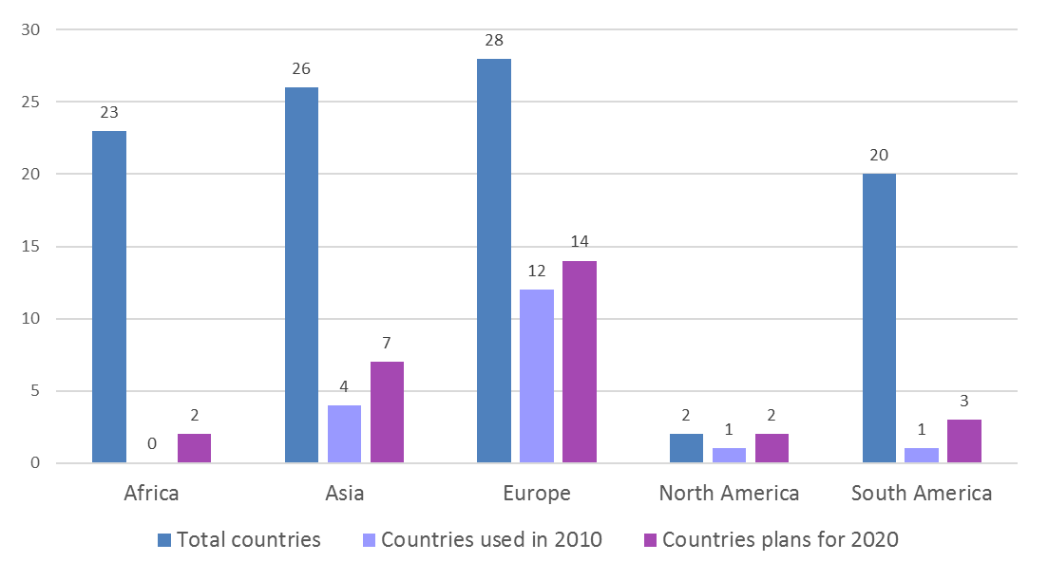
Use of Internet in 2010 and plans for 2020
Source: 2016 UNSD survey- 123 countries responded
responded

Slide 13
Lessons learnt in 2010

Slide 14
Trends in the use of technology
Census Rounds
 | Before 1990 | 1990 | 2000 | 2010 | 2020
Mapping | Sketch | Digital Sketch | Digital Sketch | Digital Georeferenced data Sketch
Enumeration | Paper questionnaire | Paper questionnaire | Electronic questionnaire – Internet Paper questionnaire | Electronic questionnaire – Internet, hand-held devices and telephone Real-time monitoring Paper questionnaire
Data Processing | Manual data capture | Optical data capture Manual data capture | Optical data capture Manual data capture | Optical data capture Automatic data capture (Internet and hand-held devices) Web-based manual data capture Manual data capture
Dissemination | Paper publication |  | Paper publications Online / digital publications | Online interactive databases Digital publications Paper publications

Slide 15
2010 Round
Challenges
Census costs
Timeliness in releasing data
Public perception and cooperation
Low response rates
Managing the outsourcing of census operations
Inadequate and insufficient exploitation of census statistics

Slide 16
2020 Round
UNSD mandate
Developing and promoting methodological framework
Monitoring the implementation of the 2020 Programme
Reporting on the implementation
Provide support to national capacities

Slide 17
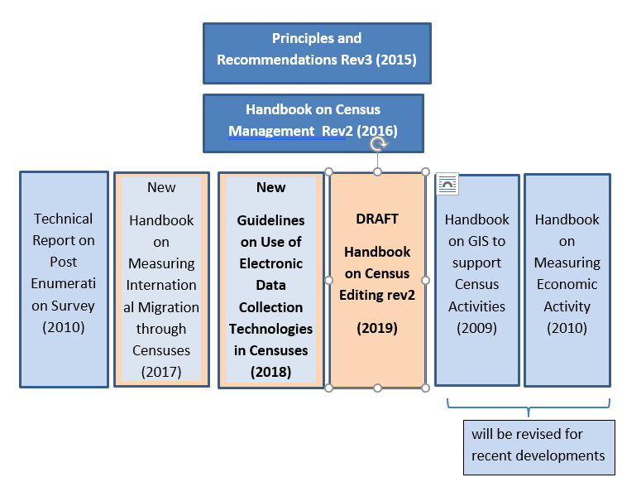
UNSD Methodological framework

Slide 18
Principles and recommendations
United Nations Statistical Commission established in 1946
Developing international standards for official statistics
In the field of population and housing censuses
Population Census Methods (1949)
Principles and Recommendations for National Population Censuses (1958)
General Principles for a Housing Census (1958)
Principles and Recommendations for the 1970 Population Censuses (1969)
Principles and Recommendations for Population and Housing Censuses (1980)
Principles and Recommendations for Population and Housing Censuses, Revision 1 (1998)
Principles and Recommendations for Population and Housing Censuses, Revision 2 (2008)
Principles and Recommendations for Population and Housing Censuses, Revision 3 (2015)

Slide 19
Principles and Recommendations, Revision 3
Four parts
Essential features and census methodology
Definitions
Essential features
Census methodology
Planning, organization and management
Strategic objectives
Legal basis
Use of technology
Quality assurance
Census operations activities
Census infrastructure
Mapping
Data processing
Dissemination
Population and housing census topics

Slide 20
Handbook on the Management of Population and Housing Censuses, Revision 2
Based on the Principles and Recommendations
Handbook on the Management of Population and Housing Censuses, Revision 2
Eight chapters
I. Essential characteristics
II. Planning, organization and administration
Overall census planning
Plans for enumeration
Administrative organization and management structure
Census legislation
Census calendar
User consultation
Communication and publicity
Financial management
Procurement
Contracting out
Use of technology
Documentation
Quality assurance

Slide 21
Handbook - continued
III. Pre-enumeration operations
Mapping
Questionnaire content and design
Testing and evaluating census questions and procedures
Instruction manual preparation
Recruitment and payment
Field staff training
Logistics for census materials
IV. Field enumeration
Enumeration
Monitoring and management of field enumeration
Quality assurance for field enumeration
Type of technology for field enumeration

Slide 22
Handbook - continued
V. Data processing
Processing strategies
Location of processing centers
Establishing the workforce structure and recruiting staff
Processing operations
Technology issues for processing
Quality assurance for data processing
VI. Census products, dissemination and utilization
Dissemination strategy
User consultation process
Broad product strategy
Product development
Product dissemination and promotion for utilization

Slide 23
Handbook - continued
VII. Evaluation
Planning and implementation
Basic measurements of overall quality
Methods of evaluation
Communicating data quality issues
VIII. Documentation and archiving
Documentation
Archiving
Digital preservation
Digital migration

Slide 24
Guidelines on the use of electronic data collection technologies
It aims to serve as a reference for:
Identification of key factors for making sound decision on the use of electronic data collection technologies
Strengthening national capacity for effective adoption of the selected technology
Designing census processes with the use of hand-held devices and/or Internet
Developing strategies for maximizing the benefits from this investment

Slide 25
Guidelines on the use of electronic data collection technologies
The guidelines elaborate on:
(the content prepared through the global technical meeting in Dec 2016)
Overview of data collection methods including multi-mode data collection approaches
Decision-making in adoption of electronic data collection technologies
Key determinants: institutional, technological, economic, social/cultural factors
Information required for decision making (cost estimates, benefits, risks, timetable, plans for reuse/disposition, success criteria, assumptions, etc.)

Slide 26
Guidelines on the use of electronic data collection technologies
The guidelines discuss:
Planning and preparation considerations
Institutional capacity development
IT acquisition management
IT systems development
Use of geospatial technology for census preparation
Supportive systems- Call center, MIS,..
Testing IT systems and processes
Contingency planning
Information and system security

Slide 27
Guidelines on the use of electronic data collection technologies
The guidelines discuss :
Data collection with handheld devices
Important features of handheld devices
Data collection application (essential features, design and performance considerations, etc.)
Data transmission and security
Use of geospatial technology during enumeration
Testing data collection applications and systems
Field operation, management and monitoring
Reuse/disposition of devices

Slide 28
Guidelines on the use of electronic data collection technologies
The guidelines discuss :
Data collection with Internet
Benefits – cost, quality, respondent burden, improving coverage
Requirements for adoption – high literacy, internet access, public trust, quality of address frame
Data collection application and portal
Implementation approaches- choice among other modes, sole initial means to respond
Identification of respondents (unique access code)
Management and monitoring
Security
Support to respondents

Slide 29
Guidelines on the use of electronic data collection technologies
Collaborative approach for drafting the guidelines with the participation of countries and international organizations
Current version in front of you
Live document – will be updated for:
significant changes in adoption of the technology
technological changes
good country practices

Slide 30
Programme of work for 2019 – partial overview
Promoting the Principles and Recommendations, the Handbook and the draft Guidelines
Series of workshops in partnership with international and regional organizations
Finalizing the editin and GIS handbooks
Regular activities related to monitoring the implementation of the 2020 round of censuses
Regular activities in providing assistance to countries

