Slide 1
United Nations Regional Workshop on the 2020 World Programme on Population and Housing Censuses
Considerations for planning census operations with multi-mode data collection methods
Tbilisi, Georgia
24-27 April 2018
Sebnem BESE CANPOLAT
sebnem.canpolat@tuik.gov.tr
Head of Demographic Statistics Department
TurkStat
Turkish Statistical Institute

Slide 2
Contents
TurkStat’s experience in 2011 PHC
Data Collection
CAPI Experiences
Other considerations

Slide 3
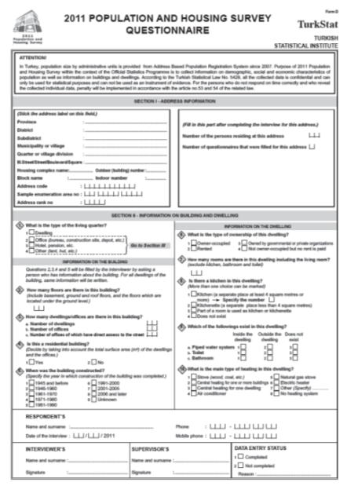
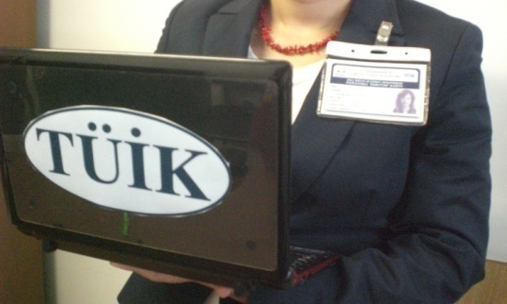
2011 PHC and Data Collection
TurkStat carried out 14 traditional censuses in between 1927-2000 and afterwards conducted the 2011 Population and Housing Census with “combined” method.
While only paper questionnaires were used in the former censuses, the netbooks were utilized in addition to printed questionnaires in 2011.
40%
60%

Slide 4
Our CAPI experiences in the last census
Netbook usage (CAPI) provided some cross checks between answers at the time of the interview.
Integrated edits in the program increased the data quality and minimized the missing data.
Netbook usage for data capture created time efficiency compared to other methods (ICR, manual data entry).
By using the netbook application, we had ongoing data analysis since the beginning of the field work and enumerators could transfer the data daily to the central office.
By the timely online data transfer, field application could be monitored daily and guided actively through the central system.

Slide 5
Our CAPI experiences in the last census (cont)
Although the use of netbooks provided many benefits in terms of time and quality, we also faced some problems in practice.
For example, there was a tendency of the enumerators to tick “no” to the first (filter) question in a set of associated questions (i.e. migration, labor force questions) in the netbook application.
Because the software was automatically skipping the related consecutive questions in these situations due to edit instructions.
But in the paper form, we observed that controllers (or data entry operators) could easily noticed these kind of systematic errors and enable them corrected.

Slide 6
Advantages of the CAPI
Using tablets or any other handheld devices provide accuracy and timeliness
No additional data entry
Easy to monitor the operation and the interwiever
Inspires confidence to respondents and attracts interest; helps to give the impression of a serious and important work is done
Easy to use in the field compared to printed questionnaires in most situations (no need for a pen, desk or a chair)
No need to additional printed forms or lists. All of them are contained in the programme

Slide 7
Our CAPI experiences in the last census
Our experiences show that if CAPI is used for data collection, following issues should be taken into consideration carefully :
Capacity of the device
Usefulness (screen visibility at the outdoor, ergonomics)
Battery capacity
Cost
Need for a separate training?
Need for internet connection
Data confidentiality and security
What will happen to the devices when the census finished?
TurkStat: Donated to schools
Alternative ideas? Selling to interviewers at an affordable price

Slide 8
Other
Internet response facility might be the solution to get information from the households in which all members are working (or absent) at the day time (to decrease the non-response rates).
(But TurkStat has no experience in this technique)

Slide 9
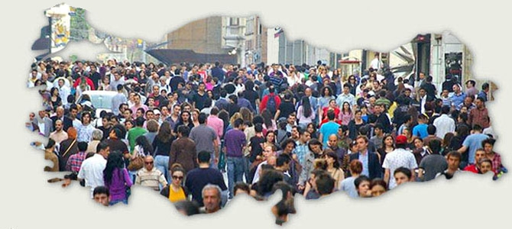
Thank you...

