Slide 1
MONGOLIA: Multi-mode data collection methods
United Nations Regional Workshop on the 2020 World Programme on Population and Housing Censuses: International Standards and Contemporary Technologies
Tbilisi, Georgia
24-27 April 2018

Slide 2
Tablet PC usage
NSOM implements the Computer Assisted Personal Interviews (CAPI) by Android and Windows based tablets.
1
NSOM has been using tablets for data collection on household based sample surveys, since 2013
2
Tablet-based technology is mainly used for sample surveys
3
Workflow of tablet-based data collection in off-line mode, although software new versions downloadable from central server
4
Collected questionnaires send to central server when tablets are connected to then network

Slide 3
Statistical survey data collection
Before
Selected household
Basic information
Administrative units
Data entry team
Database
After
Tablet-based data collection and entry software which send encrypted data to the central databases
Selected household, collecting data
Encrypted data
Database

Slide 4



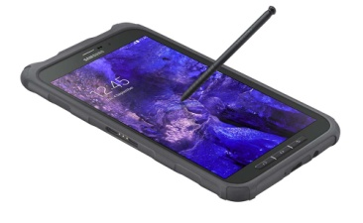
About tablet
Tablet technology
Basic requirement
      Not PDA really Tablet
      Windows, CSPro /CAPI mode/
      Internet, 3G, WiFi
      Long battery life
      SD card slot
Bluetooth
Other equipment
  External keyboard
  Car charger
  Cover
  Safety
Configuration
      Windows upgrade 8 to 8.1
      User permission: not admin, can’t install and uninstall
      Unique tablet name = user name and password for each tablet with label
      Software install MS Office, 3G modem, etc
      Screen resolution, display font
      Battery saving mode configuration
      Display protection
Tabled based applications
      Social Indicators Sample Survey
      Household Socio-Economic Survey
      Labor Force Survey
      Time Use Survey
      Multiple indicator cluster survey
      Woman’s Health and Life Experience Survey

Slide 5
Tablet specification
ASUS VivoTab Smart ME400C
4G+LTE
TranSleeve keyboard
3rd party Car Charger
Operating System: Windows 8
Battery: 9.5 hours; 25Wh Li-polymer Battery
Display: 10.1" with Multi-Touch Screen WXGA (1366x768) Screen IPS Panel
CPU: Intel® Atom™ Z2760 Dual-Core
Memory: 2GB
Storage: 64GB,
32GB 36 Months ASUS Webstorage Space
Wireless Data Network: WLAN 802.11 b/g/n@2.4GHz Bluetooth V4.0
Camera: 2 MP Front Camera, 8 MP Rear Camera
Audio: Stereo Speakers
Interface:
1 x 2-in-1 Audio Jack (Headphone / Mic-in)
1 x micro HDMI1 x Micro USB1 x Micro SD Card Reader(SDHC)
Sensor: G-Sensor, Light Sensor, Gyroscope, E-compass, Hall sensor, NFC
Application:SuperNote, Guide, Vibe Lite, ASUS Camera, MyLibrary, MyDictionary, Asus WebStorage, Amazon Kindle

Slide 6


Tablet specification
SAMSUNG GALAXY TAB ACTIVE LTE
NETWORK | Technology | GSM / HSPA / LTE
BODY | Dimensions | 213.1 x 126.2 x 9.7 mm (8.39 x 4.97 x 0.38 in)
 | Weight | 393 g (13.86 oz)
 | SIM | Micro-SIM
 |  | - IP67 certified - dust and water resistant up to 1 meter and 30 minutes
 |  | - Shock protection up to 1.2 meters drop (via protective cover included with tablet)
 |  | - C-Pen stylus
DISPLAY | Type | LCD capacitive touchscreen, 16M colors
 | Size | 8.0 inches (~69.0% screen-to-body ratio)
 | Resolution | 800 x 1280 pixels (~189 ppi pixel density)
 | Multitouch | Yes
PLATFORM | OS | Android OS, v4.4.2 (KitKat)
 | Chipset | Qualcomm Snapdragon 400
 | CPU | Quad-core 1.2 GHz Cortex-A7
 | GPU | Adreno 305
MEMORY | Card slot | microSD, up to 64 GB
 | Internal | 16 GB, 1.5 GB RAM
CAMERA | Primary | 3.15 MP, 2048 x 1536 pixels, autofocus, LED flash
 | Features | Geo-tagging
 | Video | 720p@30fps
 | Secondary | 1.2 MP
COMMS | WLAN | Wi-Fi 802.11 a/b/g/n, dual-band, Wi-Fi Direct, hotspot
 | Bluetooth | v4.0, A2DP, LE
 | GPS | Yes, with A-GPS, GLONASS
 | NFC | Yes
 | USB | microUSB v2.0
BATTERY |  | Removable Li-Ion 4450 mAh battery

Slide 7
Social Indicators Sample Survey
SISS
Social Indicators Sample Survey
MICS
Multiple indicator cluster survey
RHS
Reproductive health survey
CDS
Children Development Survey

Slide 8
About SISS
SAMPLE 15,500 HOUSEHOLDS
4 QUESTIONNAIRES
TABLET PC /CAPI/ FOR DATA COLLECTION, FIRST TIME
22 TEAMS
HOUSEHOLD QUESTIONNAIRE, 20 PAGES
NATIONAL LEVEL
DATA COLLECTION: 2013, OCTOBER-DECEMBER, 3 MONTHS
140 TABLETS AND OTHER EQUIPMENT PREPARED
WOMEN QUESTIONNAIRE, 43 PAGES
MAN QUESTIONNAIRE, 18 PAGES
CHILD QUESTIONNAIRE, 20 PAGES
OCTOBER STARTING SNOWING, DECEMBER COMPLETELY COVERED SNOW,
AVERAGE TEMPERATURE -20 C, NIGHT -35 C
SUPERVISOR – 1 TOTALLY 132 PERSON
INTERVIEWER - 5

Slide 9
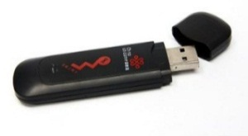
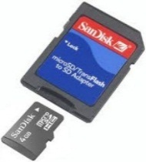
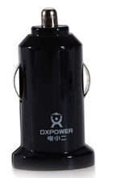
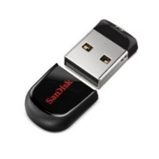
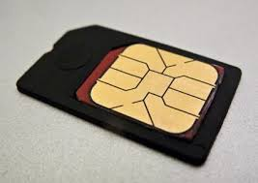
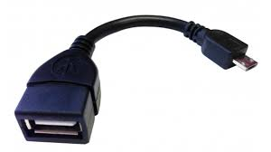
About SISS
Tablet
External Keyboard
Micro SD card 8GB
Charger
Car charger
USB drive 8GB
3G USB Modem 4 pieces
Micro SIM card 4 pieces
Internet Data, 4 months
USB convertor cable: Micro to Standard
01
03
TEAM
SUPERVISOR
INTERVIEWER
02
Accumulator-Car Battery
Invertor 12В-220В
Electric socket
Tablet
External Keyboard
Ball ben
Micro SD card 8GB
Charger
Cleaner
Car charger

Slide 10
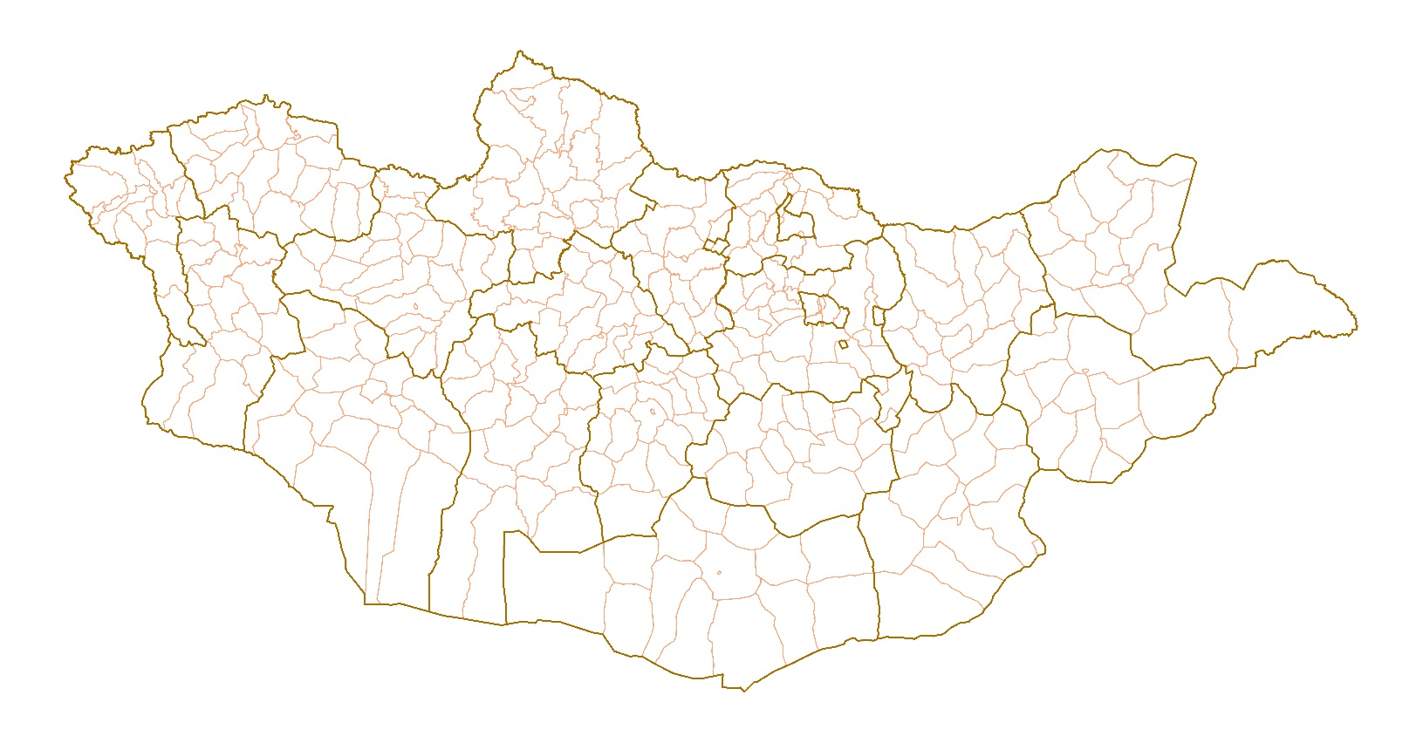
About Mongolia
Total areas: 1,56,115.75 km²
Administratively: 22 provinces → 339 districts → 1765 primary units
4 seasons
3.1 mill population

Slide 11
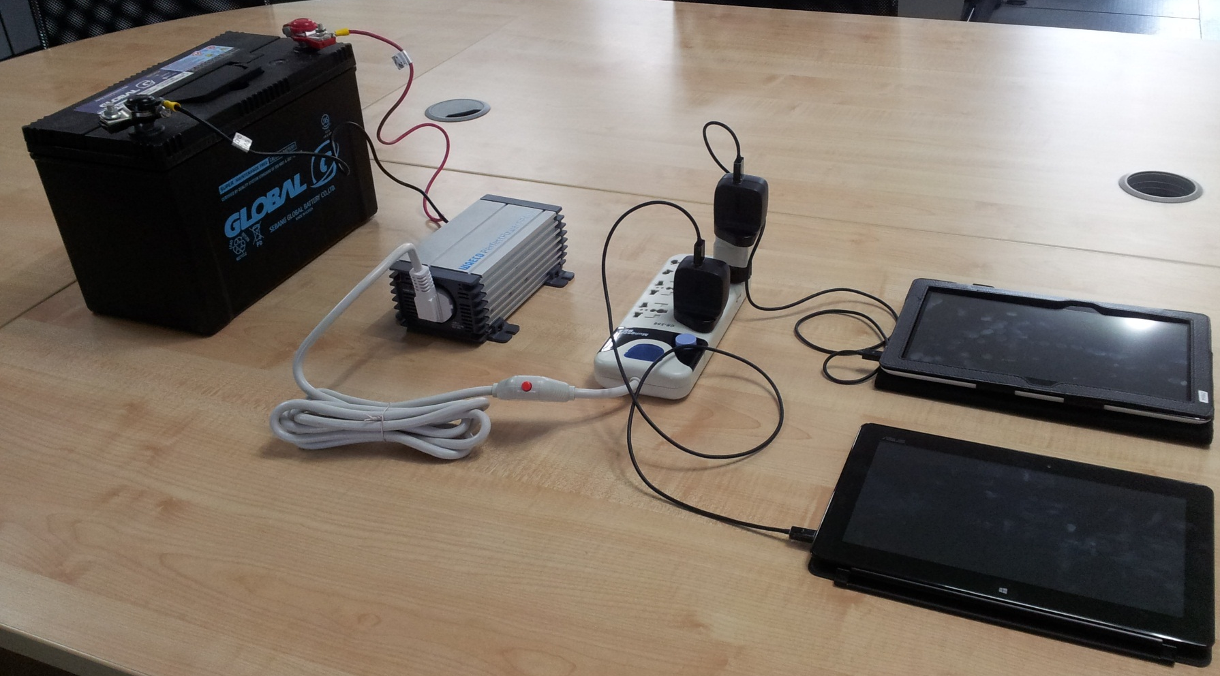
Charging tablet using car battery
90А
jumper cables
Invertor 12V to 220V
Electric socket
Charger
Tablet
Tablet

Slide 12

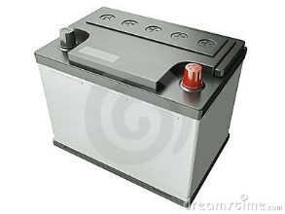
Charging tablet using car battery
Team: 1 supervisor, 5 Interviewer, 2 car, 2 driver
car battery
car battery

Slide 13
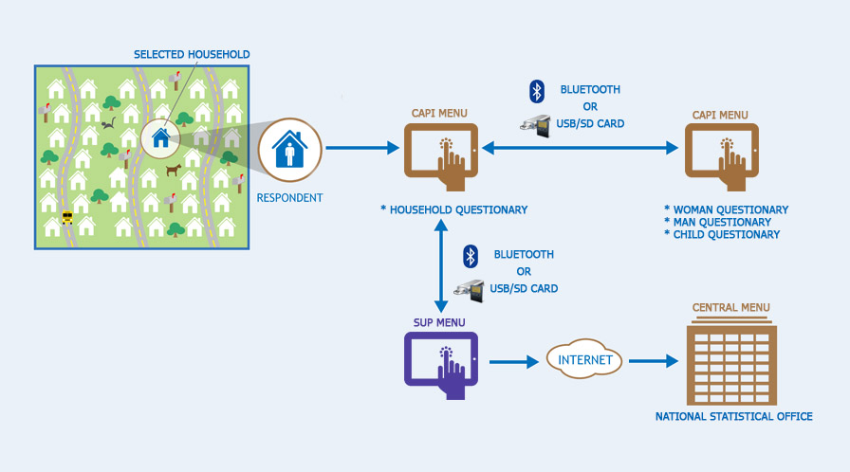
Social Indicators Sample Survey

Slide 14
Social Indicators Sample Survey
Systems:
№ | Software name | Using by | Dedication | For
1 | CapiMenu | Interviewer | Data collection | Tablet
2 | SupMenu | Supervisor | Team managing, team data merging, send receive data between team and NSOM | Tablet
3 | CentralMenu | NSO | Monitoring, checking, analysing | PC

Slide 15
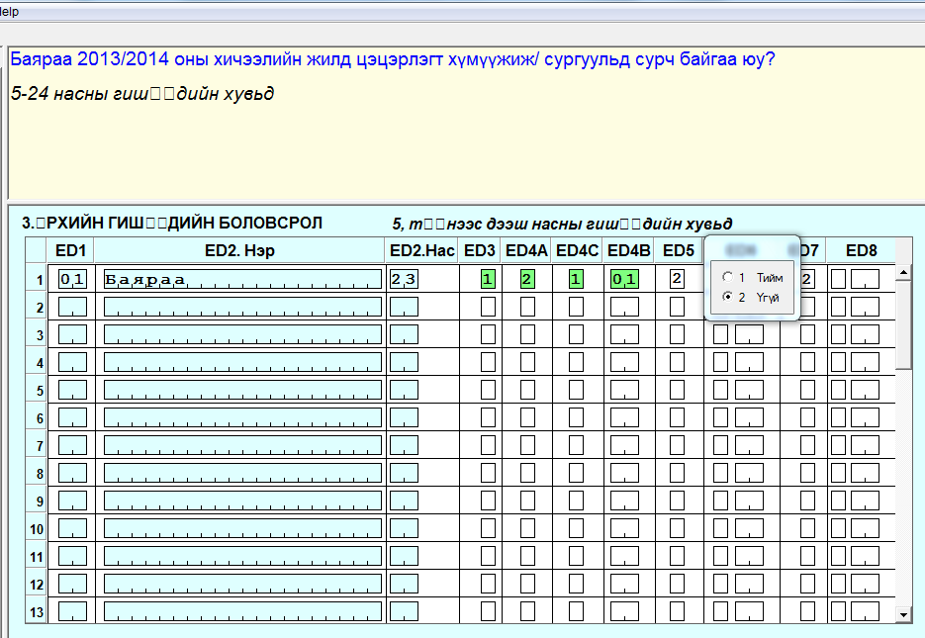
Social Indicators Sample Survey
Question for interviewer
Remarks for interviewer
Section title
ED5 Number of question
Answer and values of ED5 question

Slide 16
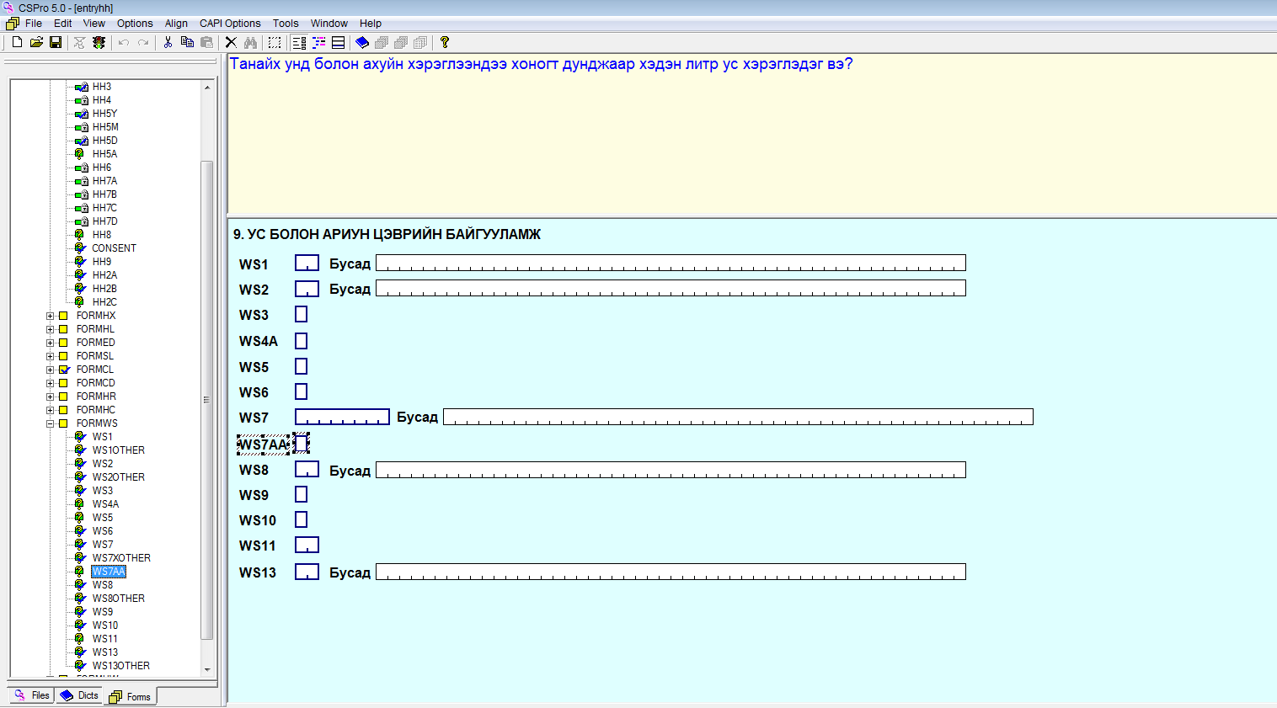

Using software packages
DATA COLLECTION:
CSPro - Census and Survey Processing System

Slide 17
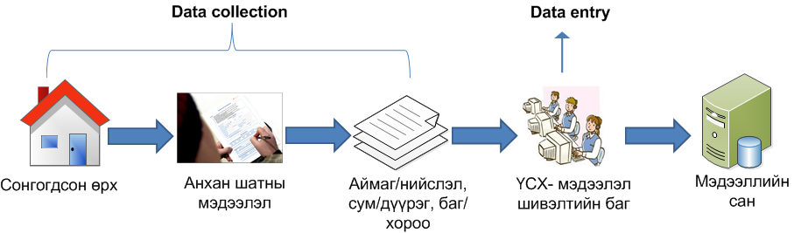
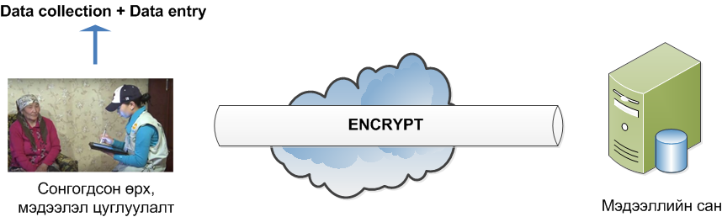
Tablet technology
Following surveys implemented tablet technology /CAPI/.
  Multi Indicator Cluster Surveys
  Household Socio-Economic Survey
  Labor Force Survey
  Time Use Survey
  Social Indicators Sample Survey
  Nationwide deliberative polling on constitutional amendment of Mongolia
  Woman’s health and life experience
before:
after:
Time saving
Financial saving
Quick
Provided database security
Data quality improvement

Slide 18
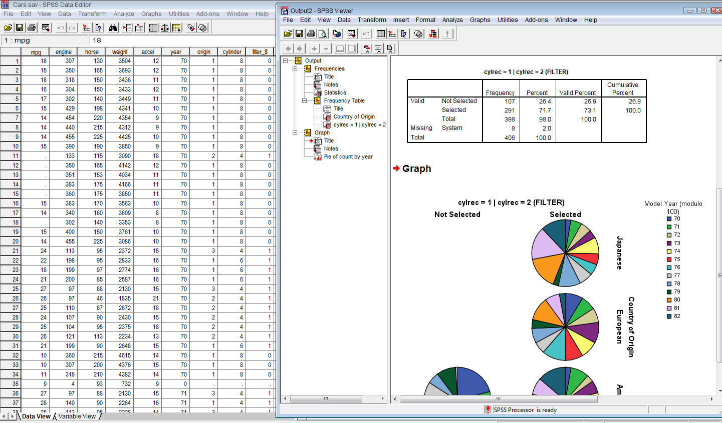


Using software packages
Analyze:
SPSS: Statistical Package for the Social Sciences
IBM SPSS: Statistical Product and Service Solutions
STATA

Slide 19
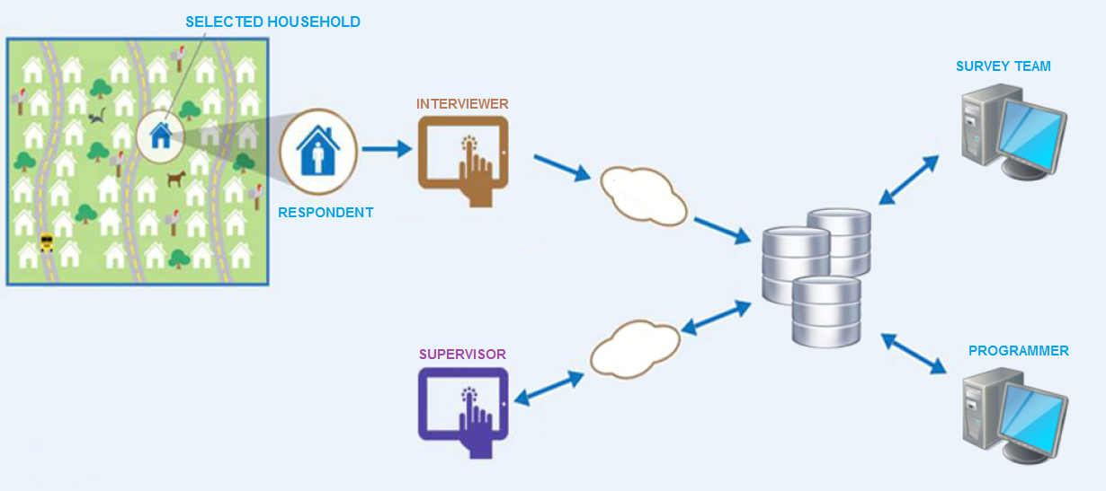
Data flow of tablet survey
INTERNET
INTERNET

Slide 20
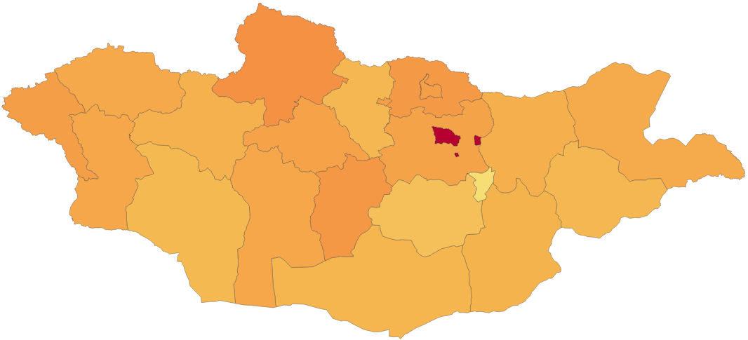
Interviewer
101 789
5
101 876
3
129 382
3
107 513
3
1 440 447
29
81 278
2
100 172
3
60 603
3
70 546
3
77 579
2
93 135
3
73 663
3
84 486
3
91 660
2
59 810
3
56 587
4
84 807
3
113 157
4
44 762
2
66 450
3
63 307
2
Population
Interviewer
Notes:
This is the number of tablets we use for our ongoing household surveys such as Labor Force Survey and Household Income and Expenditure Survey.
We also use tablets for the price survey.

Slide 21
Advantages and possibilities
ADVANTAGES
Time saving
  Time saving in household for interviewing 2 hours to 1 hour 20 minutes
  No need to data entry process after data collection
Data quality, validation, correct skips, real time monitoring
Budget saving
Data security improvement
Not only CSPro (Windows application, Web application)
POSSIBILITIES
GPS (Global Positioning System)
Voice recorder
Camera (picture, video)
Developing
  Web application
  Windows application
…etc.

Slide 22
DATA COLLECTION METHODS
Coverage ~99% | Coverage ~99% | Coverage ~85% | Coverage ~55% /urban/
Experience of previous censuses | Experience in household sample surveys | Reduce cost /enumerator transportation and DSA/ | Experience of enumerating Mongolian residents residing abroad
No added cost to related to new technology | Reduced cost in data processing and timing | Reduced cost in data processing and timing | People unavailable during day time will be enumerated via internet
Paper questionnaire | CAPI /tablet/ | CATI /telephone/ | CAWI /internet/
Added cost for transportation of census materials | Need to purchase more equipment for each enumerators | No experience | Need to improve server capacity
Ensure the security and protection of physical materials |  | Establish a call center | Unavailable to reach every person and household
Added time for data processing |  | Additional approach to reach people without telephone | Need to ensure system security
Advantages
Disadvantages
Coverage related | Human resource related | Budget related

Slide 23
LESSONS LEARNED FROM THE 2010 AND 2015 CENSUSES
E-census enumeration needed extended time
Server capacity needed to be improved
Enumerating Mongolian citizens residing abroad was not in accordance with international recommendations, however, it was essential for country-specific condition
Key indicator (personal ID #) matching between the population and household database (PDH) and other database established a good solid ground for improvement of the PHD

Slide 24
PLAN FOR 2020
Combined method
Register based + Field enumeration /new technology/
Enumeration period - 7 days /according to the Law/
  Considerations for extended time for e-census
Coverage: nationwide

Slide 25
KEY MILESTONES
2020.06
MAIN RESULTS
/within 6 months/
2019.01
PILOT CENSUS that test all essential steps and activities of field operation
/7-10 days/
2017.12
PARLIAMENT RESOLUTION to be approved at least two years prior to the census date
2020.01
CENSUS ENUMERATION
/7-10 days/
2018.06
MASTER PLAN that details all essential features, steps and activities of the census
2019.08
Address based HOUSING CENSUS
/2 months/
2019.12
E-ENUMERATION
2017 |  | 2018 |  |  |  | 2019 |  |  |  | 2020
III | IV | I | II | III | IV | I | II | III | IV | I | II

Slide 26
Thank you for attention
Question and comment?
www.nso.mn
www.1212.mn
information@nso.mn

