Slide 1
MONGOLIA: Data collection with Internet
United Nations Regional Workshop on the 2020 World Programme on Population and Housing Censuses: International Standards and Contemporary Technologies
Tbilisi, Georgia
24-27 April 2018

Slide 2
Data collection with Internet for censuses
NSOM implemented following censuses using the Data collection with Internet.
1
Population and Housing census in 2010
Citizens residing in foreign countries are enumerated through the online web system (E-Census)
Population and Housing census in 2015
Citizens residing in foreign countries are enumerated through the online web system (E-Census)
The online web system (E-Registration), that possible for citizens checking yourself registered data and if data is changed they modify and confirm data
2
3
Enterprises, companies and organizations census in 2016
Paper based data collection method
CAWI data collection method
4
Official statistics information in every quarter
Started in 2018
Included 14 official statistics questionnaires
Testing data collection method using online web system

Slide 3
Population and Housing census in 2010
1

Slide 4
CENSUSES IN MONGOLIA
E-Census result
87 423
107 140
Mongolian citizens who live in abroad for more than 6 months
*2015 – By census
Notes:
There is number of population in census years. Last 2 censuses were conducted with different approaches, compared with other censuses.
In other word, We enumerated Mongolian citizens who live in abroad for more than 6 months by using internet.
Mongolia has 3 million population. 3.8 percent of them live in abroad and they send remittances for their families who live in Mongolia. Their remittance is approximately 3 percent of GDP or their influences for economy is more. So that enumerating Mongolians who live in abroad is important for us.
1 millionth citizen of Mongolia was born in 1962, 2 millionth was born in 1988 and 3 millionth citizen of Mongolia was born in 2015.
1935-1944 Average annual population growth rate was 0.3 during war years, lowest in the 20th century.
1979 - Average annual population growth rate was 2.9 during these years, highest in the 20th century.

Slide 5
AIM OF E-CENSUS
Establishing basic database of international migration statistics
Update and expand annual census data
To create and prepare the conditions for the internet census 2020
Implementation of Law on Population and Housing Census
Notes:
And Before we don’t have international migration statistic. After e-census 2010, we got first data on international migration statistic.
Also, According to the implementation of law and program of Government, we have demand for conduct e-census.

Slide 6
AIM OF E-CENSUS
Establishing basic database of international migration statistics
Update and expand annual census data
To create and prepare the conditions for the internet census 2020
Implementation of Law on Population and Housing Census
Notes:
And Before we don’t have international migration statistic. After e-census 2010, we got first data on international migration statistic.
Also, According to the implementation of law and program of Government, we have demand for conduct e-census.

Slide 7
Population and Housing census in 2015
2

Slide 8
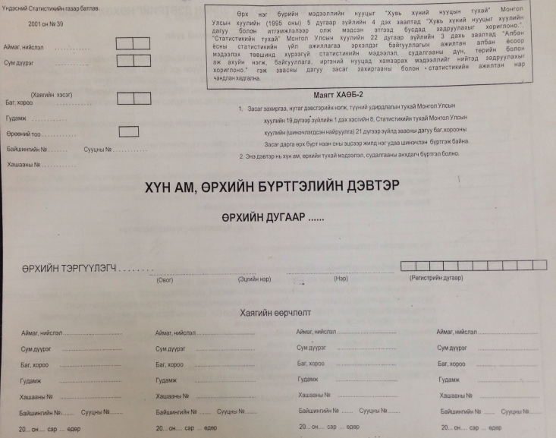
Population and household registration booklet
Official population and household registration started in 1972
Booklet:
2001
2006
2011
For those years updated booklet.

Slide 9
POPULATION and HOUSEHOLD Database
Before online system
Before every administrator units have own offline database.
Every year collecting all database and integrating.
Those steps are very complicated.
Therefore we decided shift to online system.
Bag/Khoroo
1766 databases
Soum/Districts
339 databases
Aimag/Capital
22 databases
National Statistics Office
Integrated databases

Slide 10
POPULATION and HOUSEHOLD Database - PHDB
Provinces
22
National Statistics Office
Internet
PHDB
Districts
339
Internet
Internet
Every administrative unit connected to online centralized database. For that result, every migration can be monitored.
Primary units
1766

Slide 11
DATA EXCHANGE ARCHITECTURE
National Statistics Office
Cyber Security Agency
Cyber Security Agency
Government Organization
Government Exchange Database
Cyber Security Agency
Government Organization

Slide 12
POPULATION and HOUSEHOLD Database - PHDB
Civil registration
PHDB
General authority for state registration
Other source
Other government
Real time checking people’s information from civil registration database and other government database.

Slide 13
DATA EXCHANGE ARCHITECTURE
Protocol: SOAP 1.2
URL: http://ip:port/DataExchange/nso-xChangePort?WSDL
Function: getCivilData
Input:
regnum [string]
Output:
Surname [string]
Forename [string]
givenName [string]
Gender [string]
Nationality [string]
Origin [string]
Education [string]
Birthdate [string]
maritalStatus [string]
Address [string]
civilStatus [string]
…
…
resultCode [int]

Slide 14
POPULATION and HOUSEHOLD REGISTER Database - PHDB
Civil registration
National Statistics Office
PHDB
General authority for state registration
Other source
Internet
Aimag,
Capital
22
Internet
Internet
Soum,
District
339
Bag,
Khoroo
1754
Other government

Slide 15
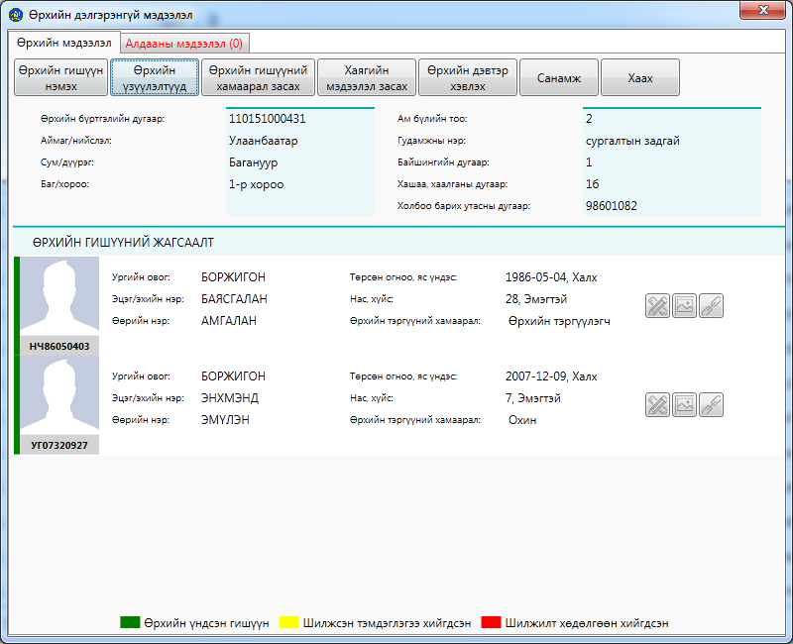
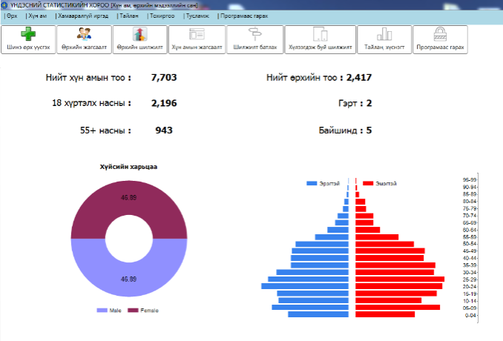
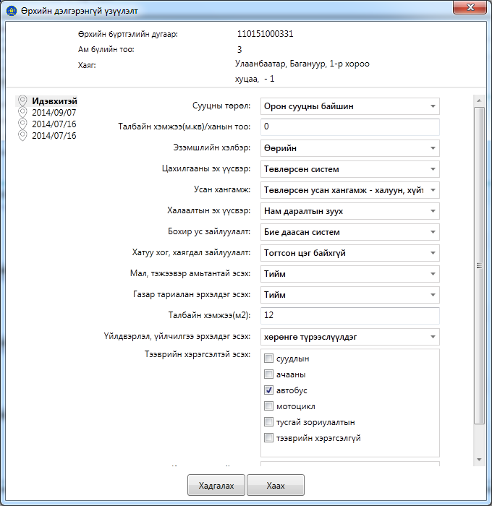
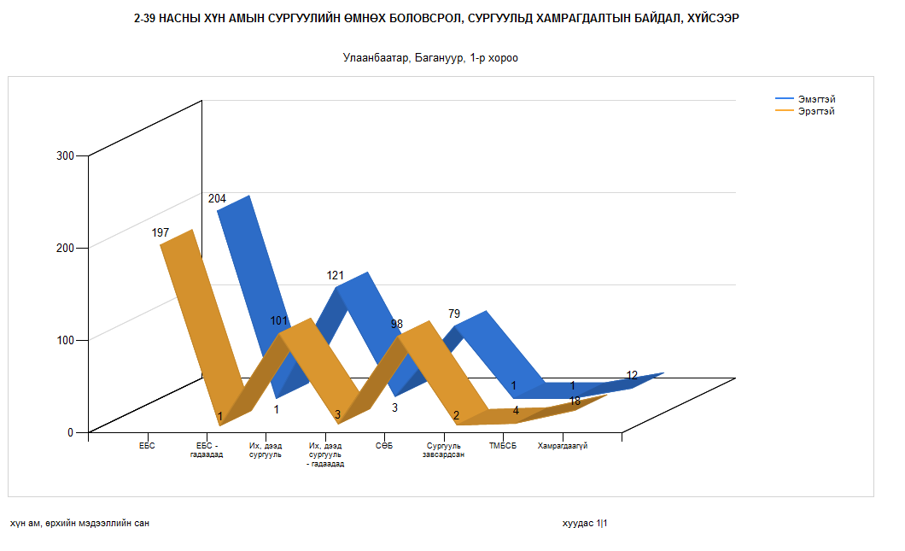
POPULATION and HOUSEHOLD Database - PHDB
Advantages
Located in DATA CENTER /Security/
No duplicate: people, household
Connected with civil registration database of General authority for state registration
Monitor population and household migration
Central control
Real time update database
Good data quality
Save time
Report: standard, BI report

Slide 16
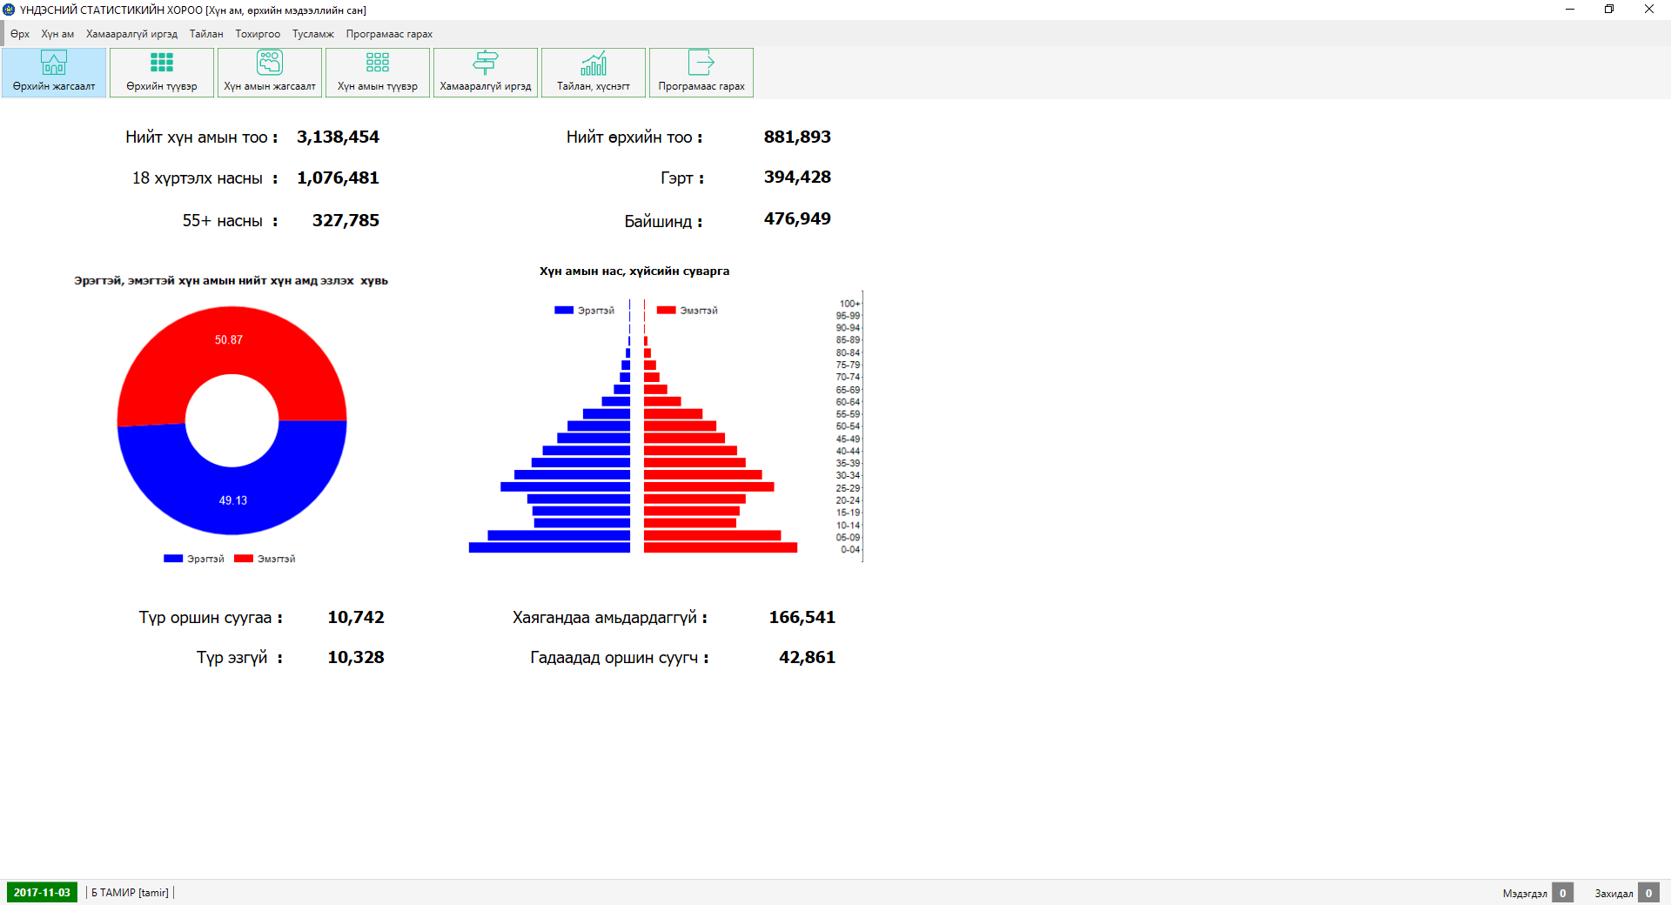
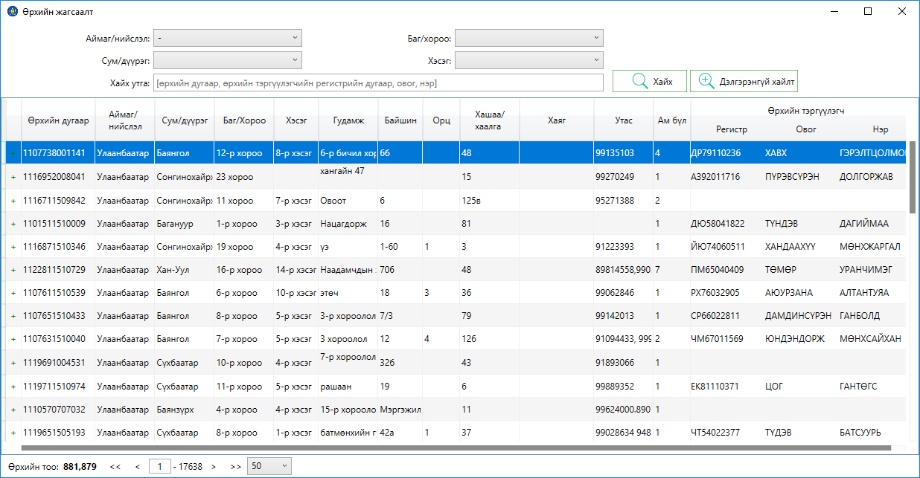
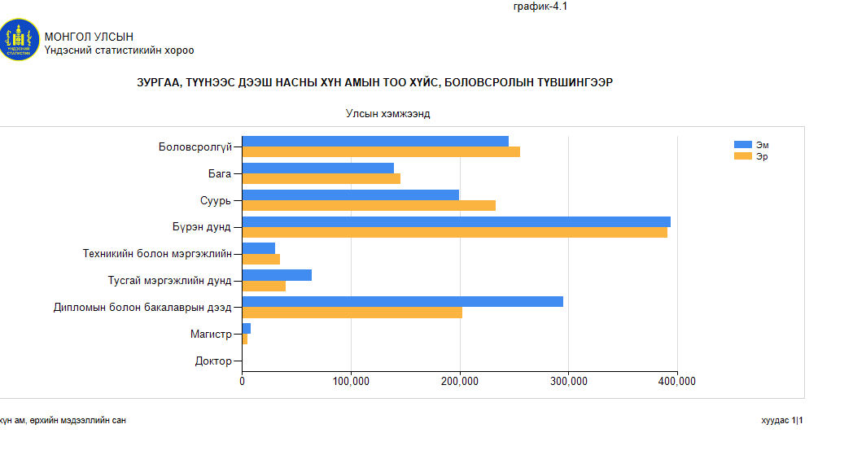
POPULATION and HOUSEHOLD Database - PHDB
Screen shots

Slide 17
E-CENSUS ONLINE WEB SYSTEM
E-Census
Citizens residing in foreign countries are enumerated through the online web system
Registration
Login
Check and confirm
Interesting information
Register for
Citizen number
Surname
Given name
E-Mail address
Checking from
PHDB
Confirmation link sent to E-Mail address
Sending username and password if confirmation is success
Login to system using username and password
Online chat system
Checking
Surname
Forename
Given name
Gender
Nationality
Origin
Education
Birthdate
Marital status
Confirm data
Interesting statistics information which contains information about yourself

Slide 18
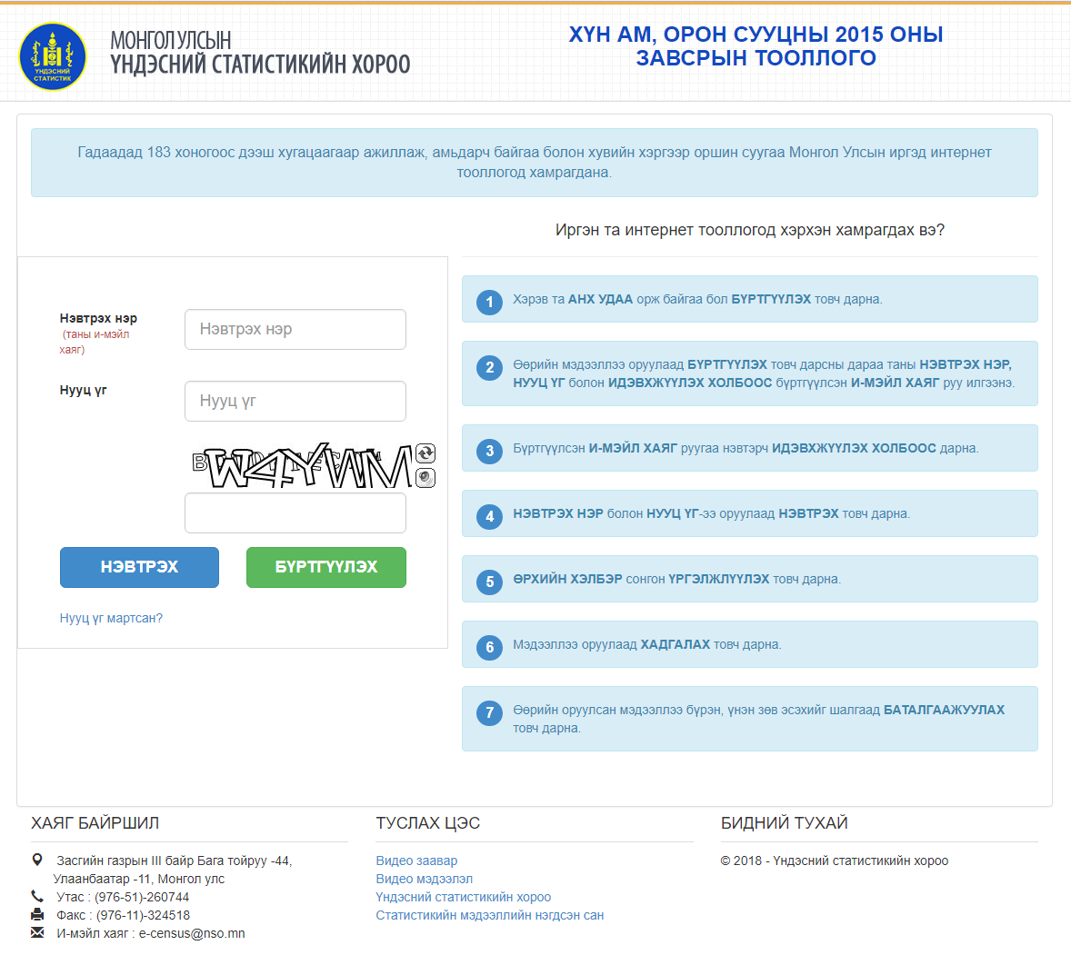
E-CENSUS ONLINE WEB SYSTEM
Screen shots
Appreciation certificate generated with personalized statistics for promotional and advocacy purposes.

Slide 19
E-REGISTRATION ONLINE WEB SYSTEM
E-Registration
The online web system, that possible for citizens checking yourself registered data and if data is changed they modify and confirm data
Registration
Login
Check and confirm
Interesting information
Register for
Citizen number
Surname
Given name
E-Mail address
Checking from
PHDB
Confirmation link sent to E-Mail address
Sending username and password if confirmation is success
Login to system using username and password
Online chat system
Checking
Surname
Forename
Given name
Gender
Nationality
Origin
Education
Birthdate
Marital status
Confirm data
Interesting statistics information which contains information about yourself

Slide 20
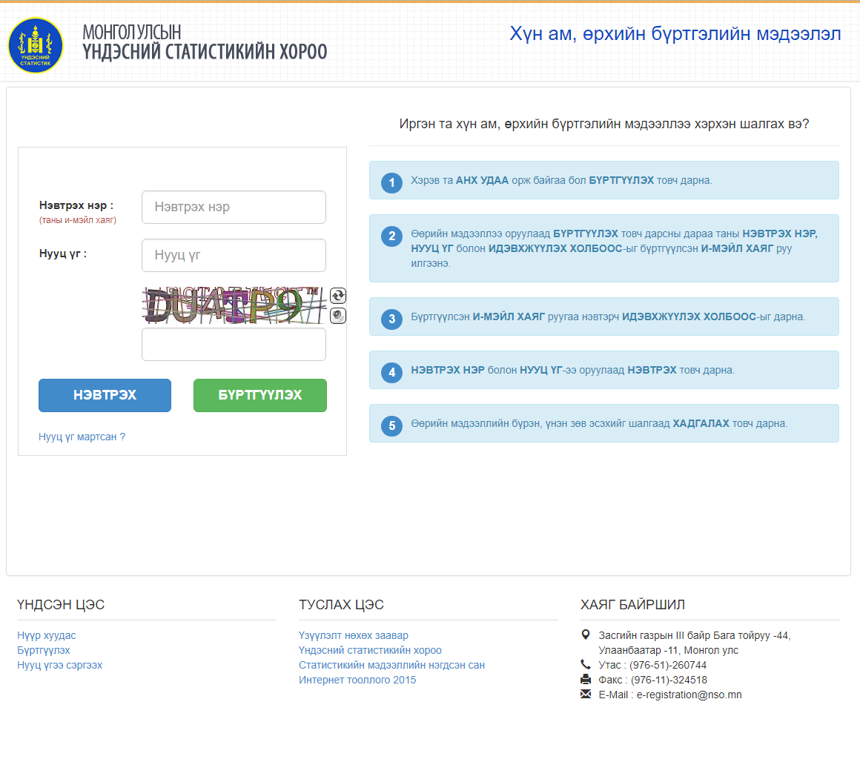
E-REGISTRATION ONLINE WEB SYSTEM
Screen shots

Slide 21
Enterprises, companies and organizations census in 2016
3

Slide 22
Enterprises, companies and organizations census
Online system
The online web system, that possible for enterprises, companies and organizations entering yourself data
Login
Data entry and confirm
Check and confirm
Reporting
Login system using
Legal entity number
Password
Checking from
E-Tax system from National Tax Office
Login successfully if tax report is filled
Online chat system
Entering
Address
Location
Income and expenditure
Assets
Investment
Branch offices
Data validation
Confirm data
Staff of headquarter and branch offices check and confirm data's
Various reports

Slide 23
Enterprises, companies and organizations census
TAX
Online
Checking Enterprise
Census/NSO/
Counter
Paper based

Slide 24
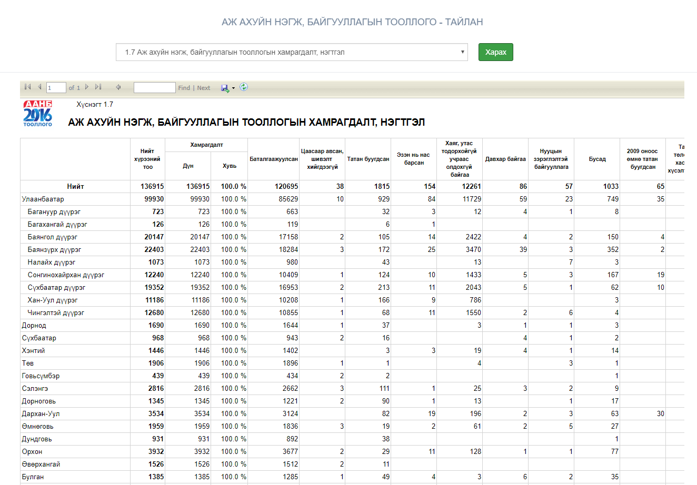
Enterprises, companies and organizations census
Screen shots

Slide 25
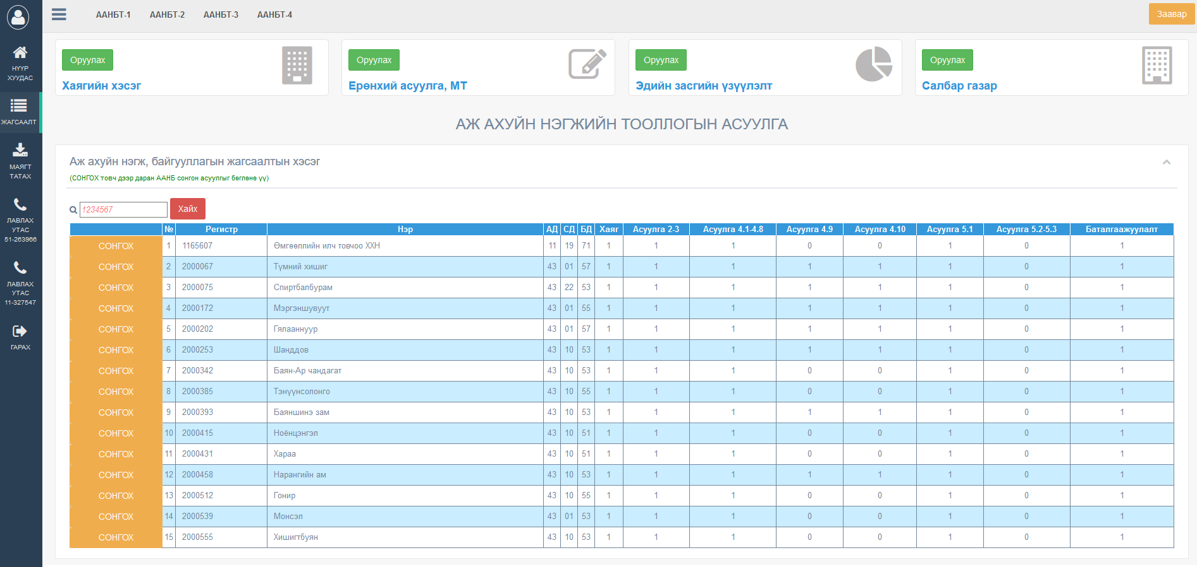
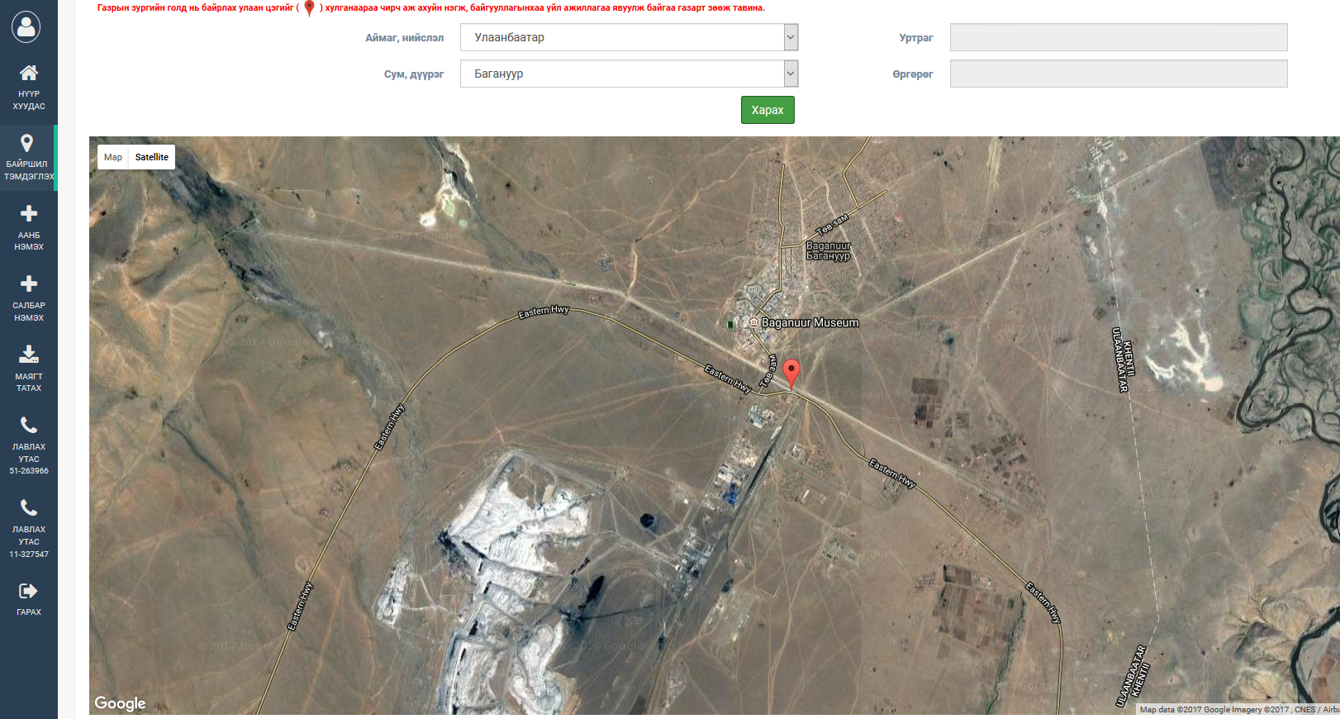
Enterprises, companies and organizations census
Screen shots

Slide 26
Official statistics information in every quarter
4

Slide 27
OFFICIAL STATISTICS INFORMATION IN EVERY QUARTER
Data System
Started in 2018
Included 14 official statistics questionnaires
Testing data collection method using online web system
Sampling and send mail
Create user and send mail
Data entry and confirm
Check and confirm data
Sampling of
Enterprises
Companies
Organizations
Sending polls whether to provide statistics data using online system
If choose to provide statistics data using online system:
Create username and password
Sending username and password
Users login to system using username and password
They enter statistics data in current period
Data validation
Confirm data if data is correct
Staff of headquarter and branch offices check and confirm data's

Slide 28
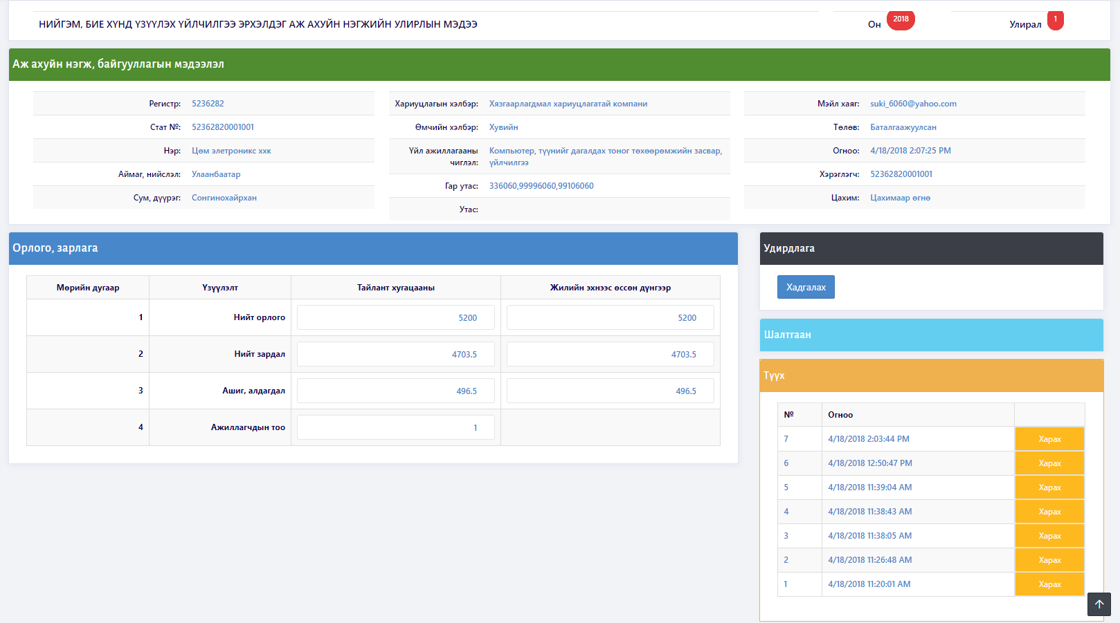
OFFICIAL STATISTICS INFORMATION IN EVERY QUARTER
Screen shots

Slide 29
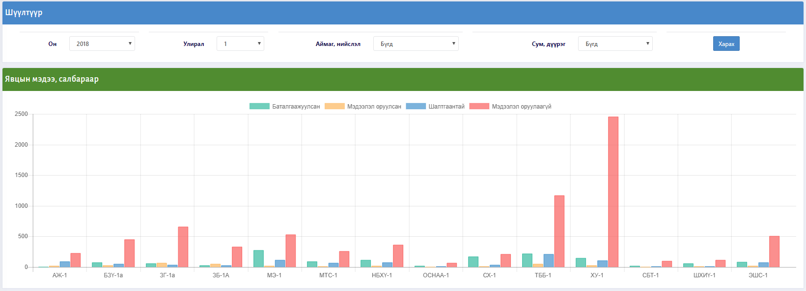
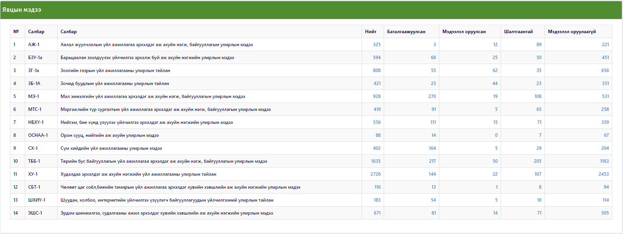
OFFICIAL STATISTICS INFORMATION IN EVERY QUARTER
Screen shots

Slide 30
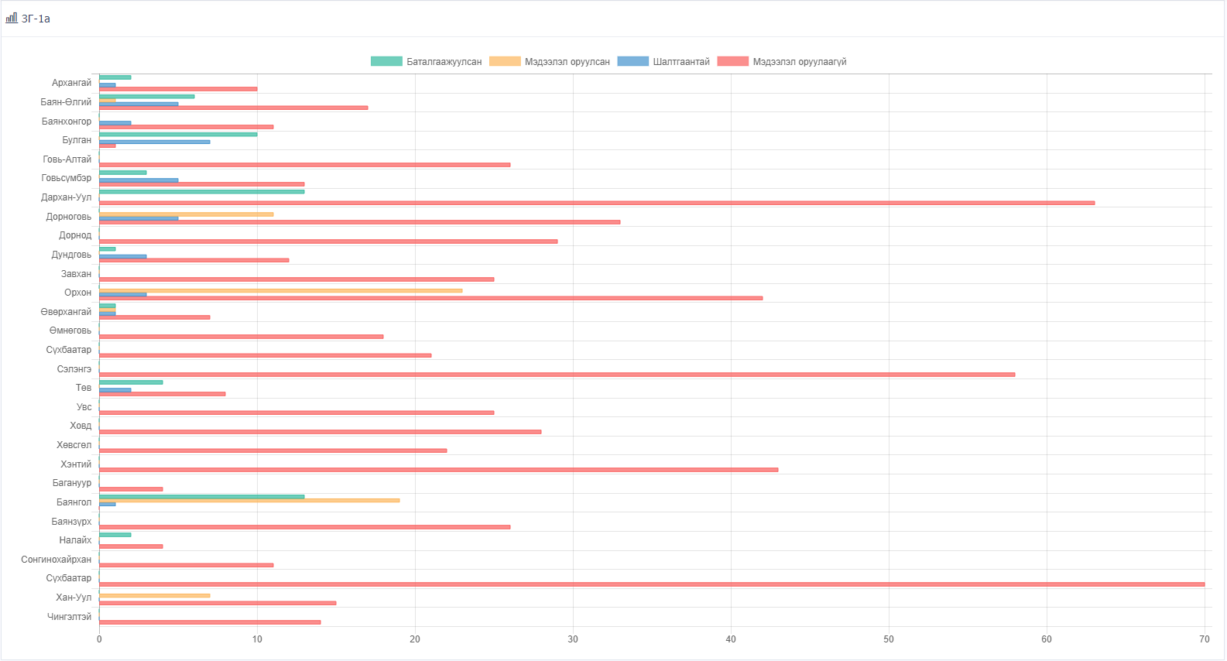
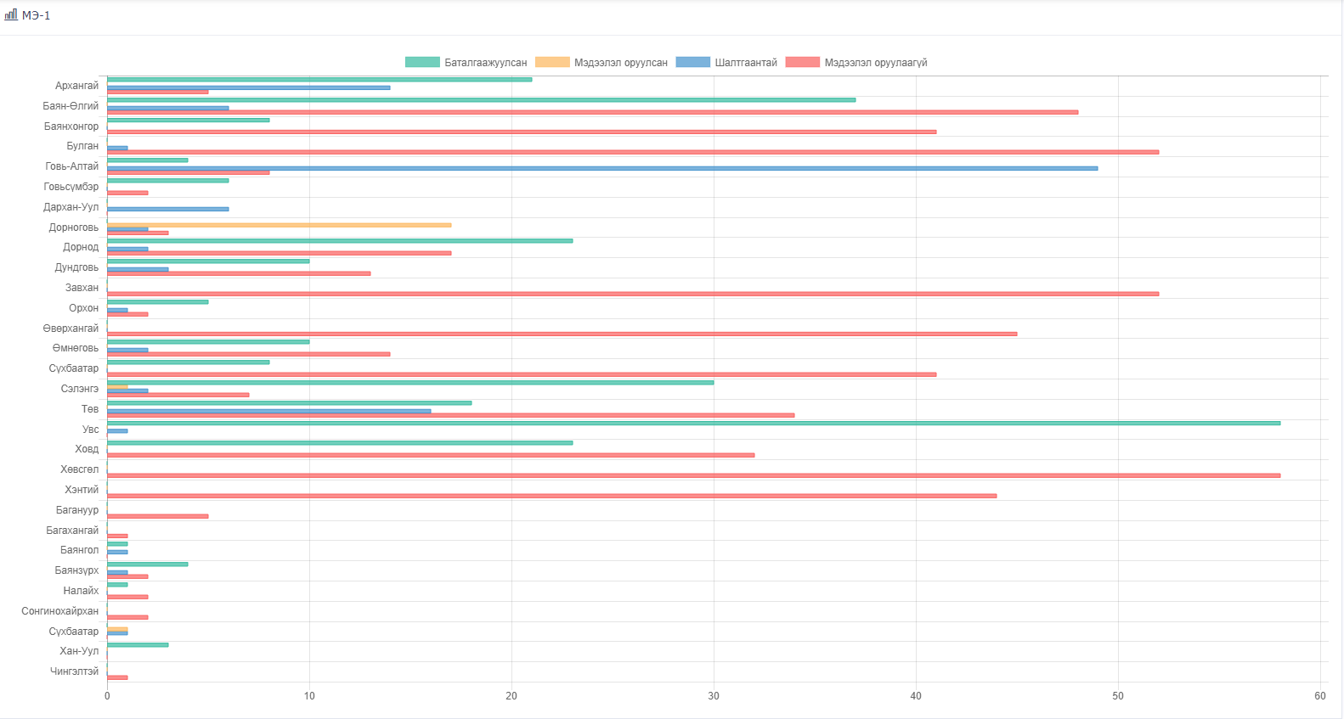
OFFICIAL STATISTICS INFORMATION IN EVERY QUARTER
Screen shots

Slide 31
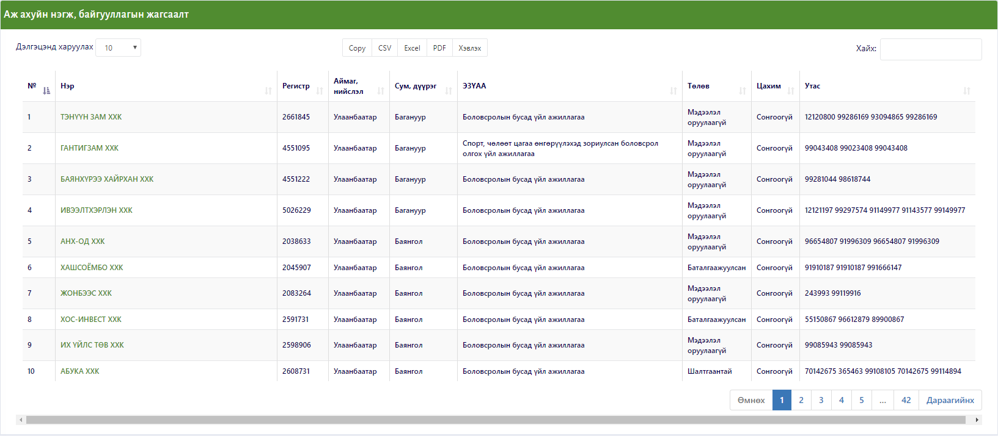
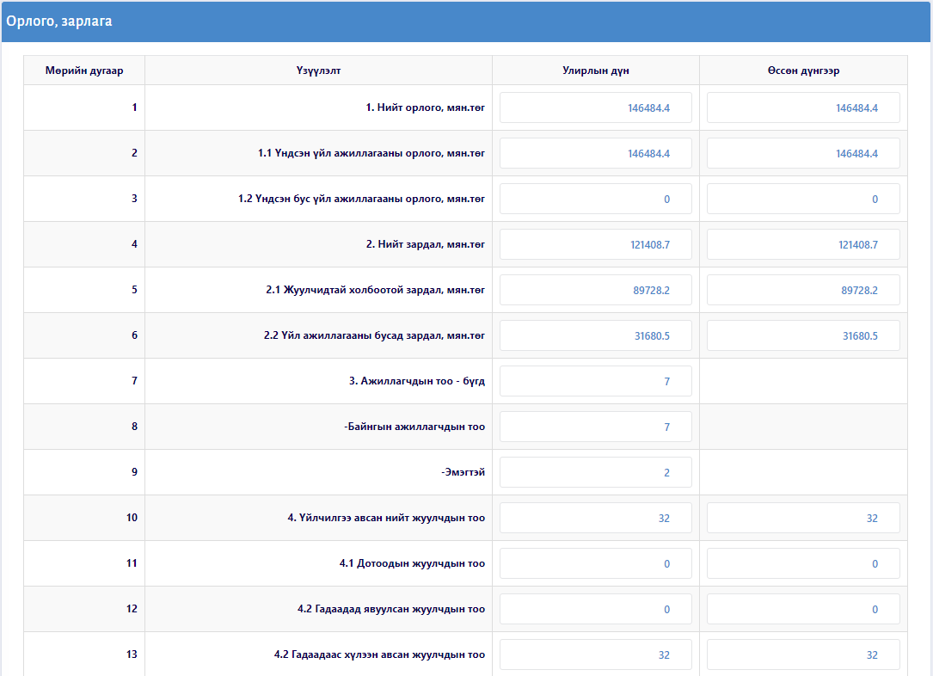
OFFICIAL STATISTICS INFORMATION IN EVERY QUARTER
Screen shots

Slide 32
Thank you for attention
Question and comment?
www.nso.mn
www.1212.mn
information@nso.mn

