Slide 1
Use of handheld electronic devices for data collection in GeoStat
National Statistics Office Of Georgia - GEOSTAT
UN regional Workshop on the 2020 World Programme on Population and Housing Censuses: International Standards and Contemporary Technologies
24-27 April, Tbilisi

Slide 2
National Statistics Office Of Georgia - GEOSTAT
Data Collection Modes
in GeoStat
Web Based - the respondent fills the questionnaire forms directly into the web based application
Paper Based - an interviewer reads questions, either face-to-face or over the telephone, to the respondent and records his or her answers on the paper form
CAPI - The questionnaire is designed using CAPI software and is loaded onto the device. The interviewer asks the questions to the respondent, and inputs the responses directly into the device.

Slide 3
National Statistics Office Of Georgia - GEOSTAT
CAPI
Introduction
Computer-Assisted Personal Interviewing (CAPI) refers to interviews conducted using handheld devices such as tablets
The questionnaire is configured using CAPI software and is loaded onto the device
The interviewer asks the questions to the respondent, and inputs the responses directly into the device
This electronic data capture approach eliminates the need for post-interview data entry and thus allows for immediate data retrieval

Slide 4
National Statistics Office Of Georgia - GEOSTAT
Introduction CAPI In GeoStat
Since 2016 GeoStat has started development of the questionnaires using CAPI Software
We made changes in questionnaires due to CAPI functionality
In 2018 we started the pilot version of agriculture survey using CAPI

Slide 5
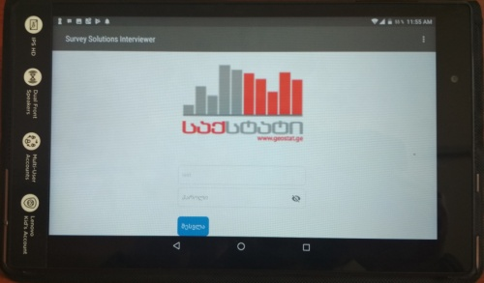
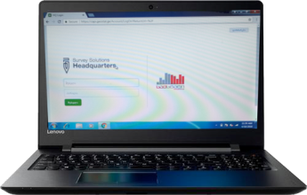
National Statistics Office Of Georgia - GEOSTAT
CAPI Technical Details in Agriculture Survey
Software - “Survey Solutions” From World Bank
Handheld Device – Lenovo Tab4, Screen size - 8”, 3G/4G internet, GPS
Server – 1 Database, 1 Web
Laptops for supervisors

Slide 6
National Statistics Office Of Georgia - GEOSTAT
CAPI Structure
questionnaire
Server
Filled up questionnaire
download questionnaire
rejected questionnaire
Interviewer
Supervisor
Filled up questionnaire
download questionnaire
Central database
Server
Supervisor
Interviewer
CAPI database
Server
CAPI web Server
approved questionnaire
Statistical analyse

Slide 7
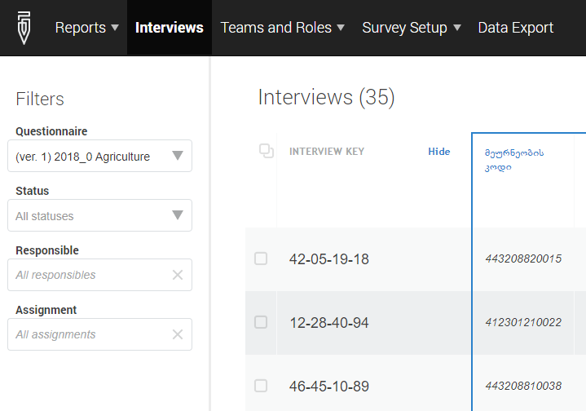
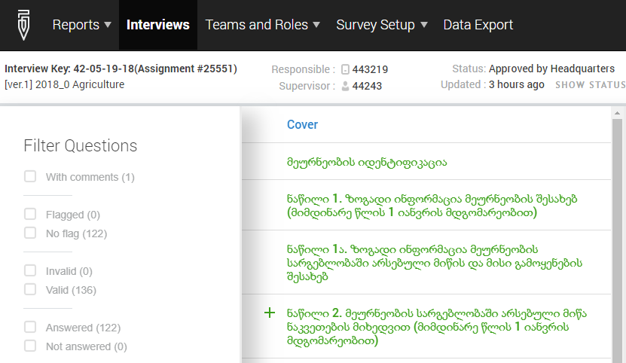
National Statistics Office Of Georgia - GEOSTAT
CAPI Process in Agriculture Survey
Create questionnaire in Designer (“Survey Solutions” Online Web application, which is located on the World Bank’s side)
Assign questionnaire to the interviewers (Local Web Application)
Receive filled up questionnaires from interviewers (Local Web Application)

Slide 8
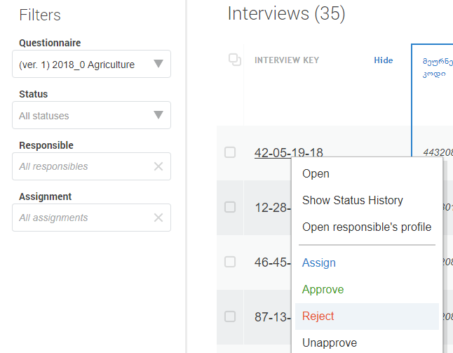
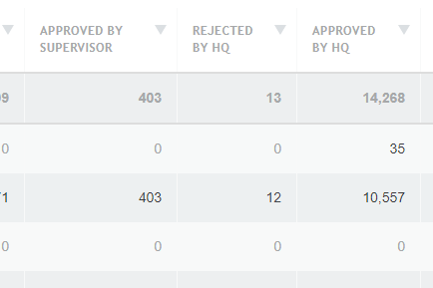
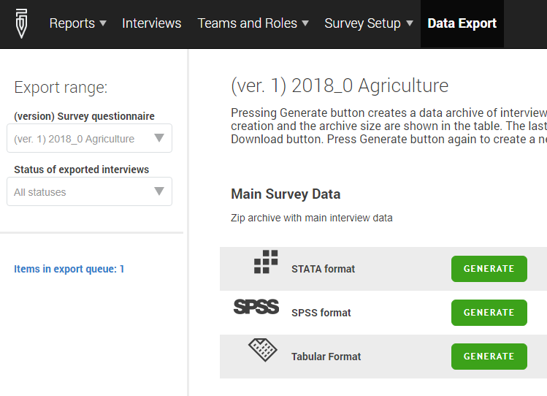
National Statistics Office Of Georgia - GEOSTAT
CAPI Process in Agriculture Survey
Review and approve/reject questionnaires (Local Web Application)
Approve questionnaires from HQ (Local Web Application)
Export data in central database for Statistical analyses

Slide 9
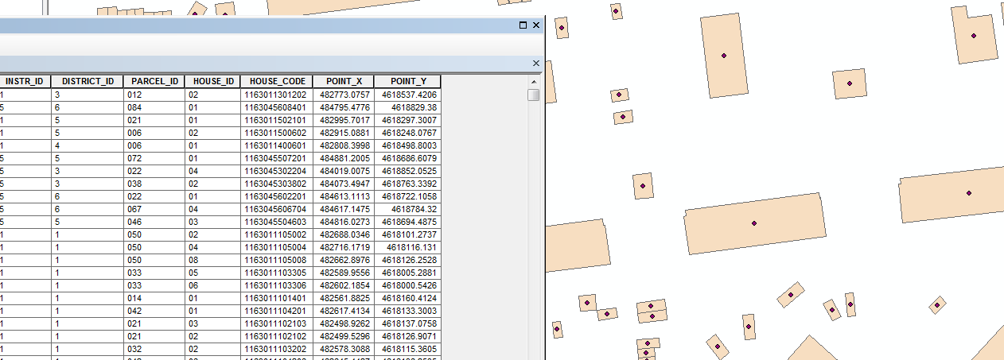
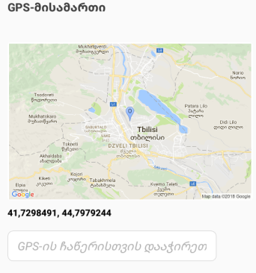
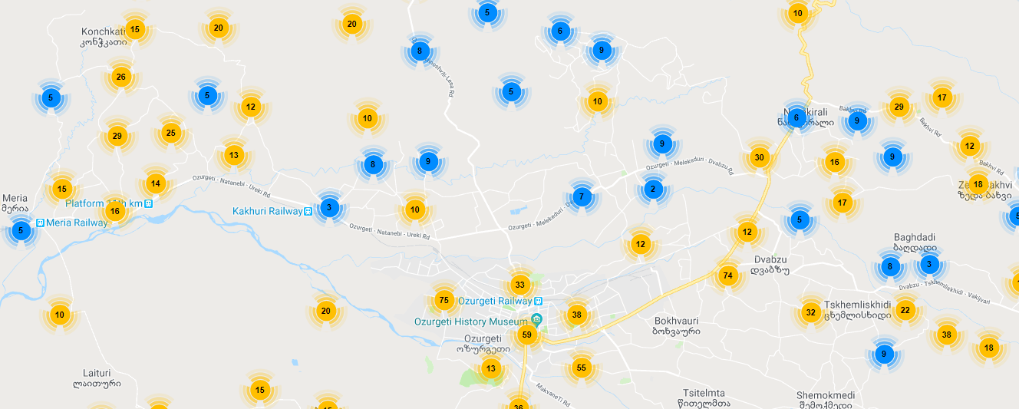
National Statistics Office Of Georgia - GEOSTAT
Using GPS in CAPI
From GIS group collect GPS coordinates for households (2014 census database)
Import GPS coordinates in CAPI
Show household location on the map
Map Report

Slide 10
National Statistics Office Of Georgia - GEOSTAT
CAPI feature plans
In GeoStat
From January 2018 Price Statistics Division has started testing web based application on Android devices (only in Tbilisi region), which collects prices from the field.
Other regions are still using the same application, but only desktop version. From the third quarter, to collect prices we are going to use Android tablets in whole country.
From the end of 2017 we have started creating Tourism statistics questionnaires in “Survey Solutions”. Today, the process is in the testing phase and we are going to start pilot survey in the third quarter.

Slide 11
National Statistics Office Of Georgia - GEOSTAT
CAPI
Advantages
Data validation - Surveys can contain validation data that make it impossible to enter values outside a given range. Supervisors may also view and check the collected information as soon as the enumerators finish the interviews, together with possible error reports. Automated routing reduces the incidence of missing data
Real-time Update - Changes in the structure of the questionnaire can be instantly reflected on the interviewers' devices. This allows for last-minute updates or error corrections. Unlike to the PAPI, Changes or corrections of the questionnaires have no cost
GPS Monitoring - The interview is normally conducted in the respondent's home or, although rarely, in another agreed upon location. GPS field in the questionnaire gives coordinates about respondent’s home. This information is used by monitoring team
Quality - CAPI has a solely positive influence on the quality of statistical processes and therefore – directly on the quality of statistics. Implementation of CAPI will allow to improve our activities in line with the ES Code of Practice

Slide 12
National Statistics Office Of Georgia - GEOSTAT
CAPI
Costs
CAPI, compared with paper surveys, generates both extra costs and savings.
set-up costs - CAPI will always be more expensive due to the time needed to convert paper questionnaires to a tablet version
data entry cost - the savings generated by CAPI (which has no separate data entry) increase as the size of the survey population increases
cleaning data - The costs of cleaning data are also higher for paper surveys since, in a CAPI interview, respondent and interviewer errors are rectified during the interview itself
Administration cost - Administration costs for paper surveys, which include the printing and distribution of questionnaires, also tend to be higher than for CAPI surveys

Slide 13
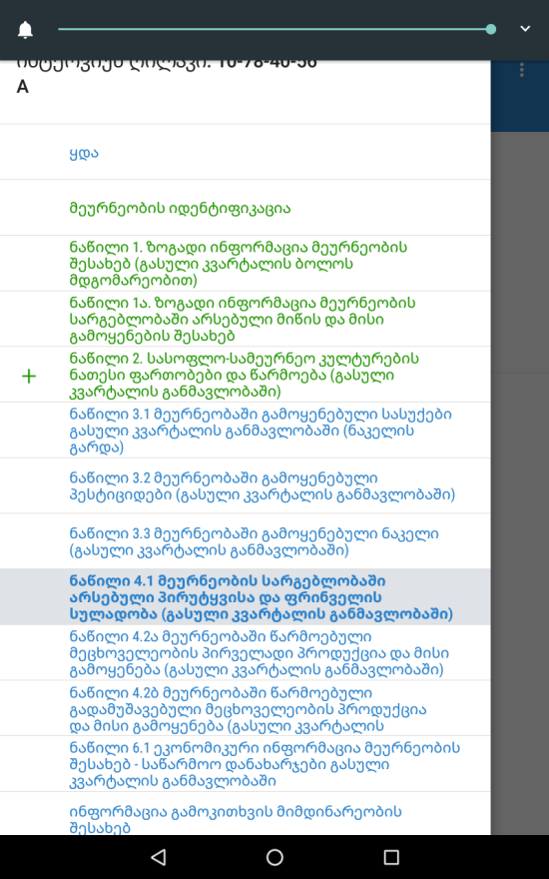
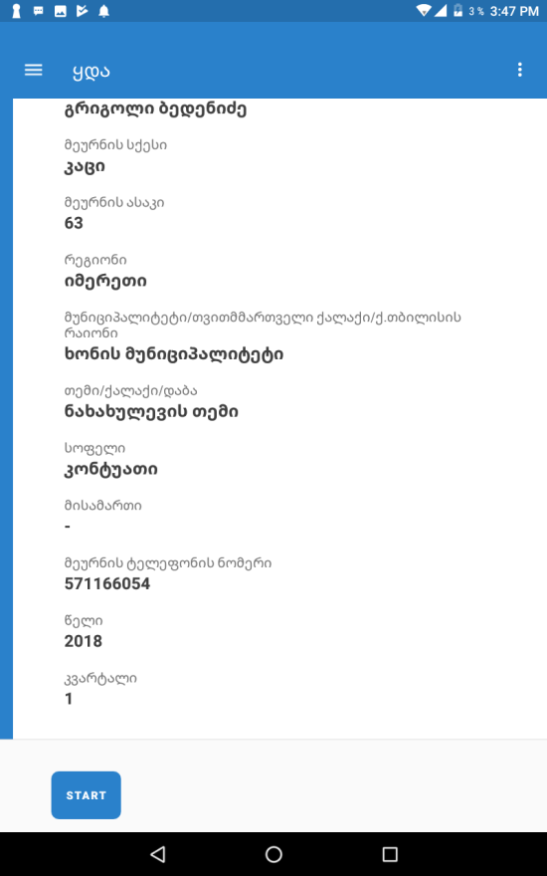
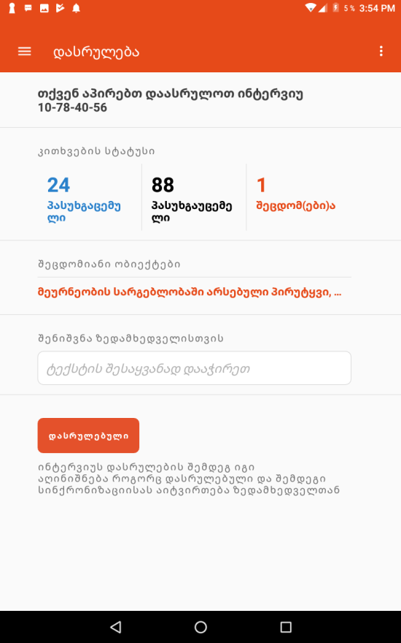
National Statistics Office Of Georgia - GEOSTAT
Screenshots from “Survey Solutions”

Slide 14
National Statistics Office Of Georgia - GEOSTAT
Thank you for your attention
Aleksandre Ambokadze
E-mail: sambokadze@geostat.ge

