Slide 1
Introduction of GIS in Population Census of Georgia 2014
United Nations Regional Workshop on the 2020 World Programme on Population and Housing Censuses: International Standards and Contemporary Technologies
24-27 April
Tbilisi

Slide 2
Introduction of GIS in 2014 Population Census
UN Recommendations
Experience of developed countries using GIS in Census activities
Past experience from 2002 Census (Paper based and manual made cartographic materials) and willingness to develop new technology for ensure quality of Census
Existed practice of using GIS methods in Georgia in non statistical purposes (land cadastre reform, privatization of agricultural land, demarcation of borders and etc.)
Existed geo-referenced database (included buildings, streets, parcels and etc.)

Slide 3
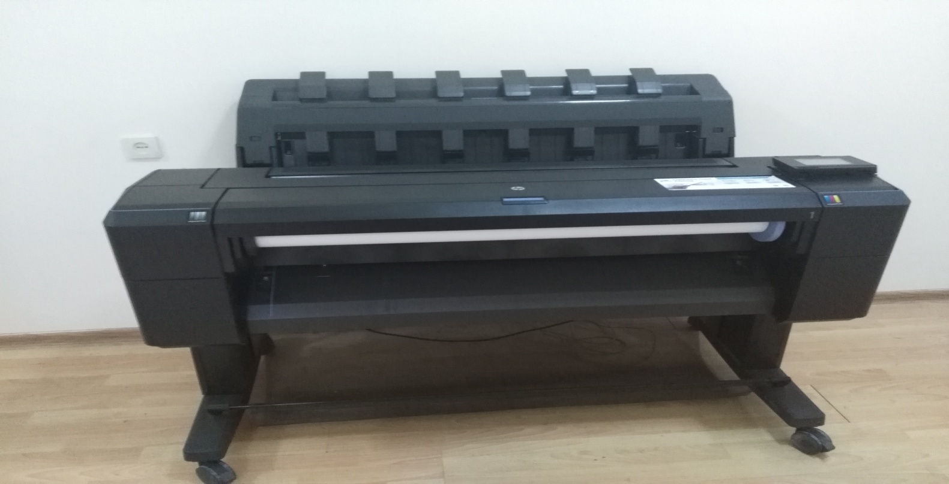
Introduction of GIS in 2014 Population Census
first steps
Geographic Information System (GIS) first was introduced in 2006
With financial support of UNFPA ESRI software and large scale printer (plotter) was acquired
In 2007 Pilot Census was conducted in one municipality of Western Georgia
GIS maps was prepared for Pilot Census field work - outsourcing
In 2008 according to Pilot Census results GIS team was established with financial assistance of UNFPA

Slide 4
Role of cartographic material in Census activities
Pre-enumeration period
To collect data on initial list of households by each buildings
To divide country by equal statistical areas (EA, SA, Sectors)

Slide 5
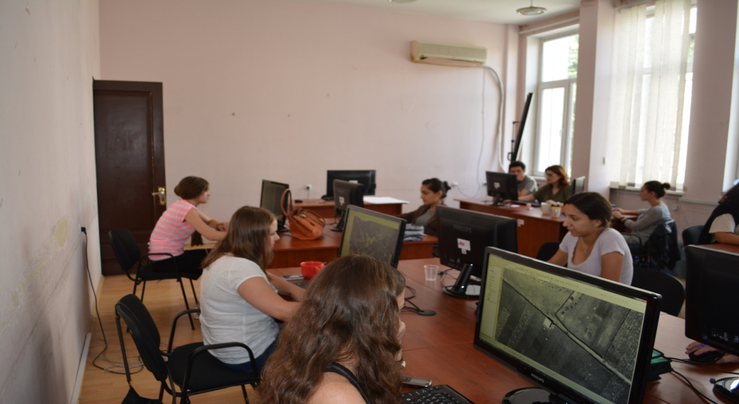
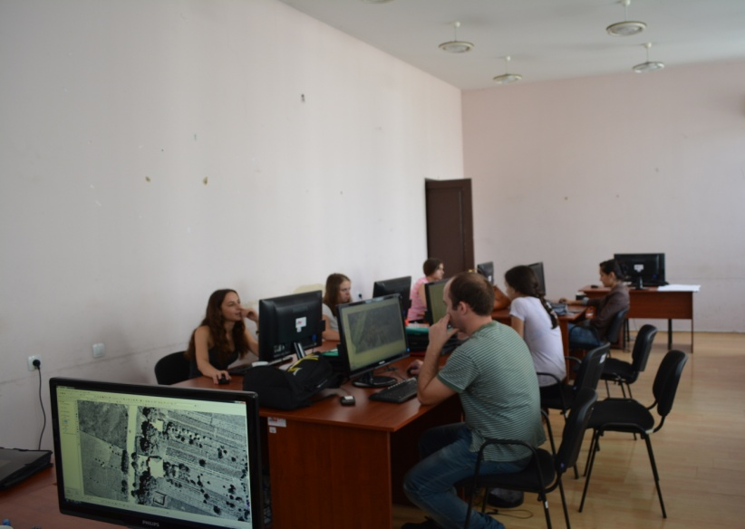
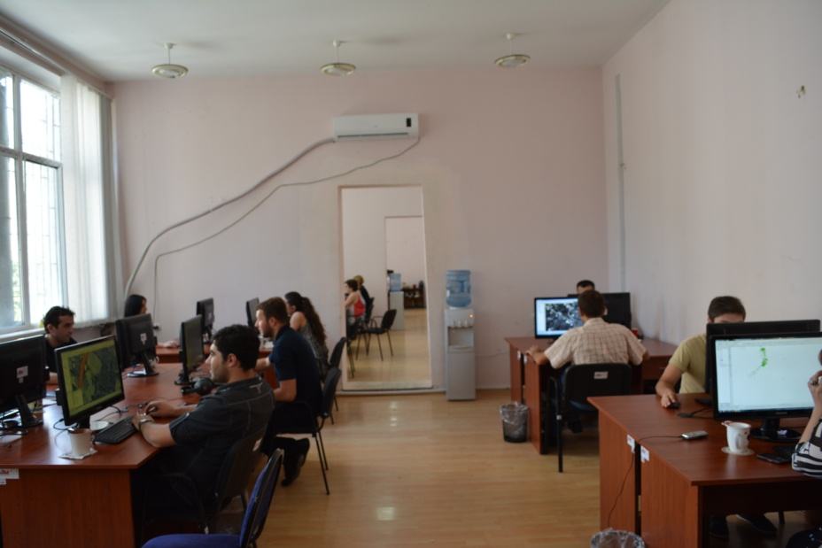
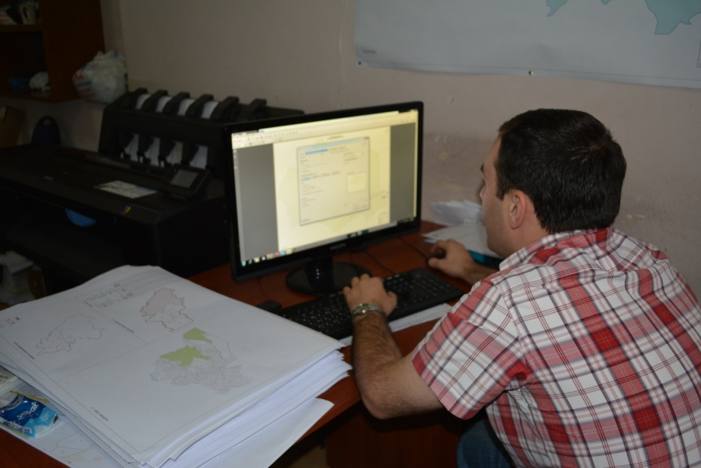
Introduction of GIS in 2014 Population Census
In 2012 - first half of 2014: GIS team (about 60 persons) developed and updated maps for the initial listing of buildings and households

Slide 6
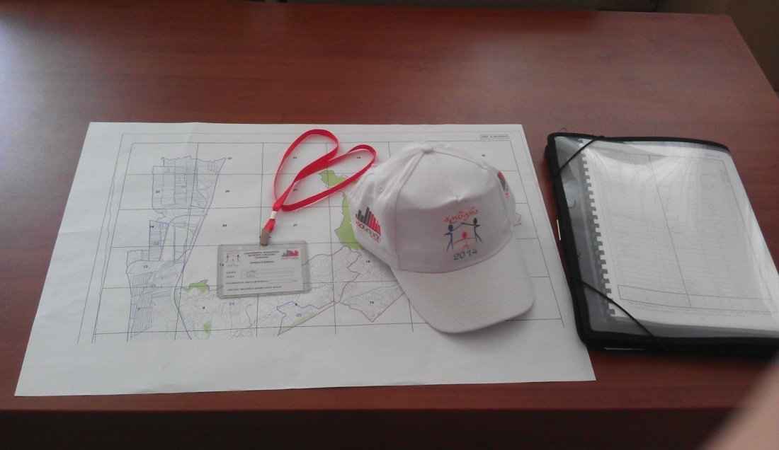
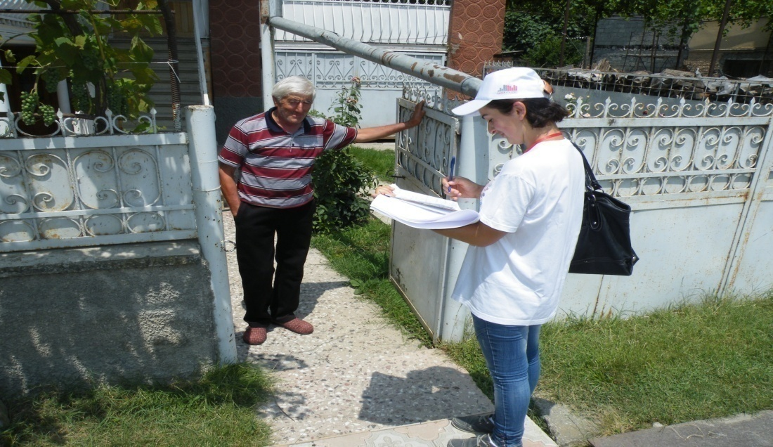
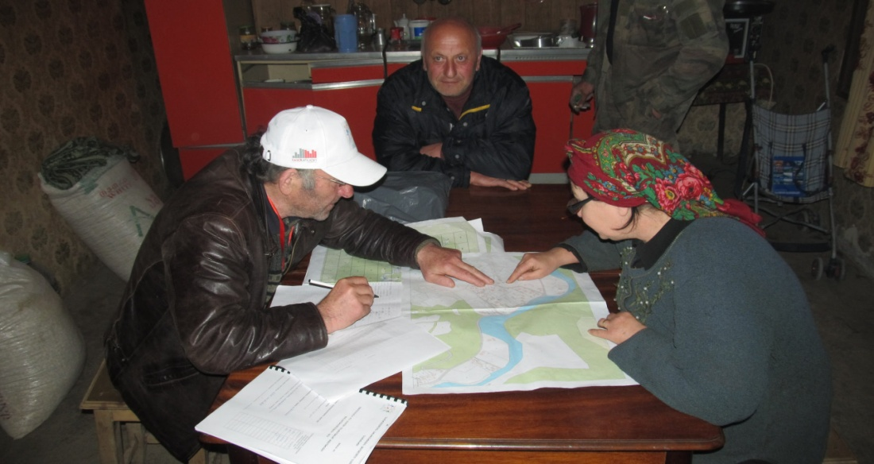
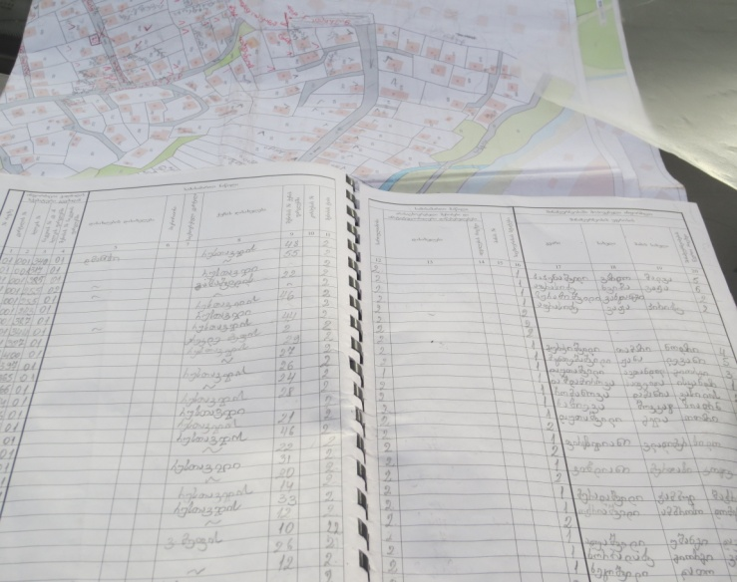
Introduction of GIS in 2014 Population Census
During 2013 and first half of 2014: Conducted fieldwork for the initial listing of buildings and households, included update of maps

Slide 7
Role of cartographic material in Census activities
Enumeration period
Assist enumerators to identify working areas
Assist to find dwellings and households
Avoid double- or undercount of population
Check field work during enumeration period

Slide 8
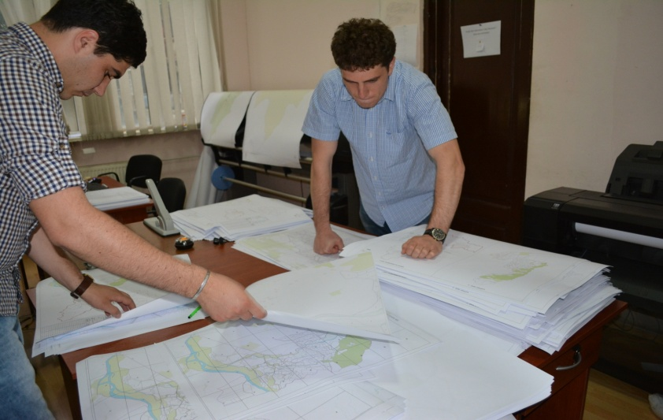
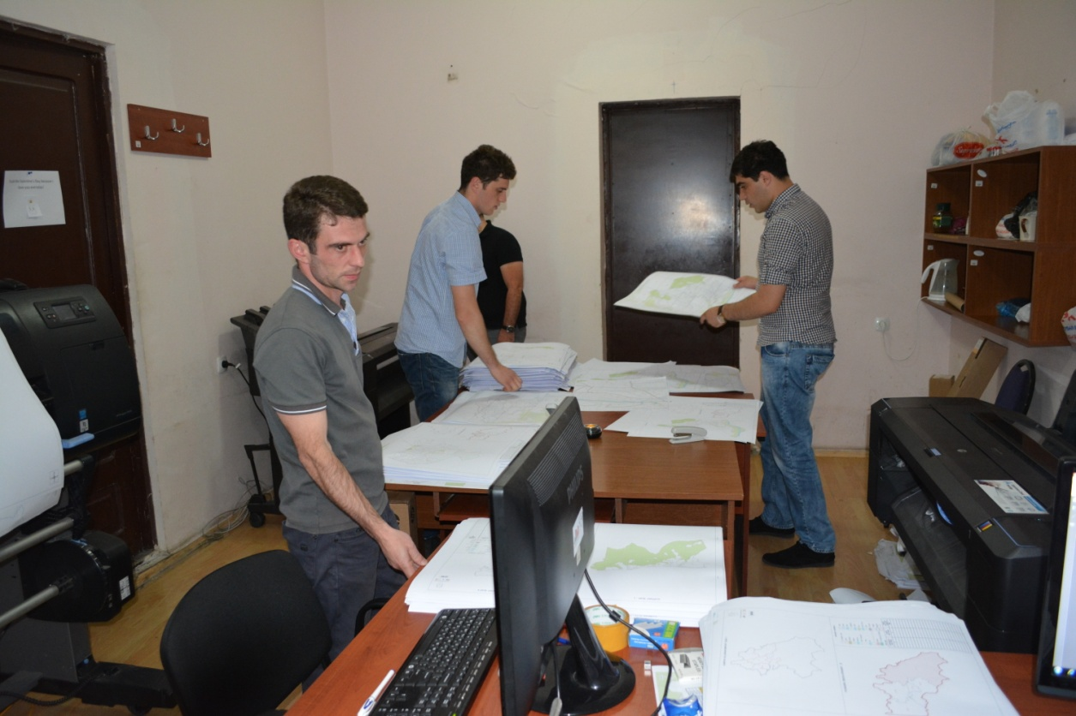
Introduction of GIS in 2014 Population Census
In 2014: Printed more than 12 thousands maps for 2014 General Population fieldwork

Slide 9
ADVANTAGES: Saves Time
Automatic or semi-automatic update of maps
Automatic or semi-automatic creation of EA
Immediate changing of identified problems
Immediate printing
Useful for other censuses or sample surveys

Slide 10
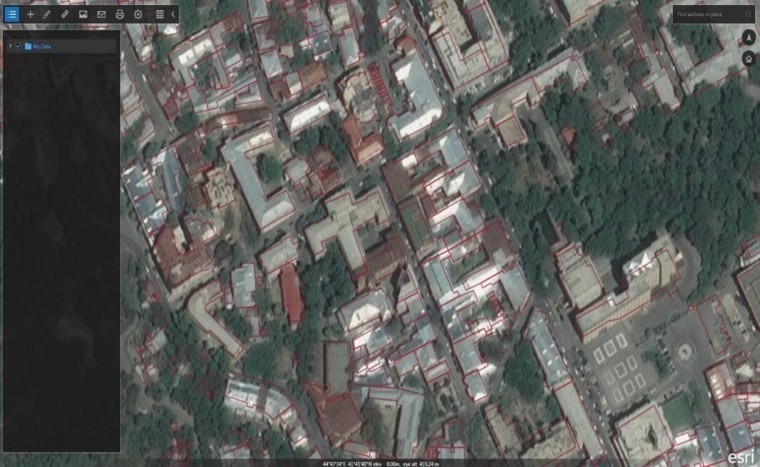
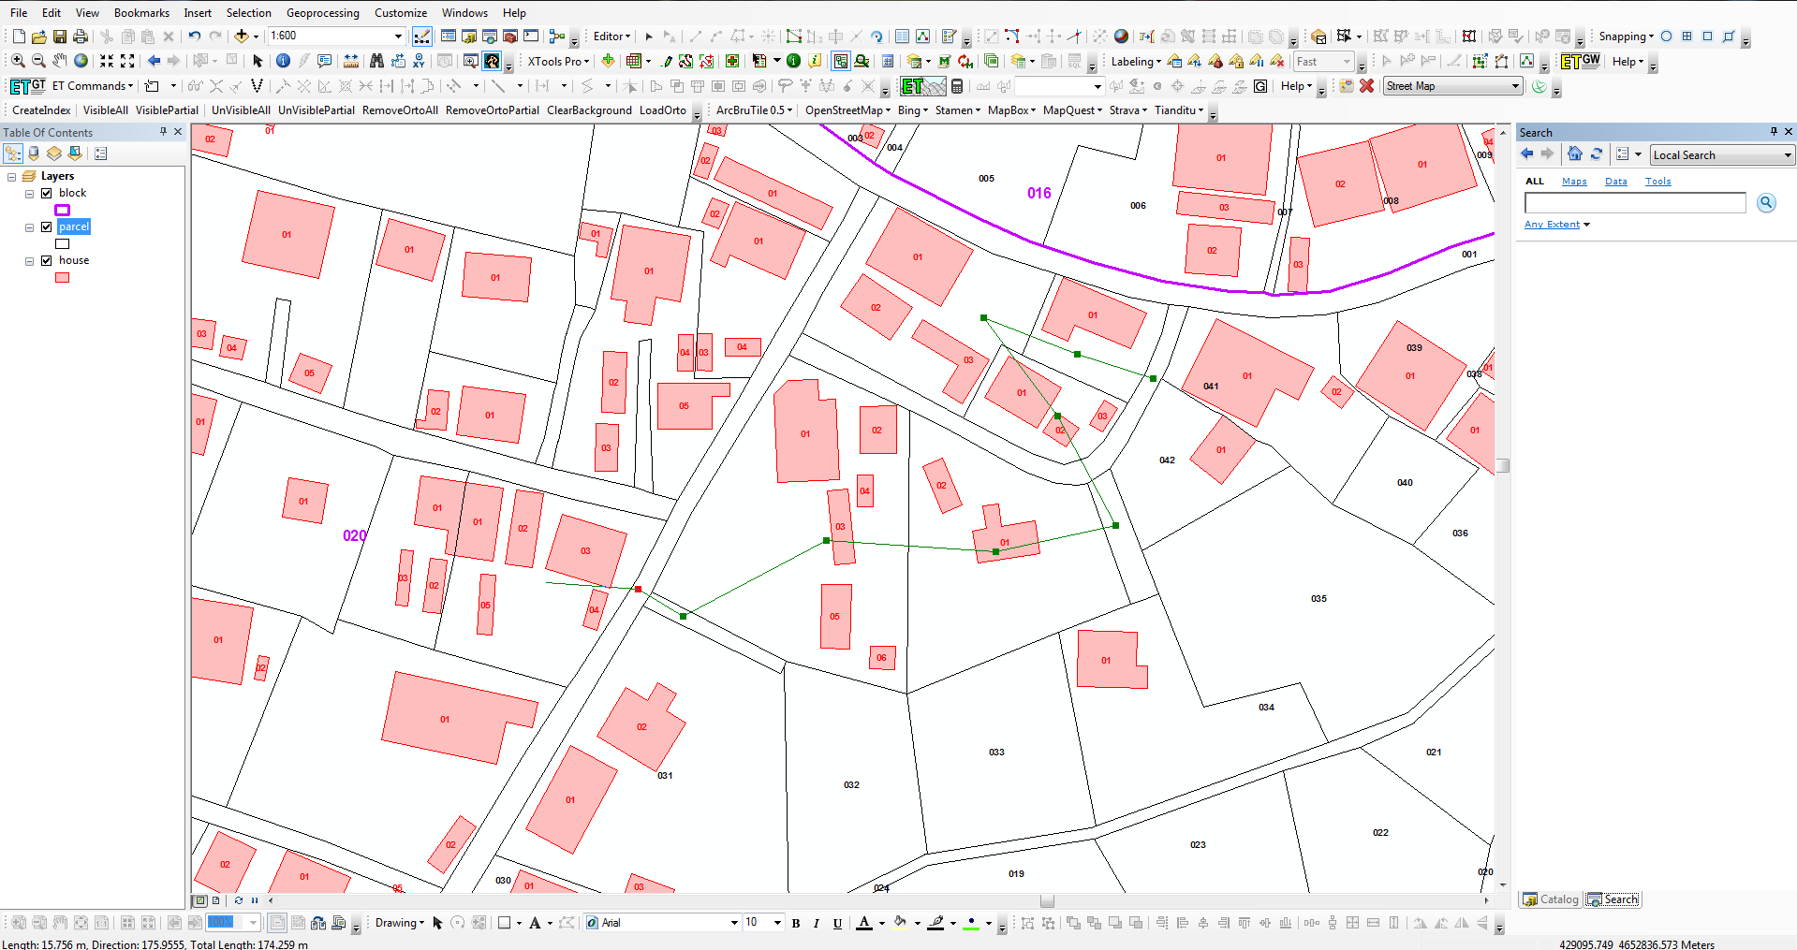
ADVANTAGES: Ensures quality of cartographic material and its accuracy

Slide 11
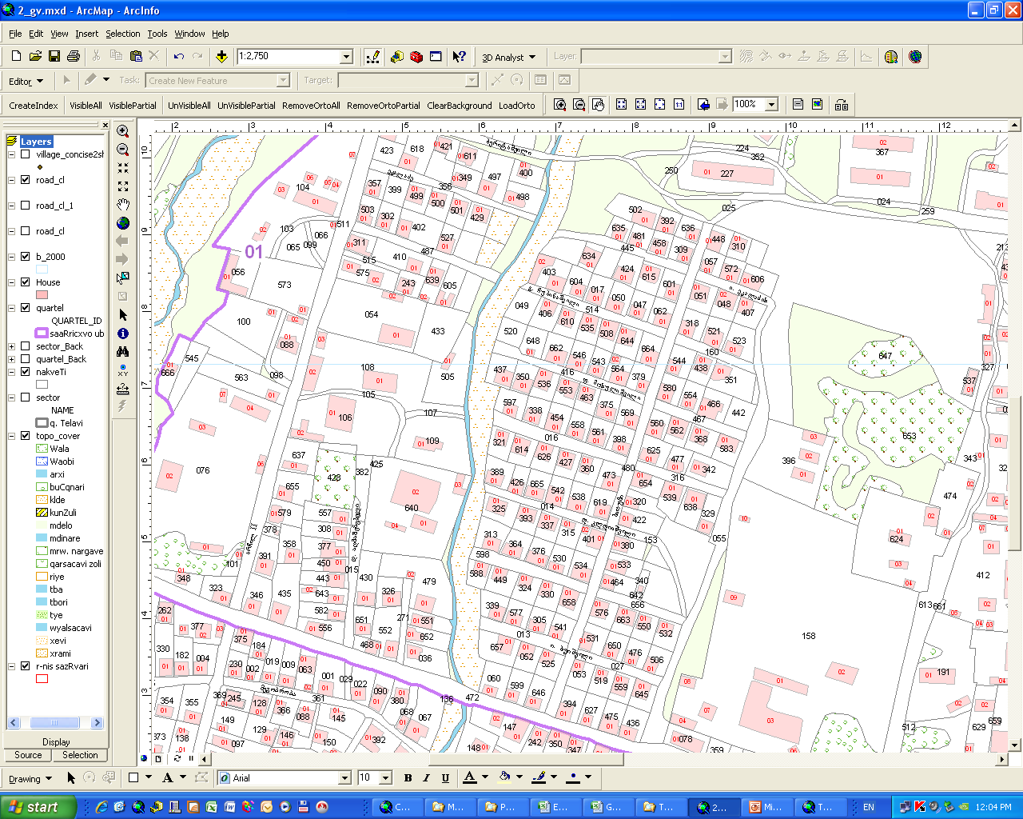
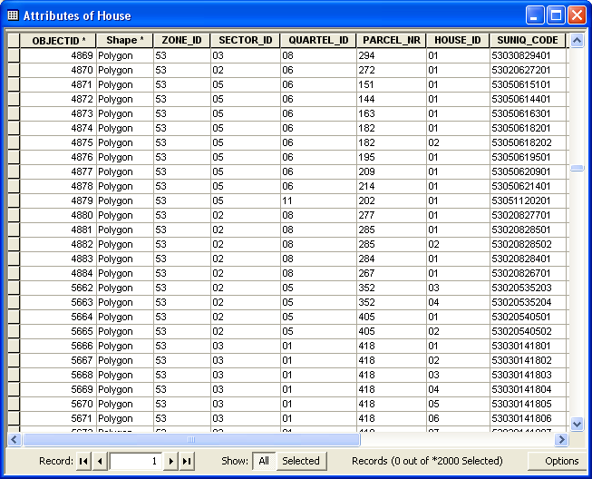
ADVANTAGES: Makes Possible to Renew Databases

Slide 12
Role of cartographic material in Census activities
Post-enumeration period
Check field work after enumeration period
Data Analysis
Dissemination

Slide 13
ADVANTAGES:
Helps to create registry of standard statistical territorial units and its use for various statistical activities and monitoring of field works
Agricultural Censuses
Economic Censuses
Social and demographic surveys

Slide 14
ADVANTAGES: Provides Good Visualization of Censuses Results
Density (number of population per 1 sq.km), Regions
Population grid, 1 sq.km,
Settlements
http://gis.geostat.ge/geomap/demografiaen.html#8/42.334/43.380
http://gis.geostat.ge/GeoMap/layersw/indexe.html

Slide 15
Introduction of GIS in 2014 Population Census: Main Challenges
Human resources
Uncovered territory by digital information
Imperfect address system
Training of field staff on using of maps

Slide 16
Thank you for your attention!
www.geostat.ge
www.census.ge

