Slide 1
Quality assurance in Population Census of Georgia 2014
United Nations Regional Workshop on the 2020 World Programme on Population and Housing Censuses: International Standards and Contemporary Technologies
24-27 April
Tbilisi

Slide 2
2014 General Population Census in Georgia
2006-2014
5-19 November, 2014
2015-2016
Pre-enumeration period
Enumeration period
Data Collection
Post-enumeration period
Collect data on initial list of households by each buildings;
Divide country by equal statistical areas (EA, SA, Sectors).
Pilot Census;
Dissemination.
Data processing;

Slide 3
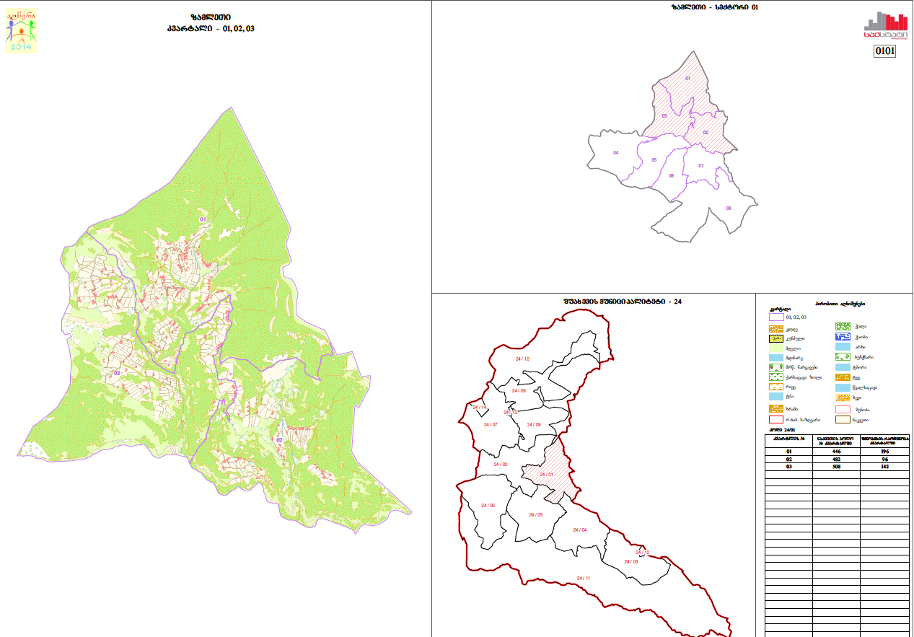
I Stage: 2013-2014 - Pre-enumeration period
Local Area
Enumerator area
Region
Municipality

Slide 4
Quality Assurance: Pre-enumeration period
Compilation of lists of buildings and households for each settlement by using cartographic materials.
The objective of this activity was to establish the number of population in each building in advance of the fieldwork.
The aim:
Quantity control during the data collection process;
Field monitoring.

Slide 5
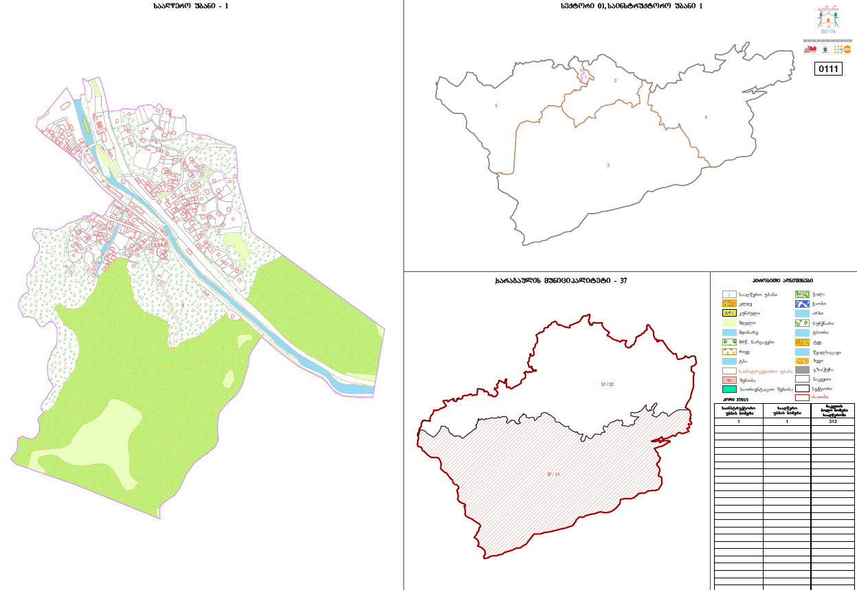
II Stage: 2014 - Enumeration period
Sector
=
6-7 Supervisor Area
Supervisor Area
=
4-5 Enumeration Area
Enumeration Area
=
Average 391 persons
Municipality
Region

Slide 6
Enumeration period, 5 – 19 November
Sector Supervisor
Quality control of the process
Supervisor
Supervisor of Municipality and Region
Organizational issues and the timeframe
Quality
Enumerator
Quality control of Enumerator’s work
Data collection
Geostat - Central Office
Receiving Reports end of the working day
Internal Audit Division
During and end of the fieldwork carry out the coverage control in each enumeration area.
21-23 November, carry out the coverage and quality control over 10% dwellings in each enumeration area.

Slide 7
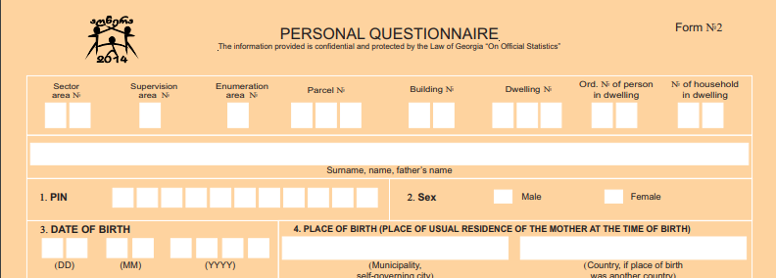
Quality Assurance: Introduce Personal Identify Number (PIN)
Advantages:
data entering process;
linking to the other administrative sources;
Avoid doubling
Quality check of other variables
Disadvantages:
caused a negative reaction of respondents

Slide 8
Thank you for your attention!
www.geostat.ge
www.census.ge

