Slide 1
United Nations Regional Workshop on the 2020 World Programme on Population and Housing Censuses
Census Planning and Management
Tbilisi, Georgia
24-27 April 2018
Sebnem BESE CANPOLAT, PhD
sebnem.canpolat@tuik.gov.tr
Head of Demographic Statistics Department
TurkStat
Turkish Statistical Institute

Slide 2
Contents
Census history
Target for 2021 PHC
Registers needed
Information on available registers
Plans of TurkStat
Financing
Regulation

Slide 3
Census History
14 traditional population censuses (1927-2000)
One-day full enumeration with national curfew
Paper based questionnaire (ICR method in 2000 Census)
No information on usual residence (de jure)
Need of a large number of staff
High cost
Overcounting
Long duration of data processing (around 3.5 years)
Population statistics are available within 5-10 year interval
To overcome these problems, it was necessary to establish an up-to-date population registration system.

Slide 4
Target
Building an Address Based Population Registration System
All addresses within the boundaries of the country were registered in the National Address Database (AR)

Slide 5
WHAT IS ADDRESS BASED POPULATION REGISTRATION SYSTEM?
Personal Information
Address
Population Registration System
By linking addresses of Turkish citizens living in the country with the Turkish ID number,
Population Registration System was established in 2007.

Slide 6
Census History
We obtain population size and its basic characteristics (age-sex structure, nationality, place of birth, type of household and internal migration annually from PR system. PR was the main facilitator to conduct …
2011 PHC: Census with combined method
Combined method: Registers + Sample field data (12%)
3 months field operation, 40 % PAPI and 60% CAPI
Use of registers for census for the first time (20% of the variables)
Sampling size of survey was about 2.4 million households.

Slide 7
History of Censuses
Difficulty in hiring and training of a large group of field staff for a short term work
Difficulty in collecting data on mortality, labour force and migration with inexperienced staff
Relatively high cost
Not being able to produce estimations for small geographic levels based on sample survey
Lack of interest and support of municipalities
Rising concern about confidentiality and privacy

Slide 8
Targets for 2021 PHC
With the goal of producing more timely, less costly, more useful and annual population statistics:
Changing the census methodology from combined to register based.
Using the LFS data by combining them with related registers.
Producing census data on 1 km² grids.
Producing selected set of census variables annually.

Slide 9
Registers Needed
Population
(demography, migration, household/family)
Address
Education
Employment and Unemployment
Building and Dwelling

Slide 10
Population Register (PR)
Address Based Population Registration System (ABPRS)
Population of localities
Age & sex
Country of citizenship
Legal marital status
Place/country of birth
Internal migration
Reason for internal migration (2018-2019)
Household types, size of households
Relationships between household members
Births & deaths

Slide 11
Address Register (AR)
National Address Database (NAD) + Spatial Address Registration System (SARS)
Unique codes for localities, quarters, streets, buildings and all kind of independent units in the building (dwelling, office etc.)
Link with PR
Type of the building (residential, non-residential, governmental)
Type of the address/living quarter (residence, office, school, student dormitory, hotel, nursing home etc.)
Number of floors in the building
Spatial data (X,Y coordinates)
Ministry of Interior
By the end of 2018

Slide 12
Education Register
National Education Statistics Database
Literacy
Educational attainment
Registers of Ministry of Education and Higher Education Council
Active student records

Slide 13
Employment and Unemployment Register
Registers of Social Security Institution (Labour force status, economic activity)
Registers of Turkish Unemployment Agency (Job applications and unemployment benefits)
Tax records
Farmer Registration System
Social assistance records
Student records
Existing Labour Force Survey data will be used together with the administrative registers

Slide 14
Building and Dwelling Registers (BDR)
Main Sources:
Building permits (municipalities)
Includes most of the required variables for census
But these variables are only available since 2007 in electronic format.
Although all of the buildings in the boundary of Turkey are covered in our National Address Data Base, there are no such variables for buildings built before 2007.
Property tax records (municipalities)
Kept in local databases of municipalities
Mostly contains different address coding system because some municipalities have not introduced unique address codes of AR to their records yet.

Slide 15
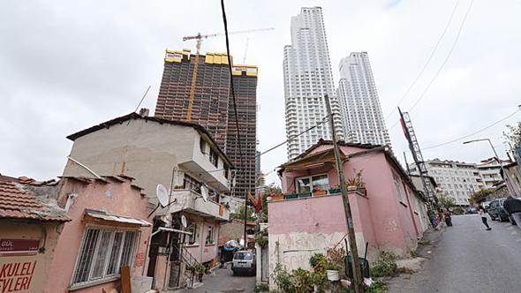
Building and Dwelling Registers (BDR)
Supportive Sources:
Land Registry and Cadastre Information System
(Title Deed Records)
Compulsory Earthquake Insurance Records
Rental Income Declarations (Ministry of Finance, Revenue Administration)
Other (Subscription records of natural gas, water supply and electricity companies etc.)

Slide 16
Plans for Establishing a BDR
After carrying out several studies to link every related registers that include characteristics of building and dwelling, we decided to go field to get missing variables to establish a continuously updated and complete “Building and Dwelling Registration System”.
It is planning to conduct a building enumeration for whole country in 2019-2020 period.

Slide 17
Financing
The cost of all work related to 2021 PHC will be covered from the TurkStat's own budget.
Relavant institutions of the state may support the establishment of the BDR Sytem.
The possible budget of main survey for collecting missing dwelling variables for entire country will be determined one year before the operation according to the pilot studies.

Slide 18
Regulation
Statistics Law of Turkey (dated 18 November 2005):
Determines basic principles and standards concerning the production and organization of official statistics
Regulates the duties of the Turkish Statistical Institute
Orders to prepare the Official Statistics Programme (OSP)
Censuses and surveys should be carried out within the framework of OSP

Slide 19
Thank you...

