Slide 1
United Nations Regional Workshop on The 2020 World Programme on Population and Housing Censuses: International Standards and Contemporary Technologies
GIS in the 2010 Malaysia Census of Population
&
Housing and Preparation for 2020
Department of Statistics, Malaysia
28 June 2018 | Park Royal Hotel, Kuala Lumpur
www.dosm.gov.my
@StatsMalaysia @Dr_Uzir
@StatsMalaysia @DrUzirMahidin
Notes:
My presentation for this morning is regarding GIS in the 2010 Malaysia Census of Population
& Housing and Preparation for 2020

Slide 2
Presentation Outline
GIS implementation in 2010
Census
Modernization in 2020 Census * DOSM Smart Listing, DOSM Smart Map & MSAR
Issues & Challenges
Notes:
My presenta

Slide 3
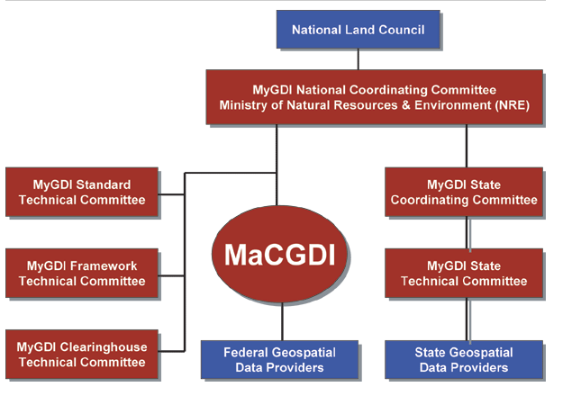
Introduction
Malaysian Centre for Geospatial Data Infrastructure (MaCGDI) is a centre established by the government to manage and promote the development of geospatial data infrastructure for Malaysia (MyGDI). MaCGDI is also responsible for coordinating access and delivery of the geospatial information held by all government agencies.
The main role of MaCGDI is to continously make available and accessible current and accurate geospatial data that promotes a sustainable living environment, economic growth and social progress for public.
Objectives:
To provide mechanism/infrastructure in supporting the usage and sharing of current, accurate and reliable geospatial information among agencies by employing the latest geospatial techologies; and
To avoid redundancy of duplicating effort in collecting, processing,maintaining, providing and dissemination of required geospatial information.

Slide 4
History of GIS in DOSM
1989-1991
Preparatory Stage
After 1991 Census
Create a census cartographic database

Slide 5
Development
2000-2007
Data Dissemination
Statistical boundaries
2015
StatsDW
Location intelligent Integration BI and GIS
Census Mapping
&
Digital Maps
2007-2009
Development
Statistical boundaries Vector data (topographic digital map)
2011-2012
Census Geodatabase
Integrating census with Statistical boundaries
2010
National Enterprise wide Statistical System (NEWSS)
Internal GIS Portal

Slide 6
Current Use
Delineation and digitizing of Enumeration Block (EB) boundaries for 2010 Census by using base maps from OGA.
Establish the centralised geodatabase and internal GIS Portal for updating maps by State Office.
Generating census data at small area statistics or specific area for the users.
Producing thematic maps from various sources especially on Census and other data.

Slide 7
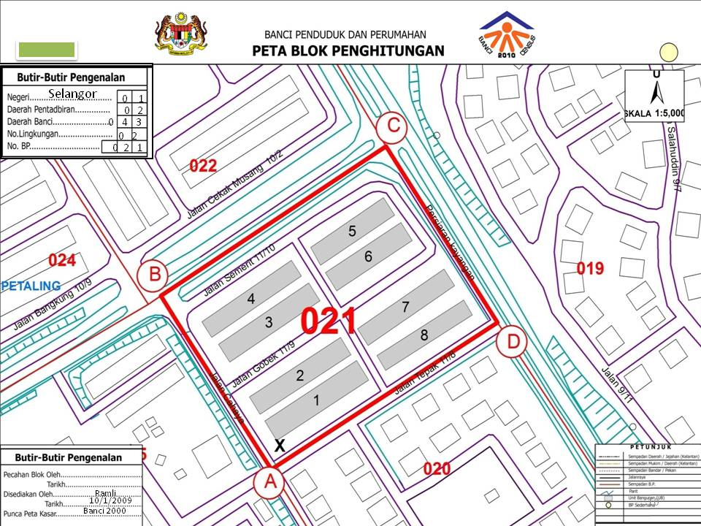
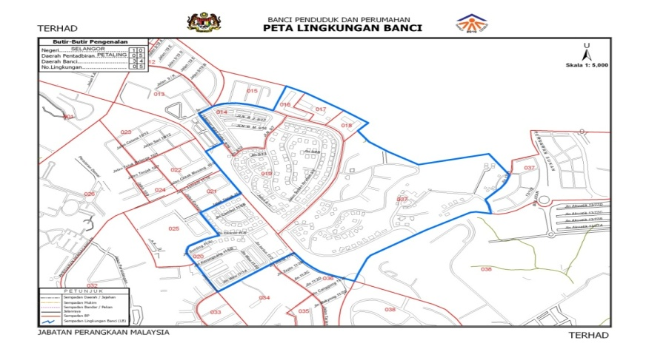
Products
About 70% of statistical digital map were used for the 2010 census.
All the map was produced using GIS software.
EB’s map -A3 sized maps up-dated based on base map from various resources
Enumeration Block(EB) Map
Census Circle Map

Slide 8
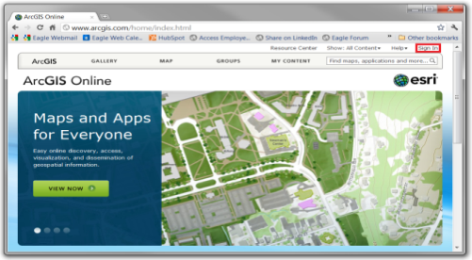
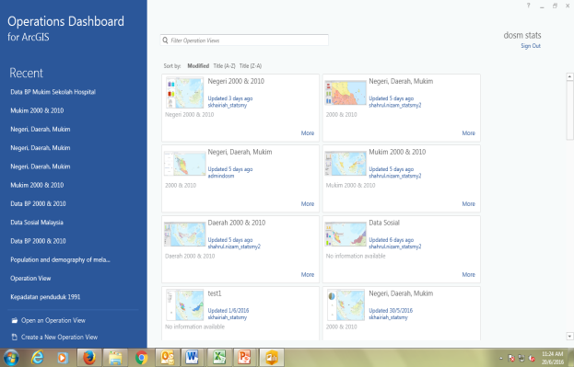
GIS Platform
ArcGIS Online
Database
Design web map
Configure attribute
Share to public/group
Desktop 10.3.1
Operational Dashboard
Design spatial data
Share to webmap
Connect to DB
Spatial editing
Server
Configure widget
Notes:
ArcGIS Desktop includes a suite of integrated applications including ArcCatalog, ArcMap, ArcGlobe, ArcToolbox, and ModelBuilder. Using these applications and interfaces in unison, users can perform any GIS task, from simple to advanced, including mapping, geographic analysis, data editing and compilation, data management, visualization, and geoprocessing. DOSM has adopted ArcView, a basic solution from ArcGIS desktop as GIS platform to manage spatial related data during Census 2010. ArcView comprises of ArcMap, ArcCatalog and Arc Toolbox, each with its own functionalities to perform GIS operations.

Slide 9
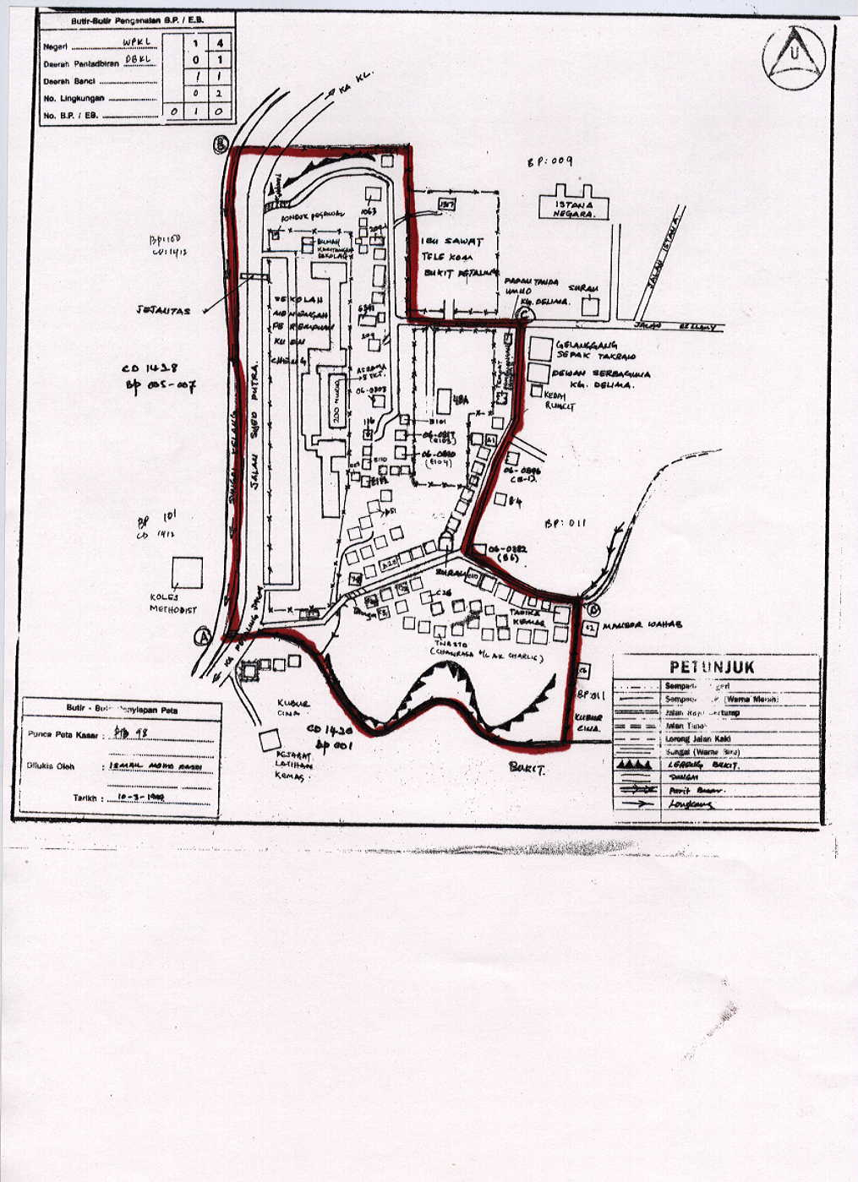
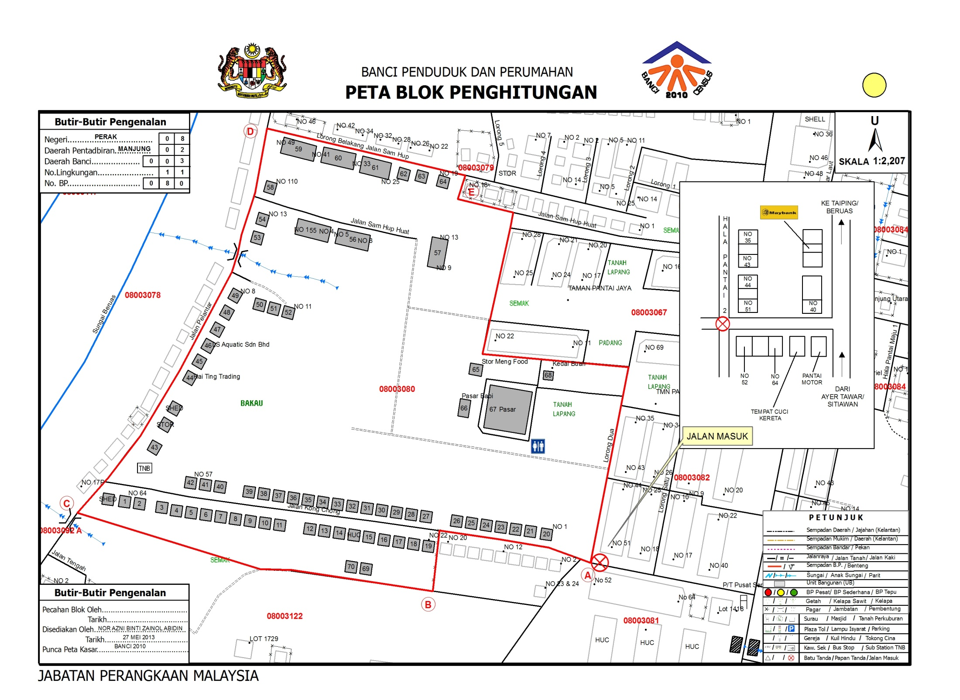
Statistic Map
Sketch map
Before Census 2010
Digital map
Census 2010

Slide 10
2010 Census : Issues
No | Issues | Suggestion
1 | Isolated system to manage collected Listing and GIS data (NEWSS & ArcGIS). Lead to data inconsistencies. Listing in NEWSS not reflected in GIS and vice versa. | Listing and GIS data should be in an integrated database.
2 | Difficulty in managing distributed GIS databases (ESRI Shape files at State DOSMs) HQ DOSM required to gather data from states and consolidated into master database. Master database did not contain the latest copy since data collection at states were still on going. | State and HQ should be synced through an online system.
3 | Outdated base map for GIS updating (hardcopy topo map, development plans etc.) Hardcopy map accuracy may defer depending on scale size. | System should use an online basemap that is being updated regularly.
4 | Difficulty in monitoring listing coverage (system is not online). Report can only be generated after status is updated into monitoring systems. | System should have a dashboard that have a direct access to listing data and status.

Slide 11
2010 Census : Lesson Learnt
Lack of expertise and technical capabilities to enhanced the use and development of GIS with the most updated technology.
Insufficient funds to purchase the most updated base maps especially on raster data.
Integrating the variety of spatial data from OGA in order to create updated statistical maps.

Slide 12
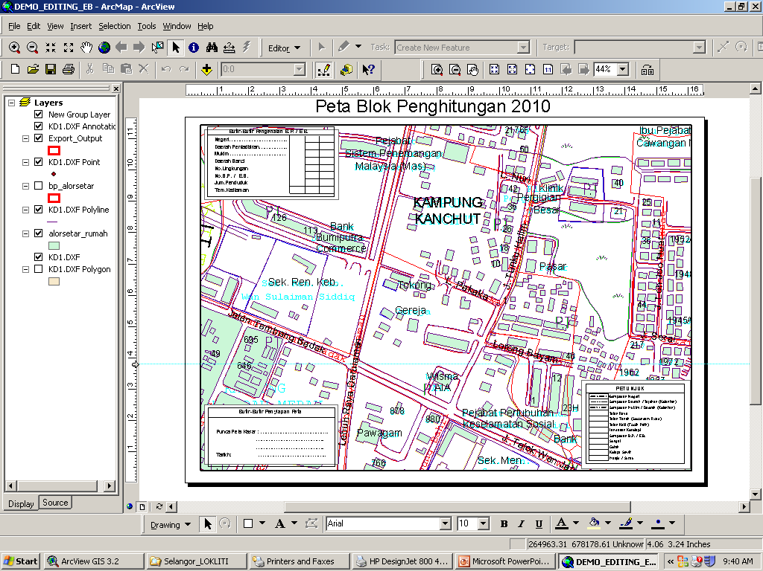
Modernisation in 2020 Census
(DOSM Smart Listing, DOSM Smart Map & MSAR)
Listing Application
Online Self Listing (OSL)
Mobile App:
CAPI (FE)

Slide 13
Fundamental
Managing Resources and Infrastructure Efficiently
THURST STRATEGIC 2
STRATEGY 1
PROGRAMME 3
ACTIVITY 1
Transforming Statistical Compilation System and Process
Strengthening the Management of Statistical Frame
Strengthening the living quarters frame – Malaysia Statistical Address Register (MSAR) towards strengthening the usage of e-Census and e-Survey
Address Register - A list of household address/spaces, whether occupied or not containing postal address information and geographical location

Slide 14
Malaysia Census Transformation Programme (MyCTP) – Innovation element
Modernization of listing methods (Reengineering Address Canvassing/listing) : MSAR, OSL
Improves data security: Security/Risk
6
1
Census Portal as a one stop centre for the dissemination of information pre, current and post census
5
2
Integrating administrative data from OGA & survey data : MSAR & MSPR
4
3
Modernization in field work: Mobile apps, tablet
Increase Self-Response rate : e-Census, MOMB, DOPU

Slide 15
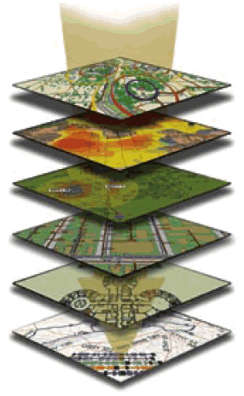
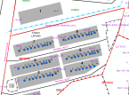
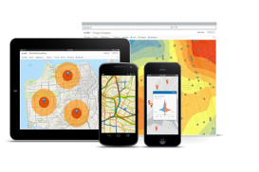
GIS Plan For 2020 ………………
2020
2010
Started in 1989 study paper “Potential and Possible Uses of GIS in DOS for Post Census Activities”.Budget was approved for development of GIS in 1990 and a year later GIS consultant from US Bureau of Census provided functional requirement for DOS.
2000
Layer;
Enumeration Block
- Point
- Polygon
- Road
- River
Layer;
- Enumeration Block
1991
Layer;
Enumeration Block
- Point
- Polygon
- Road
- River
Address geocode/Mobile map/Web map
Layer;
- Enumeration Block

Slide 16
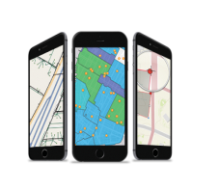
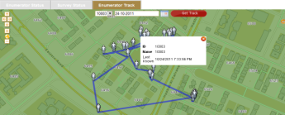
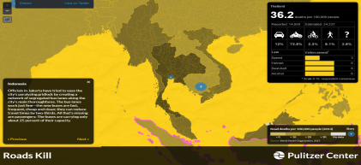
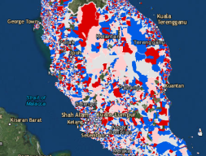
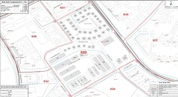
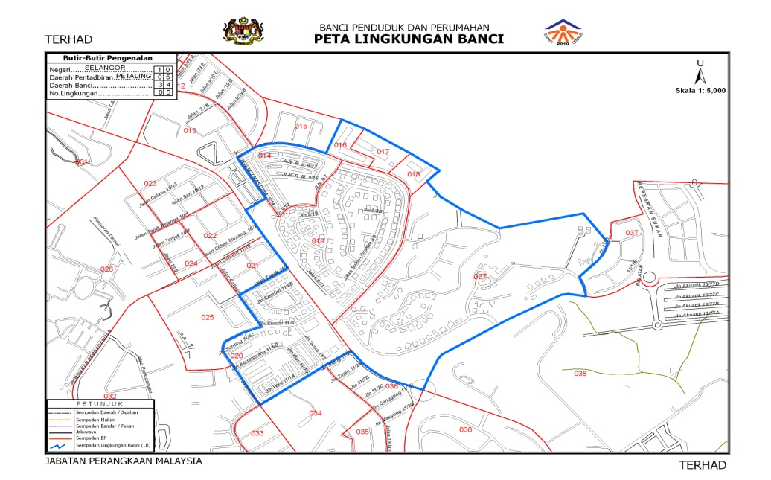
Geospatial Technology For Census 2020
2017-2019
2020
2021-2022
PRE-ENUMERATION
ENUMERATION
POST ENUMERATION
Census tracking and progress monitoring
during operation
Create and update digital Map
Address geocode
Dissemination via Web based and
spatial analysis

Slide 17
Modernization of DSL and DSM
Integrated system to manage Listing and
GIS data.
Technology on application – web responsive and mobile application.
Transformation towards digitised map.
Near real-time monitoring of listing progress.
Technology on Internet access and connectivity.
Technology on devices (paper form transforms to devices).

Slide 18
2010 Listing VS 2020 DSL
Technology Transformation DOSM SMART LISTING (DSL) | CENSUS 2010 | CENSUS 2020
Listing form can be filled in directly into the FL system by using tablet/mobile | ✖️ | ✔️
Implementation of OSL system for the public respondent to update their Address, HH and LQ information. | ✖️ | ✔️
Improvement of LQ location using device GPS | ✖️ | ✔️
Ability to submit Mark Up for map update during listing | ✖️ | ✔️
Base map with properties points and property lots for easier HH and LQ updating. | ✖️ | TM Map

Slide 19
2010 GIS VS 2020 DSM
Technology Transformation DOSM SMART MAP (DSM) | CENSUS 2010 | CENSUS 2020
Centralized system between Listing and GIS | ✖️ | ✔️
Centralized database between HQ DOSM and State DOSM | ✖️ | ✔️
Ability to update the coordinate for LQ | ✖️ | ✔️
Analysis EB burst using LQ count | ✖️ | ✔️
CAD-like GIS editing tools to reduce topology error during map updating | ✖️ | ✔️
Automated EB renumber suggestion | ✖️ | ✔️

Slide 20
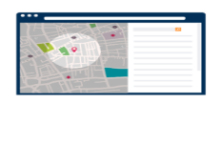
Main objectives of DSL:
To provide a platform and features to facilitate Field Listing process and approval flow.
To provide an online interface for respondents to self-update their information.
To provide an integrated solution in managing, updating and viewing Listing’s digital data
DOSM SMART LISTING
DOSM SMART MAP
Field Listing
Online Self Listing
LQ
EB UPDATE
GIS PROCESSING

Slide 21
The main objectives of DSM are as follows:
To provide an integrated solution in managing, updating and viewing geospatial data for the process elaborated in this document.
To establish a structured and centralized GIS database for;
Centralized data updates at states and HQ.
Accessing the latest basemap and operational map layers during the process elaborated in this document.

Slide 22
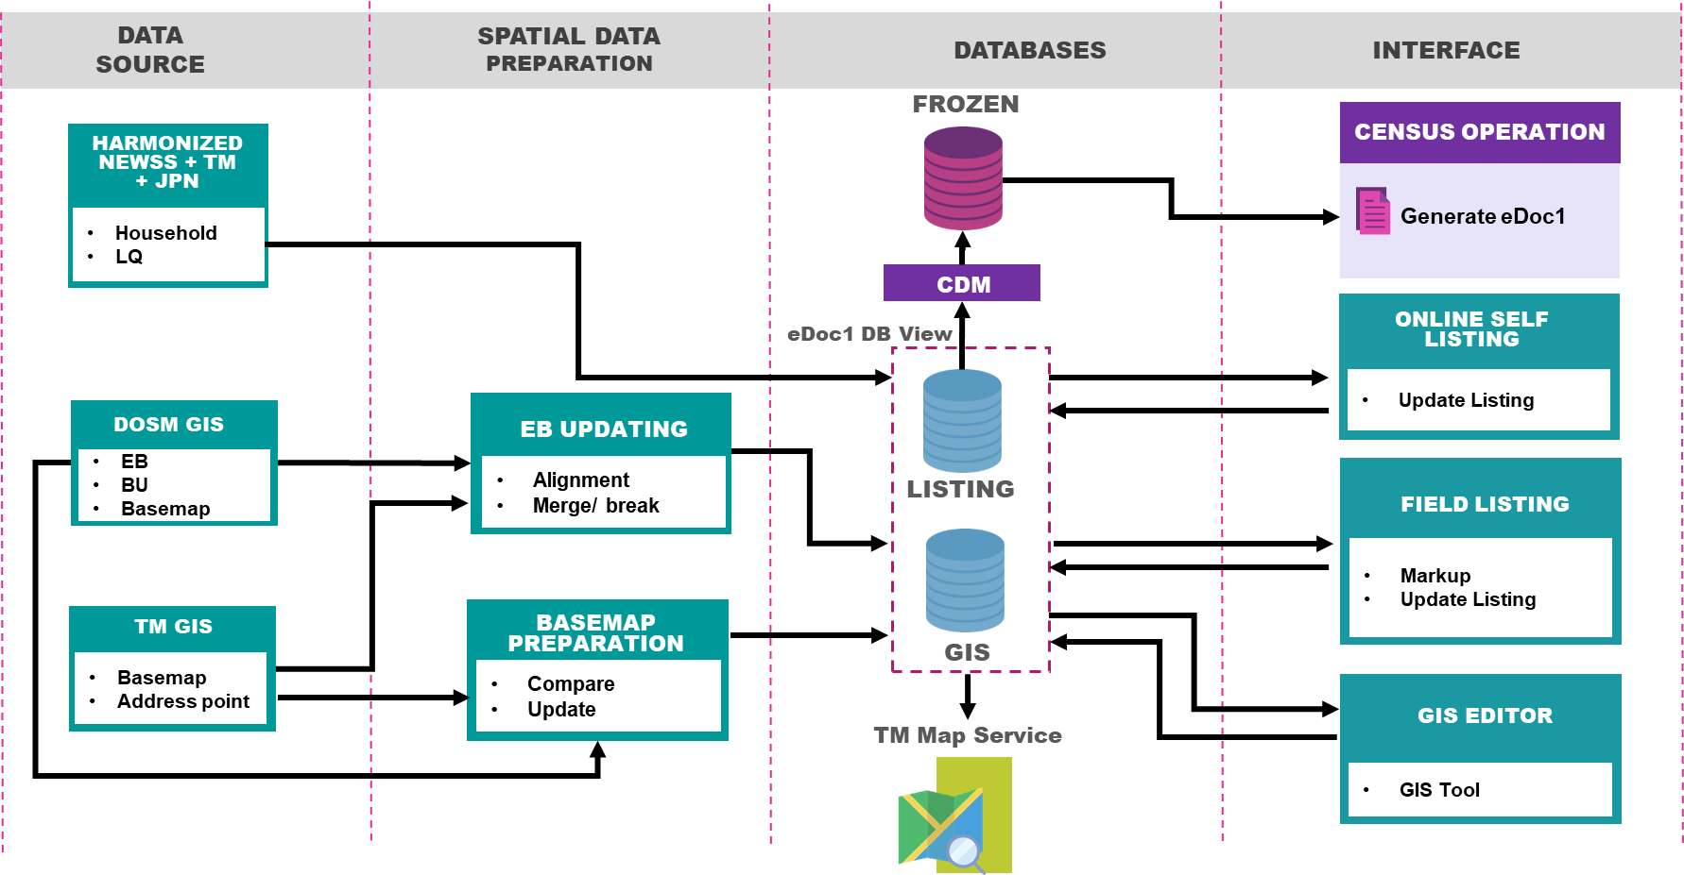
Overall Conceptual Model : DSL/DSM

Slide 23
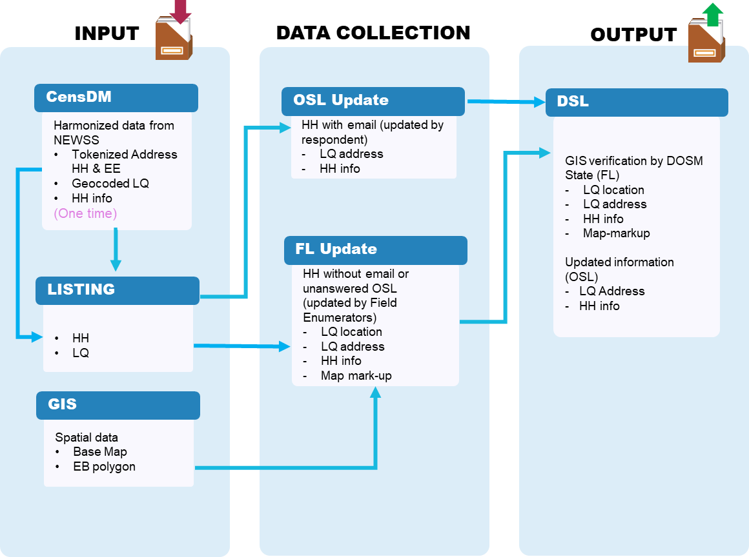
DSL Information Architecture

Slide 24
DSM Architecture
INPUT
GIS UPDATING
EB OPERATION
OUTPUT
GIS
Verify GIS
EB Merge / Split
H/C CO
Data from GIS database
EB polygon
Base Map
Verify GIS data
LQ location
LQ address
EB alignment
Existing EB require
update
New EB polygon
Temporary EB number
Data for hardcopy
printing required by CO
Layout Map
M3
M8
DSL
Update GIS
Re-Number EB
Census Data Mgt
Data from listing
activities
LQ location
LQ address
HH info
GIS data require update
New LQ from address
New EB polygon
EB ready to be
renumbered before
Census
New EB number
New CC, CD number
Data to be pushed into
MSAR
LQ info
HH info
EB info
DSL Markup
CO
Mark-up for map
updates
Map mark-ups
New information for
Census
EB polygon
EB number
CC, CD polygon
LQ & HH info
Legend
Other modules

Slide 25
ESTIMATE COST FOR DSL & DSM
Database
Workstation & Server
Tablet
Application Development
6.9 million

Slide 26
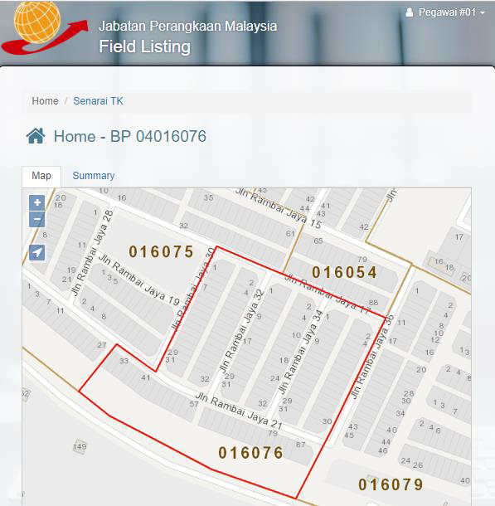
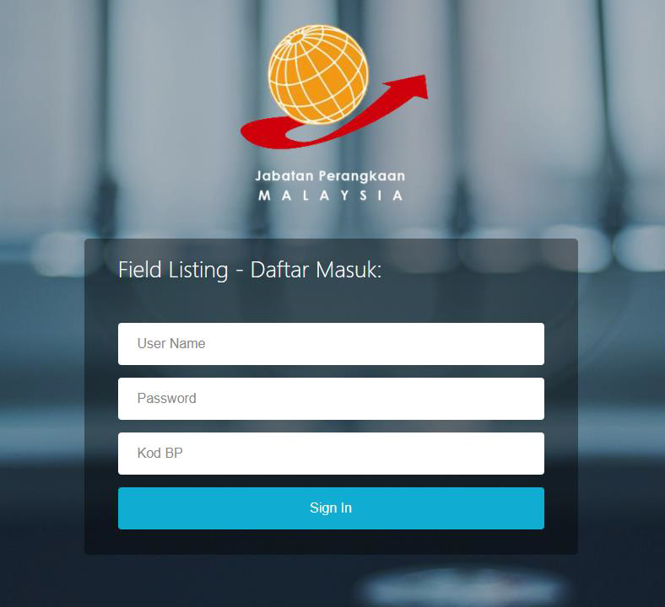
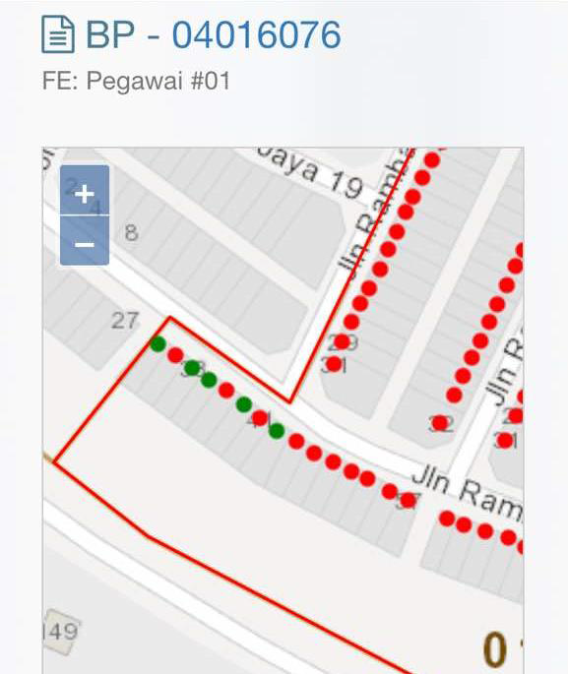
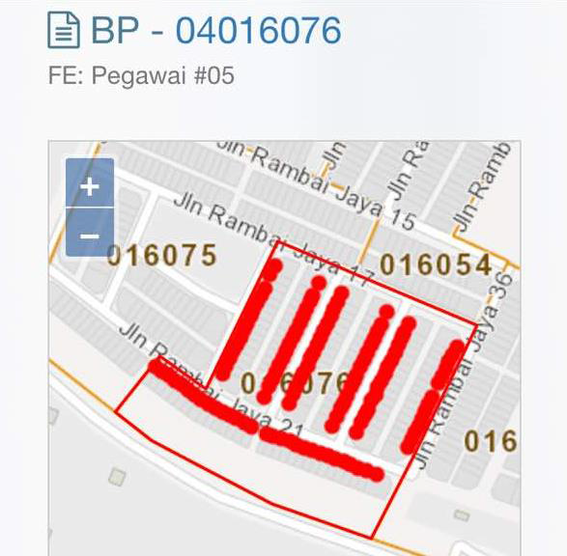
Interface DSL/DSM

Slide 27
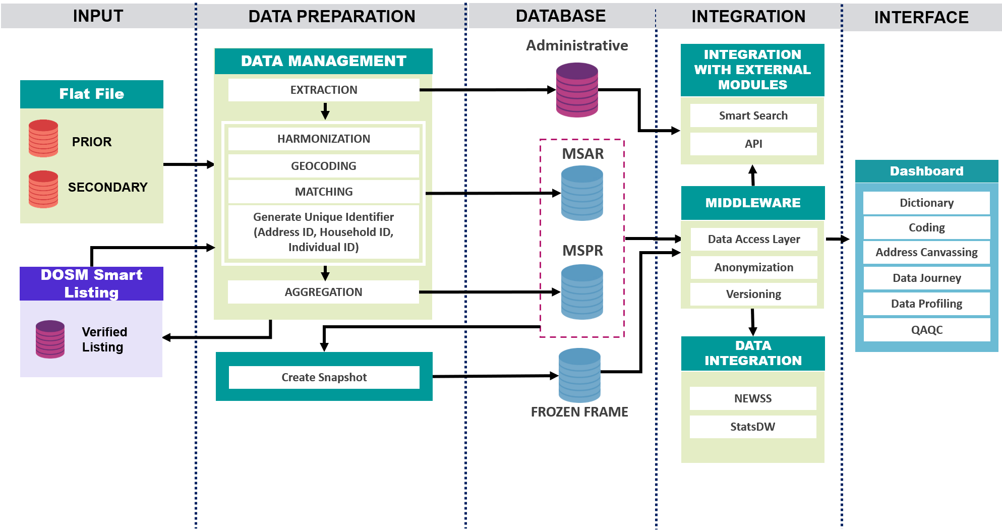
Conceptual Model for Census Data Management Module

Slide 28
MALAYSIA STATISTICAL ADDRESS REGISTER (MSAR)
MSAR
is a database which contains complete information of all Living Quarters (LQs) in Malaysia with basic individual information tied to each LQ.
Have A unique ID for all addresses in Malaysia. Address ID can detect area in which state/city/section it resides in. Address ID is permanent; it does not change if any administrative boundary breaks up or change.
Geocoded will be used where spatial data (latitude and longitude) has been assigned to all addresses
Notes:
The data from prior sources required to go through the data preparation process which are extraction process and harmonization process
The secondary sources only gone through the extraction process
data preparation process will obtain LQ basic information and individual basic information
he matched data will then to go through the geocoding process in order to get the geocoded HH. At the same time unique address ID will be generated
In addition, the data also will use by the listings team for the verification

Slide 29
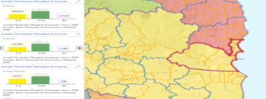
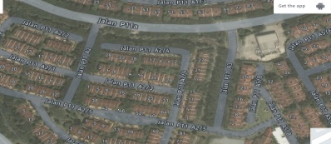
Ongoing / Status Process
Providing the most efficient platform for data dissemination through GIS Portal and MyIPCS
Use of mobile application during census mapping activities
Develop address geocode and integrate with multiple data sources.
Enhancing web map for monitoring and data quality checking during enumeration
Strategic partnership with OGA’s for the use of high resolution of raster data and UAV (drone) for spatial data collection/quality

Slide 30
Issues & Challenges
Integrating the variety of spatial data from OGA in order to create updated statistical maps.
Time constrain-the system should be completed and can use before Census 2020.
Lack of expertise and technical capabilities to enhanced the use and development of GIS with the most updated technology.
Implementation Problems:
Data Formats
Coherence in Geocoding
Address ID generate
Dictionary Creation

Slide 31
Thank You

