Slide 1

SESSION 6
QUALITY ASSURANCE IN
POPULATION AND HOUSING CENSUSES
(PHILIPPINES)
RD MARILYN ESTRADA
TEODORO ORTEZA
Notes:
Quality assurance in CPH is a very important aspect that we have to look into. Proper management and implementation this cou

Slide 2
Contents of Presentation
1. What our processess show?
2. What are the institutional arrangements that supported quality assurance for CPH 2010 results ?
3. What were the institutiona arrangements done the previous censuses?
4. Initiatives to safeguard Quality Assurance for CPH 2020?
CONTENTS
Notes:
Quality Assurance of CPH results has continuously became a challenge to the whole process

Slide 3
What our processes SHOW ?
  Methodological Soundness - Our adherence to professional methods , concepts , definitions and (international)agreed standards UN Fundamental Principles of Official Statistics
Efficiency- practices to which statistics are compiled in such a way that the cost and respondents burden are minimized
Notes:
In the previous censuses we saw to it that we follow the UN Fundamental Priciples of Official Statistics. Nowadays the PSA is ISO Certified. Improved and well planned processes
Generate quality statistics or output.

Slide 4
Institutional Arrangements
Legal environment – the enactment of statistical legislation in conformity with
the UN Fundamentals of Official Statistics
Planning Mechanism – long term procedures had been instituted systematically
3.Resources- Proper funding from the Government
4. Administrative sharing of resources from
member agencies like vehicles, training venues, medicines for the SR’s, security provisions etc.

Slide 5
Census Coverage
Section 27 of Republic Act No. 10625 states that…
Respondents of primary data collection activities such as censuses and sample surveys are obliged to give truthful and complete answers to statistical inquiries
The gathering, consolidation and analysis of such data shall likewise be done in the most truthful and credible manner
To ensure compliance, any violation of this Act shall result in the imposition of the penalty of one (1) year imprisonment and a fine of One hundred thousand pesos (P100,000.00)
Notes:
To ensure that every one will be rightfully listed this section of RA 10625 provides the legal bases. This act also ensures that we get the right and complete information desired

Slide 6
Confidentiality
Section 26 of Republic Act No. 10625 states that…
Individual data furnished by a respondent to statistical inquiries, surveys, and censuses conducted by the PSA shall be considered privileged communication and as such shall be inadmissible as evidence in any proceedings
The PSA release data gathered from censuses only in the form of summaries or statistical tables, in which no reference to an individual, corporation, association, partnership, institution or business enterprises shall appear

Slide 7
2010 Census of Population and Housing (CPH) Manpower and Area Coverage
  65,000 Enumerators
  13,000 Team Supervisors
  3,200 Census Area Supervisors
  3,200 Assistant Census Area Supervisors
  42,025 Barangays (Villages)
  70,750 Enumeration areas

Slide 8
2015 Census of Population (POPCEN) Manpower and Area Coverage
  90,000 Enumerators
  23,000 Team Supervisors
  5,000 Census Area Supervisors
  42,036 Barangays
  93,781 Enumeration areas
Notes:
The four levels of trainer that you are connecting flight

Slide 9
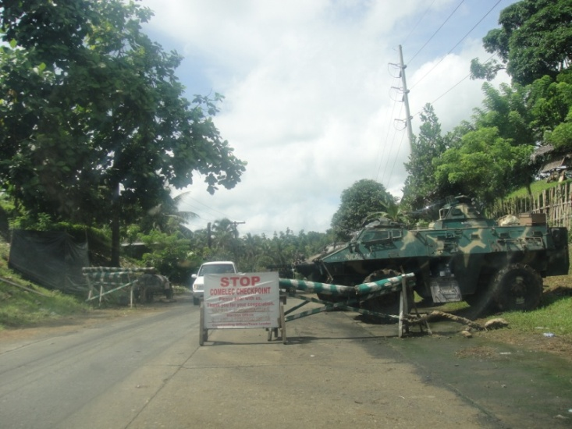
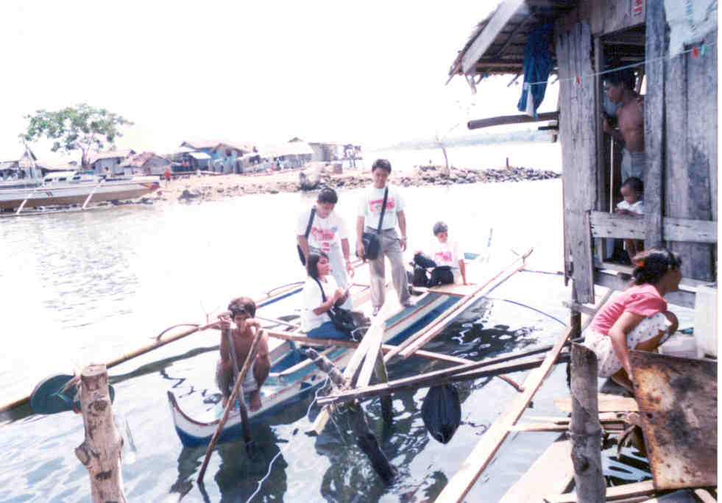
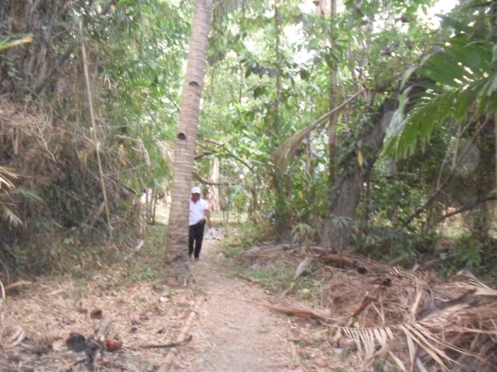
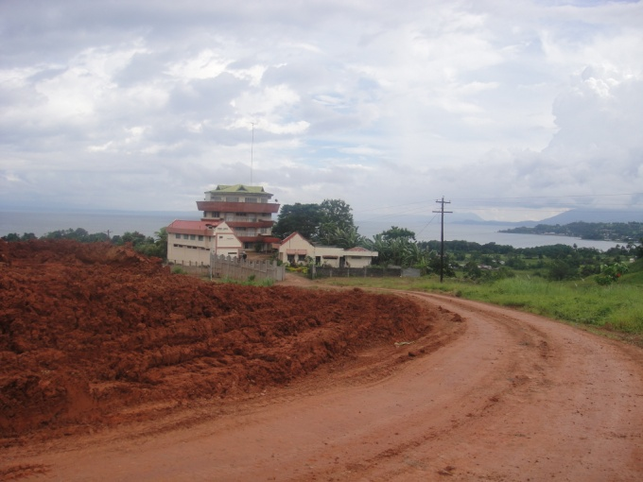
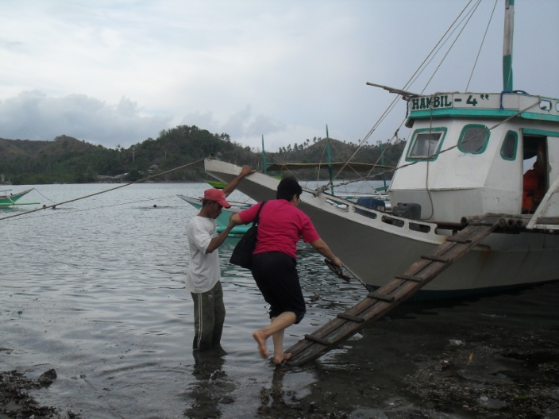
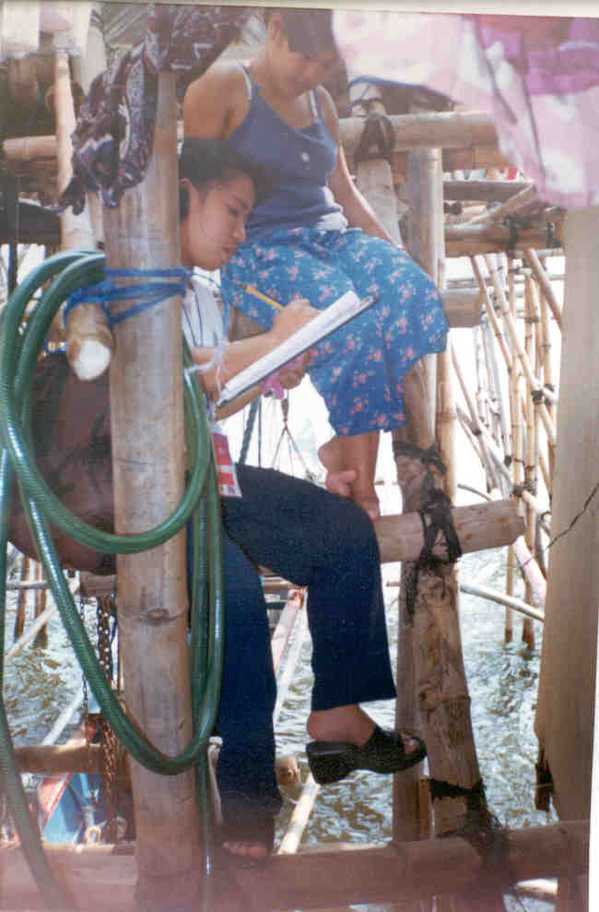
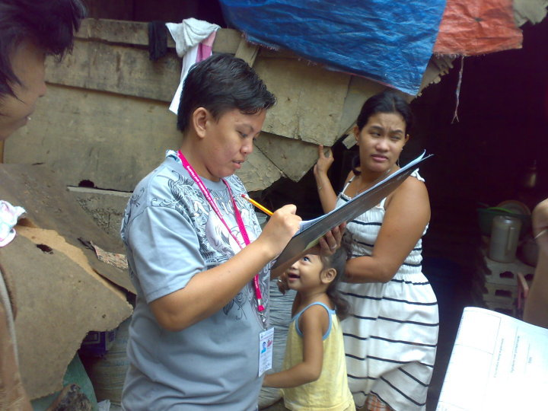
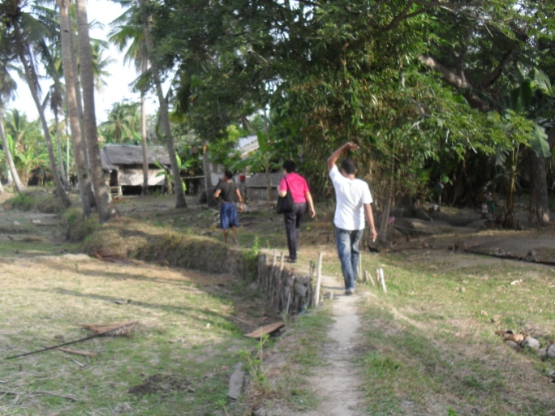

Enumeration Period
Amidst any terrain, distance and risks . . .

Slide 10
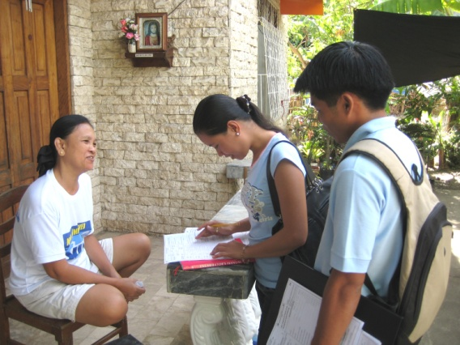
Respondent
the head or any responsible member of the household who provided accurate answers to the census questions and who could give information for all household members

Slide 11
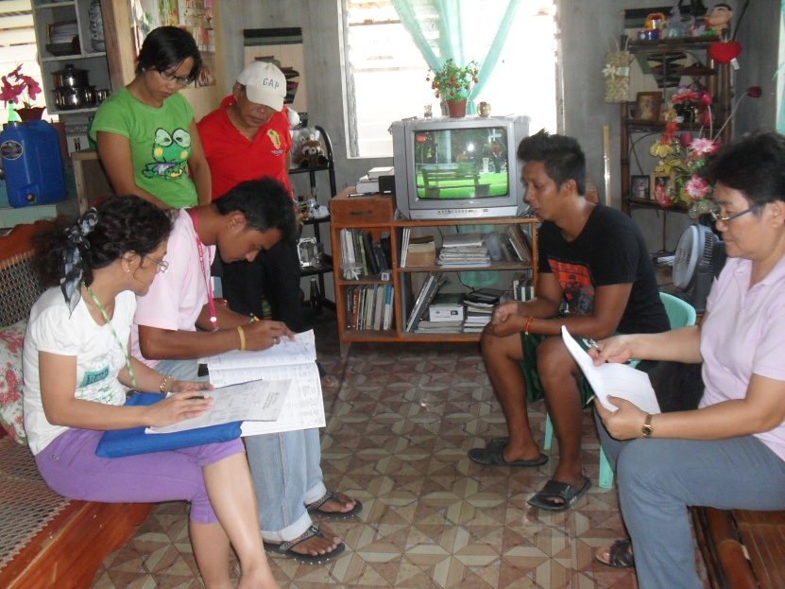
Field Supervision
Observing interviews conducted by the enumerators
Reinterview/Spotchecking of households by the supervisors
Conduct of weekly meetings

Slide 12
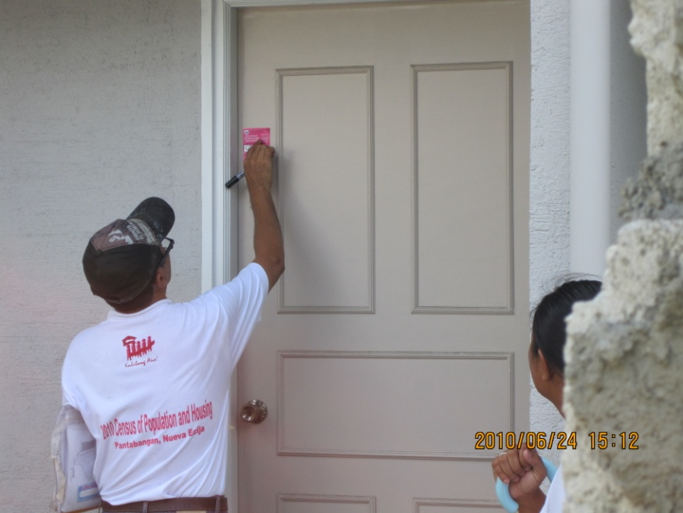

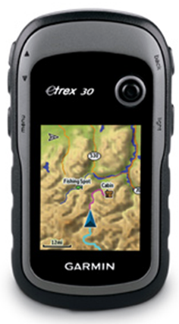
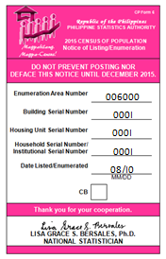

Census Coverage Monitoring
Posting of Census Stickers After an Interview
Computer-aided field editing system (CAFES) of census supervisors
CAFES is a module of the (Computer Aided Data Collection System) CADaCS, a data entry program installed in a tablet that the head CAS will use to encode selected items in the accomplished CP Form 2 during his/her supervision

Slide 13
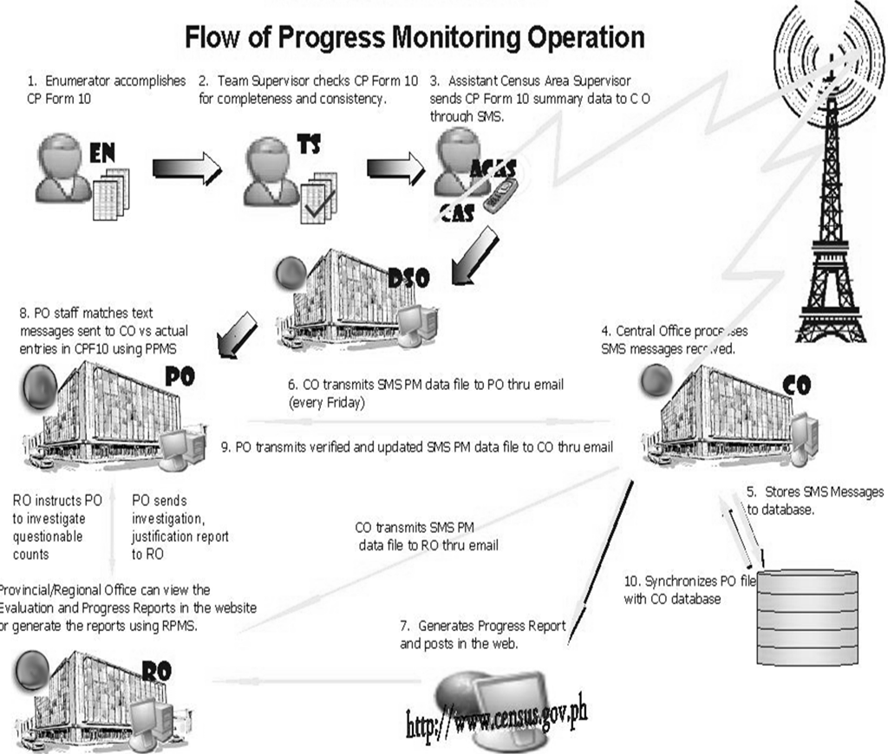
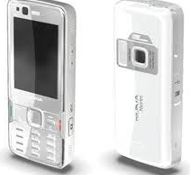
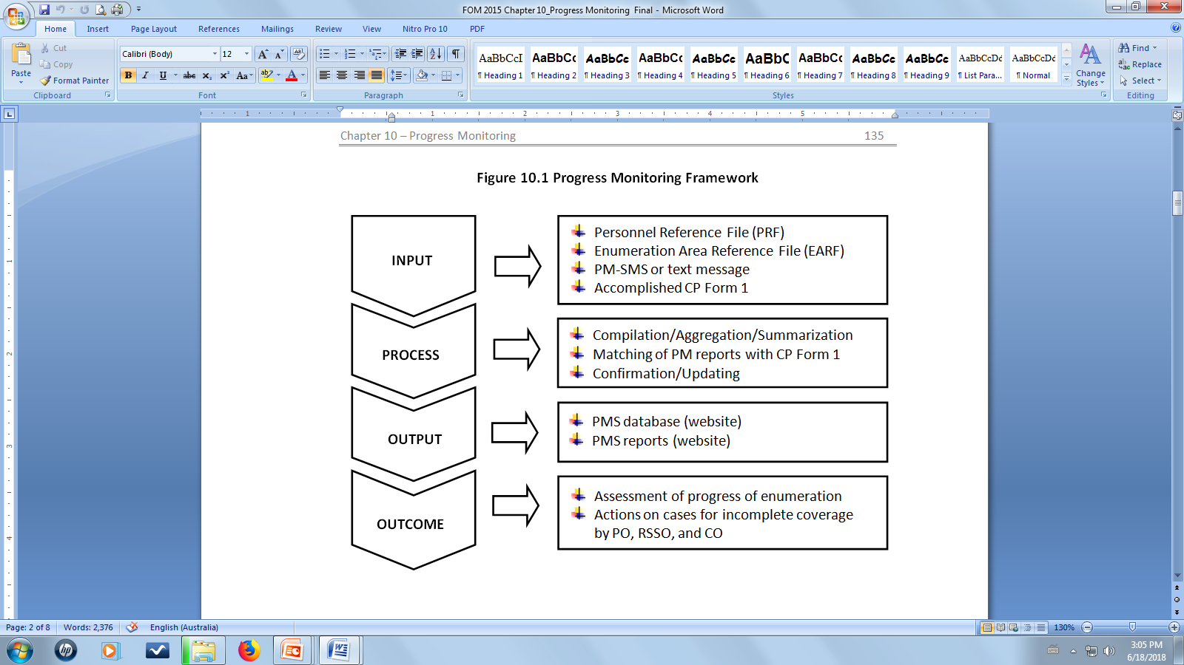
Progress Monitoring
2010 CPH
2015 POPCEN

Slide 14
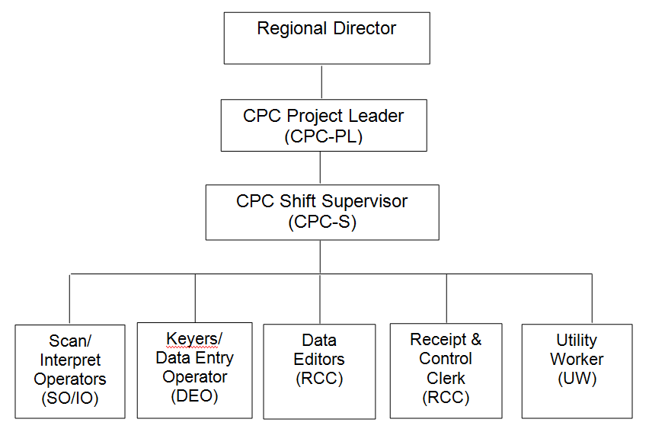
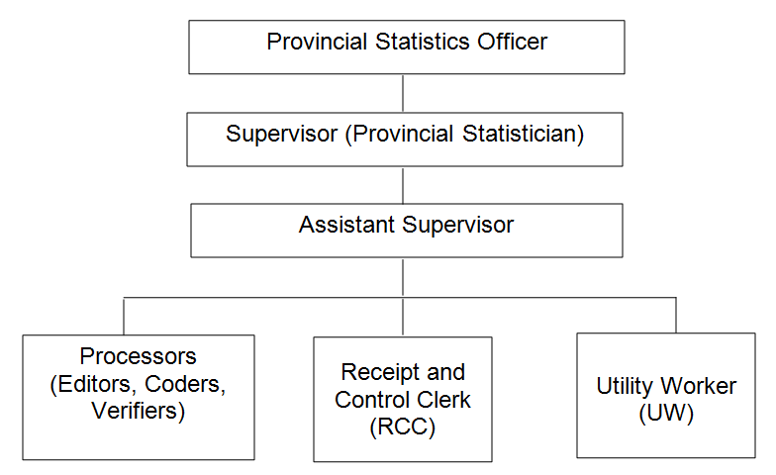
Provincial Project Staff (PPS 2010)
Manual Processing
Census Processing Center (CPC 2010)
Machine Processing
Central Office
Further Processing
Final Tabulation
Data Processing
Organizational Setup of CPC 2010
Organizational Setup of PPS 2010

Slide 15
Further Processing/Evaluation
Use of satellite images to evaluate buildings/housing units consistency
Use of administrative data such as the number of voters registration and enrolment data as validation parameters
Generation of demographic indices such as Myers index, Whipple’s blended index, and UN age-sex accuracy index among others
Field validation/Confirmation from the field offices

Slide 16






Plans for the 2020 CPH
BCRS Planned Architecture
Civil Registry Server
@ Provincial Capitol
Internet
Provincial Civil Registry
Barangay
Content:
Services:
BCRS
Map
Upload BCRS
Population Count
Person Registry
Municipality
PSA
Notes:
Using BCRS (piloting in one province to assist in the evaluation of results.

Slide 17

Plans for the 2020 CPH
Map-based Listing and Enumeration Operation
Completed forms will be submitted to the server thru the web.
Built-in consistency edits and checks to ensure completeness and accuracy of entries.
Area maps will serve as guide to the enumerator to provide an ease in identifying the buildings.

Slide 18
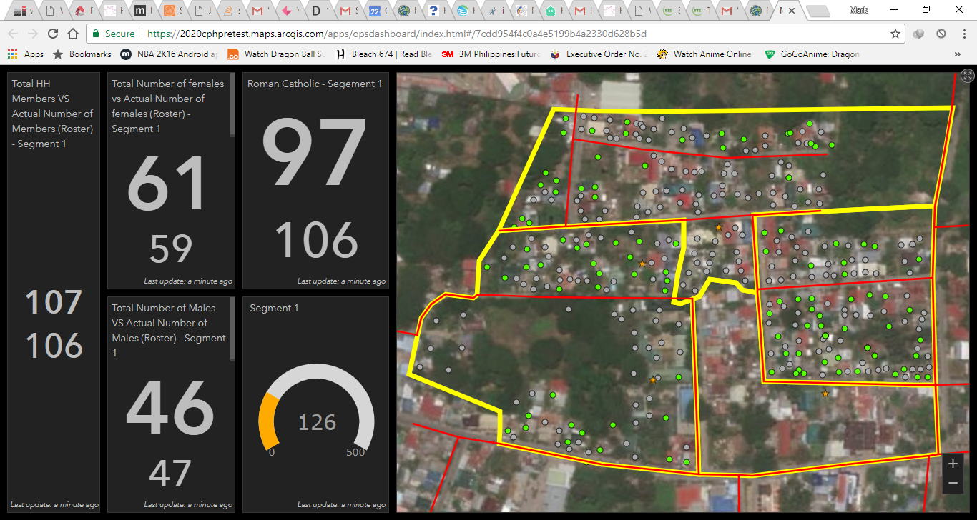
Plans for the 2020 CPH
Progress Monitoring Using Dashboard
Notes:
Monitoring of progress of operations.

Slide 19

http://www.psa.gov.ph
Solid Responsive World-Class

