Slide 1
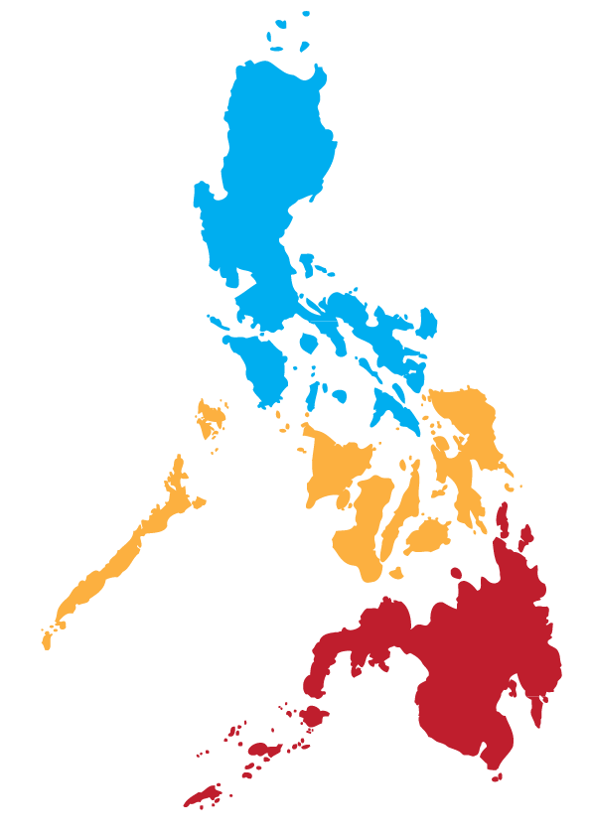
SESSION 3
METHODOLOGIES OF
POPULATION AND HOUSING CENSUSES
Notes:
It’s a great day today and I hope you all feel great, I am Marilyn Estrada and I am extending our warm greetings from my beautiful country the Philippines. My topic for this morning is on….

Slide 2
Outline of Presentation
1. Legal Basis
2. Objectives (General and Specific)
3.Definitions
4. Coverage
5. Results of the CPH
6. The Major Activities
Notes:
Population and housing censuses have stood as the biggest, most extensive and most costly statistical activity our the country. None the less the great benefits the government and other stakeholders derive from it can not be discounted, hence a country has to do it. In the Philippines human resource is the biggest contribution to the country’s economy and the society as a whole. So the country has to invest on it. How to conduct it entails a lot of planning , preparation, costs and hard work esp. for a country like Philippines which is an archipelago. All the more it has become imperative to conduct bec of the need of evidence based for SDG assessment and monitoring.

Slide 3
Legal Basis
Republic Act No. 10625
Section 6(b) of this Act mandates the Philippine Statistics Authority (PSA) “to prepare and conduct periodic censuses on population, housing, agriculture, business, industry, and other sectors of the economy”
Executive Order No. 352
Stipulates the conduct of a mid-decade census primarily to update the population count in all barangays (villages) nationwide
Batas Pambansa Bilang (Republic Act No.) 72
An Act providing for the taking of an integrated census every ten years beginning in 1980, and for other purposes
Notes:
The conduct of censuses have these enactments as our legal basis whether the CPH conducted censal or mid decade. Phil Stat’l Act of 2013 merged four agencies into a single agency the PSA. The mandate of the former NSO in the system of designated statisics was carried out .

Slide 4
Definition
Census of Population and Housing (CPH) is designed to take an inventory of the total population and housing in the Philippines and collect information about their characteristics.
General Objectives
To provide government planners, policy makers, and administrators with data on which to base their social and economic development plans and programs
4
Notes:
Our statistical system in the Philippines adhere to the United Nations Fundamentals of Official Statistics particularly on the generation and delivery of our statistical products and services.So concepts and definitions are based on international standards set by U.N. For the general objectives etc…..

Slide 5
Specific Objectives
Obtain comprehensive data on the size, composition, and distribution of the population of the Philippines
Gather data on demographic and socio-economic characteristics of the population and determine their geographic distribution
5
Notes:
Five specific objectives are as follows to address specific needs of our stakeholders.

Slide 6
Specific Objectives
Take stock of the housing units existing in the country and to get information about their geographic location, structural characteristics, and facilities among others
Obtain information on the characteristics of the barangay, which will be used as basis for urban-rural classification
Serve as sampling frame for use in household-based surveys
6

Slide 7
Reference Period
“De Jure” Concept of Enumeration
Persons were enumerated in the area where they usually reside as of the reference date
All persons were listed and enumerated as members of the household or as residents of an institutional living quarters as of a specified date and time
Notes:
Rightful entitlement or claim

Slide 8
Reference Date and Time
As of May 1, 2010
At 12:01 am
2010
CPH
2015
POPCEN
As of August 1, 2015
At 12:01 am

Slide 9
Census Coverage
All Households and institutional living quarters in all barangays (villages) throughout the country are listed to gather information about their members
All Filipinos residing in Philippine embassies, missions, and consulates abroad will also be enumerated
Notes:
In terms of coverage all HH and ILQ through out the country are listed to gather information about them. All Filipinos residing in missions, embassies ansd consulates were likewise were covered.

Slide 10
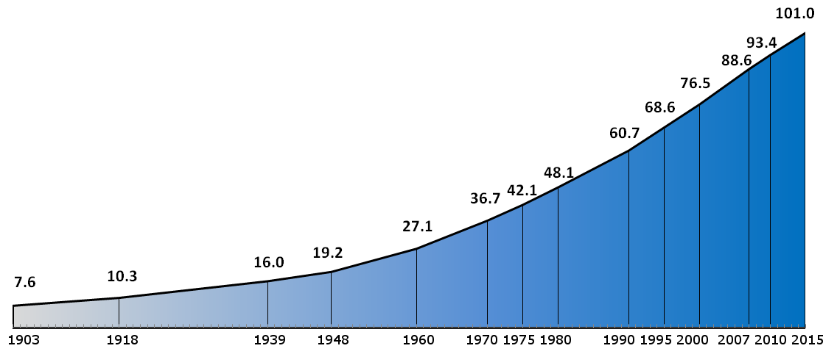
Philippine Total Population by Census Year: 1903 to 2015
August 1, 2015
100,981,437 persons
May 1, 2010
92,337,852 persons
May 1, 2000
76,506,928 persons
Notes:
This is the actual count through the years, Its moving upward. Same trend as what the projections are but at a slower pace.

Slide 11
2010 Census-Based Population Projections Philippines: 2010 to 2045

Slide 12
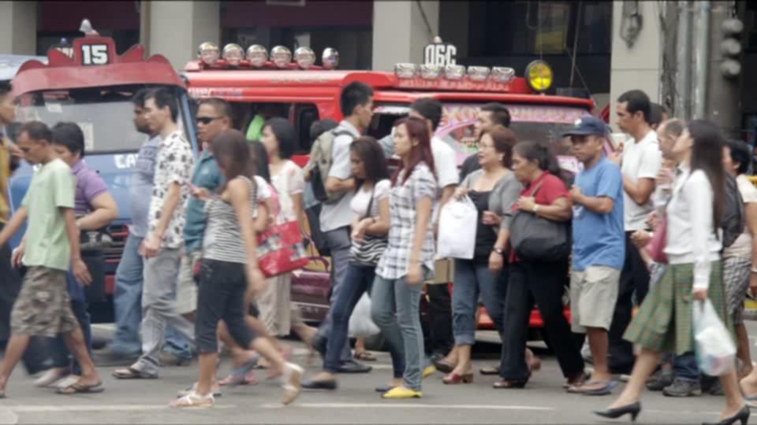
Philippine Population in Comparison with Countries in the Southeast Asian Region: 2016
In Millions
Source:
Population Reference Bureau
2016 World Population Data Sheet
Notes:
The Philippines ranks second among countries in the Southeast Region. Indonesia with the highest and Brueni with the least.

Slide 13
Census Major Activities
Pre-Enumeration Phase
Post Enumeration Phase
EA Delineation & mapping
Census forms & manuals reproduction
Workload analysis
Coordination with local govt. agencies
Procurement of supplies & materials
Recruitment hiring & training
Setting financial & admin. Procedures
EA assignment
Allocation, distribution & retrieval of forms
Consultation with stakeholders & users
Bundling & packaging of forms
Setting up of processing centers
Data processing
Transmittal of image files from FO to CO
Evaluation of population counts
Proclamation of the President
Generation of detailed census results
Data Dissemination
Enumeration Phase
Field enumeration
Spotchecking and supervision
Receipt & control of accomplished forms
Progress monitoring
Handling enumeration & other field problems

Slide 14
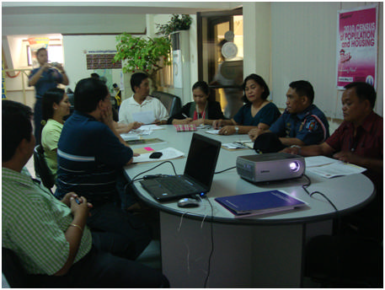
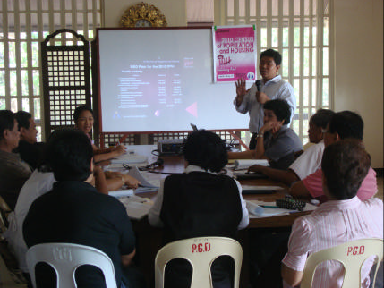
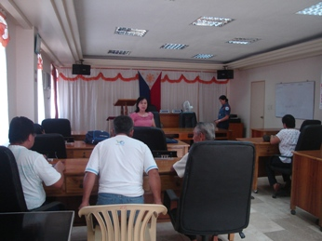
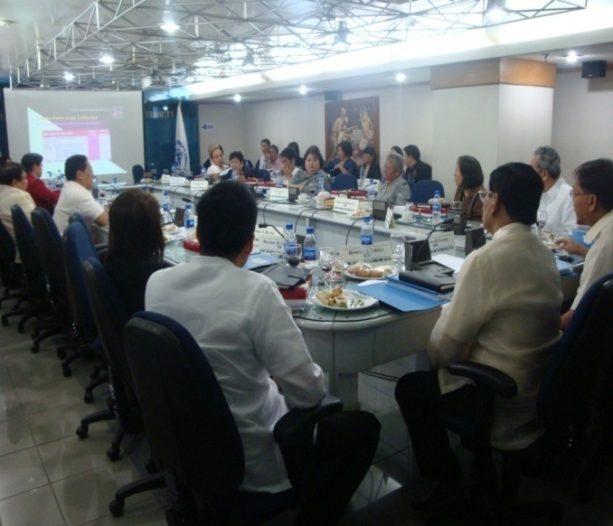
Convening Census Boards

Slide 15
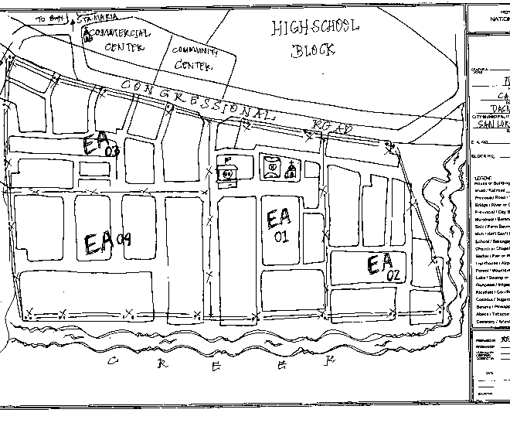
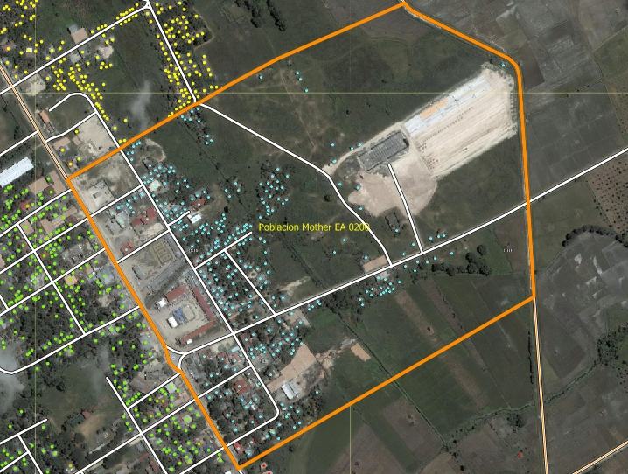
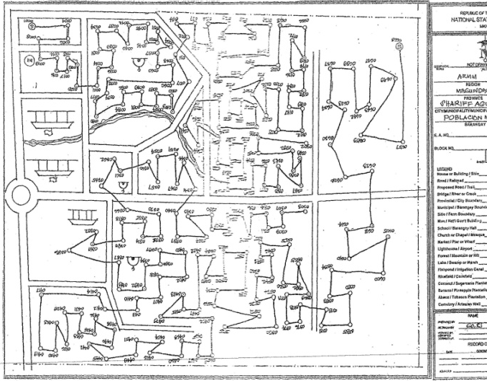
Mapping and Delineation
Notes:
Mapping and delineation were done to determine enumeration areas. For every enumeration area it covers about 400 households or less.

Slide 16
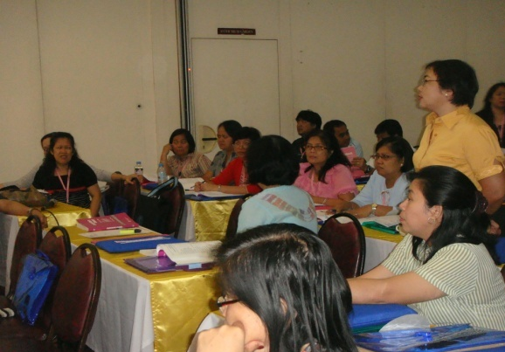
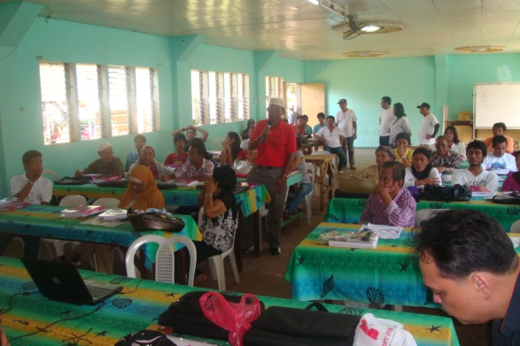
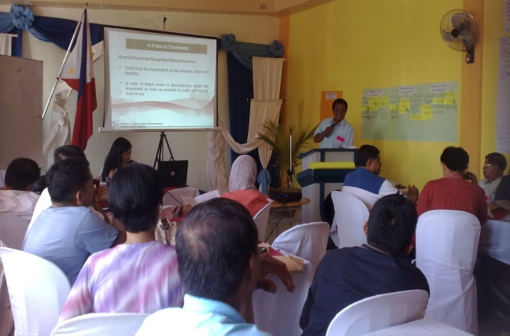
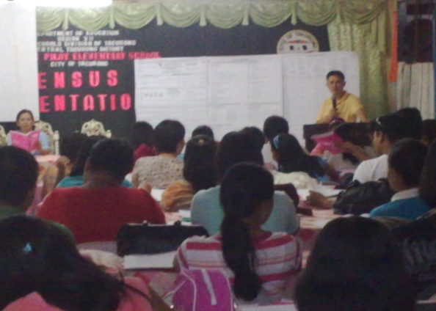
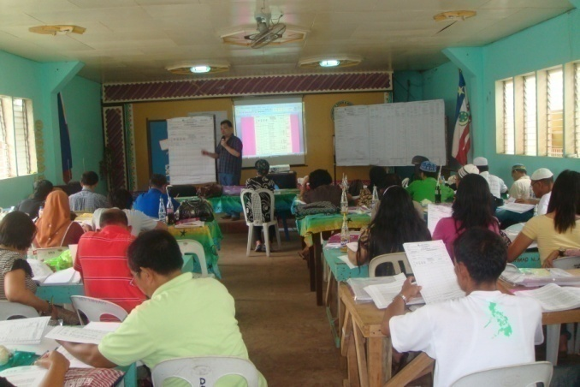
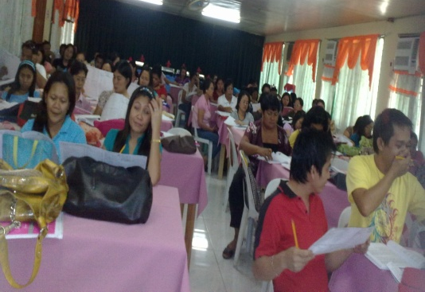
Training on Enumeration
Task Force – Central Office
2nd Level – Regional
3rd Level – Provincial
4th Level – City/Municipal

Slide 17
Data Collection Method
House to house visit
personal interview
self-administered questionnaires

Slide 18
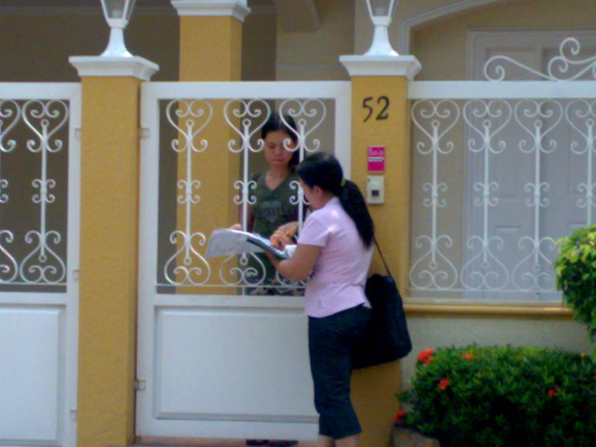
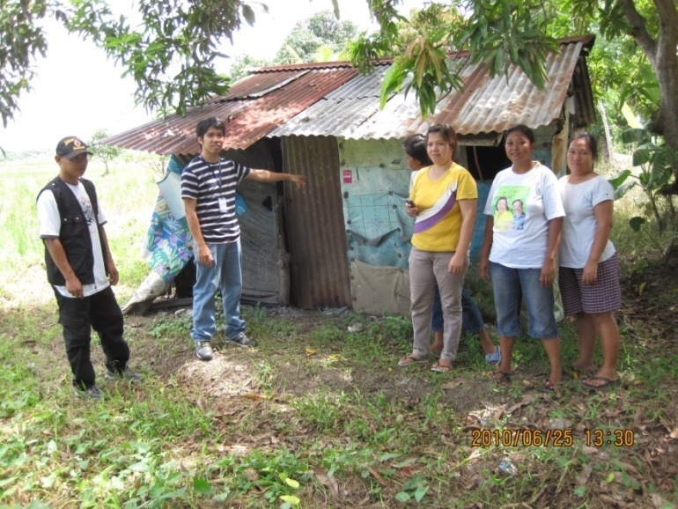
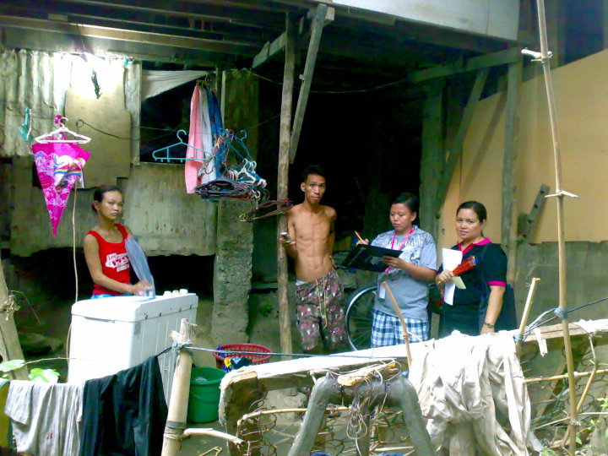
Enumeration Period

Slide 19
Census Technology
Use of Short Message Service (SMS) for Progress Monitoring System
Use of Optical Mark Recognition (OMR) and data entry (scan, interpret and key-in)

Slide 21
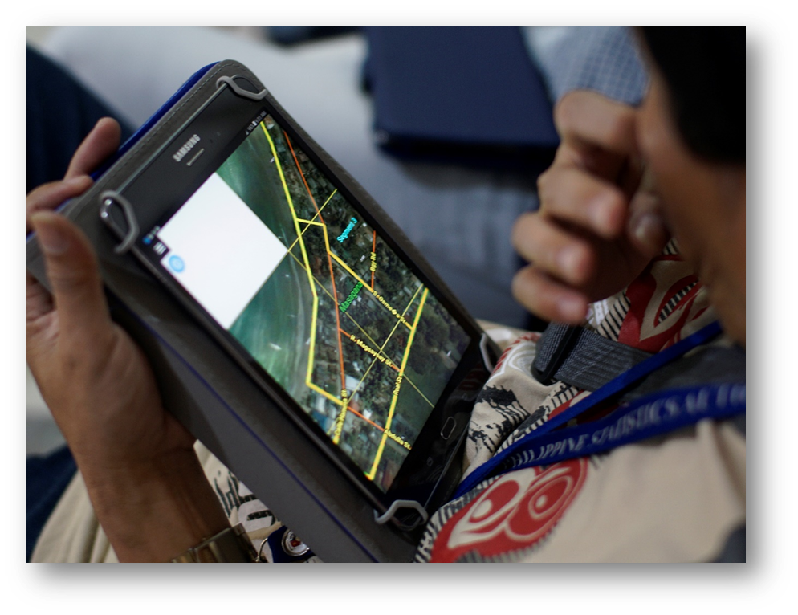
Map-based Listing and Enumeration

Slide 22
Data Processing
Data Processing
Generation of Data
Manual Processing
Machine Processing

Slide 23
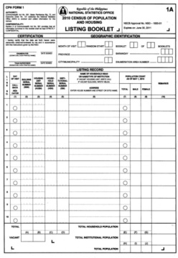
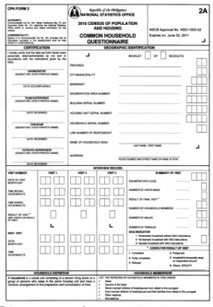
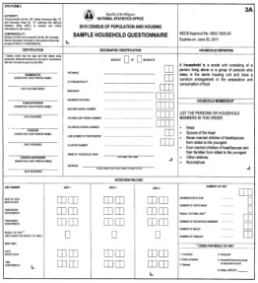
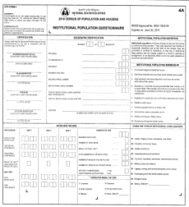
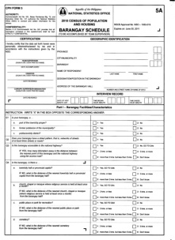
Data Processing
Manual Processing involves:
receipt and control of forms and maps;
verification of geographic identification and completeness of forms;
review of entries for completeness consistency, and acceptability of responses;
coding of selected items; and
bundling/packaging of forms

Slide 24
Data Processing
Machine Processing involves:
receipt and control of forms;
scanning of forms and maps to provide digital copies (images);
data entry/interpretation; and
key verification of entries
It also includes:
computer editing of entries for completeness and consistency of data items within and between records;
and consolidation of data according to predetermined table formats.

Slide 25
Proclamation of Population Count
Section 8 of Batas Pambansa Bilang (Republic Act No.) 72
Before the end of the year (starting in 1980) and of every census year thereafter, a count of the population by province, city/municipality and barangay (village) shall be published based on the census conducted. The final population count as determined from the processed census returns shall be considered official for all purposes upon proclamation by the
President of the Republic of the Philippines.
Notes:
Proclamation of the Popcen Results is done before the year ends by the President of the Philippines.

Slide 26
Proclamation of Population Count
Executive Order No. 352 - Designation of Statistical Activities that will Generate Critical Data for Decision-making of the Government and the Private Sector
Designated Activity | Agency | Frequency of Conduct | Geographic Identification | Schedule of Data Dissemination
Census of Population and Housing | PSA | Every 10 years | National , Regional, Provincial, City/Municipality, Urban-Rural | Before the end of every census year for population figures from national down to barangay levels 18 months after the reference year for other statistics.
Mid-Decade Census of Population and Housing | PSA | Every 10 years | National , Regional, Provincial, City/Municipality, Urban-Rural | Before the end of every census year for population figures from national down to barangay levels 18 months after the reference year for other statistics.

Slide 27
Maraming Salamat!
HOSPITALITY: The Core of a Filipino Soul

Slide 28
http://www.psa.gov.ph
Solid Responsive World-Class

