Slide 1
Session 3 - country presentation by Chinadfddddddddddd Methodologies of population and housing censuses: with the use of administrative records to support field enumeration
National Bureau of Statistics, China
United Nations Regional Workshop on the 2020 World Programme on Population and
Housing Censuses: International Standards and Contemporary Technologies
Kuala Lumpur, Malaysia, 25 - 28 June, 2018

Slide 2
Outlines
Background of China’s previous Population Census
Challenges in 2010 round Population Census
Planning of using administrative records to support field enumeration in 2020 round Population Census

Slide 3
Part 1
Background of China’s previous Population Census

Slide 4
Current System of China’s Population Statistics
Statistical survey
decennial population census, in the year ending with zero(since 1990)
inter-census population survey(micro-census), in the year ending with five, the sample size is about 1% of the total population;
annual population change sample survey, the sample size is about 1‰ (1 per thousand) of the total population
Administrative records
Data from Ministry of Public Security
Data from National Health Commission
Data from Ministry of civil affairs
…
No official linkage between these two sources
Notes:
In China, compared with other data source, the population census is the most comprehensive source of information on population aggregate and structure. it

Slide 5
Cont’d…
The UN’s Principles and Recommendations for Population and Housing Census defines a population census as the total process of collecting, compiling, evaluating, analyzing and publishing demographic, economic and social data pertaining, at a specified time, to all persons in a country.
In China, the population census is the most comprehensive source of information on population summarization and structure. It provides benchmark for all demographic, social and labor force statistics.
.
Notes:
The UN’s Principles and Recommendations for Population and Housing Census defines a population census as the total process of collecting, compiling, evaluating, analyzing and publishing demographic, economic and social data pertaining, at a specified time, to all persons in a country.

Slide 6
Cont’d…
Sequence | Year | Population (million)
First | 1953 | 594.53
Second | 1964 | 694.58
Third | 1982 | 1008.18
Fourth | 1990 | 1133.68
Fifth | 2000 | 1265.83
Sixth | 2010 | 1339.72
.
So far China has undertaken six population and housing censuses in 1953, 1964, 1982, 1990, 2000 and 2010, and China is primarily taking traditional methods to conduct the census, the face-to-face interview with paper questionnaires.
Notes:
The UN’s Principles and Recommendations for Population and Housing Census defines a population census as the total process of collecting, compiling, evaluating, analyzing and publishing demographic, economic and social data pertaining, at a specified time, to all persons in a country.

Slide 7
2010 round Population Census
Legal basis for census - Stronger protection of privacy to win cooperation and support from the public
Census organization
Central government
Province 31
City 330+
County 2800+
Township 40000+
Village/Community 680000+
Supervisors/Enumerator over 6 million
Traditional approach – field enumeration with face-to-face interviews

Slide 8
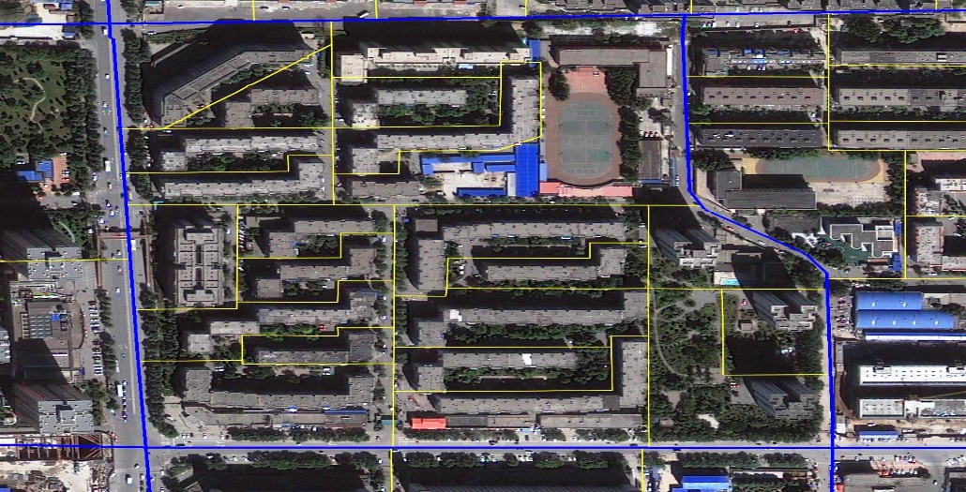
Cont’d…
Image maps used to facilitate census demarcation and mapping
Pilot surveys
Technical preparation
Recruitment and training of enumerators
To divide EA and mapping
Householder name listing
Publicity
…
Enumeration:
1-15 November 2010
Over 6 million enumerators and supervisors
Visits to more than 400 million households in 5 million Enumeration blocks in 40000 townships

Slide 9
Part 2
Challenges in 2010 round Population Census

Slide 10
1. Ensure every individual is counted once and only once
Increasing size, scope and frequency of population migration
Unstable residence of migrants making survey more difficult
Multi-residence phenomena are common in cities
Less communication between owners and tenants-less information obtained from relevant person

Slide 11
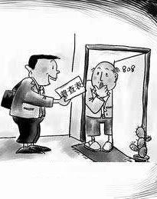
2. Difficulty in Obtaining Information Complete and Accurate
Increasing individual awareness of privacy
More reluctant to provide personal information
More refusal to cooperate with census
Access to households more difficult
Difficulty in capturing floating population
More residence-registration inconsistency
Difficulty in recruiting enumerators

Slide 12
2. Difficulty in Obtaining Information Complete and Accurate
Main Problems Encountered:
Respondent refusals
Difficulty in getting access to respondents
Difficulty in capturing floating population
More residence-registration inconsistency
Difficulty in recruiting enumerators

Slide 13
3. Impact on Census data
Under-reporting in child birth and population at younger age
TFR of childbearing women by direct census registration was relatively low
There is under-reporting in dead people, esp. infant death and death of elderly people
Over-reporting and under-reporting issues in floating population

Slide 14
Part 3
Planning of using administrative sources and big data to support field enumeration in 2020 round Population Census

Slide 15
Identification of trends learned from 2010 census
Making use of other sources data, such as administrative data and big data
Advances in information technology
Increased demand for comprehensive data on the population on a timely basis

Slide 16
More widely use of administrative records
Initiative application of administrative records to support population census
Lack of unified, standard and general system of administrative database, incomplete register(birth and death, esp. in rural area), hard to access
Helpful as reference for data quality control
Considering the fact that China has a relative comprehensive administrative recording and management system to cover a person of the entire life cycle, a register-based census is believed to be the future direction of censuses in China. NBS has intention to try out data comparison between administratively recorded data and census enumerations in the forthcoming 2020 round of census as the starting point .

Slide 17
Cont’d…
A 2017 regional pilot survey was done successfully adding the resident id card number in the questionnaire, more than 90% of the respondents reported their id card number.
in the 2017 population changes sample survey, Id card number was officially added for the first time, more than 80% of the respondents reported their id card number
Data compared with women’s inpatient delivery information database through the id number, better data quality control of the birth data

Slide 18
Planning for 2020 census
Add ID number in population census, real-time/ batch to compare between administrative records and on-site registration, in order to improve the quality of census data
The national population basic information database
Records combined from five commissions- high coverage rate, comprehensive,
repeated key ID, basic information, part missing information of new born child without register and not timely cancellation of deaths
Women’s inpatient delivery information database
National Health Commission
Information of childbearing women to support solving the problem of birth undercount

Slide 19
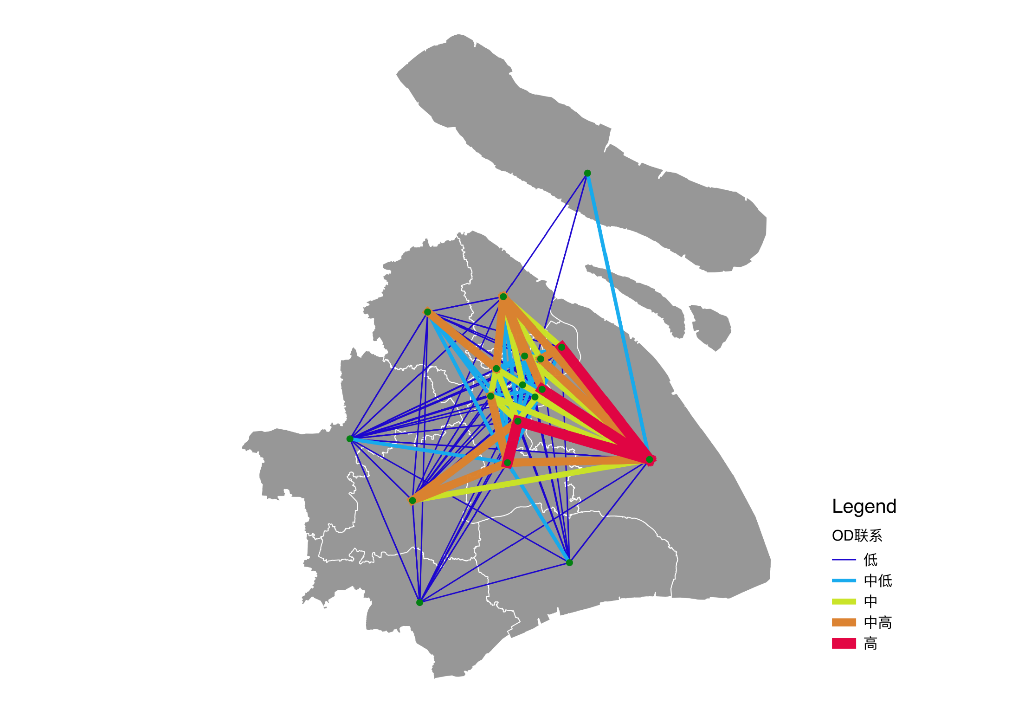
Use of big data to support field enumeration in census
Pilot work in population census using mobile data
Group analysis of mobile phone signal—estimate the total population and predict trends
Individual analysis of mobile phone signal—know the residence of the floating population and enhance data quality

Slide 20
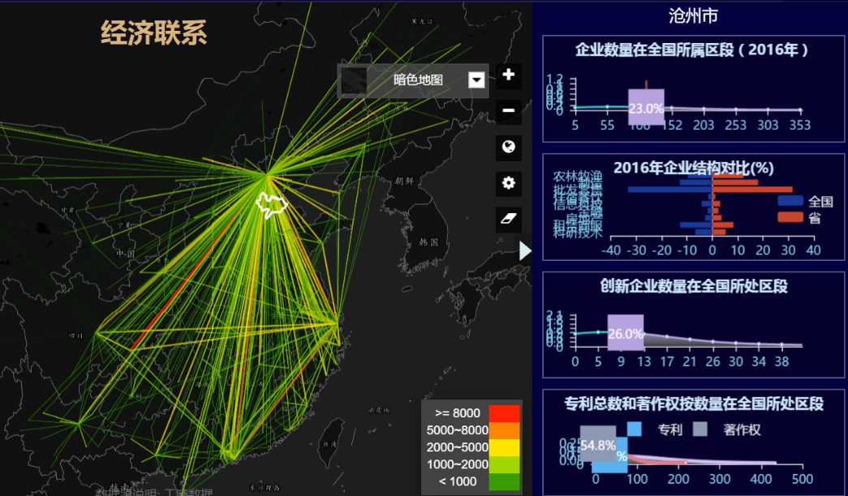
Use of big data to support field enumeration in census
Internet and big data technologies
Massive personal data
Timely information and useful for trends prediction
Provide technical support to census and validate the census data

Slide 21
Census Data Collection System
Enumeration
Big Data
Register

Slide 23
Session 13 - country presentation by Chinadfddddddddddd Application of multi-mode data collection in micro-census in 2015
National Bureau of Statistics, China
United Nations Regional Workshop on the 2020 World Programme on Population and
Housing Censuses: International Standards and Contemporary Technologies
Kuala Lumpur, Malaysia, 25 - 28 June, 2018

Slide 24
CONTENTS
1
Backgrounds for multi-mode data collection
2
Data collection in 2015
micro-census
3
Comparisons of different methods in 2015 micro-census
4
Outlook for 2020 census data collection methods

Slide 25
Background
High internet penetration rate and computer literacy, coupled with the increasing difficulty of reaching respondents at their homes, are key considerations in the adoption of Internet enumeration for census taking
Requirement for Statistics--- Electronic collection
Application of PDA is mature-succeed in the third economic census
Smart phones and the Internet penetration rate is high
Large-scale application in population survey for the first time

Slide 26
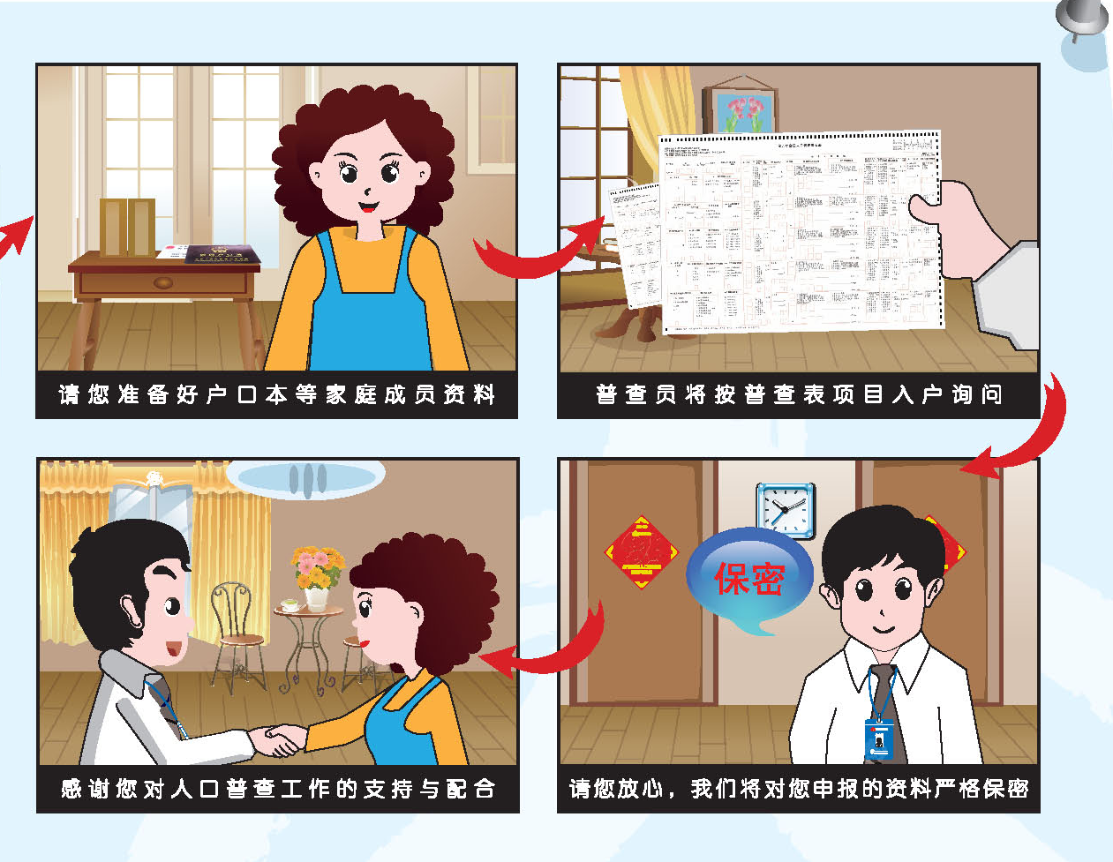
Cont’d

Slide 27
Cont’d
Learn from Canada, Australia, South Korea
Design self-enumerated questionnaire by internet
Design work flow of electronic collection
Develop and test programs

Slide 28
Cont’d
Pilot survey for internet in Beijing, Shanghai, Pilot survey in Guangdong, Comprehensive pilot in Jiangsu,Test self-enumerated indicators
Available 24h *7, internet enumeration provides respondents with the flexibility of responding at any time they desire. It allows respondents to provide their survey returns directly to the system without having to go through a third party.

Slide 29
2.Data collection in micro-census 2015
Reference Time: Nov.1, 2015
There are two modes of data collection in micro-census 2015.
PPT模板下载：www.1ppt.com/moban/ 行业PPT模板：www.1ppt.com/hangye/
节日PPT模板：www.1ppt.com/jieri/ PPT素材下载：www.1ppt.com/sucai/
PPT背景图片：www.1ppt.com/beijing/ PPT图表下载：www.1ppt.com/tubiao/
优秀PPT下载：www.1ppt.com/xiazai/ PPT教程： www.1ppt.com/powerpoint/
Word教程： www.1ppt.com/word/ Excel教程：www.1ppt.com/excel/
资料下载：www.1ppt.com/ziliao/ PPT课件下载：www.1ppt.com/kejian/
范文下载：www.1ppt.com/fanwen/ 试卷下载：www.1ppt.com/shiti/
教案下载：www.1ppt.com/jiaoan/ PPT论坛：www.1ppt.cn

Slide 30
Enumerators interviews with PDA.
Self-enumeration on the Internet.

Slide 31
Main Working Stages
Pre-survey：Oct.16-31
Field enumeration ：Nov.1-10
Self enumeration on internet： Nov.1-10
Coding： Nov.1-10
Post enumeration survey ： Finished before Nov.25
Data processing ：Finished before Dec.31

Slide 32
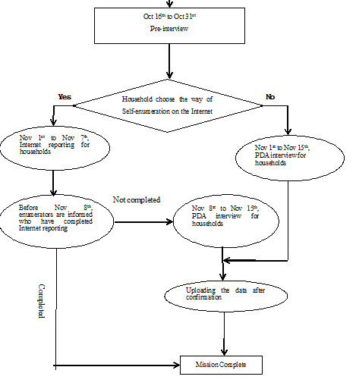
Working flow

Slide 33
Main Characteristics:
Multi-mode：PDA ＆ Internet
Only one stage
Household will
Household number(18 digits) and Initial password

Slide 34
Self-enumeration on the Internet.
The household will fill in e-questionnaire online, according to the network password.
Residents were asked to complete self-enumeration on Internet and upload data platform within 7 days.
For the households not finishing self-enumeration on the Internet, enumerators will conduct face to face interviews with PDA.

Slide 35
Self-enumeration on the Internet.
Automated branching of questions is used to direct respondents to questions that are only relevant to them based on previous entries/selection. Tips and definitions are also included to aid respondents.
To ensure completeness of returns and data consistency, basic verification rules are built in the online system

Slide 36
Enumerators interviews with PDA
After questionnaires completed with PDA, the respondents gave an electronic signature.
Questionnaires data uploaded to Bureau of Statistics Internet.
The average number of households in enumeration area have 80 households and requires to complete field work within 15 days.

Slide 37
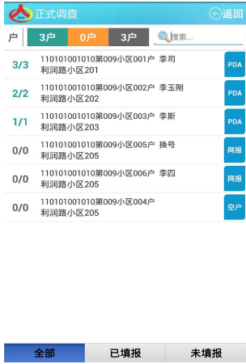
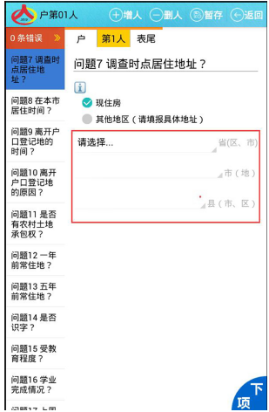
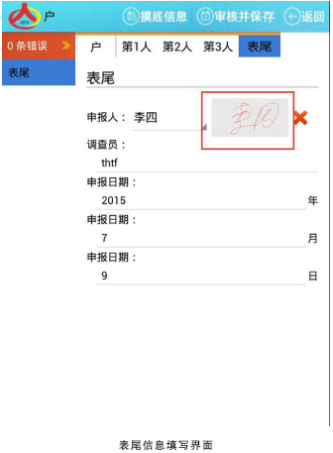
demonstration for PDA application

Slide 38
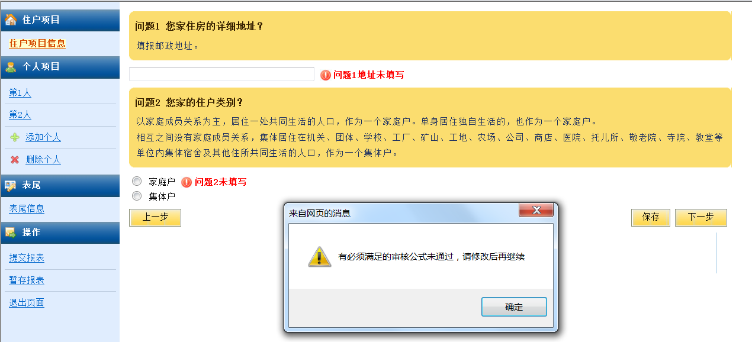
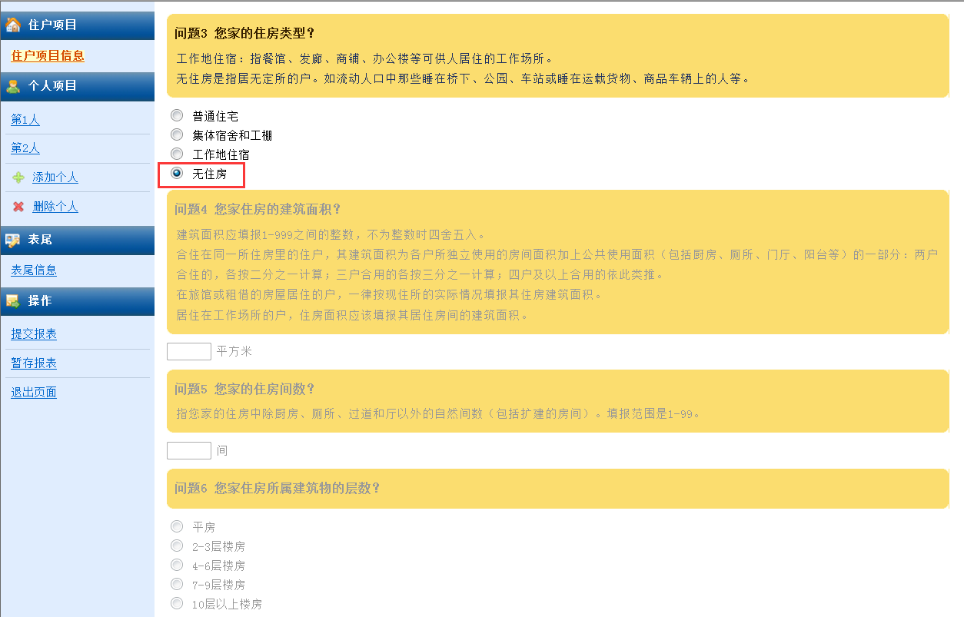
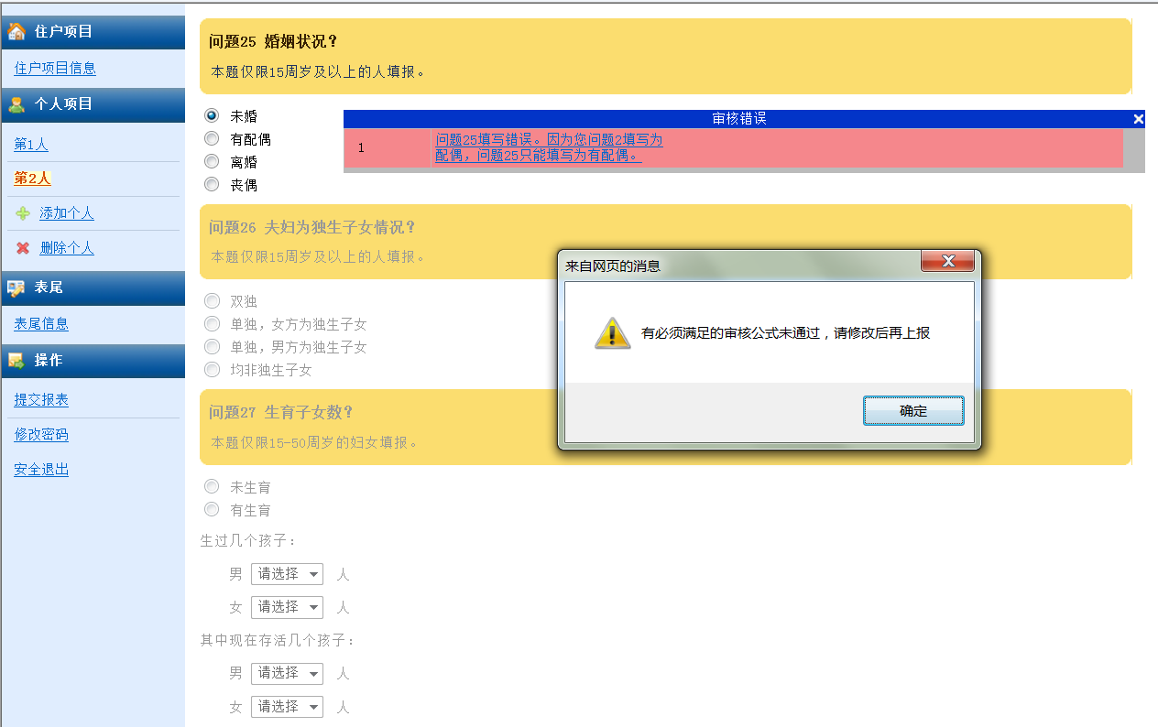
Demonstration for internet survey questionnaire

Slide 39
Population(10,000 persons) | 2453
Households(10,000 households) | 721
PDA | 719
Self-enumeration on the Internet | 2.3

Slide 40
3.Comparisons of different methods in 2015 micro-census
Advantages
PPT模板下载：www.1ppt.com/moban/ 行业PPT模板：www.1ppt.com/hangye/
节日PPT模板：www.1ppt.com/jieri/ PPT素材下载：www.1ppt.com/sucai/
PPT背景图片：www.1ppt.com/beijing/ PPT图表下载：www.1ppt.com/tubiao/
优秀PPT下载：www.1ppt.com/xiazai/ PPT教程： www.1ppt.com/powerpoint/
Word教程： www.1ppt.com/word/ Excel教程：www.1ppt.com/excel/
资料下载：www.1ppt.com/ziliao/ PPT课件下载：www.1ppt.com/kejian/
范文下载：www.1ppt.com/fanwen/ 试卷下载：www.1ppt.com/shiti/
教案下载：www.1ppt.com/jiaoan/ PPT论坛：www.1ppt.cn
Problems of PDA
Problems of self-enumaration

Slide 41
Difficulty for hiring enumerators and instructors
Maintaining cost of PDA
1
3
PDA
2
4
PDA training is difficult
Network platform is instability

Slide 42
Quality of self-enumeration
Households will is not strong
1
3
Internet
2
4
Restriction by age, education, etc.
Reporting environment is limited

Slide 43
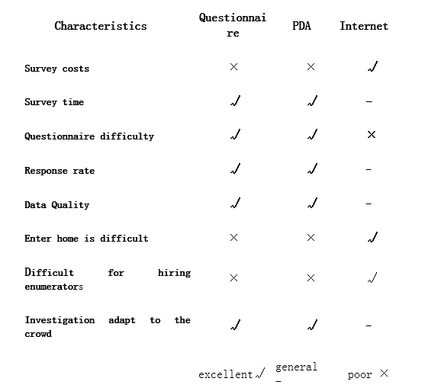

Slide 44
4.Outlook for 2020 census data collection methods
At the end of Jun.2016, Chinese net citizens reached 710 million. Internet penetration rate reached 51.7%, half of the Chinese people have access to the Internet.
Leveraging on the success and lessons from the micro-census 2015, multi-mode data collection strategy will be used in 2020.

Slide 45
1
The acceptance of internet enumeration is growing
2
Explore survey with more costless devices, such as smart phone, and device rental
Future
3
Improve the quality of network platform to create flexible Internet survey methods
4
Explore the data quality control method of the internet survey
5
Conduct the pilot of self-administered on the internet

