Slide 1
REPUBLIC OF IRAQ

Slide 2
SWOT ANALYSIS
Strengths
A law regulating the registration of births, deaths and an instruction for providing citizens with documents. Presence of the births and deaths registration offices to prepare good covering all districts and sub districts in all governorates. Having trained staff about filling the data according to the international classification of diseases (ICD-10). Central support from the General Secretariat of the Council of Ministers for the purpose of automating birth and death certificate through an electronic network linking relevant ministries. Great coordination between the Ministry of health and the Central statistical organization about statistics. Presence of higher committee abut the SDG’s.

Slide 3
SWOT ANALYSIS
Weakness
Lack of specific financial allocations in the budget of the Ministry of health and the relevant ministries to support civil registration issue. The difficulty of updating laws commensurate with the development of technology. Poor infrastructure and lack of modern equipment needed to develop the work. Lack of incentives for workers in the civil registry and statistics. Difference of some data by different sources. The unstable security situation in some areas

Slide 4
SWOT ANALYSIS
Opportunities
Support from international organizations. Community support and some media awareness on the topic of civil registration. Willingness of various stakeholders to cooperate.

Slide 5
SWOT ANALYSIS
Threaths
The instability of employees in health services and statistics ongoing movements for them. Lack of Internet linking health services centers with registration centers and Ministry Center. Inaccurate some information from the health departments of some workers inefficient. Insufficient training for personnel in the statistical sections. Lack of awareness about the importance of accuracy of statistical information.

Slide 6
Flow Chart of the Vital Statistics
PLANING & RESOURCSE DEVELOPMENT DIRECTORATE
HEALTH DIRECTORATES IN GOVERNORATES
HEALTH & VITAL STATICSTICS DEPARTMENT
CENTRAL STASTICAL ORGANIZATION
EDITING

Slide 7
Report on Births and Deaths Completeness, Including Obstacles For Acheiving100%
Having a higher committee in the prime minister office that contain the MOH, CSO, MoT, MoC & IT Specialists that is responsible to computerize the birth and death certificates and getting a network between the concerned parts , this will help us to get a more complete data .
Increasing the use of media to increase the awareness of the community about CVRS.
Increasing the coordination between the MOH,CSO to get a more accurate statistical numbers.
Increasing the quality control about the statistical data by more training of the staff in all governorates.
Increasing the training of doctors and coders in the field of ICD10,ANACONDA in cooperation with the WHO and other agencies.
-Putting a plan in order to convince the higher authorities to do a new census to have a new and complete data about the population as the latest complete census was done in 1977

Slide 8
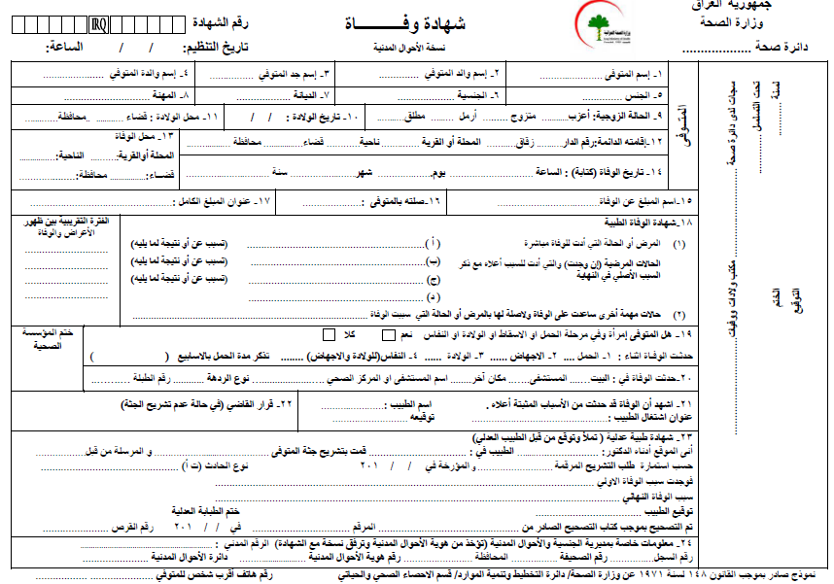
Comparison of Core Topics with National Practices

Slide 9
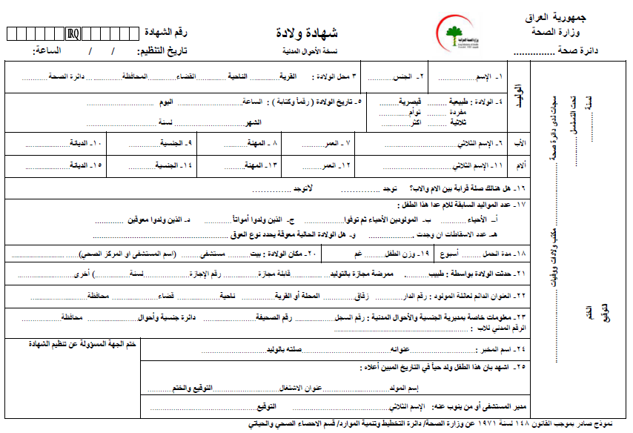
Comparison of Core Topics with National Practices

Slide 10
Comparison of Core Topics with National Practices

Slide 11
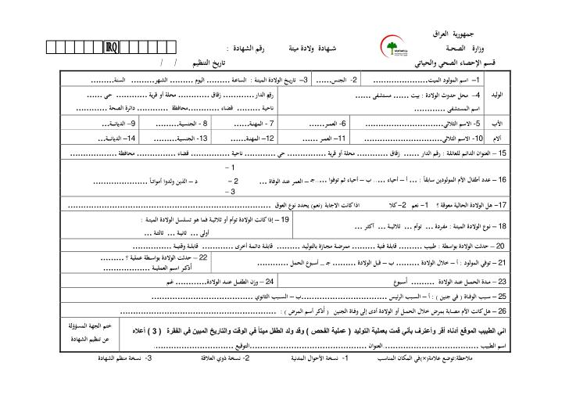
Comparison of Core Topics with National Practices

Slide 12
THANK YOU

