Slide 1
Vital Statistics on
Births and Deaths
Vibeke Oestreich Nielsen
von@ssb.no

Slide 2
Content
Birth variables
Birth indicators
Death variables
Mortality indicators

Slide 3
Birth variables

Slide 4
Definitions
CRVS produces data on live births
Definition:
A live birth is the complete expulsion or extraction from its mother of a product of conception, irrespective of the duration of the pregnancy, which, after such separation, breathes or shows any sign of life (WHO)
Foetal deaths are considered vital events (also referred to as “dead-born foetus” and “stillbirth”, according to P&R)

Slide 5
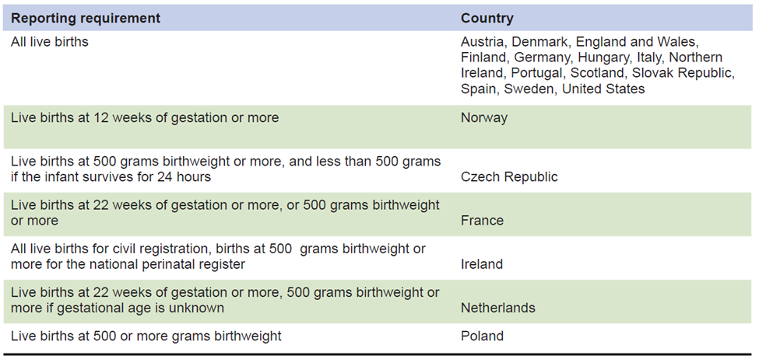
Requirements for Reporting a Live Birth: 2004

Slide 6
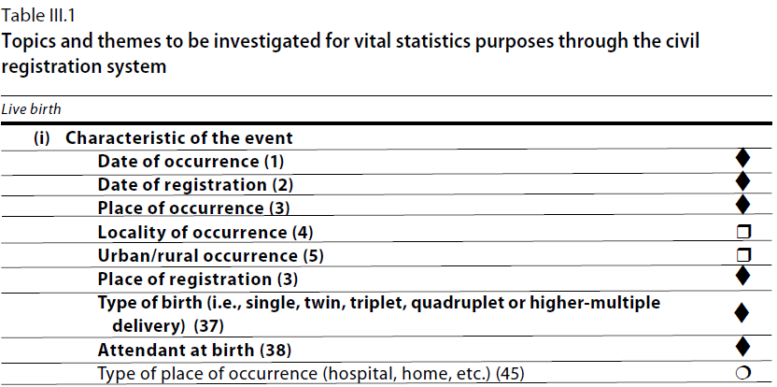
United Nations Principles and Recommendations, 2014 (pp. 18-19)
Booldface: core topic
♦ Information is collected directly
□ Information is derived
○ Additional topic.
See also Guidelines and Template, Annex I: Civil registration variables

Slide 7
United Nations Principles and Recommendations, 2014, contd.
(iii) Characteristics of the mother
Date of birth
Age
Marital status
Child born in wedlock (legitimacy status of the child)
Educational attainment
Place of usual residence
Locality of residence
Urban/rural residence
Duration of residence in usual place
Place and country of birth
Migrant status
Children born alive to mother during her entire lifetime
Birth order or parity
Foetal deaths to mother during her entire lifetime
Date of last previous live birth
Interval since last previous live birth
Date of marriage
Duration of marriage

Slide 8
Annex I: Civil registration variables. Birth registration variables
Number | Topic | Avail-able from CR of birth | Available from other sources | Not available | Year(s) available
(i) | Characteristic of the event
a | Date of occurrence
b | Date of registration
c | Place of occurrence
d | Locality of occurrence
e | Urban/rural occurrence
f | Place of registration
g | Type of birth (i.e., single, twin, triplet, quadruplet or higher multiple delivery)
h | Attendant at birth
i | Type of place of occurrence (hospital, home, etc.)
(ii) | Characteristics of the newborn

Slide 9
Vital Statistics on Births
Time series for the country
Regional numbers
Place of occurrence
Place of usual residence of mother
Place of registration
Month
Delayed births
Gender
Type of institution
Age of mother (and father)
Marital status of parents
Previous no. of births
Weight and height of child (?)
Gestational age (?)
Urban – rural place of birth
….

Slide 10
Recommended tables on live births (UN P&R)
LB-l Live births by place of occurrence and sex of child
LB-2 Live births by place of occurrence and place of usual residence of mother
LB-3 Live births by place of registration, month of occurrence and month of registration
LB-4 Live births by month, place of occurrence and place of usual residence of mother
LB-5 Live births by age, place of usual residence and marital status of mother
LB-6 Live births by age of father
LB-7 Live births by place of usual residence, age and educational attainment of mother
LB-8 Live births by educational attainment and age of mother, and live-birth order
LB-9 Live births by place of usual residence and age of mother, sex of child and live-birth order
LB-10 Live births by live-birth order and interval between last and previous live births to mother

Slide 11
Recommended tables on live births (UN P&R)
LB-11 Live births by place of birth, place of usual residence and age of mother
LB-12 Live births by place of usual residence and age of mother and legitimacy status
LB-13 Live births by place of occurrence, site of delivery and attendant at birth
LB-14 Live births by site of delivery, attendant at birth and birth weight
LB-15 Live births by birth weight and place of usual residence and educational attainment of mother
LB-16 Live births by gestational age, place of usual residence of mother and birth weight
LB-17 Live births by birth weight, place of usual residence of mother and month in which prenatal care began
LB-18 Live births by age and place of usual residence of mother and month in which prenatal care began
LB-19 Live births by live-birth order, place of usual residence of mother and month in which prenatal care began
LB-20 Live births by place of usual residence of mother and duration of residence at the current usual residence

Slide 12
Annex II: Tabulation plan: Live births
Tab-le no. | P&R | Table content | Pos­­sible: Yes/ No | Possible if CR data are com­­bined with other data sources | Year
 |  | First priority tables
4.1 | IB-1 | Total number of live births by sex, incl. sex ratio at birth and site of deliveryª
4.2 | ST-3 | Live births by place of residence¹ and urban–rural residence of the motherª
4.3 | LB-9 | Live births by age of mother (15-19, 20-24 … 45-49)
4.4 | LB-1 | Live births by place of occurrence and sex of childª
4.5 | LB-2 | Live births by place of occurrence and place of usual residence of mother

Slide 13
Registered live births by place of occurrence
 | Total | Health facility | At home | Other
:
2012
2013
2014

Slide 14
Births Registered Currently or Late: Botswana 2012
 |  | Type of Birth
 |  | Live Births |  | Still Births
Status |  | Number | Percent | Number | Percent | Total
Current | Number | 40,856 | 98.7 | 528 | 1.3 | 41,384
 | Percent | 63.4 |  | 97.1 |  | 63.7
Late | Number | 23,599 | 99.9 | 16 | 0.1 | 23,615
 | Percent | 36.6 |  | 2.9 |  | 36.3
 | Total | 64,455 | 99.2 | 544 | 0.8 | 64,999

Slide 15
Additional issues
Delayed and late regsitration of births
Agreement on transfer of microdata from CR agency to NSO
Cut-off date

Slide 16
Calculating and interpreting key indicators on births

Slide 17
Key indicators on live births
Crude Birth Rate (CBR)
General Fertility Rate
Sex ratio at birth
Age-specific fertility rates (ASFR)
Total Fertility Rate (TFR)

Slide 18
Crude Birth Rate:
CBR = Total resident live births X 1,000
Total Population
Sex Ratio at Birth:
SRB= Number of male live births X 100
Number of female live births

Slide 19
Sex ratio at birth
Year | Male births | Female births | SRB
2010
2011
2012
2013
2014
2015
2016

Slide 20
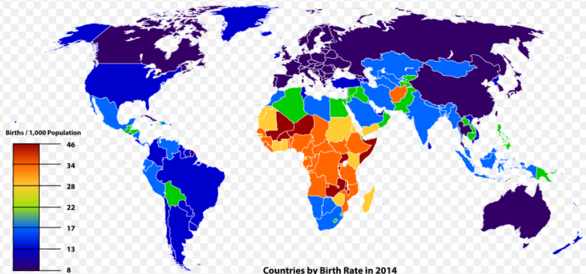
Countries by crude birth rate (CBR) in 2014
Crude Birth Rate:
CBR = Total resident live births X 1,000
Total Population

Slide 21
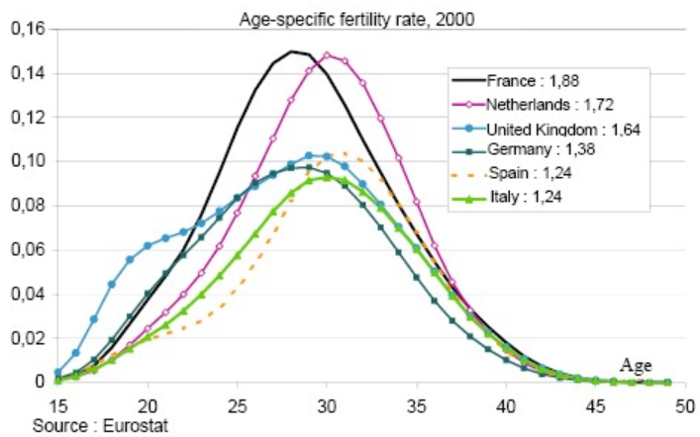
Age-Specific Birth Rate
Number of live births to women in a specific age group for a specific area during a specified period divided by the total population of women in the same age group for that area and period multiplied by 1,000 to obtain a rate:
# live births to women in a specific age group X 1,000
# of women in the same age group

Slide 22
Total Fertility Rate
TFR is the sum of the age-specific birth rates (ASBR) (5-year age groups between 10 and 49) of female residents of a specific area during a specified period multiplied by 5:
(ΣASBR) x 5, where ASBR is each 5-year age-specific birth rate:
ASBR= Bx (the number of live births to mothers age x) x 1,000
Px (the number of women of age x)

Slide 23
Exercises
Calculate the CBR for a population with 180,000 live births in the 12,300,000 estimated population in 2005
What is the sex ratio at birth for the area in 2008?
58,000 = male live births in 2008 to area residents
55,000 = female live births in 2008 to area residents
3. What is the 2008 birth rate for women 20-24 yrs?
36,000 = live births in 2008 among resident women 20-24 years old
310,000 = area resident women who are 20-24 years old in 2008

Slide 24
4. Calculate the TFR for an area for 2015 from these numbers:
Mother’s Age Group | 2000 Live Births (Bx) | 2000 Mid-year Female Population (Px) | ASBR
10-14 | 300* | 165,000
15-19 | 11,000 | 179,000
20-24 | 20,000 | 192,000
25-29 | 22,000 | 222,000
30-34 | 20,000 | 213,000
35-39 | 10,000 | 212,000
40-44 | 2,000 | 210,000
45-49 | 500* | 200,000
* *For groups 10-14 & 45-49, births to ages < 15 and 45+ are used

Slide 25
Vital Statistics on Deaths

Slide 26
What are the possible data sources on mortality?
Censuses?
Sample surveys?
Civil registration!
(Population registers)

Slide 27
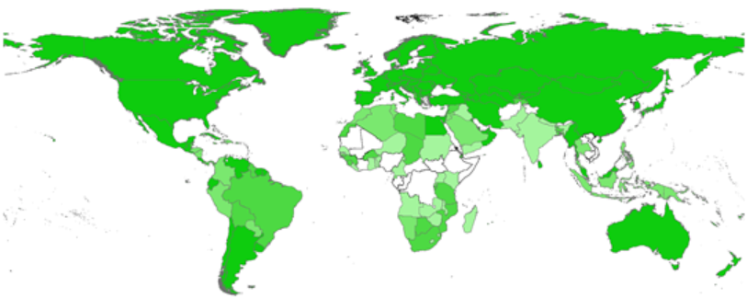
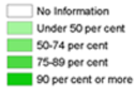
CRVS: Deaths
57% of countries register at least 90% of deaths
85 countries produce high-quality COD data

Slide 28
Why is registration of deaths important?
Death certificate
  Inheritance
  Remarriage
  Burials
Statistics on population growth, size and distribution
Monitoring diseases, including epidemics
Planning for health
Mortality an esential indicator of living conditions

Slide 29
Sustainable Development Goals
3.1 By 2030 reduce the global maternal mortality
ratio to less than 70 per 100,000 live births
3.2 By 2030 end preventable deaths of newborns and children under 5 … and reduce
- neonatal mortality to below 12 per 1,000 live births
- under-5 mortality to below 25 per 1,000 live births
3.3 By 2030 end the epidemics of AIDS, tuberculosis, malaria …
3.4 By 2030 reduce by one third premature mortality from non- communicable diseases …
3.6 By 2020 halve the number of global deaths … from road traffic accidents
3.9 By 2030 substantially reduce the number of deaths … from hazardous chemicals …
16.9 By 2030 provide legal identity for all, including birth registration
Use Civil Registration ?
Notes:
SDGs are great – but how about the European Health 2020 targets???

Slide 30
Key death registration variables, according to UN P&R
(i) Characteristics of the event
Date of occurrence
Date of registration
Place of occurrence
Locality of occurrence
Urban/rural occurrence
Place of registration
Cause of death
Certifier
Type of certification
Type of place of occurrence (hospital, home, etc.)
Sex
(ii) Characteristics of the decedent
Date of birth
Age
Sex
Marital status
Place of usual residence
Place of usual residence of the mother (for deaths under 1 year of age)
Locality of residence
Urban/rural residence
(iii) Characteristics of population at risk

Slide 31
Key death registration variables – foetal death
(i) Characteristics of the event
Date of occurrence (of foetal delivery)
Date of registration
Place of occurrence
Locality of occurrence
Urban/rural occurrence
Place of registration
(ii) Characteristics of the foetus
Sex
iii) Characteristics of the mother
Date of birth
Age
Children born alive to mother during her entire lifetime
Birth order or parity
Foetal deaths to mother during her entire lifetime
Date of last previous live birth
Interval since last previous live birth
Date of marriage
Duration of marriage
Place of usual residence
Locality of residence
Urban/rural residence
(iv) Characteristics of the father
Date of birth
Age
Place of usual residence
Locality of residence
Urban/rural residence

Slide 32
Tables on deaths recommended by P&R
DE-1 Deaths by place of usual residence and sex of decedent
DE-2 Deaths by place of occurrence and place of usual residence and sex of decedent
DE-3 Deaths by month and place of occurrence and place of usual residence of decedent
DE-4 Deaths by place of registration, month of occurrence and month of registration
DE-5 Deaths by place of occurrence and site of occurrence*
* hospital, other institution, at home, or other place (prison, custodial care facility, trains, airplanes, ships, automobiles and public byways, such as roads and sidewalks, ….)
DE-6 Deaths by place of usual residence, age and sex of decedent
DE-7 Deaths by age, sex, place of usual residence and marital status of decedent
DE-8 Deaths by place of usual residence, age, sex and educational attainment of decedent
DE-9 Deaths by sex, cause of death, place of usual residence and age of decedent
DE-10 Deaths by month of occurrence and cause of death
DE-11 Deaths by place of occurrence, sex of decedent and type of certification*
* physician, medical practitioner, coroner, medical-legal authority, midwife, nurse or layperson
DE-12 Maternal deaths by cause of death and age of woman
DE-13 Deaths by age and type of usual activity of decedent

Slide 33
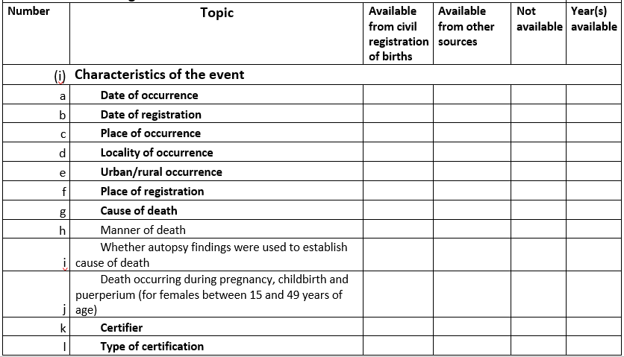
Annex I: Death registration variables
Guidelines and template for a vital statistics report

Slide 34
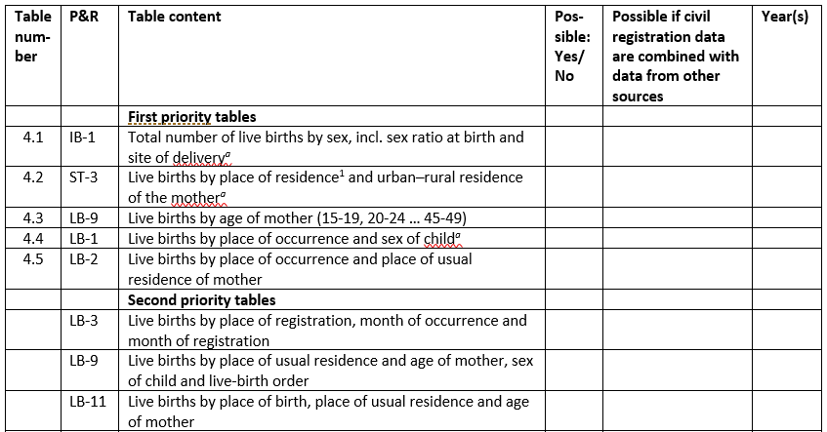
Annex II: Tabulation plan for deaths
Guidelines and template for a vital statistics report, page 86

Slide 35
Vital Statistics on Deaths
Time series for the country
Regional divisions
Age and gender
Month
Place of occurrence
Place of usual residence of decedent
(Place of registration)
Type of institution
Cause of death
Maternal deaths

Slide 36
Registered deaths by age and gender, 201x
 | Total | Male | Female
Age
Neonatal (< 7 days)
Late neotatal (7-28 days)
Post neonatal (28-265 days)
0
1-4
5-9
10-14
15-19
20-24
…
…
95-99
100+
Not known
Total

Slide 37
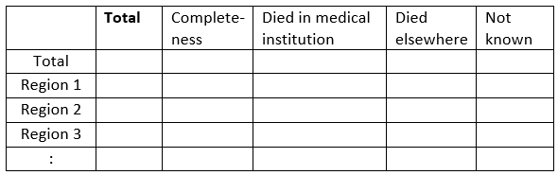
Registered deaths by region, 201x

Slide 38
Mortality Indicators

Slide 39
Mortality indicators
Total number of deaths
Number of deaths by age and sex
Crude Death Rate (CDR)
Infant mortality rate (IMR)
Under five mortality rate (U5MR)
Maternal mortality rate (MMR)
Age-specific mortality rates
Death probabilities by age and sex (qx)
Life expectancy at birth (LE, e0)

Slide 40
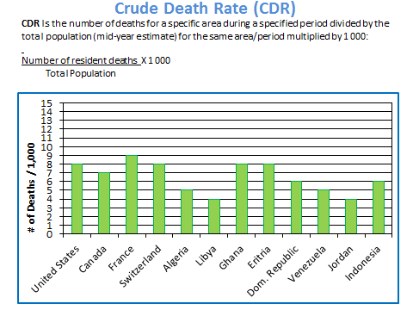

Slide 41
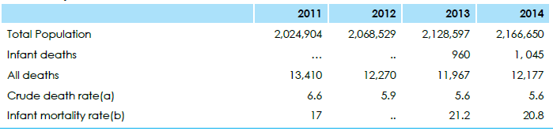
Summary table on deaths, Botswana 2011-2014

Slide 42
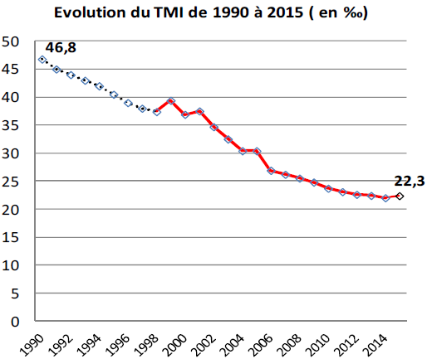
Infant Mortality Rate (IMR)
Number of new-borns dying under 1 year of age for a specific area during a specified period divided by the number of resident live births for the same area/period multiplied by 1,000:
# of infant deaths X 1,000
# of live births
Algeria 1980-2015

Slide 43
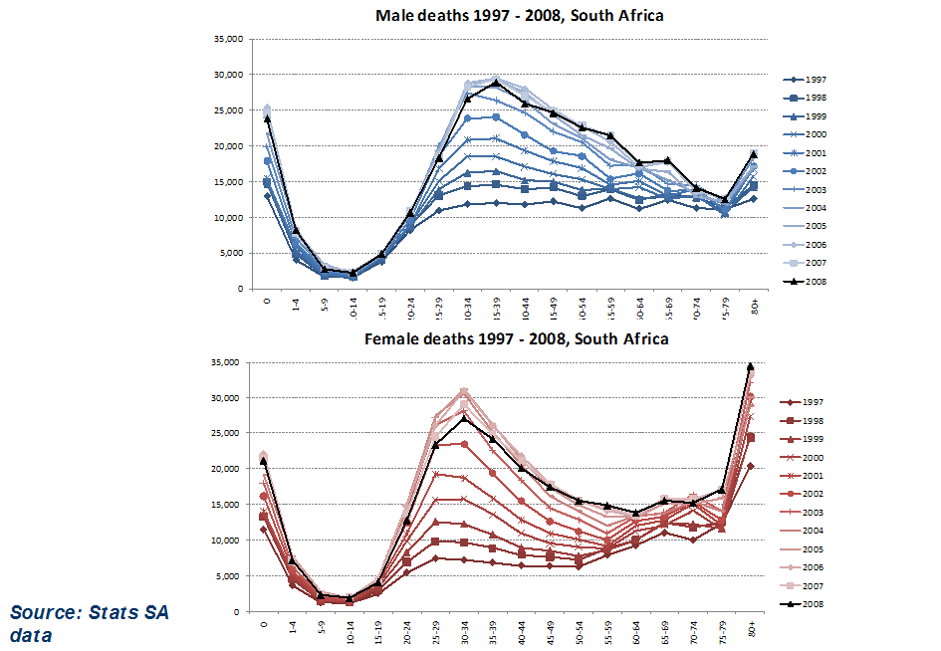
Number of deaths by sex and age for different years in South Africa

Slide 44
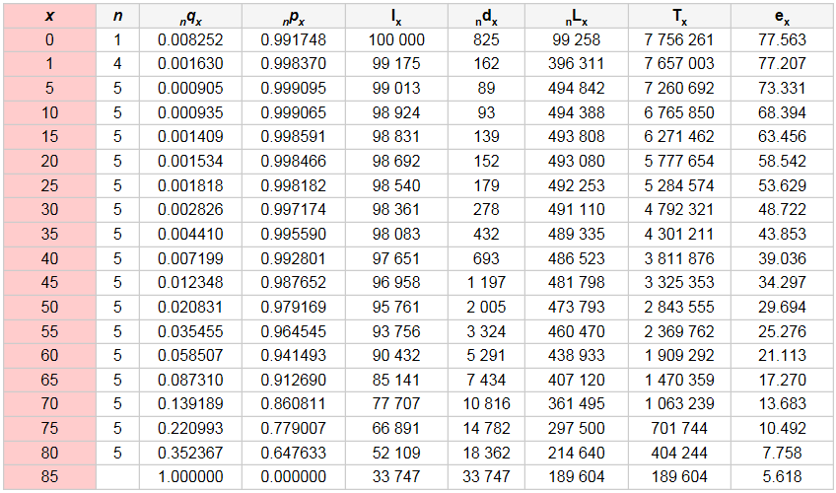
Life Table (abridged)
Source: Population Analysis for Policies & Programmes, http://papp.iussp.org/sessions/papp101_s07/PAPP101_s07_030_010.html

Slide 45
Life expextancy at birth for Norway 1850-2013
79,70 | 83,60
Females
Males

Slide 47
Life expectancy at birth in England & Wales by social class
Kilde: Valkonen, Council of Europe, 2001; Vallin, 9.11.2007

Slide 48

World Comparison of Prop. Elderly: 1950-2050
Projection
Japan
Italy
Germany
Korea
Ryuichi KANEKO, Oct. 2007
Data from United Nations, Census, NIPSSR(2006), Population Projection for Japan:2006-2055.

Slide 49
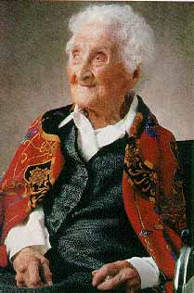
Jeanne Calment
Oldest well documented
Born 21 February 1875 in Arles in Southern France
Died 4 August 1997
Lived 122 years and 164 days

Slide 50
Exercises
There was a total of 14 500 deaths registered in country Y in 2012. The estimated population in country Y for 2012 was 2 230 000. Given that the completeness rate of registration is very high, what was the crude death rate in country Y in 2012?
In 2011 there were registered 1 300 infant deaths in Country Q. In total 150 000 live births were registered. What was the infant mortality rate (IMR) based on these figures? If the estimated number of births from population estimates based on a recent population census was 200 000, which figure would you use and why?
Can you estimate the life expectancy at birth for your country?

