Slide 1
Results of the regional assessment:
Outcome of the APAI-CRVS monitoring framework
Workshop on the Operation of CR, VS and ID Management systems and the Production of VS reports for the Eastern Mediterranean region Countries
26-30 March 2018, Tunis, Tunisia
Kassahun Admassu
African Centre for Statistics
United Nations Economic Commission for Africa

Slide 2
Outline
Introduction
APAI-CRVS regional monitoring platform
Main findings of the regional assessment
Legal framework
Registration and records transmission processes
Vital Statistics and data quality checks
Birth and Death registrations completeness
Conclusion

Slide 3
Introduction
The first step to improve CRVS is to evaluate the functionality of the exiting systems by assessing registration process and monitoring quality of records of vital events and vital statistics.
With out standard-based quality assurance system and production of reliable vital statistics it is not possible to know the quality of the registration system, its coverage and completeness rate.
However, many of the Member States do not have monitoring and quality assurance mechanism for their civil registration systems
Realizing the gap, the Second Conference of Ministers recommended to “develop results-based monitoring and evaluation systems to monitor and report on progress of CRVS” in the region

Slide 4
APAI-CRVS monitoring platform
Following to this call, a web-based regional monitoring platform was developed by the APAI-CRVS Secretariat in 2016.
The monitoring platform was designed to assess the status of CRVS systems and progress made by each country.
The first web-based regional CRVS monitoring was rolled out in early 2017, and to be filled in once a year to monitor progresses in each member State.
This presentation is based on responses from 39 countries that completed the monitoring form out of the 54 member states, a response rate of 72%

Slide 5
Legal framework
All countries, except one, have legal provision for civil registration
Existing legal provisions are not in compliance with international standards
In more than one third of the countries, the law does not specify late and delayed registration;
In many countries registration of marriage and divorce are not compulsory, divorce registration is compulsory only in 17 out of the 39 countries;
In half of the countries, the law does not adequately address producing of vital statistics and on recording causes of death.

Slide 6
Registration and records transmission processes
Notification of birth and death events:
Community chiefs or local administrators are main notifies for events occur at homes
Health workers serve as primary notifies for events occur at health facilities
Only few countries use mobile technology to notify birth and death at the community
Most health facilities notify local registration offices using paper forms
Registration and transmission of records:
Only one-thirds of the countries register birth and death events electronically at all local registration offices
Few countries use an electronic registration system for recording marriage and divorce events
A larger number of countries fully depend on a paper-based registration and transferring of records

Slide 7
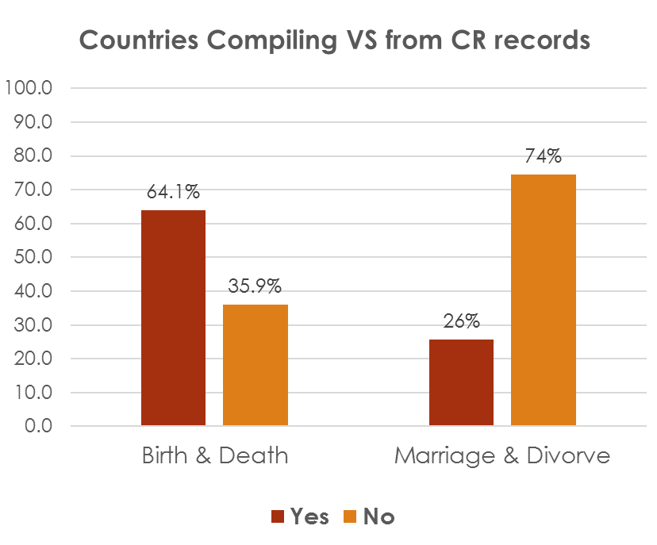
Vital Statistics and data quality checks
About two-thirds of the countries compile birth and death statistics from civil registration
only 10 countries (26%) compile data from marriage and divorce records.
Only 15 countries (38%) publish annual VS reports regularly
11countries (33%) publish VS report on an ad hoc basis.

Slide 8
Vital Statistics and data quality(cont’d)
As large as two-thirds of the countries do not have a routine data quality and plausibility checks mechanism.
Some contrives do not distinguish between current, late and delayed registrations and report backlogs as current registration.
This resulted completeness rate of over 100%
Few countries able assess and monitor completeness of their civil registration system.

Slide 9
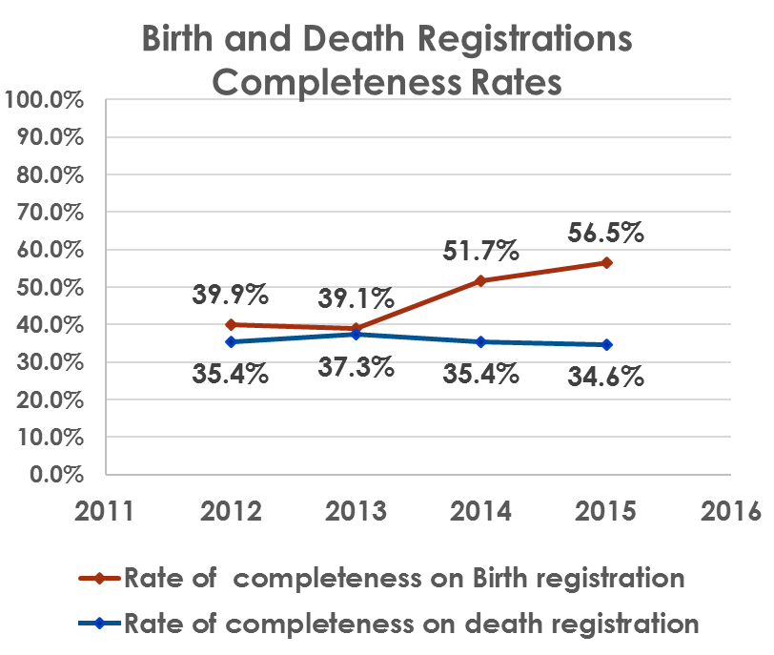
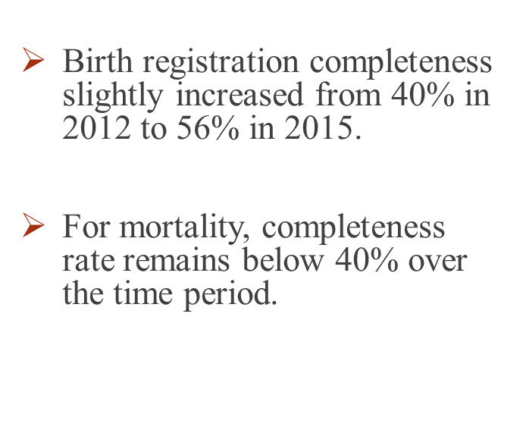
Birth and death registration completeness

Slide 10
Conclusion
Most of the countries have legal frameworks for civil registration, but the laws are not aligned to the international standards.
Registration has not increased as fast as expected for accelerated improvement of CRVS in the region.
In the region, on average, only about 50% of births and less than 40% deaths are captured by civil registration system.
Without improvement in the CR system, no improvement in VS system and vise versa.

Slide 11
Thank you

