Slide 2
ASIAN AND PACIFIC CRVS DECADE 2015-2024

Slide 3
Digitising civil registration and vital statistics
S. Ehsanikalkhoran
Expert on Social and Household Statistics, Office of Population Statistics, Labour Force and Census
Statistical Centre of I.R. Iran (SCI)

Slide 4
E-Governance
E-CRVS
E-banking
E-health
E-commerce
E-learning
Electronic Insurance
Electronic social security (subsidies)
Electronic election

Slide 5
Road map to a Digitised NOCR in I.R. Iran
Planning to establish NOCR population information database (NDP)
Organizing the national ID number and postal code on the NOCR Database
Providing E-identity services
Identity management in cyberspace
National Smart Identity
We are here now

Slide 6
Traditional Identity Management
Digital Identity Management
Propulsions
Traditional Paradigm
Digitised Paradigm
Digitised identity services
IT Solutions
World Trends
Transformation
Customer needs
Governance Policies and obligations

Slide 7
Electronic Assets

Slide 8
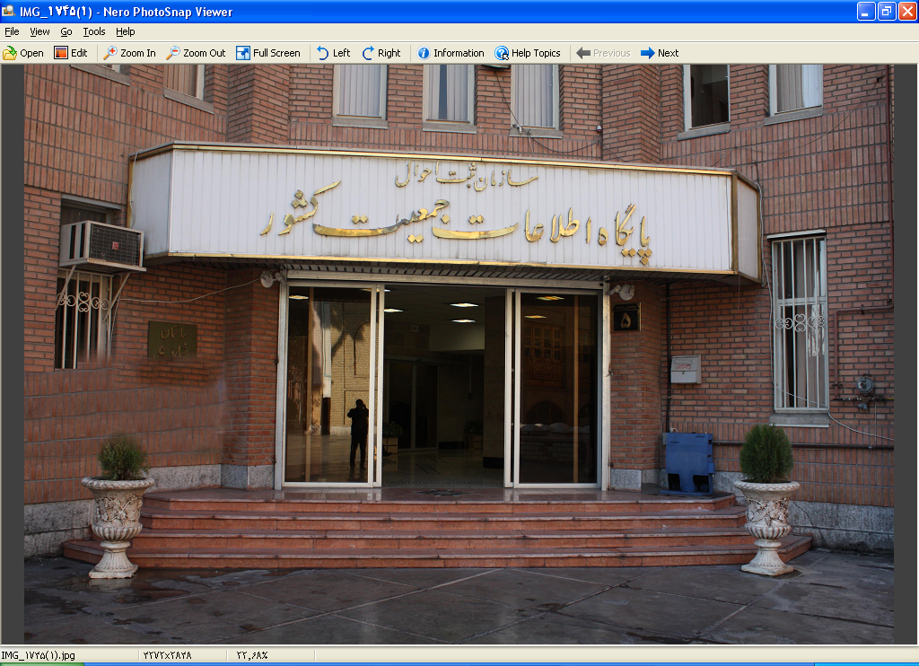
Electronic Assets
A National Population Database with more than 110 million records registered

Slide 9
Electronic Assets
Administrative registers In More than 800 offices
Costumers of Electronic Individual Identity Inquiry
More than 200,000 end users (banks, Police stations, Post Offices, …)

Slide 10
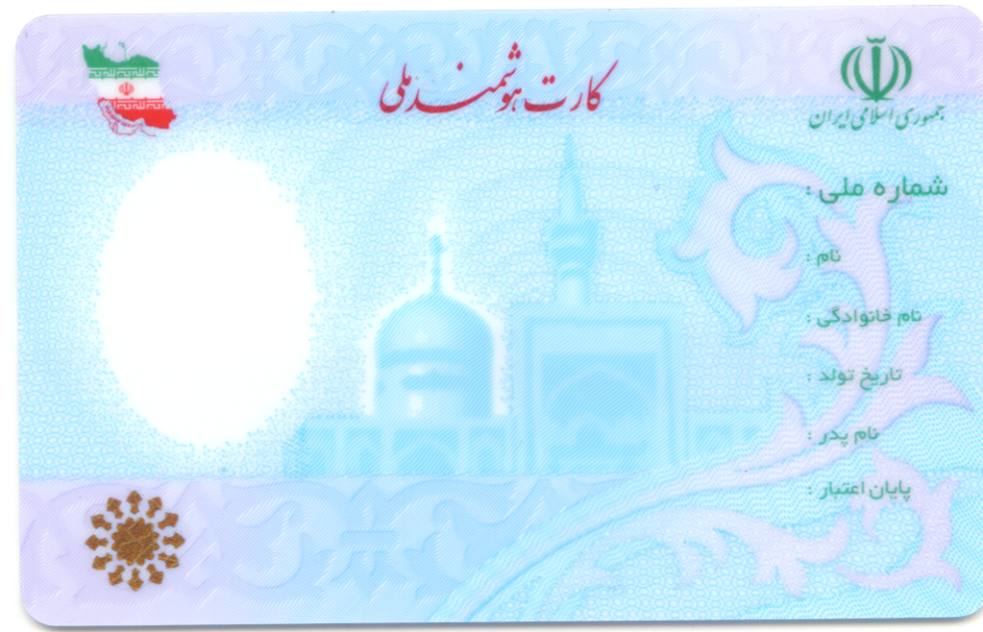
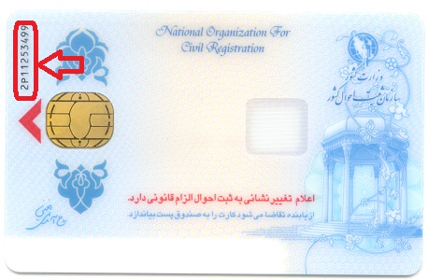
Smart National ID Card
The issuance of the smart National ID card has started in the whole country since 2012. So far, about 38 million cards have been issued (equivalent to 60% of eligible population).

Slide 11
Electronic/ Digitised Services
Registration of changes related to Identity Features and location Address
Electronic Individual Identity Inquiry
Registration of Birth, death, marriage and divorce
Issuing Birth certificate

Slide 12
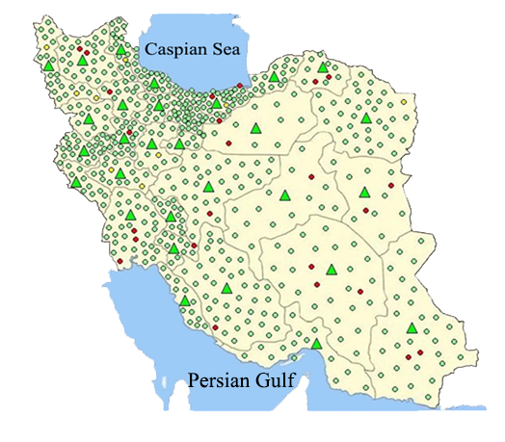
The map of the Civil Registration Organization’s online data transmission network, with 833 members ( Departments and Offices)

Slide 13
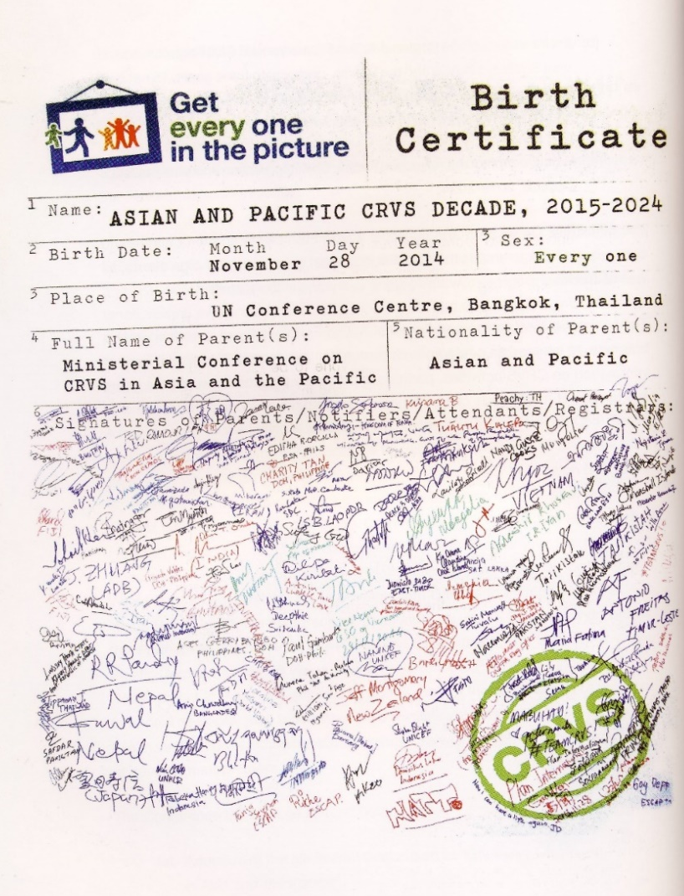
2015-2024
CRVS Decade
In Asia And Pacific

Slide 14
Photo : Getty Image

