Slide 1
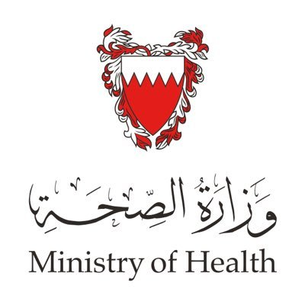
The Role of Health Institute Kingdom of Bahrain
Notes:
The Kingdom of Bahrain is an island in the Arabian Gulf
with an area of 779 sq.km (approximately)
with population of 1,423.7 (in 000) as estimated in 2016;
the percentage of Bahraini was 46% and Non-Bahraini 54%.
The crude birth rate was 14.5 per 1000 population,
and the population growth rate was 5.8% (Central Informatics Organization, 2011&2012).
GDP per capita of US$ 22,602 (2016 data)
and the adult literacy rate is 93.5 ^{Bahraini15+, 2010}
Similar to other Gulf Cooperation Council (GCC) countries, Bahrain has a relatively young population with two thirds of its residents in the age group of 15–64 years; a noticeable increase in this category has been in the working-age group of non-Bahrainis.

Slide 2
Healthcare Governance in Bahrain
Supreme Council of Health
Ministry of Health (MoH)
Private Health Sector
King Hamad University Hospital
(KHUH)
Bahrain Defense Force Royal Medical Services (BDF)
National Health Regulatory Authority (NHRA)
Notes:
The Kingdom of Bahrain is an island in the Arabian Gulf
with an area of 779 sq.km (approximately)
with population of 1,423.7 (in 000) as estimated in 2016;
the percentage of Bahraini was 46% and Non-Bahraini 54%.
The crude birth rate was 14.5 per 1000 population,
and the population growth rate was 5.8% (Central Informatics Organization, 2011&2012).
GDP per capita of US$ 22,602 (2016 data)
and the adult literacy rate is 93.5 ^{Bahraini15+, 2010}
Similar to other Gulf Cooperation Council (GCC) countries, Bahrain has a relatively young population with two thirds of its residents in the age group of 15–64 years; a noticeable increase in this category has been in the working-age group of non-Bahrainis.

Slide 3
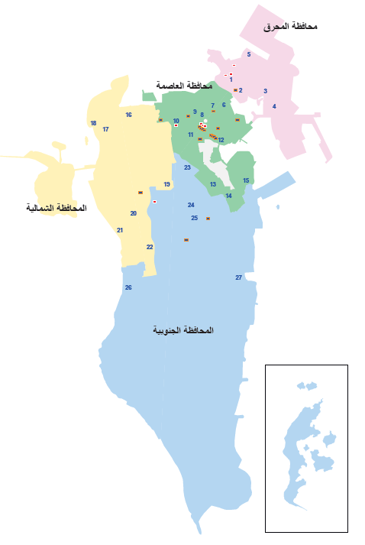
Healthcare Facilities in Bahrain
Private |  |  | Government |  | Governorate
Pharmacies | Clinics Med. & Dental | Hospitals | Health Centers | Hospitals
39 | 74 | 1 | 7 | 2 | Muharraq
85 | 319 | 14 | 11 | 4 | Capital
28 | 43 | 2 | 7 | - | Northern
43 | 90 | 2 | 5 | 1 | Southern
Notes:
The Kingdom of Bahrain is an island in the Arabian Gulf
with an area of 779 sq.km (approximately)
with population of 1,423.7 (in 000) as estimated in 2016;
the percentage of Bahraini was 46% and Non-Bahraini 54%.
The crude birth rate was 14.5 per 1000 population,
and the population growth rate was 5.8% (Central Informatics Organization, 2011&2012).
GDP per capita of US$ 22,602 (2016 data)
and the adult literacy rate is 93.5 ^{Bahraini15+, 2010}
Similar to other Gulf Cooperation Council (GCC) countries, Bahrain has a relatively young population with two thirds of its residents in the age group of 15–64 years; a noticeable increase in this category has been in the working-age group of non-Bahrainis.

Slide 4
Healthcare Facilities in Bahrain
GEOGRAPHICAL SCOPE Covered by MoH
Salmaniya Medical
Complex
Peripheral Hospitals
29 Health Centres
Notes:
The Kingdom of Bahrain is an island in the Arabian Gulf
with an area of 779 sq.km (approximately)
with population of 1,423.7 (in 000) as estimated in 2016;
the percentage of Bahraini was 46% and Non-Bahraini 54%.
The crude birth rate was 14.5 per 1000 population,
and the population growth rate was 5.8% (Central Informatics Organization, 2011&2012).
GDP per capita of US$ 22,602 (2016 data)
and the adult literacy rate is 93.5 ^{Bahraini15+, 2010}
Similar to other Gulf Cooperation Council (GCC) countries, Bahrain has a relatively young population with two thirds of its residents in the age group of 15–64 years; a noticeable increase in this category has been in the working-age group of non-Bahrainis.

Slide 5
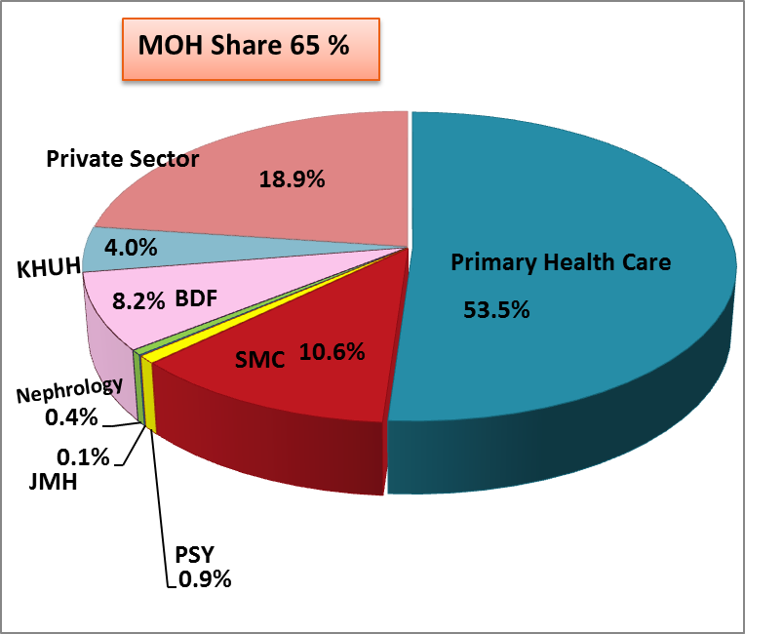
Patients Visits & Admissions in Bahrain- 2015
Out-Patient
In-Patient
Notes:
The Kingdom of Bahrain is an island in the Arabian Gulf
with an area of 779 sq.km (approximately)
with population of 1,423.7 (in 000) as estimated in 2016;
the percentage of Bahraini was 46% and Non-Bahraini 54%.
The crude birth rate was 14.5 per 1000 population,
and the population growth rate was 5.8% (Central Informatics Organization, 2011&2012).
GDP per capita of US$ 22,602 (2016 data)
and the adult literacy rate is 93.5 ^{Bahraini15+, 2010}
Similar to other Gulf Cooperation Council (GCC) countries, Bahrain has a relatively young population with two thirds of its residents in the age group of 15–64 years; a noticeable increase in this category has been in the working-age group of non-Bahrainis.

Slide 6
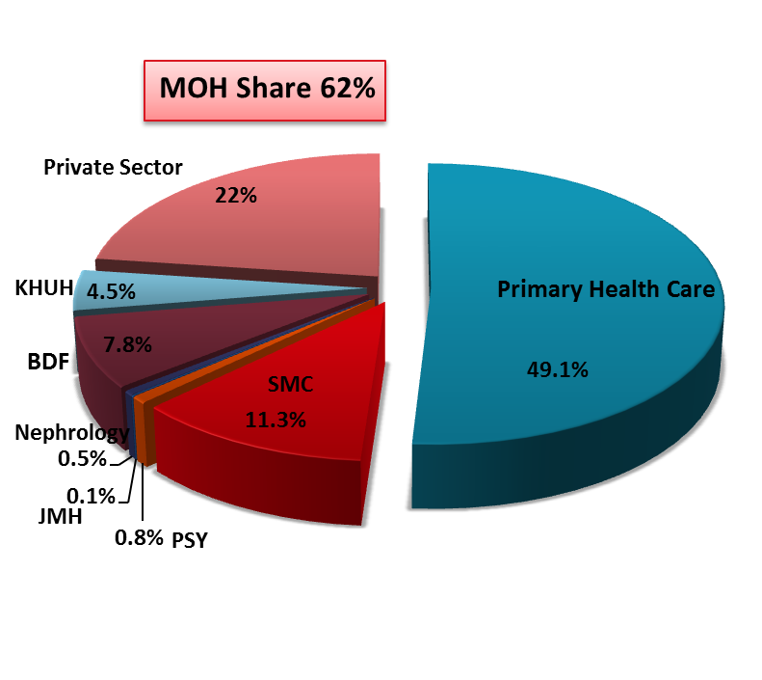
Patients Visits & Admissions in Bahrain- 2016
Out-Patient
In-Patient
Notes:
The Kingdom of Bahrain is an island in the Arabian Gulf
with an area of 779 sq.km (approximately)
with population of 1,423.7 (in 000) as estimated in 2016;
the percentage of Bahraini was 46% and Non-Bahraini 54%.
The crude birth rate was 14.5 per 1000 population,
and the population growth rate was 5.8% (Central Informatics Organization, 2011&2012).
GDP per capita of US$ 22,602 (2016 data)
and the adult literacy rate is 93.5 ^{Bahraini15+, 2010}
Similar to other Gulf Cooperation Council (GCC) countries, Bahrain has a relatively young population with two thirds of its residents in the age group of 15–64 years; a noticeable increase in this category has been in the working-age group of non-Bahrainis.

Slide 7
Some Important Socio-Economic Indicators 2016
Area: 779 sq km
Population: 1.4 Million
Childhood Dependency ratio (0-14): 25.7*
Aging Dependency (aged 65+): 3.3*
Total Dependency Ratio: 29.0*
Crude Birth Rate /1000 pop. (reported): 14.5
Crude Death Rate/1000 pop. (reported): 2.0
Life Expectancy Rate at Birth Both Sex : 77.2
Literacy: 93.5 ^{(Census-2010)}
Notes:
The Kingdom of Bahrain is an island in the Arabian Gulf
with an area of 779 sq.km (approximately)
with population of 1,423.7 (in 000) as estimated in 2016;
the percentage of Bahraini was 46% and Non-Bahraini 54%.
The crude birth rate was 14.5 per 1000 population,
and the population growth rate was 5.8% (Central Informatics Organization, 2011&2012).
GDP per capita of US$ 22,602 (2016 data)
and the adult literacy rate is 93.5 ^{Bahraini15+, 2010}
Similar to other Gulf Cooperation Council (GCC) countries, Bahrain has a relatively young population with two thirds of its residents in the age group of 15–64 years; a noticeable increase in this category has been in the working-age group of non-Bahrainis.

Slide 8
Birth Registration and Issuing Birth Certificate
Delivery of birth in MoH Hospitals which covered most of Bahrain citizen.
Birth Registration to notify IGA issuing the Birth Baby ID.
Getting the ID number within one hour.
All clinical Birth Baby data will be entered in the system.
We have web service to issue the Birth Certificate.

Slide 9
Death in MoH Premises
The death Will register in I-Seha(HIS).
Discharge Summary will be entered in the system with disease as Death.
The doctor will write the causes of Death.
The coders will enter the coding of Cause of Death using ICD10 CM v2009.

Slide 10
Mortuary in Salmaniya Medical Complex(SMC)
System available in Mortuary.
Dead body received outside MoH will be registered in this system.
The Mortuary system part of our HIS(I-Seha).

Slide 11
Death Registration
All death now in MoH available in Mortuary System .
All death Notifications Form will be sent to Birth and Death Office.
Birth and Death office is responsible to register death.
MoH qualified coders will verify and enter the causes of death using ICD10 Who version in Death System.
All reports related to Vital indicators will be generated from this system.

Slide 12
eDeath
Integration with IGA System.
Getting the Death Certificate(Notification).

Slide 13
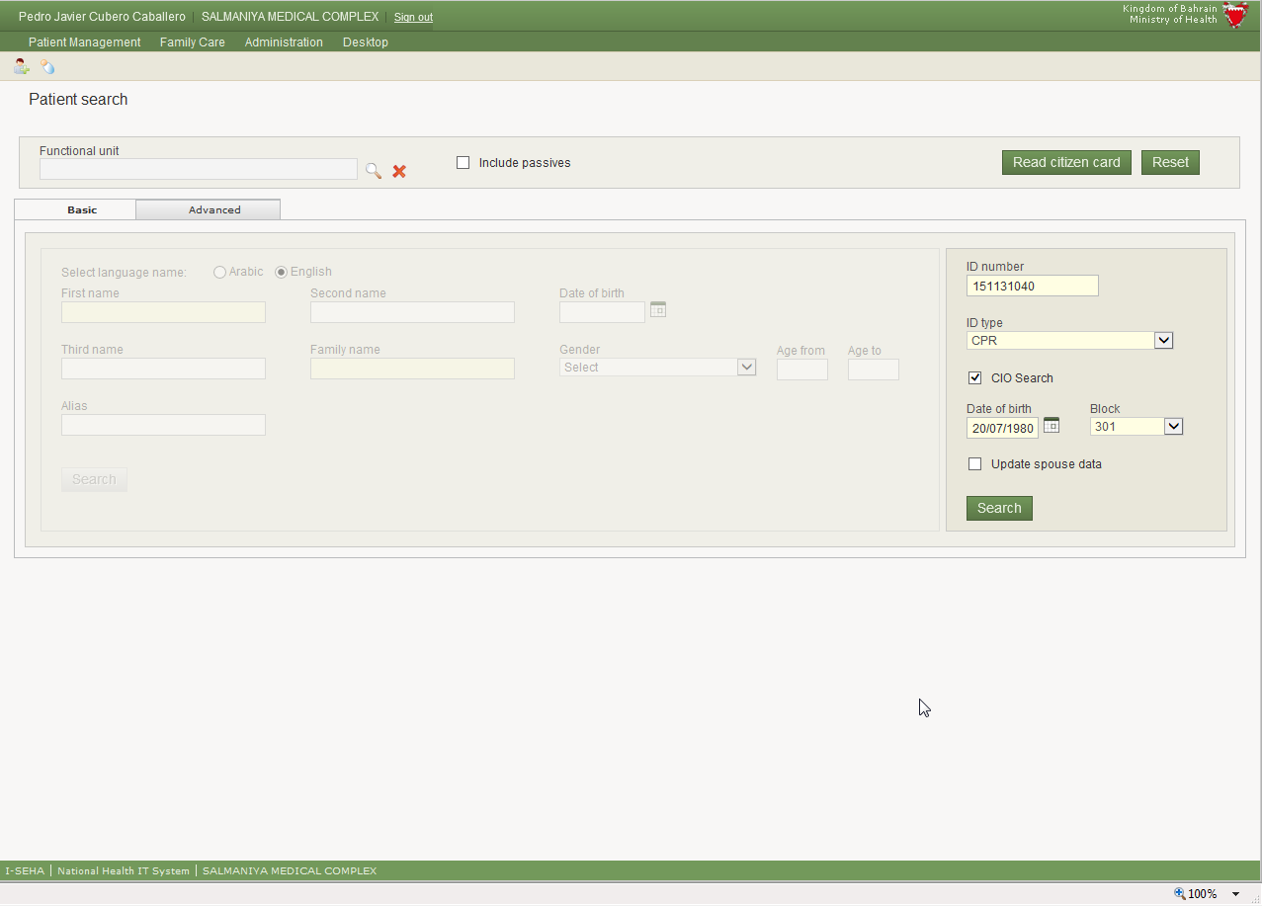
eDeath
Integration with IGA System.

Slide 14
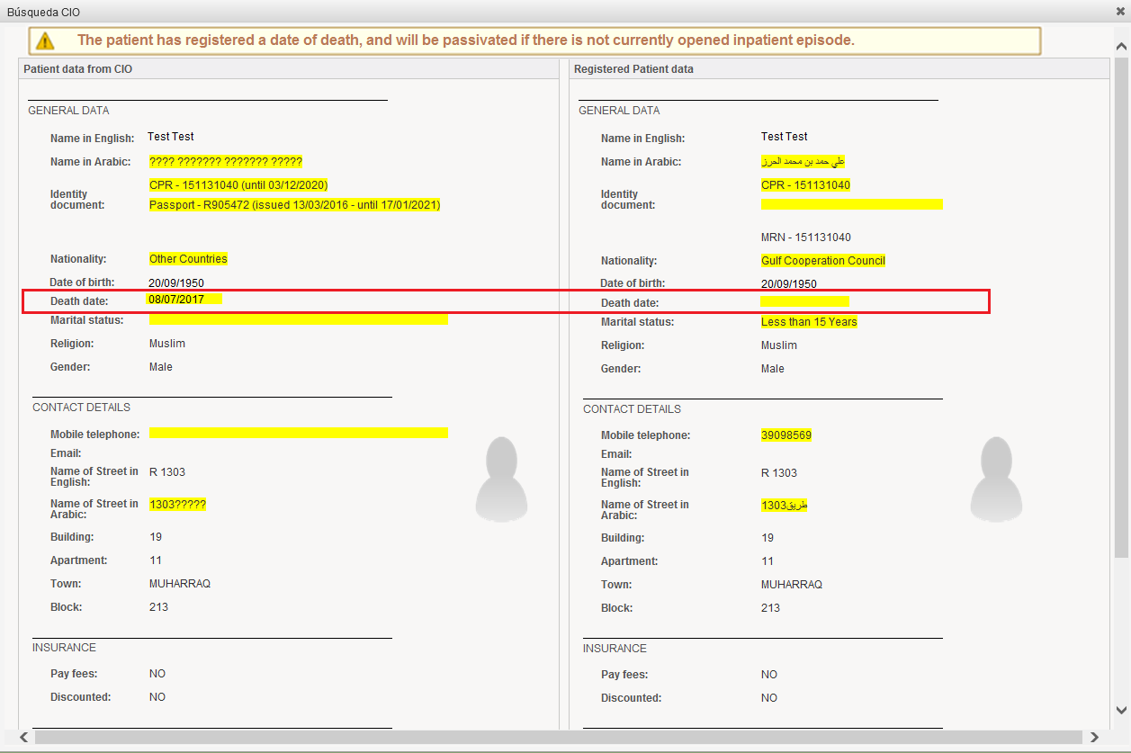
eDeath
Integration with IGA System.

Slide 15
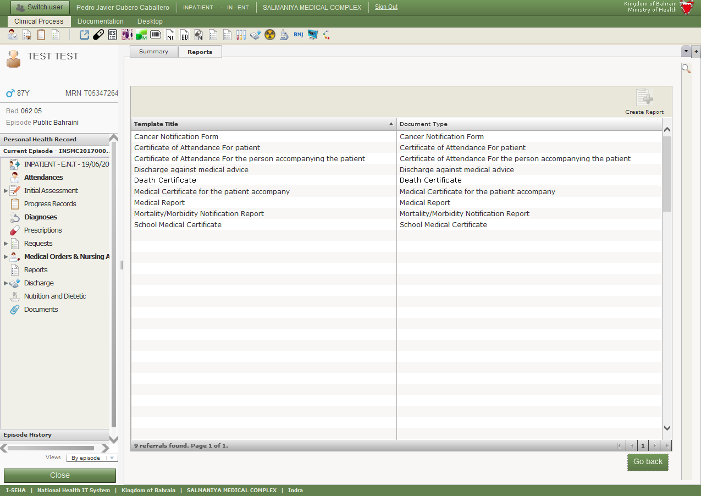
eDeath
Getting the Death Certificate(Notification)

Slide 16
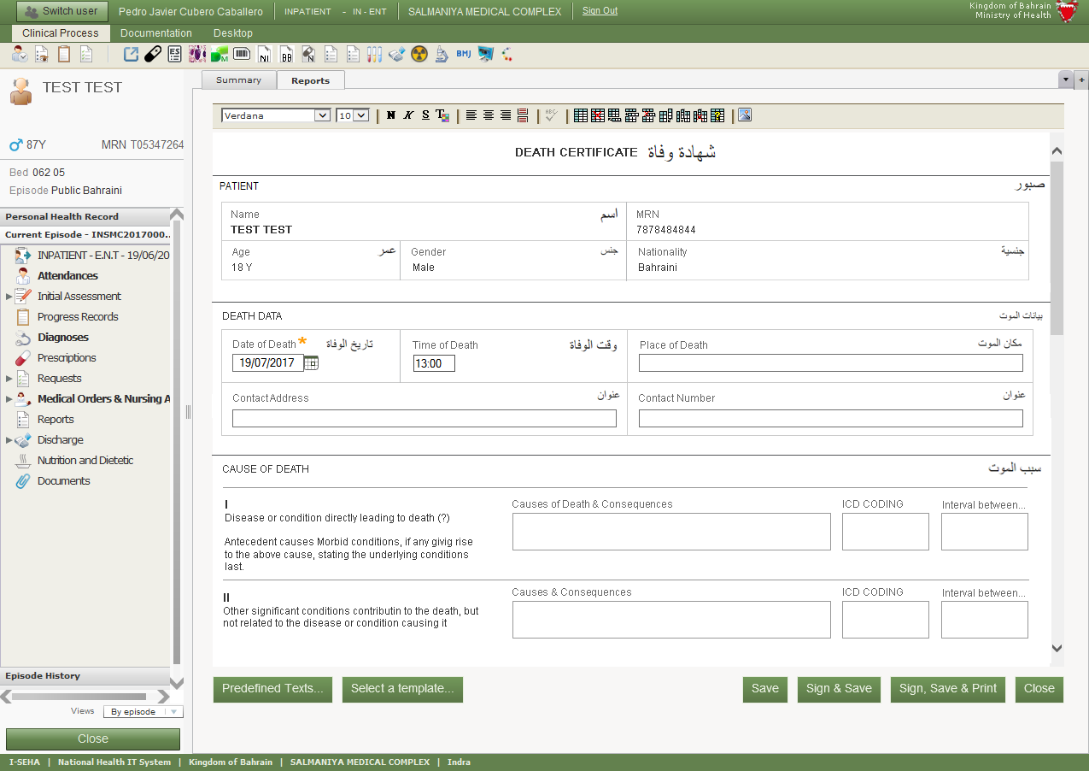
eDeath
Getting the Death Certificate(Notification)
Generate the report

Slide 17
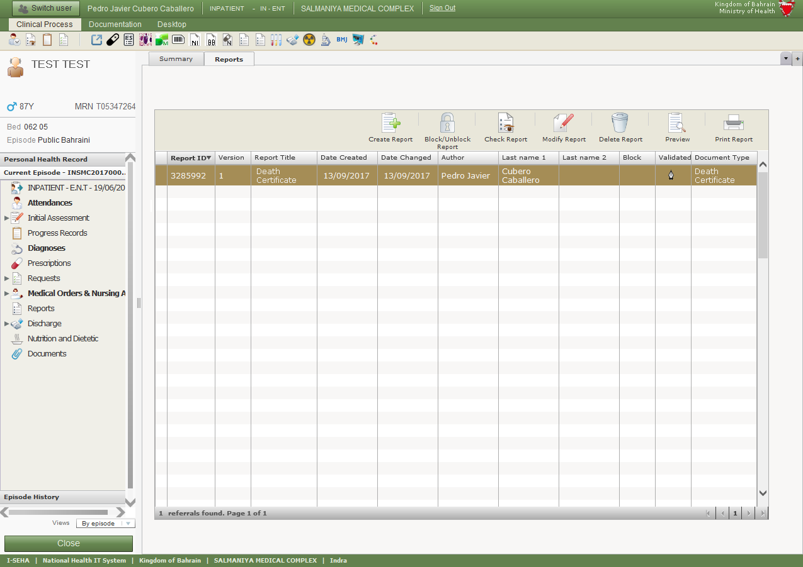
eDeath
Getting the Death Certificate(Notification)
Select the previously created report of this type and click on “Print”

Slide 18
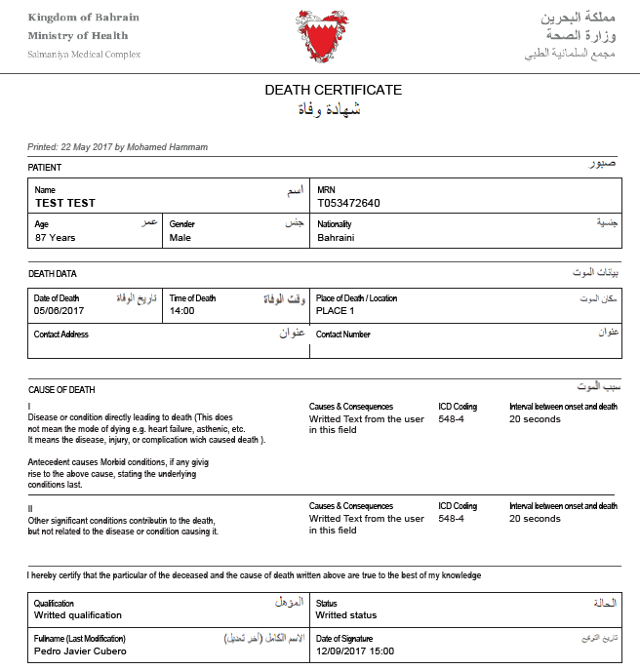
eDeath
Getting the Death Certificate(Notification)

Slide 19
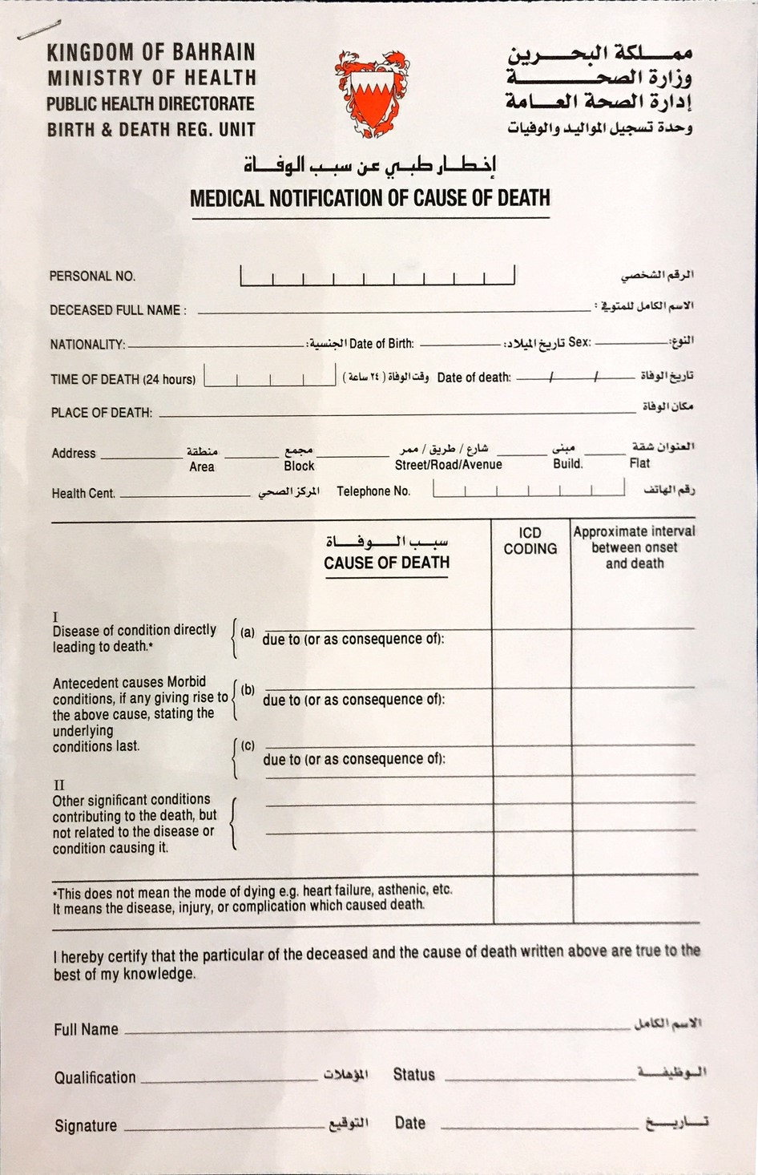
eDeath
Getting the Death Certificate(Notification)

Slide 20
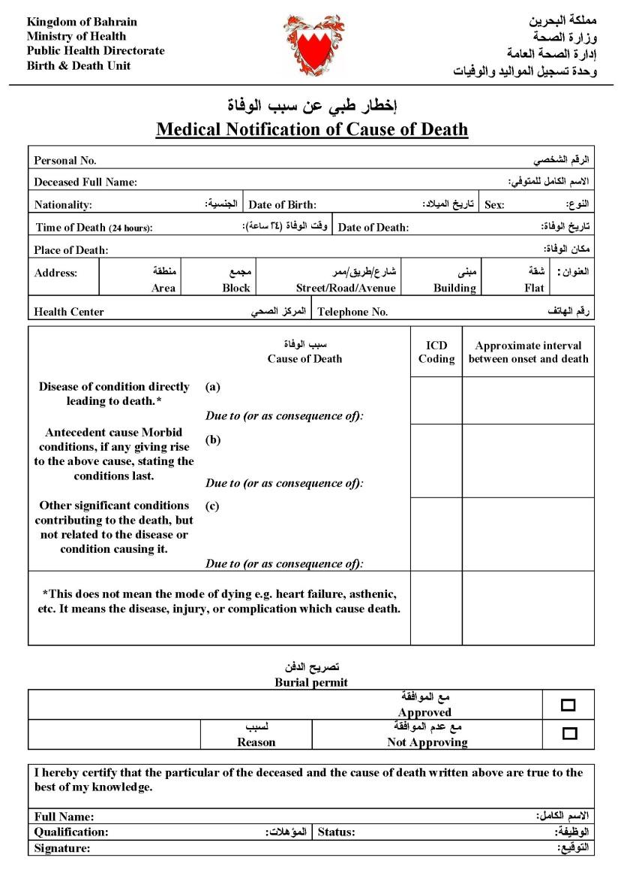
eDeath
Getting the Death Certificate(Notification)

Slide 21
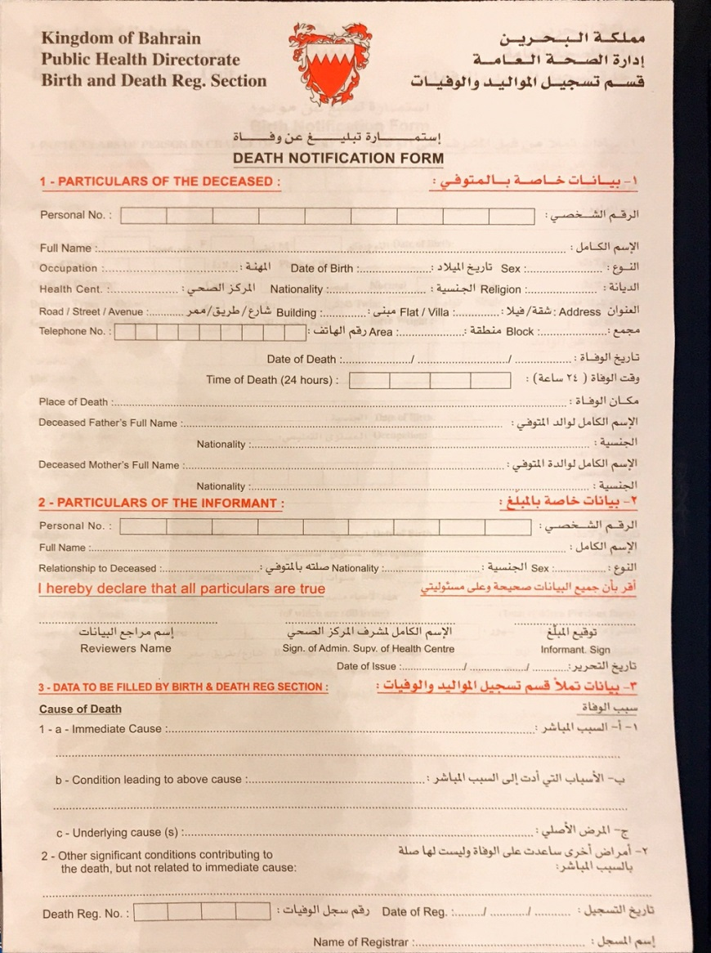
eDeath
Getting the Death Certificate(Notification)

Slide 22
Codification System at MoH
ICD10 CM V2009
National Coding System
MoH Main Hospital
King Hamad University Hospital(KHUH)
Bahrain Defense Force Royal Medical Services (BDF)
ICD10-AM & ACHI Codes

Slide 23
Diagnosis Related Groups (DRG) v8 & ICD10 Coding
DRG Context: Obtaining DRG
From natural language to encoded language
Initial Information
Coding
Date of birth
Gender
Diagnoses
Procedures
Diagnoses
Procedures
E888.9 – Unspecified fall
Main diagnosis
Moment of discharge
820.09 - Other closed transcervical fracture of neck of femur
Specialized training
Coding standards
Support software
From medical record:
A 73-year-old female patient who is admitted for a subcapital fracture of the left femur by a random fall.
Patient undergoes Partial Hip Prosthesis. In the postoperative period, acute urinary retention is present and urethral catheterization is practiced.
81.52 - Partial hip replacement
788.20 - Retention of urine

Slide 24
DRG Context: Obtaining DRG
From natural language to encoded language
¿Mappings?
Initial Information
Coding
Grouping
Date of birth
Gender
Diagnoses
Procedures
Diagnoses
Procedures
Age
Gender
Diagnoses
Procedures
The Grouper affects
Moment of discharge
Validation
DRG
Specialized training
Coding standards
Support software
Age
Gender
Diagnoses
Procedures
Specific Alerts
DRG001
DRG002
…
DRG470 - Error
What
High quality (detailed)
Medical Records
Coding
quality
Conceptual equivalence
Grouper
itself
Who
Physicians
Coders
Knowledge
Software

Slide 25
Selected Health Indicators Vs GCC Countries
Benchmark average 76.2
Life expectancy at birth years
Benchmark average 8.5
Infant mortality per 1,000 live births
Benchmark average 9.9
Under 5 years mortality rate per 1,000 live births
Benchmark average 10.4
Maternal mortality per 100,000 live births
1996
2002
2015
Notes:
The Kingdom of Bahrain is an island in the Arabian Gulf
with an area of 779 sq.km (approximately)
with population of 1,423.7 (in 000) as estimated in 2016;
the percentage of Bahraini was 46% and Non-Bahraini 54%.
The crude birth rate was 14.5 per 1000 population,
and the population growth rate was 5.8% (Central Informatics Organization, 2011&2012).
GDP per capita of US$ 22,602 (2016 data)
and the adult literacy rate is 93.5 ^{Bahraini15+, 2010}
Similar to other Gulf Cooperation Council (GCC) countries, Bahrain has a relatively young population with two thirds of its residents in the age group of 15–64 years; a noticeable increase in this category has been in the working-age group of non-Bahrainis.

Slide 26
Selected Health Indicators Vs Developed Countries
Life expectancy at birth years
Benchmark average 81.9
Infant mortality per 1,000 live births
Benchmark average 2.7
Under 5 years mortality rate per 1,000 live births
Benchmark average 3.2
Benchmark average 6.6
Maternal mortality per 10,000 live births
1996
2002
2015
Notes:
The Kingdom of Bahrain is an island in the Arabian Gulf
with an area of 779 sq.km (approximately)
with population of 1,423.7 (in 000) as estimated in 2016;
the percentage of Bahraini was 46% and Non-Bahraini 54%.
The crude birth rate was 14.5 per 1000 population,
and the population growth rate was 5.8% (Central Informatics Organization, 2011&2012).
GDP per capita of US$ 22,602 (2016 data)
and the adult literacy rate is 93.5 ^{Bahraini15+, 2010}
Similar to other Gulf Cooperation Council (GCC) countries, Bahrain has a relatively young population with two thirds of its residents in the age group of 15–64 years; a noticeable increase in this category has been in the working-age group of non-Bahrainis.

Slide 27
Top Five Leading Causes of Death Rates Per 100,000 Pop. 2015
Notes:
The Kingdom of Bahrain is an island in the Arabian Gulf
with an area of 779 sq.km (approximately)
with population of 1,423.7 (in 000) as estimated in 2016;
the percentage of Bahraini was 46% and Non-Bahraini 54%.
The crude birth rate was 14.5 per 1000 population,
and the population growth rate was 5.8% (Central Informatics Organization, 2011&2012).
GDP per capita of US$ 22,602 (2016 data)
and the adult literacy rate is 93.5 ^{Bahraini15+, 2010}
Similar to other Gulf Cooperation Council (GCC) countries, Bahrain has a relatively young population with two thirds of its residents in the age group of 15–64 years; a noticeable increase in this category has been in the working-age group of non-Bahrainis.

Slide 28
Top Five Leading Causes of Death Rates Per 100,000 Pop. 2016
Notes:
The Kingdom of Bahrain is an island in the Arabian Gulf
with an area of 779 sq.km (approximately)
with population of 1,423.7 (in 000) as estimated in 2016;
the percentage of Bahraini was 46% and Non-Bahraini 54%.
The crude birth rate was 14.5 per 1000 population,
and the population growth rate was 5.8% (Central Informatics Organization, 2011&2012).
GDP per capita of US$ 22,602 (2016 data)
and the adult literacy rate is 93.5 ^{Bahraini15+, 2010}
Similar to other Gulf Cooperation Council (GCC) countries, Bahrain has a relatively young population with two thirds of its residents in the age group of 15–64 years; a noticeable increase in this category has been in the working-age group of non-Bahrainis.

Slide 29
Notes:
The Kingdom of Bahrain is an island in the Arabian Gulf
with an area of 779 sq.km (approximately)
with population of 1,423.7 (in 000) as estimated in 2016;
the percentage of Bahraini was 46% and Non-Bahraini 54%.
The crude birth rate was 14.5 per 1000 population,
and the population growth rate was 5.8% (Central Informatics Organization, 2011&2012).
GDP per capita of US$ 22,602 (2016 data)
and the adult literacy rate is 93.5 ^{Bahraini15+, 2010}
Similar to other Gulf Cooperation Council (GCC) countries, Bahrain has a relatively young population with two thirds of its residents in the age group of 15–64 years; a noticeable increase in this category has been in the working-age group of non-Bahrainis.

Slide 30
Notes:
The Kingdom of Bahrain is an island in the Arabian Gulf
with an area of 779 sq.km (approximately)
with population of 1,423.7 (in 000) as estimated in 2016;
the percentage of Bahraini was 46% and Non-Bahraini 54%.
The crude birth rate was 14.5 per 1000 population,
and the population growth rate was 5.8% (Central Informatics Organization, 2011&2012).
GDP per capita of US$ 22,602 (2016 data)
and the adult literacy rate is 93.5 ^{Bahraini15+, 2010}
Similar to other Gulf Cooperation Council (GCC) countries, Bahrain has a relatively young population with two thirds of its residents in the age group of 15–64 years; a noticeable increase in this category has been in the working-age group of non-Bahrainis.

Slide 31
Notes:
The Kingdom of Bahrain is an island in the Arabian Gulf
with an area of 779 sq.km (approximately)
with population of 1,423.7 (in 000) as estimated in 2016;
the percentage of Bahraini was 46% and Non-Bahraini 54%.
The crude birth rate was 14.5 per 1000 population,
and the population growth rate was 5.8% (Central Informatics Organization, 2011&2012).
GDP per capita of US$ 22,602 (2016 data)
and the adult literacy rate is 93.5 ^{Bahraini15+, 2010}
Similar to other Gulf Cooperation Council (GCC) countries, Bahrain has a relatively young population with two thirds of its residents in the age group of 15–64 years; a noticeable increase in this category has been in the working-age group of non-Bahrainis.

Slide 32
Notes:
The Kingdom of Bahrain is an island in the Arabian Gulf
with an area of 779 sq.km (approximately)
with population of 1,423.7 (in 000) as estimated in 2016;
the percentage of Bahraini was 46% and Non-Bahraini 54%.
The crude birth rate was 14.5 per 1000 population,
and the population growth rate was 5.8% (Central Informatics Organization, 2011&2012).
GDP per capita of US$ 22,602 (2016 data)
and the adult literacy rate is 93.5 ^{Bahraini15+, 2010}
Similar to other Gulf Cooperation Council (GCC) countries, Bahrain has a relatively young population with two thirds of its residents in the age group of 15–64 years; a noticeable increase in this category has been in the working-age group of non-Bahrainis.

Slide 33
Notes:
The Kingdom of Bahrain is an island in the Arabian Gulf
with an area of 779 sq.km (approximately)
with population of 1,423.7 (in 000) as estimated in 2016;
the percentage of Bahraini was 46% and Non-Bahraini 54%.
The crude birth rate was 14.5 per 1000 population,
and the population growth rate was 5.8% (Central Informatics Organization, 2011&2012).
GDP per capita of US$ 22,602 (2016 data)
and the adult literacy rate is 93.5 ^{Bahraini15+, 2010}
Similar to other Gulf Cooperation Council (GCC) countries, Bahrain has a relatively young population with two thirds of its residents in the age group of 15–64 years; a noticeable increase in this category has been in the working-age group of non-Bahrainis.

Slide 34
Notes:
The Kingdom of Bahrain is an island in the Arabian Gulf
with an area of 779 sq.km (approximately)
with population of 1,423.7 (in 000) as estimated in 2016;
the percentage of Bahraini was 46% and Non-Bahraini 54%.
The crude birth rate was 14.5 per 1000 population,
and the population growth rate was 5.8% (Central Informatics Organization, 2011&2012).
GDP per capita of US$ 22,602 (2016 data)
and the adult literacy rate is 93.5 ^{Bahraini15+, 2010}
Similar to other Gulf Cooperation Council (GCC) countries, Bahrain has a relatively young population with two thirds of its residents in the age group of 15–64 years; a noticeable increase in this category has been in the working-age group of non-Bahrainis.

Slide 35
Thanks
Notes:
The Kingdom of Bahrain is an island in the Arabian Gulf
with an area of 779 sq.km (approximately)
with population of 1,423.7 (in 000) as estimated in 2016;
the percentage of Bahraini was 46% and Non-Bahraini 54%.
The crude birth rate was 14.5 per 1000 population,
and the population growth rate was 5.8% (Central Informatics Organization, 2011&2012).
GDP per capita of US$ 22,602 (2016 data)
and the adult literacy rate is 93.5 ^{Bahraini15+, 2010}
Similar to other Gulf Cooperation Council (GCC) countries, Bahrain has a relatively young population with two thirds of its residents in the age group of 15–64 years; a noticeable increase in this category has been in the working-age group of non-Bahrainis.

