Slide 1
Vital Statistics in Afghanistan
Ministry of Public Health
General Directorate of EHIS
Vital Statistics Department

Slide 2
Outline
Background
Results & Achievement
Challenges
Way forward

Slide 3
A Comprehensive Assessment of Civil Registration and Vital statistics System initiated by the MOPH on 15-18 Sep 2013
Background
Leading Ministries and Sections:
Ministry of Interior
Ministry of Public Health
Central Statistics Organization
Participants (Development Partners):
WHO, UNICEF, UNFPA and Others

Slide 4
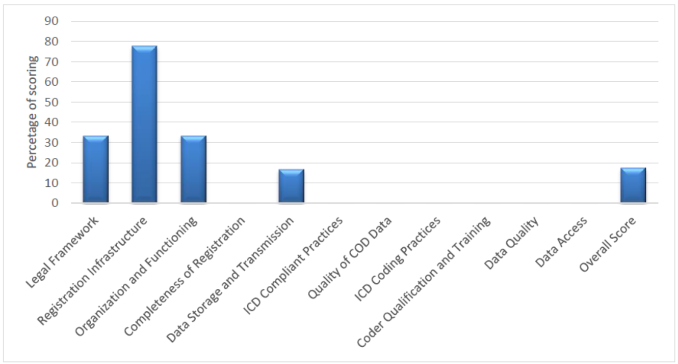
Result of Comprehensive baseline Assessment of CRVS in 2013

Slide 5
Aim Of the Assessment
To develop a Detailed Strategic Plan for improving CRVS, with cost estimation, a time schedule and clear responsibilities assigned to each stakeholder for implementing the action

Slide 6
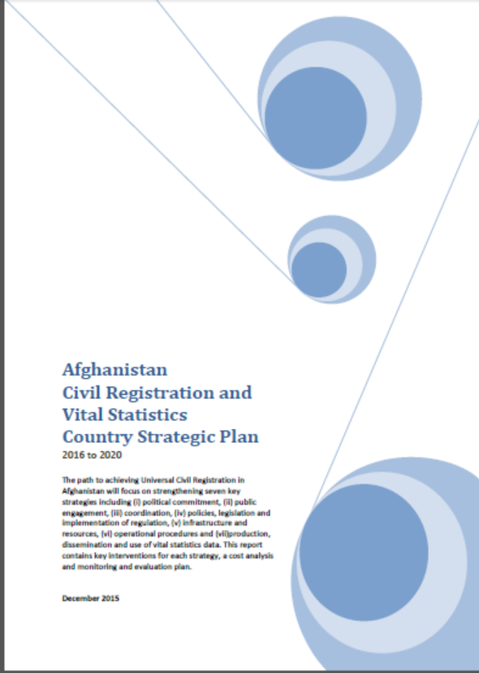
Results
strategic plan developed
Areas of action identified in the SP for stakeholders
Ministry of Public Health got the responsibility of collecting Death Reports Based (ICD10) & Birth Registration
10 Master Trainers trained by support of WHO

Slide 7
Results …
An access based database developed considering the standard Death Certification Report according to ICD10
22 Hospitals (including District, Provincial & National Hospitals) selected for piloting the reporting in 9 Provinces of The country
Training conducted for Around 200 participants
19 Hospitals are reporting Death Certification Reports
Notes:
Badakhshan, Bamyan, Ghazni, Herat, Kabul, Nangarhar, Parwan, Takhar & Wardak

Slide 8
Achievements
Totally 4259 Death Certificates Reported
Among which 942 DC excluded from analysis due to (632 DC did not show any specific UCD and “Other” & 310 DC was left blank)
Total Number of DC with specific UCD 3317

Slide 9
Death Certificate vs. HMIS

Slide 10
% of Death Cases By Gender

Slide 11
Distribution of Death Cases by Age Category

Slide 12
Underlying Cause of Deaths

Slide 13
Challenges
Capacity in identification of UCD still exist at Hospitals
Ignorance in death reports
Coordination issues
Staff turnover at different level (hospitals & MOPH)
Shortages of IT equipment (Computers & Internet)
Lack of technical staff (official vs. focal points)

Slide 14
Way Forward
Expansion of data collection to 10 More Hospitals
Provision of capacity building to new hospital staff
provision of refresher trainings
Efforts will be made on strengthening of coordination among other stakeholders
Replacement of Data entry in SMOL through DHIS2 instead of Previous Ms. Access database

Slide 15
Way Forward…
Piloting Verbal Autopsy in few provinces
A pilot project of VA implemented in Bamyan Provinces (2017)

Slide 16
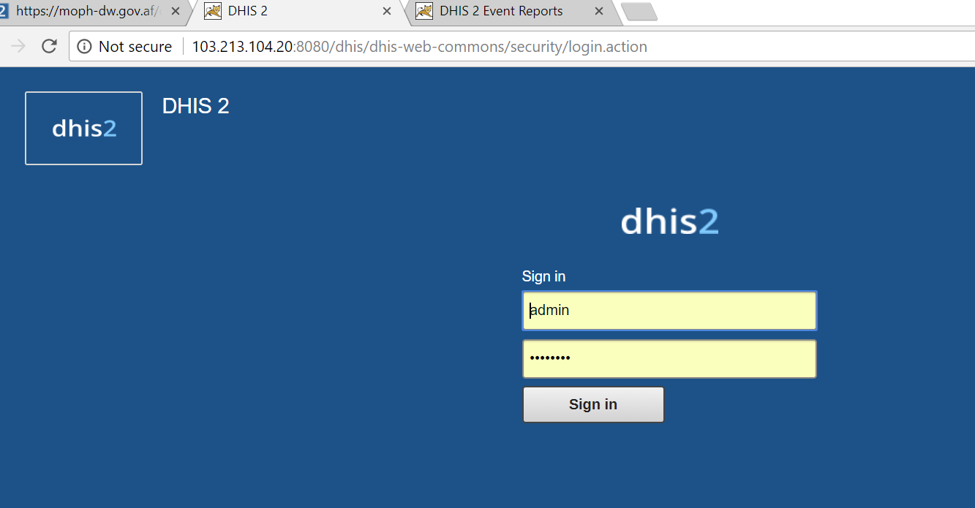
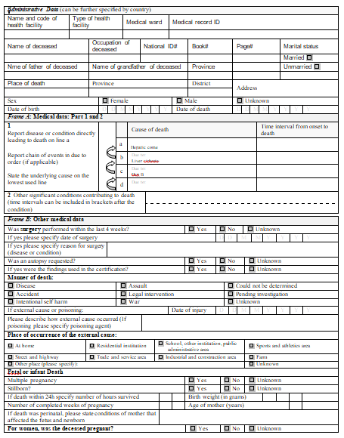
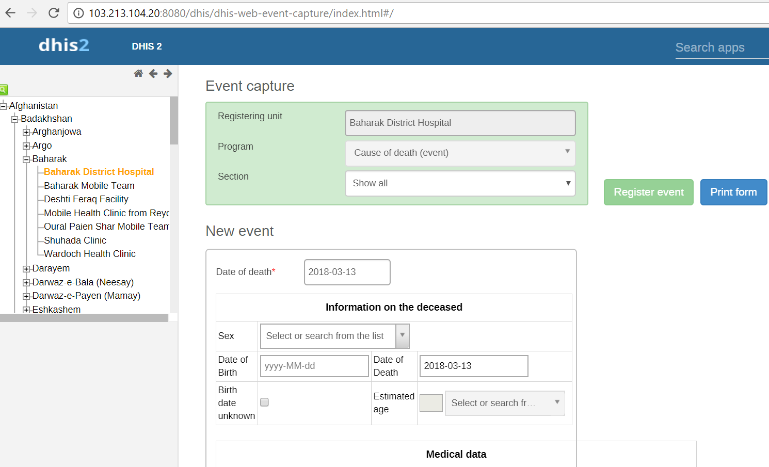
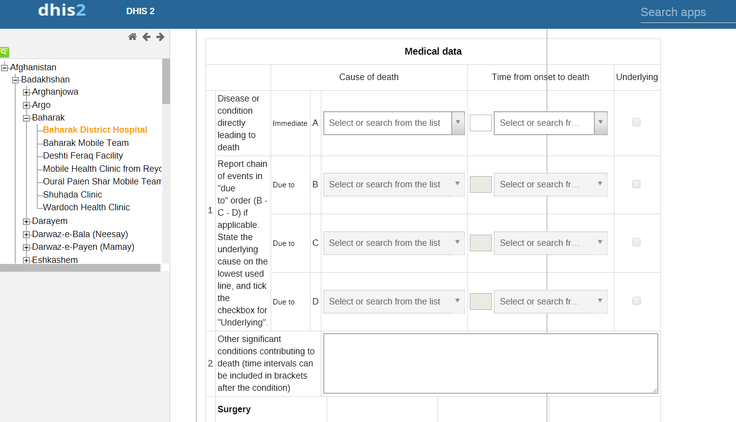

Slide 17
Thank you

