Slide 1
SUDAN TEAM for CRVS
CRO, NSO, MOH

Slide 2
Contents
CV Architecture for Birth & Death
SWOT Analysis
Comparison of the core topics with the national practices
Measure taken to improve quality & interoperability of CRVS
Birth and Death Registration Coverage
Sudan Indicators for Births and deaths

Slide 3
CV Architecture for Birth & Death
HF
Local CRO
Central Database
Community
Issuing of VE Documents
Web based
Self reported
Paper based
Paper based
CRO

Slide 4
SWOT Analysis

Slide 5
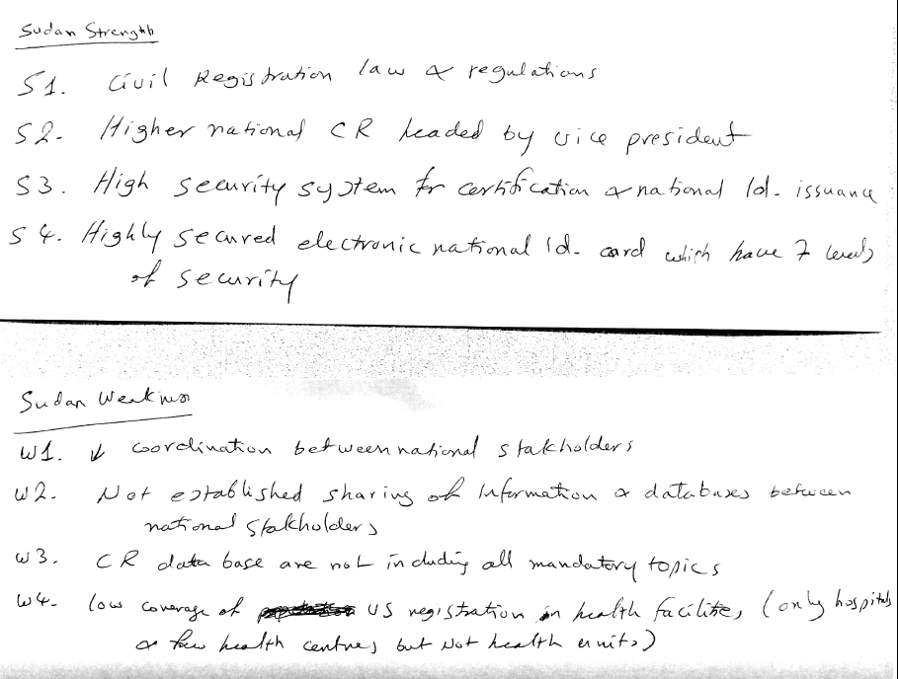
Strength
Weakness

Slide 6
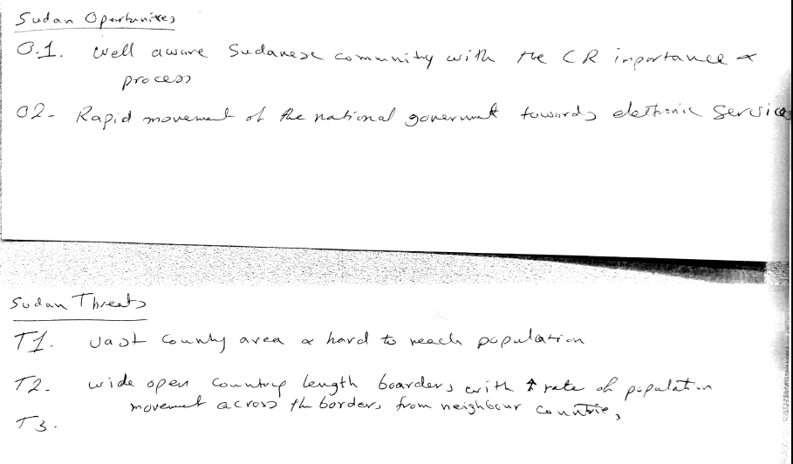
Opportunities
Threats

Slide 7
Comparison of the core topics with the national practices, Birth
المواضيع الاساسية | موجودة (نعم/لا)
(3) خصائص الأم
مكان الإقامة المعتاد | نعم
محل الإقامة | نعم
إقامة حضرية / ريفية | نعم
مدة الإقامة في المكان المعتاد (الحالي) | لا
مكان / بلد الميلاد | نعم
المركز من حيث الهجرة | لا
(4) خصائص الأب | نعم
(5) خصائص السكان المعرضين للخطر | نعم
المواضيع الاساسية | موجودة (نعم/لا)
(1) خصائص الواقعة
تاريخ حدوث الواقعة | نعم
تاريخ التسجيل | نعم
مكان حدوث الواقعة | نعم
محل حدوث الواقعة | نعم
الحدوث في الحضر/الريف | نعم
مكان التسجيل | نعم
نوع الولادة (وحيد/ توأم / 3 توائم ...) | لا
أختصاصي التوليد | لا
(2) خصائص المولود حديث الولادة | جزئياً (الجنس: نعم، الوزن: لا)

Slide 8
Comparison of the core topics with the national practices, Death
المواضيع الاساسية | موجودة (نعم/لا)
(2) خصائص المتوفى
تاريخ الميلاد | نعم
نوع الجنس | نعم
الحالة الزواجية | نعم
مكان الإقامة المعتاد | نعم
مكان الإقامة المعتاد للأم (بالنسبة للوفيات دون الـ 1 سنة من العمر) | لا
(3) خصائص السكان المعرضين للخطر | نعم
المواضيع الاساسية | موجودة (نعم/لا)
(1) خصائص الواقعة
تاريخ حدوث الواقعة | نعم
مكان حدوث الواقعة | نعم
مكان التسجيل | نعم
سبب الوفاة | لا
مسؤول التصديق | نعم

Slide 9
National List & SDGs Indicators that depends on the CV as a source

Slide 10
Tabulation: First priority tables
 | Possible: Yes/No | Possible if civil registration data are combined with data from other sources
Total number of live births by sex, incl. sex ratio at birth and site of delivery | Yes
Live births by place of residence and urban–rural residence of the mother | Yes
Live births by age of mother (15-19, 20-24 … 45-49) | Yes (Through link with mother Id.) | Yes (CR)
Live births by place of occurrence and sex of child | Yes
Live births by place of occurrence and place of usual residence of mother | Yes (Through link with mother Id.) | Yes (CR)

Slide 11
Tabulation: Second priority tables
 | Possible: Yes/No | Possible if civil registration data are combined with data from other sources
Live births by place of registration, month of occurrence and month of registration | Yes
Live births by place of usual residence and age of mother, sex of child and live-birth order | Yes (Through link with mother Id.) | Yes (CR)
Live births by place of birth, place of usual residence and age of mother | Yes (Through link with mother Id.) | Yes (CR)
Live births by place of occurrence, site of delivery and attendant at birth | No.
Live births by month, place of occurrence and place of usual residence of mother | Yes (Through link with mother Id.) | Yes (CR)
Live births by age, place of usual residence and marital status of mother | Yes (Through link with mother Id.) | Yes (CR)
Live births by age of father | Yes (Through link with mother Id.) | Yes (CR)
Live births by place of usual residence, age and educational attainment of mother | Yes (Through link with mother Id.) | Yes (CR)

Slide 12
Tabulation: Second priority tables
 | Possible: Yes/No | Possible if civil registration data are combined with data from other sources
Live births by educational attainment and age of mother, and live-birth order | No | No
Live births by live-birth order and interval between last and previous live births to mother | No | No
Live births by place of usual residence and age of mother and legitimacy status | No | No
Live births by site of delivery, attendant at birth and birth weight | No | No
Live births by birth weight and place of usual residence and educational attainment of mother | No | No

Slide 13
Tabulation: Second priority tables
 | Possible: Yes/No | Possible if civil registration data are combined with data from other sources
Live births by gestational age, place of usual residence of mother and birth Weight | No | No
Live births by birth weight, place of usual residence of mother and month in which prenatal care began | No | No
Live births by age and place of usual residence of mother and month in which prenatal care began | No | No
Live births by live-birth order, place of usual residence of mother and month in which prenatal care began | No | No
Live births by place of usual residence of mother and duration of residence at the LB (life birth) current usual residence | No | No

Slide 14
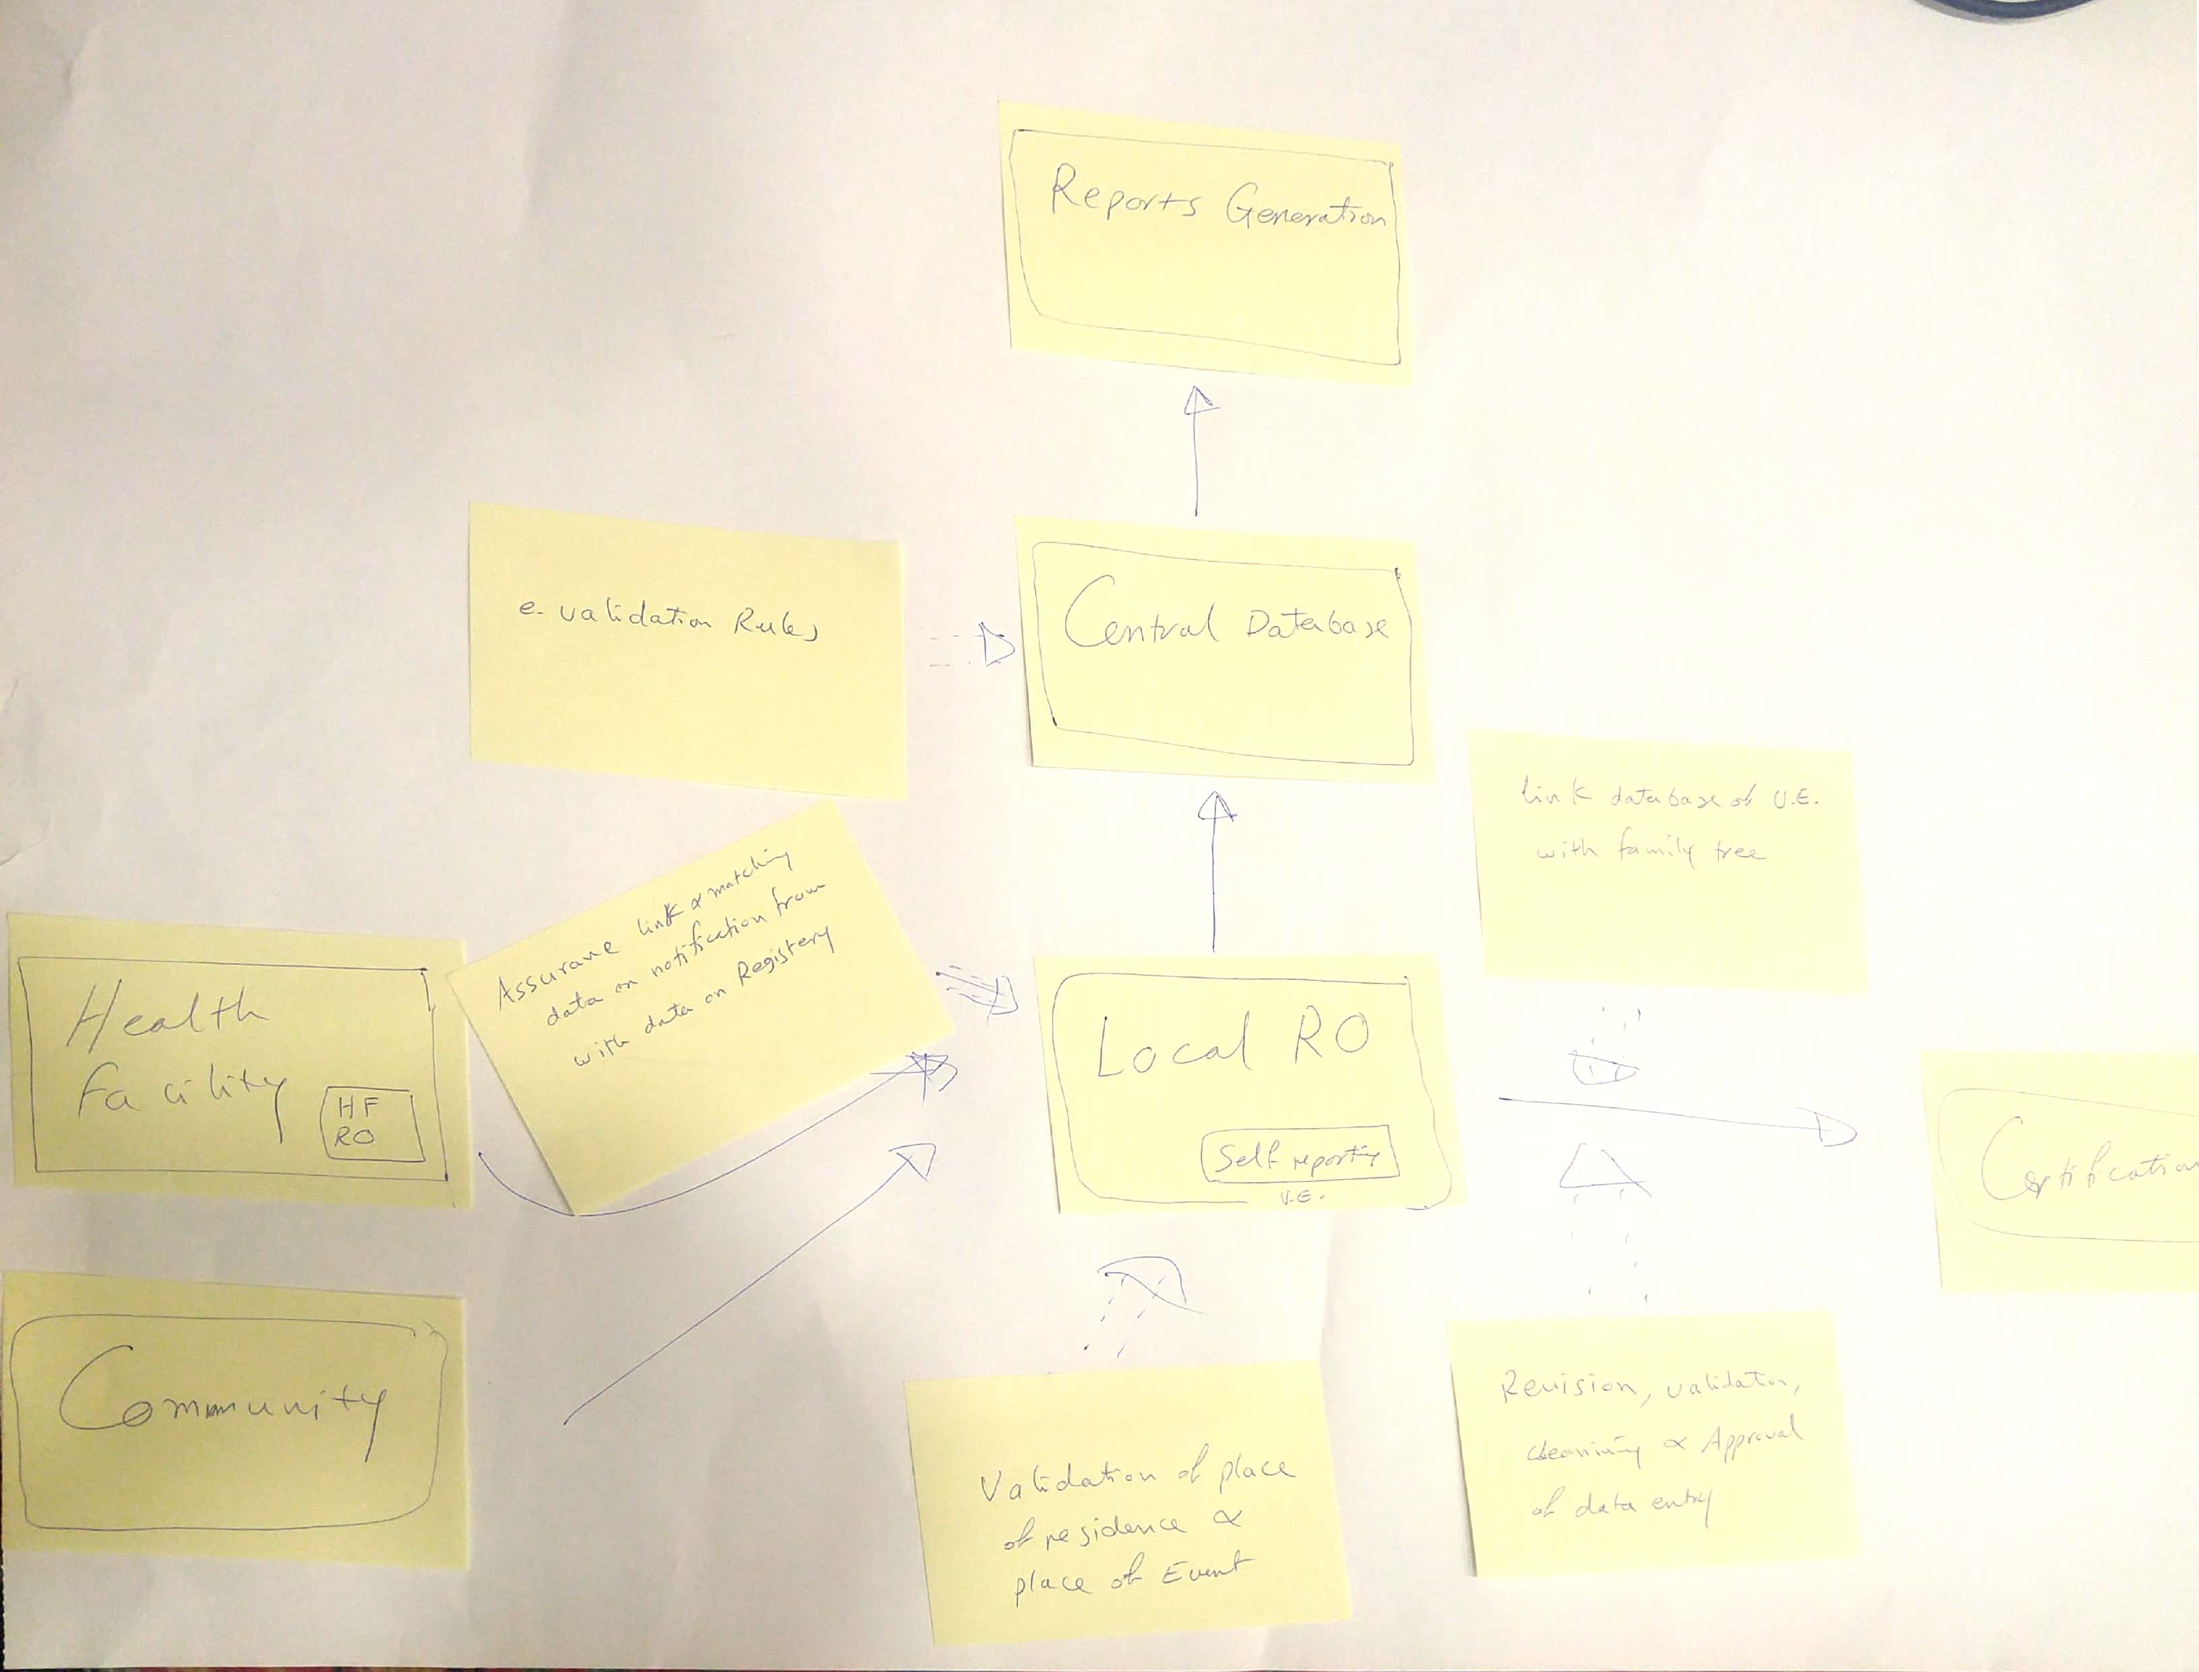
Measure taken to improve quality & interoperability of CRVS

Slide 15
Birth and Death Registration Coverage
Birth Registration Coverage: 67.3%
Death Registration Coverage: ~ 10%
Obstacles for 100% coverage:
Vast country, with remote area and hard to reach population
Low coverage with health facilities
Community incentives for incentives
The main reason for not compiling vital statistics based on CV is: coordination between VRO & NSO

Slide 16
Sudan Indicators for Births and deaths (Source: NSO 2017)
Birth:
Crud birth rate (CBR): 37.9 per 1000
Total fertility rate (TFR): 5.1%
Death:
Crud death rate (CDR): 8.8 per 1000
Total life expectancy (TLE): 62.7 years
Under 5 mortality rate (U5MR): 115.7 per 1000 LB

Slide 17
Thanks You

