Slide 1
PRESENTING VITAL STATISTICS
Analysis of levels, patterns and trends
Vibeke Oestreich Nielsen Statistics Norway
von@ssb.no

Slide 2
Good and bad practices
What would you consider good and bad practices when it comes to presenting vital statistics? Specify for
  Graphs
  Tables
  Descriptive or explanatory text

Slide 3
Statistics is:
- to compare numbers (and to make the numbers comparable)
User-friendliness is:
- to present the numbers in a way that encourages and enables the users to make comparisons
Notes:
IOA-day was, of course, not a celebration, but more…?

Slide 4
General motto: KISS!
Keep It Short and Simple!
This applies to:
  Tables
  Graphs
  Titles
  Text
Notes:
Simple – does not mean that everything should be simple, but that the presentation should not include too much and that it should be understandable for people with little prior knowledge of statistics – test it on your family members!

Slide 5



Useful resource:
https://www.ssb.no/en/omssb/samarbeid/internasjonalt-utviklingssamarbeid/a-handbook-on-dissemination-of-statistics

Slide 6
Graphs

Slide 7
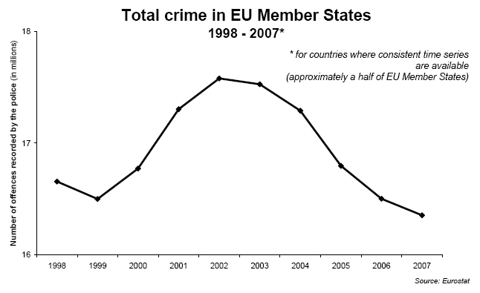
How to lie with graphs
The data behind are the same, but the y-axis starts at different points.
In general, it is recommended to start at 0.

Slide 8
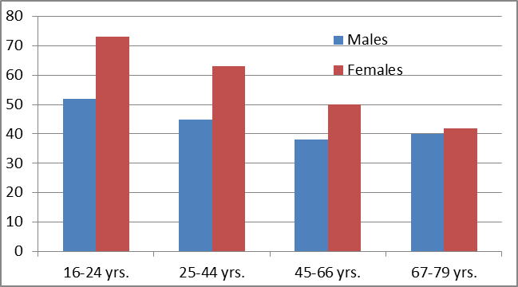
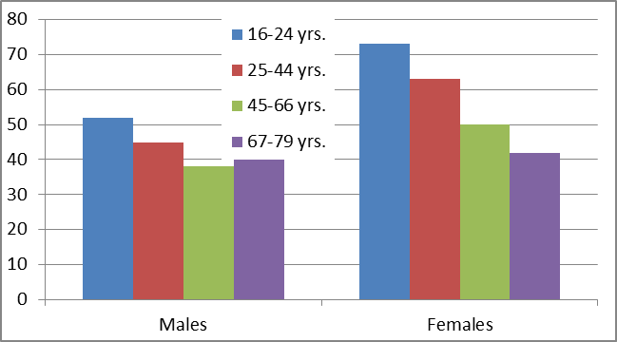
Grouped bar charts:
Two (or more) categories
Example: Percent using a library last year. Males and females in various age groups
With two categories, we have two ways of grouping, inviting to different comparison

Slide 9
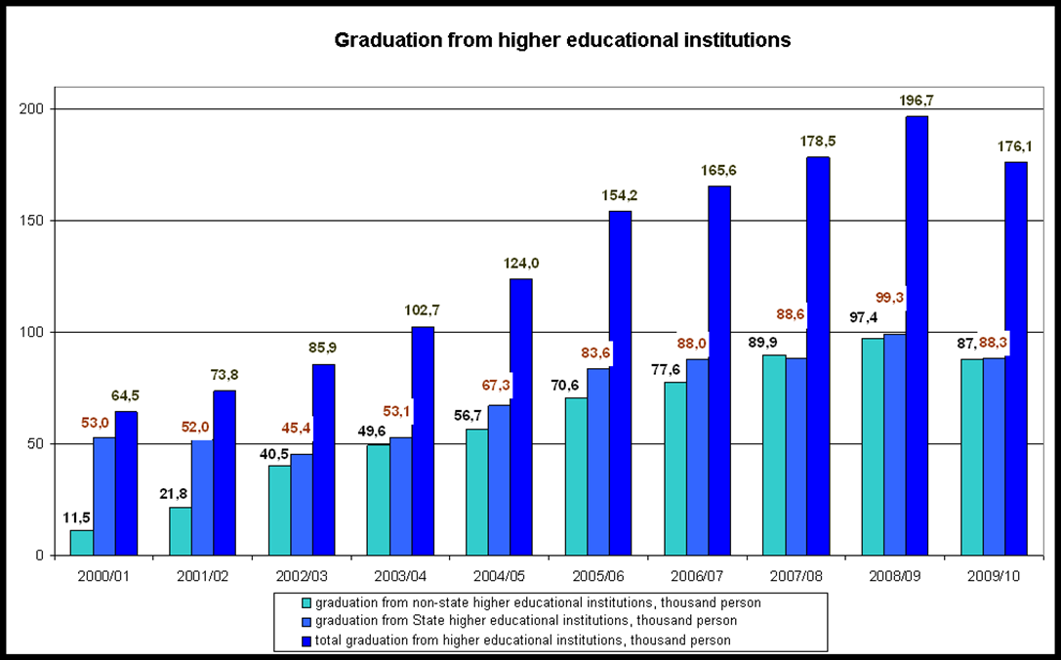
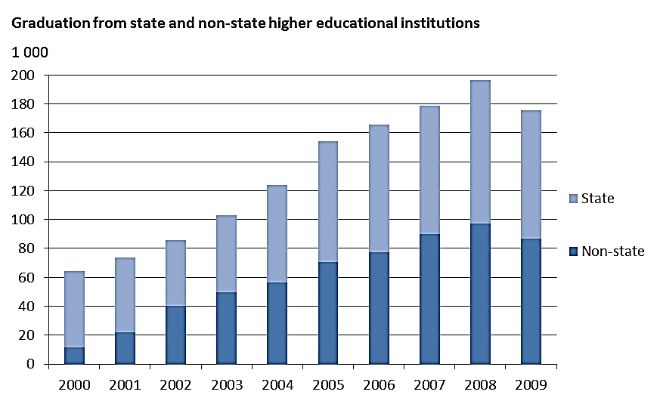
Stacked bar charts
Kazakhstan
Show total frequency and how the total is divided into different components

Slide 10
Line charts:
Most often used for time series
= years, quarters, months, weeks, days, hours and minutes + age
What is a time “series”? Minimum = 4 data points? Up to 4, use vertical bar chart
The longer series, the better?!

Slide 11
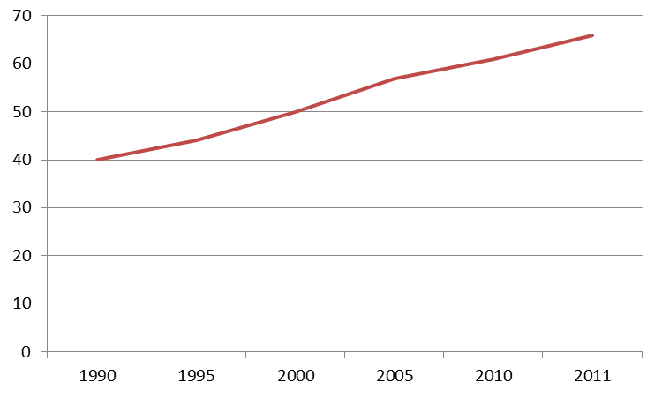
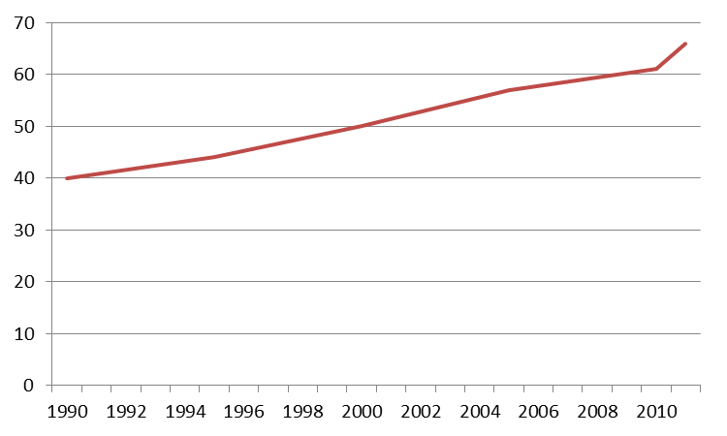
Standard line charts
“A time series” requires at least 4? data points (if not: use bar chart)
Be careful when the data points are not evenly spaced; like 1990, 1995, 2000, 2005, 2010 and 2011

Slide 12
Line graphs should never be used to illustrate differences between group, for instance countries

Slide 13
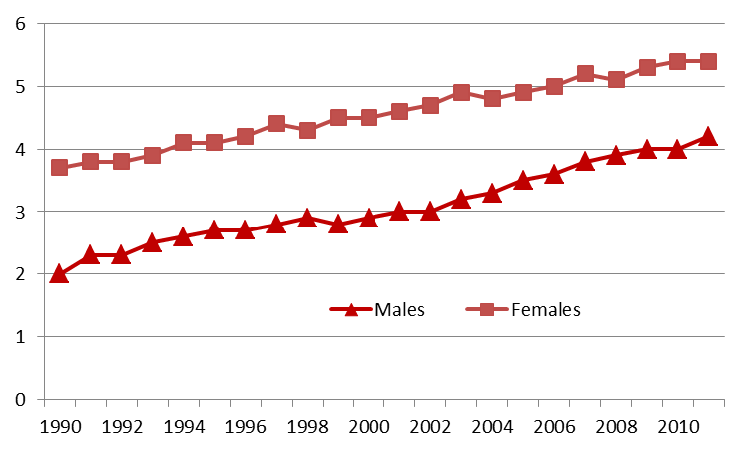
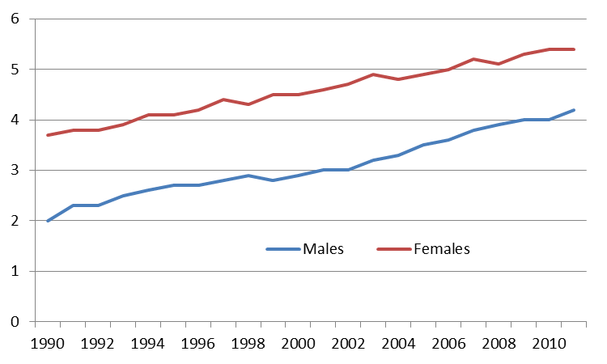
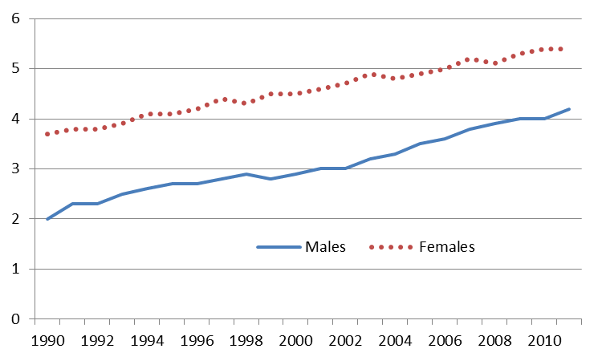
Line charts: Symbols?
Indicators or symbols ( ∇) are often used to differentiate between series, but these symbols overload the chart
It is better to use different colours ...
... and/or line styles

Slide 14
Spagetti:
Don’t use too many lines!

Slide 15
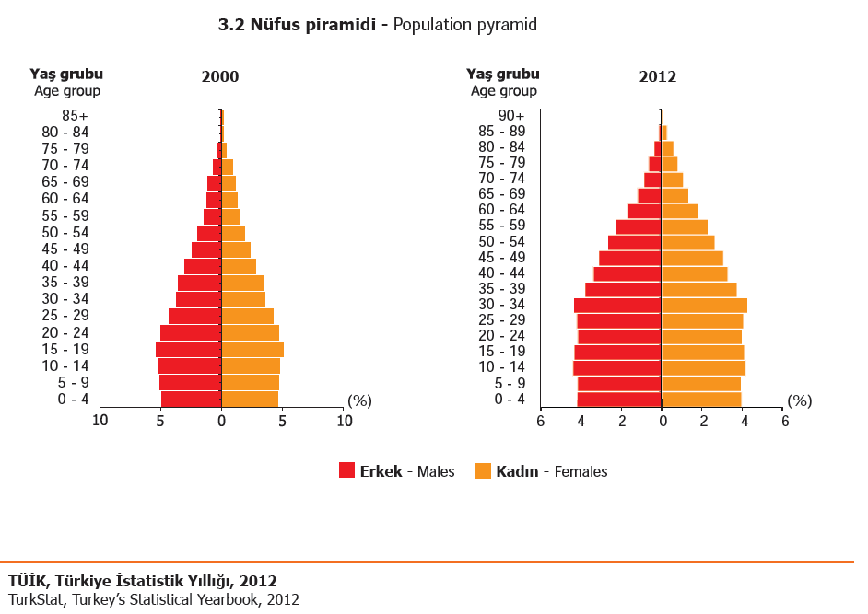

Slide 16
Graphs
Good practice
Bad practice
Title includes what, where and when (e.g. date or time period)
Specify source
Keep the presentation simple
Make sure there is a clear message
Choose the appropriate graph for the data and message
Consider using maps where relevant
Don’t use borders, shading and too much colour
Don’t over complicate the graphs
Don’t use labels in a way that is distorting the reception of the graph
Start y-axis from 0
Don’t use different scales when presenting two graphs for comparison
.

Slide 17
Tables

Slide 18
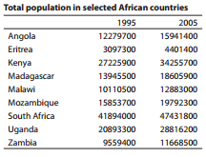
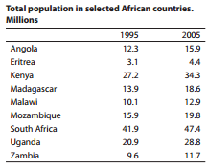
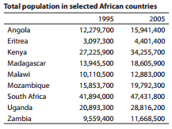
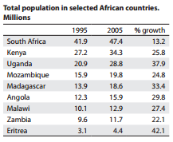

Slide 19
Columns and rows
The State Statistical Committee of the Republic of Azerbaijan

Slide 20

Columns and rows

Slide 21
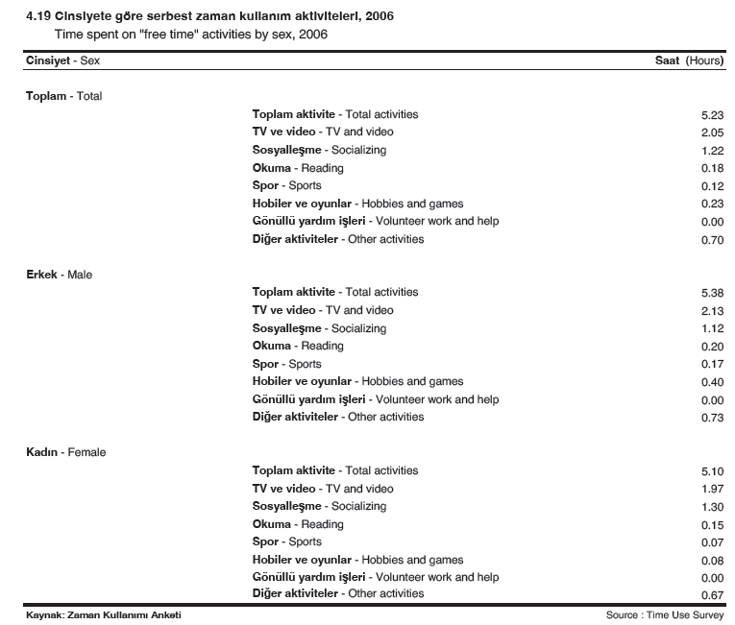
Columns and rows
 | Total | Male | Female
Toplam aktivite - Total activities | 5.23 | 5.38 | 5.10
TV ve video - TV and video | 2.05 | 2.13 | 1.97
Sosyalleşme - Socializing | 1.22 | 1.12 | 1.30
Okuma - Reading | 0.18 | 0.20 | 0.15
Spor - Sports | 0.12 | 0.17 | 0.07
Hobiler ve oyunlar - Hobbies and games | 0.23 | 0.40 | 0.08
Gönüllü yardım işleri - Volunteer work and help | 0.00 | 0.00 | 0.00
Diğer aktiviteler - Other activities | 0.70 | 0.73 | 0.67

Slide 22
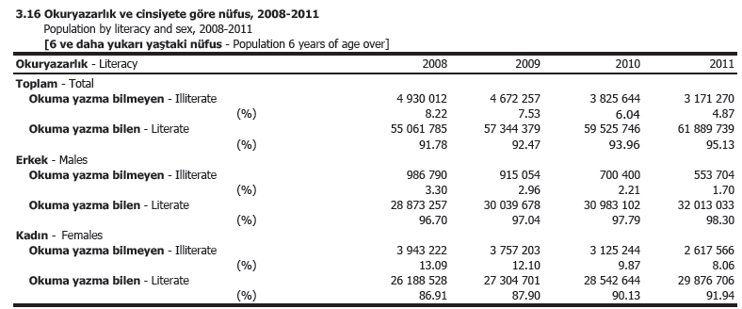
Tables with absolute and relative numbers
 | 2008 | 2009 | 2010 | 2011
Total |  | Number
Illiterate | 4 930 012 | 4 672 257 | 3 825 644 | 3 171 270
Literate | 55 061 785 | 57 344 379 | 59 525 746 | 61 889 739
Males
Illiterate | 986 790 | 915 054 | 700 400 | 553 704
Literate | 28 873 257 | 30 039 678 | 30 983 102 | 32 013 033
Females
Illiterate | 3 943 222 | 3 757 203 | 3 125 244 | 2 617 566
Literate | 26 188 528 | 27 304 701 | 28 542 644 | 29 876 706
Total |  | Per cent
Illiterate | 8.2 | 7.5 | 6.0 | 4.9
Literate | 91.8 | 92.5 | 94.0 | 95.1
Males
Illiterate | 3.3 | 3.0 | 2.2 | 1.7
Literate | 96.7 | 97.0 | 97.8 | 98.3
Females
Illiterate | 13.1 | 12.1 | 9.9 | 8.1
Literate | 86.9 | 87.9 | 90.1 | 91.9
Percentage illitterate
 | 2008 | 2009 | 2010 | 2011
Total | 8.2 | 7.5 | 6.0 | 4.9
Males | 3.3 | 3.0 | 2.2 | 1.7
Females | 13.1 | 12.1 | 9.9 | 8.1

Slide 23
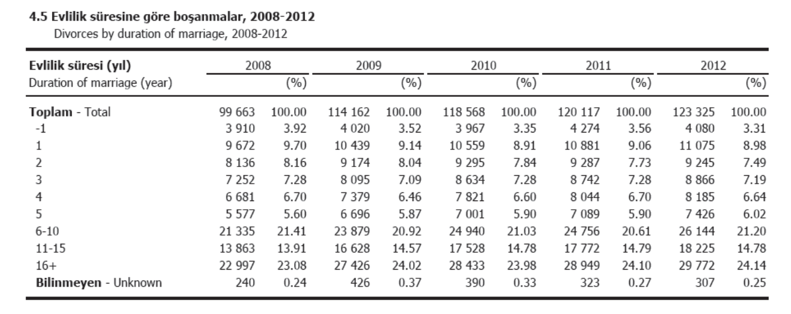
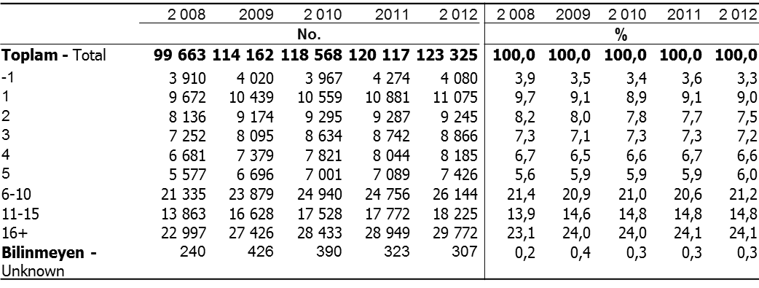
Absolute and relative numbers

Slide 24
Percentages in tables: Two ways of comparing
Gender specific distribution
Gender distribution

Slide 25
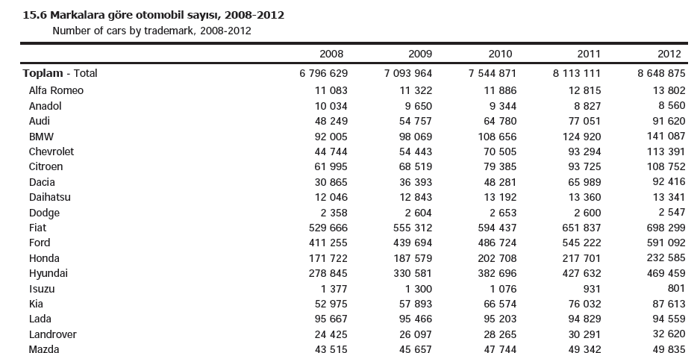

 | 2008 | 2009 | 2010 | 2011 | 2012
Toplam - Total | 6 796 629 | 7 093 964 | 7 544 871 | 8 113 111 | 8 648 875
Renault | 1 792 933 | 1 831 504 | 1 896 922 | 1 984 801 | 2 052 457
Murat (Tofa) | 1 241 487 | 1 222 985 | 1 213 976 | 1 205 804 | 1 198 066
Fiat | 529 666 | 555 312 | 594 437 | 651 837 | 698 299
Opel | 464 722 | 485 159 | 520 249 | 570 545 | 619 573
Ford | 411 255 | 439 694 | 486 724 | 545 222 | 591 092
Volkswagen | 322 228 | 348 729 | 387 439 | 441 221 | 507 921
Hyundai | 278 845 | 330 581 | 382 696 | 427 632 | 469 459
Toyota | 325 013 | 348 607 | 383 016 | 420 720 | 452 291
Peugeot | 181 492 | 194 166 | 211 443 | 227 433 | 240 566
Honda | 171 722 | 187 579 | 202 708 | 217 701 | 232 585
Mercedes | 151 338 | 159 685 | 170 085 | 182 303 | 194 676
BMW | 92 005 | 98 069 | 108 656 | 124 920 | 141 087
Skoda | 93 466 | 96 244 | 101 825 | 109 056 | 118 545
Chevrolet | 44 744 | 54 443 | 70 505 | 93 294 | 113 391
Nissan | 59 449 | 64 606 | 74 545 | 92 291 | 110 601
Citroen | 61 995 | 68 519 | 79 385 | 93 725 | 108 752
Lada | 95 667 | 95 466 | 95 203 | 94 829 | 94 559
Dacia | 30 865 | 36 393 | 48 281 | 65 989 | 92 416
Audi | 48 249 | 54 757 | 64 780 | 77 051 | 91 620
Kia | 52 975 | 57 893 | 66 574 | 76 032 | 87 613
Seat | 45 590 | 48 154 | 52 972 | 58 954 | 64 657
Mazda | 43 515 | 45 657 | 47 744 | 49 342 | 49 835
Instead of using alphabetical order,
sort by value – from highest to lowest (latest year)

Slide 26
Tables
Good practice
Bad practice
Align numbers on the decimal point
Be consistent in how many decimal places are shown
Title includes what, where) and when
Choose absolute/relative numbers based on relevance to the topic
Don’t make a small table spread across the page – columns should only be wide as needed to show the data
Don’t use borders around every cell or heavy shading that will distract from the data

Slide 27
Descriptives/explanatory text

Slide 28
Death rates per 1000 people in country X by year and region
 | National | Urban | Rural
2015 | 5.5 | 4.8 | 5.8
2014 | 6.5 | 6.0 | 6.9
2013 | 6.9 | 6.6 | 7.3
Higher death rates in the rural areas
The death rates are higher in rural areas than in the urban areas. This trend has not changed substantially over the years
Highest mortality reduction in the cities
While there has been a reduction in the death rates overall, the most substantial fall has happened in the urban areas of the country. Important reasons for this are…
In 2015, the death rates at the national level were 5.5 per 1,000 people, 4.8 per 1,000 in urban areas, and 5.8 in rural areas.
The death rates at national level were 6.9 per 1,000 people in 2013 and fell to 5.5 in 2015.
Notes:
Which of the two texts do you prefer?
What is the main difference?

Slide 29


Absolute vs relative measures
«24 000 more children were vaccinated last year»
«The rate of children vaccinated has decreased»
Politician B (representing the opposition)
Politician A (representing the Government)
Notes:
Both politicians are right, they have only chosen different ways of presenting the data. While Peter uses absolute vaccination numbers, Jane uses the share of children vaccinated out of the total number of children eligible for vaccination. The change laying behind is that the birth rate has increased from the year before.

Slide 30
Percentages and percentage points:
71/47% = 51 per cent
71 ÷ 47 = 24 percentage points

Slide 31
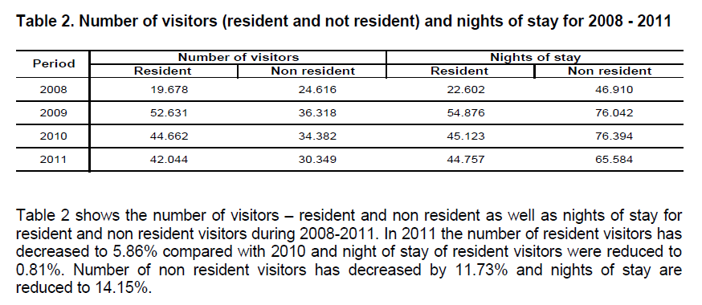
Decimals
Hotel Statistics Q4 2011, Statistical Agency of Kosovo
One decimal is enough!

Slide 32
Decimals
13.47 %?
  Never use two decimals when reporting percentages
  When reporting percentages from censuses, registers, etc., use one decimal
  When reporting percentages from surveys, use no decimal (unless the sample is very large: LF survey)
  One exception: Population growth: 0.76%

Slide 33
Descriptive/explanatory text
DO
Make it interesting by linking the data to national policies, goals and issues that people understand
Use headings and bulleted lists to make it easy to scan long sections of text
Make the headlines (titles) and first paragraph about the main findings so it draws the reader in
Keep sentences and paragraphs short
Use everyday language
Include definitions / explanation of complex concepts
Include clear references to described tables or charts and
Be careful when describing the relative changes of variables expressed as a percentage – percentage vs. percentage point
Don’t ‘table read’ by just writing what is already shown in a table– draw out the main findings instead
Don’t use technical jargon
DON’T

Slide 34
In general
Make sure graphs and tables stand alone, meaning they have enough metadata and information to make sense if they were copied and pasted into another document
KISS: Keep it short and simple
Present data from different angles and analyse information presented in the explanatory text
Test on friends and family members
– do they understand it, do they find it interesting?

Slide 35
Something easily accessible to gain attention?

Slide 36
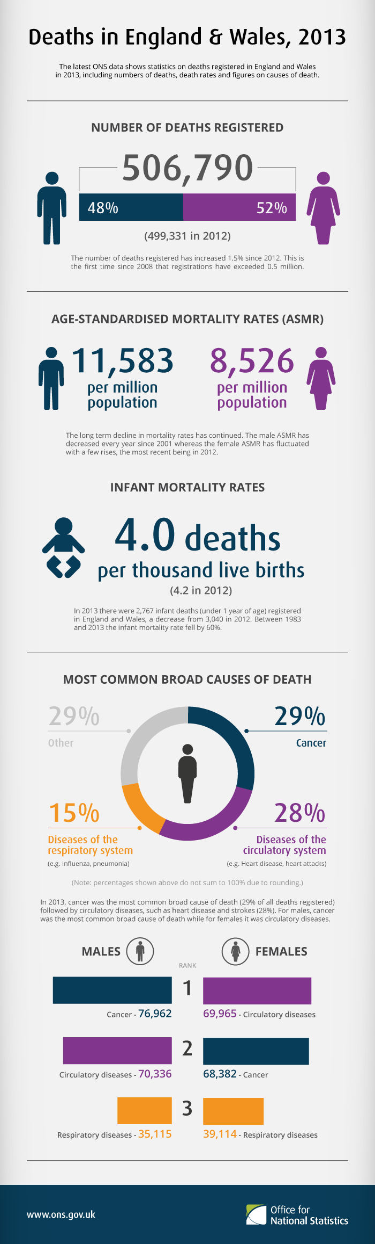

Slide 37
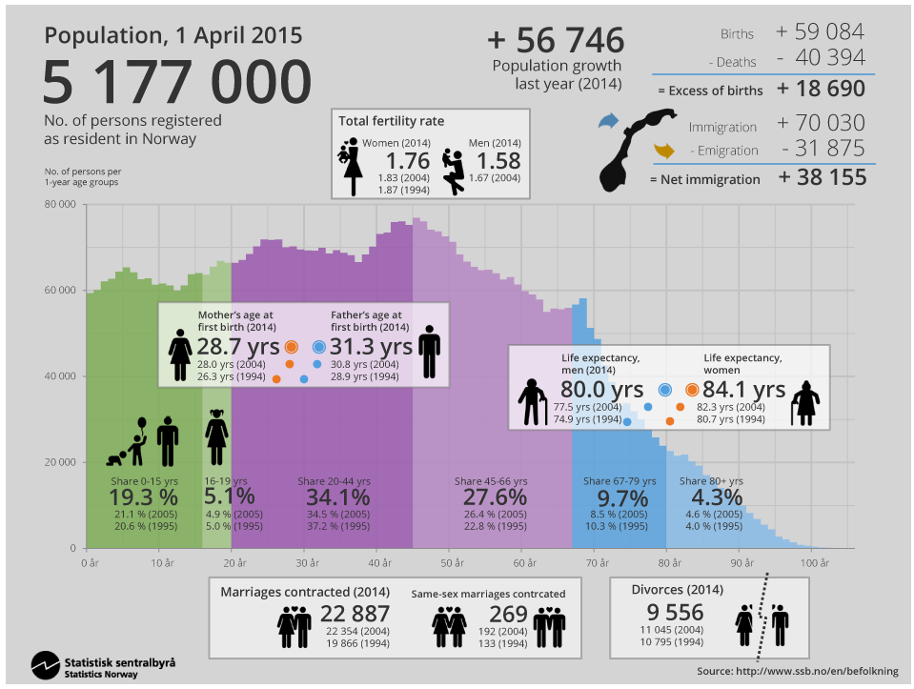

Slide 38
