Slide 1
PRODUCTION PROCESS AND FLOW
Vibeke Oestreich Nielsen
Head of Division for Development Cooperation
Statistics Norway
von@ssb.no

Slide 2
CRVS system
Live births
Health services
Certification of
cause of death
Complementary/
Interim sources
Population census
Surveys
Sample registration
areas
Deaths
Fetal deaths
Civil
Registration, including population registers
Principles:
Compulsory
Universal
Continuous
Confidentiality
Vital
Statistics
Compilation
Processing
Validation
Quality control
Dissemination
Marriages
Authorized
institutions
Divorces
Annulments
Additional
administrative
sources
Coronary
Police
Registries
Health records
Judicial
separations
Courts
Judicial
institutions
Adoptions
Legitimation
National IDs’
Electoral lists
Passports
…
Recognition

Slide 3
Goals of a Statistical Processing Plan
Collection of information needed by major data users
Determine user priorities on tabulations and attempt to satisfy those deemed most important
Prepare a long-range program for the conduct of the statistical processing programme ; usually made a few years in advance; three- or four-year

Slide 4
National centralized compilation from individual statistical reports
Uniform for the country
Common definitions, classifications, coding, querying, data entry and editing procedures
Predetermined tabulations plans
Flexible and adaptable to meet national and international requirements
Compilation from individual reports, either paper-based or electronic, be undertaken centrally
If decentralized, detailed written guidelines, dealing with such procedures as coding, editing, querying and data entry, must be issued by the central national authority

Slide 5
Steps involved in processing
Control of receipt of statistical reports
Editing
Querying
Imputation of missing or inconsistent data items
Coding of data
Converting data into an electronically readable form
Produce statistics
Publish statistics

Slide 6
Steps involved in processing
Control of receipt of statistical reports
Reporting schedule (manual and electronic systems)
control the receipt of reports diligently addressing issues of promptness and completeness of reporting
ascertain whether or not reports are received on time, as well as whether returns are received from every geographical reporting area
control method must reveal whether the reporting frequencies are consistent with those of the preceding period

Slide 7
Steps involved in processing
Converting data into an electronically readable form
Punching, scanning or similar methods can be used if data are received on paper
may be possible to carry out some of the editing, coding and imputation of missing or inconsistent data as an automated process concurrent with the data-capture function
essential to establish codes to be used in situations
where the answer is “unknown” or “not stated”.
ding of data

Slide 8
Steps involved in processing
translation of items of information into numerical values to facilitate data processing
age or birth weight, are reported as numerical values and need no translation
unit of measurement ie hours, days, months or years in the case of age or kilograms, grams, in the case of weight, should be coded in addition to the numerical value.
establish codes to be used in situations where the answer is “unknown” or “not stated”.
Coding of data

Slide 9
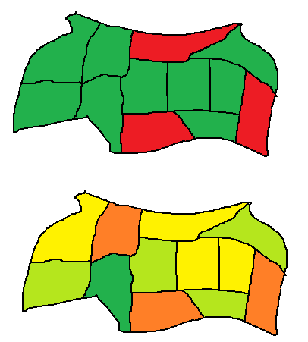
Coverage and completeness
Covered?
Yes/no
Rate of registration?
30 %? 65 %?
Complete?

Slide 10
Steps involved in processing
Querying
missing, inconsistent or inappropriate responses should be questioned or “queried” by referring the item to the data-collection agency for clarification
contact the local or regional office and request that it contact the appropriate source
corrected data must be transmitted to the central office (or, in the case of decentralization, to the subnational office), either manually or electronically

Slide 11
Steps involved in processing
electronic checking
visual checking for completeness and accuracy and errors have been minimized
missing, inconsistent or obscure should be detected and corrections should be made.

Slide 12
Steps involved in processing
Imputation of missing or inconsistent data items
assigning a probable value to an item whose true value is unknown
aid of last resort in the attempt to supply missing or obviously incorrect data
be employed only if the querying process described above has failed to produce the information sought

Slide 13
Basic Record Flow
Source: US Center for Disease Control and Prevention

Slide 14
Vital statistics template: Chapter 2.3
The description of the organizational structure should cover the two following issues:
How the CRVS system is organized between agencies at the central level, who has which responsibilities, and the data flow between the different agencies
How the different agencies are organized internally, the data flow between the different units and administrative levels, and their responsibilities.

Slide 15
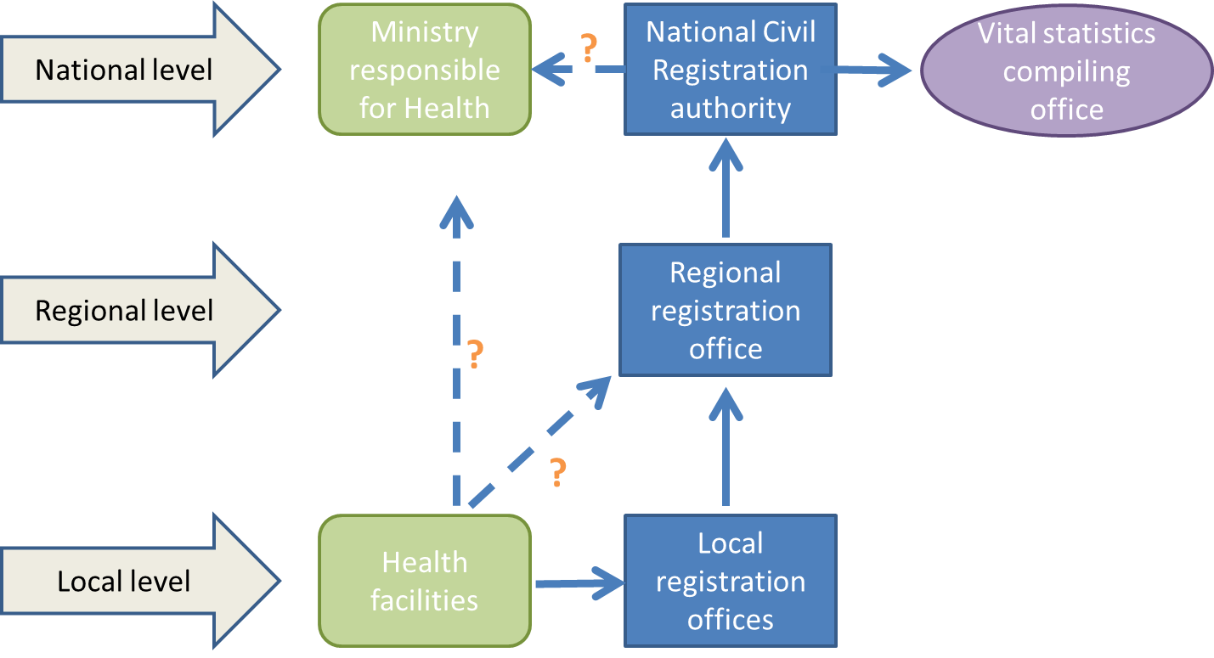
Figure B4.1 Possible organizational chart presenting different levels and cooperation partners
Notes:
Regional levels of registration offices: In some countries, there are only one or two levels, while in others there can be three or more. In the example, there are three levels. It is useful to mention the number of local registration offices as well as the number of regional offices.
Flow of information from one unit to another: In the figure, it is assumed that the local health facility is the first point of registration. The arrows show how the information flows go from there. It is assumed that information is shared with the local CR office, but, in some countries, there are no registration offices at the local level. In some countries, information may also be sent directly to the Ministry of Health or the Vital Statistics Compiling Office.
Data flow at central level: It is common that the data flow from the Civil Register to the Vital Statistics Compiling Office, as shown in the figure. In some countries, the Civil Registration Authority carries out the compilation and statistical work itself while in others, a Ministry, often the Ministry of Health, might be responsible.

Slide 16
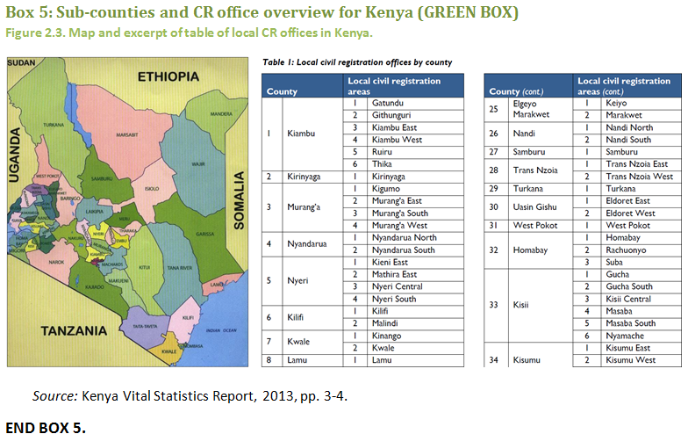

Slide 17
Exercise Flowchart of VS Production Process
Produce a flow chart for your country
What are the weaknesses or issues on the process?
How can the process be improved?
20 minutes

